Slide 1
Malamander Chapter 17

Slide 2
Chapter 17
https://www.youtube.com/watch?v=udgKi1Ia8kc
1) How was Violet feeling when she ‘stares’ at the book ‘open-mouthed’?
2) Which part of the mermonkey does the text mention Peter mending?
3) Why did Peter stay at the book dispensary a lot?
4) True or False?
a)Jenny got new parts for the mermonkey
b)Violet’s father looks intelligent
c)They are all drinking cocoa
d)Sebastian Eels and Peter Parma were old friends

Slide 3
The seaside.
Discuss the last time that you visited the seaside.
Where did you go?
What is your best experience or memory of the seaside? What do you know about the sea?
How can it be considered frightening?
Consider the question: what does the seaside mean to you?
Let’s create a list of words that come into your head when you think about the seaside.

Slide 4
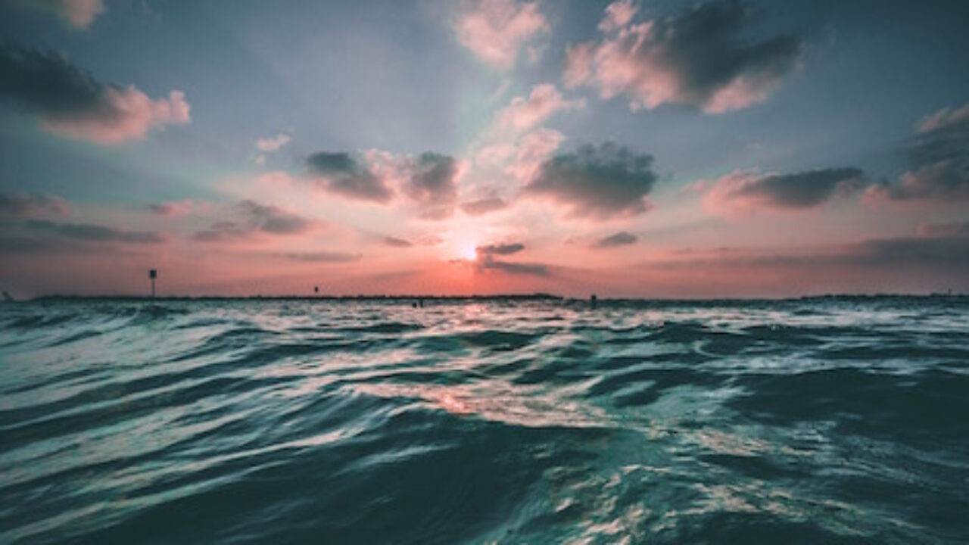
L.C. Can I write a poem to describe the sea?
Toolkit

Slide 5
Poetry writing
You are going to write a poem to show what the sea means to you.
You are going to include:
Similes
Metaphors
Personification
Alliteration
Onomatopoeia
Your poem can be as happy or as eerie as you like! Use what you’ve read so far of Malamander to give you inspiration!

Slide 6
Similes
A simile is when you say that something - a person or place, animal or thing - is LIKE something else.
A simile always uses the word ‘as’ or ‘like’. Here are some examples of similes:
The waves frothed and bubbled as a whirlpool.
The sea glittered like a mirror.

Slide 7
Metaphors
A metaphor makes an even stronger image in the reader's head.
When you use a metaphor, you are saying that a person, place, animal or thing IS
some thing else (not just LIKE it!).
Metaphors are stronger images than similes. They don’t mean exactly what the
words say. Here are some examples of metaphors:
The ocean is a mighty beast.
The sea is a beating drum.

Slide 8
Personification.
Personification is when you make an object or idea do something only a human can do.
For example:
The waves danced.
The sand warmed my toes. wrapped itself around my face.
The sea licked the soft shore.
Personification is used in poetry to emphasise meaning and description.

Slide 9
Example poem.
My heart is the ocean,
full of colours,
depths,
and dreams.
I easily dive into the waters,
get lost in my waves,
and quench my thirst
of grace
and love.
My heart is the ocean.
Our ocean.

Slide 10
Poetry writing
Use the planning sheet to plan your poem.
You are going to write in as a free verse poem. Remember, it does not have to rhyme!
Write or type it up.
Check that you have used similes, metaphors and personification.
You can illustrate your poem.

