Slide 1
L.C. Can I calculate costs?
Toolkit

Slide 2



I’ve chosen to go to Rome in Italy for 5 days.
Manchester
Birmingham
Leeds
£150
£128
£200
You should fly from Birmingham Amir, it’s the cheapest!
Amir lives in Leeds.
He will have to drive to the airport and back home, and pay to leave his car there for 5 days.

Slide 3



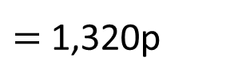

Manchester
Birmingham
Leeds
£150
£128
£200
Round trip - distance
Manchester – 110 miles
Birmingham – 246 miles
Leeds – 9 miles
Parking
Manchester – £12 per day
Birmingham – £15 per day
Leeds – £8 per day
Petrol – 12p per mile
Which airport works out cheaper for Amir to fly from?
Manchester
Flight –
Petrol –
Parking –
110 $×$ 12p
£150
£13.20
110 $×$ 10p
110 $×$ 2p
1,100p
£60
$$+$$
220p
$=$1,320p

Slide 4

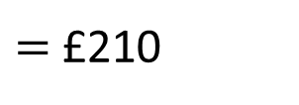

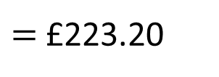
Manchester
Birmingham
Leeds
£150
£128
£200
Round trip - distance
Manchester – 110 miles
Birmingham – 246 miles
Leeds – 9 miles
Parking
Manchester – £12 per day
Birmingham – £15 per day
Leeds – £8 per day
Petrol – 12p per mile
Which airport works out cheaper for Amir to fly from?
£150
$$+$$
£60
Manchester
Flight –
Petrol –
Parking –
$=$£210
£150
£210
$$+$$
£13.20
$=$£223.20
£13.20
It will cost £223.20 to fly
from Manchester.
£60

Slide 5

Manchester
Birmingham
Leeds
£150
£128
£200
£223.20
Round trip - distance
Manchester – 110 miles
Birmingham – 246 miles
Leeds – 9 miles
Parking
Manchester – £12 per day
Birmingham – £15 per day
Leeds – £8 per day
Petrol – 12p per mile
Which airport works out cheaper for Amir to fly from?
Birmingham
Flight –
Petrol –
Parking –
Leeds
Flight –
Petrol –
Parking –
Have a go

Slide 6



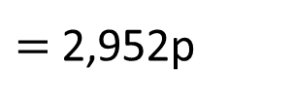

Manchester
Birmingham
Leeds
£150
£128
£200
£223.20
Round trip - distance
Manchester – 110 miles
Birmingham – 246 miles
Leeds – 9 miles
Parking
Manchester – £12 per day
Birmingham – £15 per day
Leeds – £8 per day
Petrol – 12p per mile
Which airport works out cheaper for Amir to fly from?
Birmingham
Flight –
Petrol –
Parking –
246 $×$ 12p
Leeds
Flight –
Petrol –
Parking –
£128
£29.52
246 $×$ 10p
246 $×$ 2p
2,460p
£75
$$+$$
492p
$=$2,952p

Slide 7

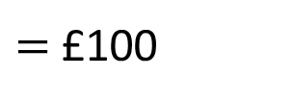

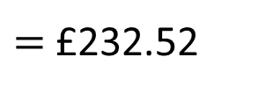

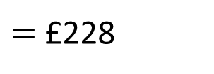
Manchester
Birmingham
Leeds
£150
£128
£200
£223.20
Round trip - distance
Manchester – 110 miles
Birmingham – 246 miles
Leeds – 9 miles
Parking
Manchester – £12 per day
Birmingham – £15 per day
Leeds – £8 per day
Petrol – 12p per mile
Which airport works out cheaper for Amir to fly from?
£75
$$+$$
£25
Birmingham
Flight –
Petrol –
Parking –
$=$£100
£100
£128
£25
$$+$$
£128
$=$£228
£228
£29.52
$$+$$
£4.52
$=$£232.52
£4.52
It will cost £232.52 to fly
from Birmingham.
£75

Slide 8
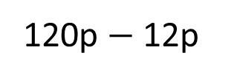


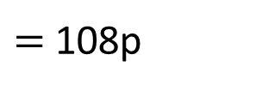
Manchester
Birmingham
Leeds
£150
£128
£200
£223.20
£232.52
£241.08
Round trip - distance
Manchester – 110 miles
Birmingham – 246 miles
Leeds – 9 miles
Parking
Manchester – £12 per day
Birmingham – £15 per day
Leeds – £8 per day
Petrol – 12p per mile
Which airport works out cheaper for Amir to fly from?
Manchester is the cheapest airport to fly from.
Birmingham
Flight –
Petrol –
Parking –
9 $×$ 12p
Leeds
Flight –
Petrol –
Parking –
£128
£200
I wonder…
What if Amir got a lift to Leeds airport from his friend?
Would it work out cheaper to use public transport to
get to each airport?
10 miles $=$ 120p
£29.52
£1.08
120p $−$ 12p
$=$ 108p
£75
£40

Slide 9
Airport worksheet

Slide 10
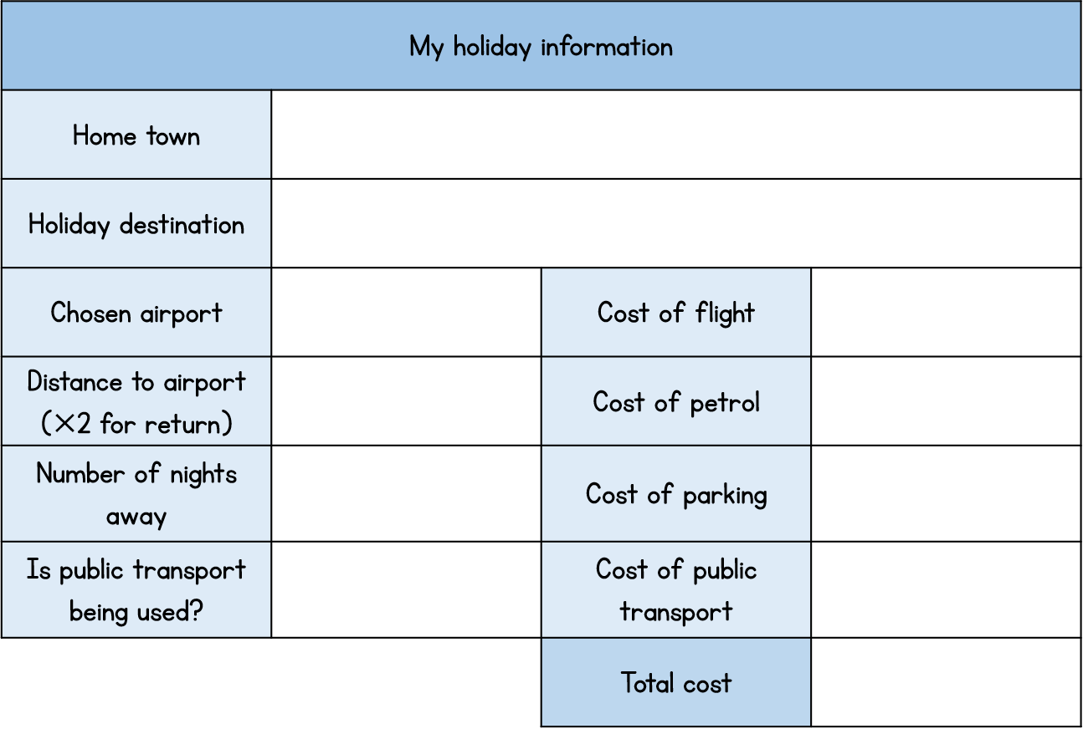
Activity 2
Research different airports to fly from or use the information we have provided.
Think about
The price of the flight
The price of fuel to get to the airport
The cost of parking at the airport
Public transport options
Work out the flight time to your destination.

