Slide 1
L.C. Can I use conversions?
Toolkit

Slide 2


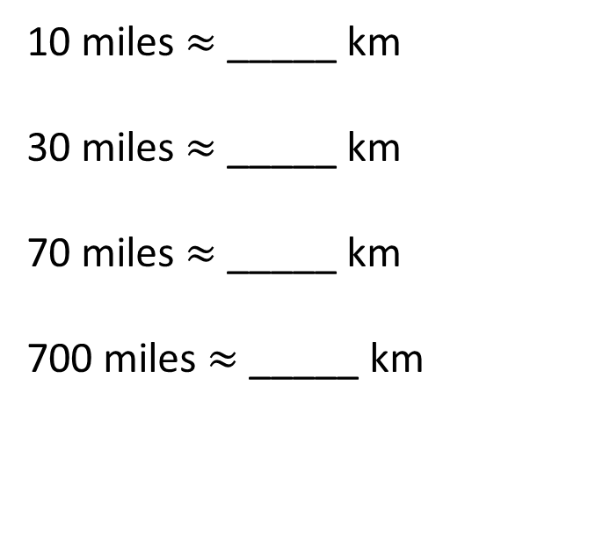
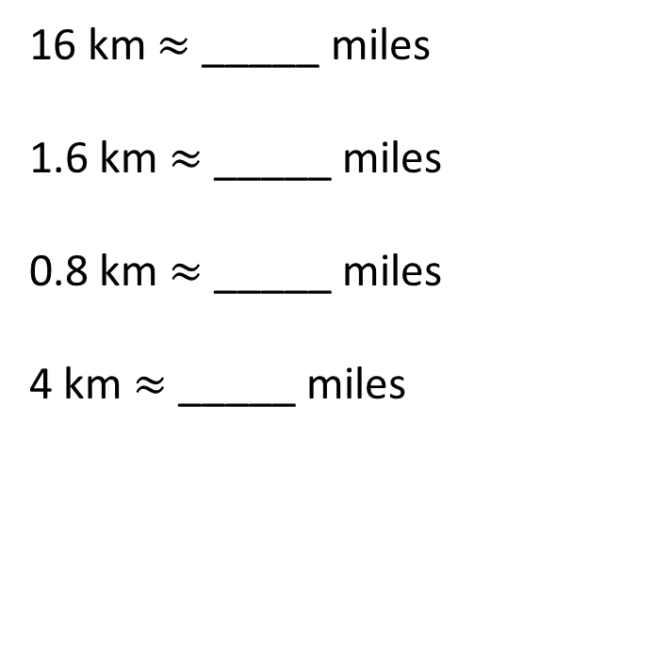
Unit conversions
5 miles $≈$ 8 km
Complete the conversions.
16
10
10 miles $≈$_____ km
30 miles $≈$_____ km
70 miles $≈$_____ km
700 miles $≈$_____ km
16 km $≈$_____ miles
1.6 km $≈$_____ miles
0.8 km $≈$_____ miles
4 km $≈$_____ miles
48
1
112
0.5
1,120
2.5
Have a go

Slide 3
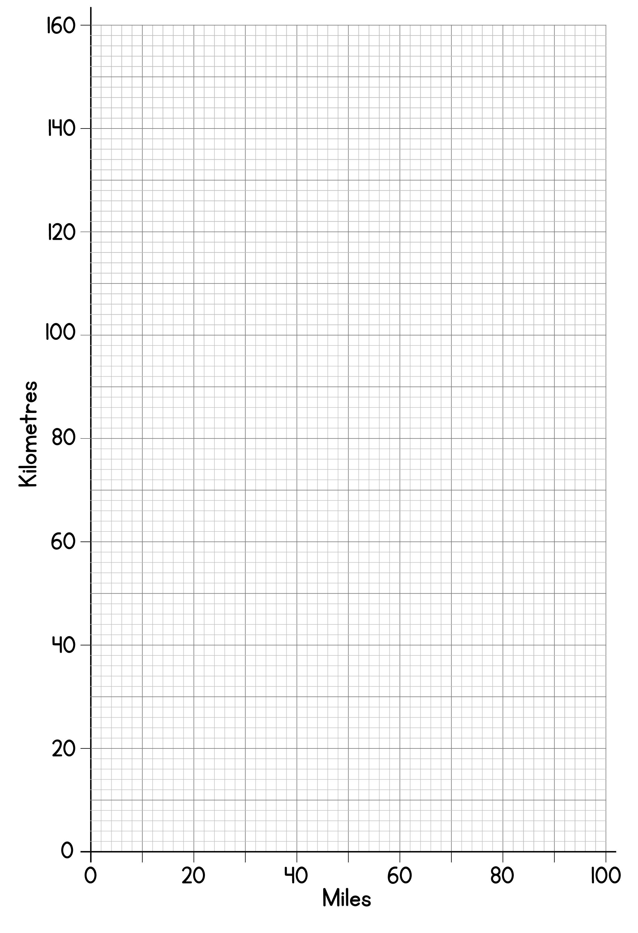

Slide 4

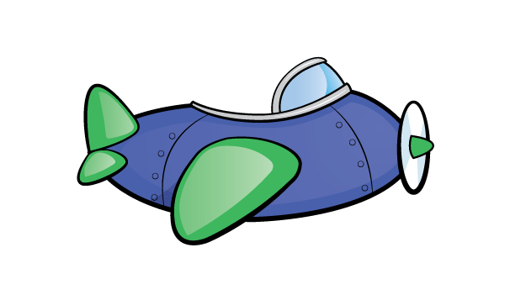
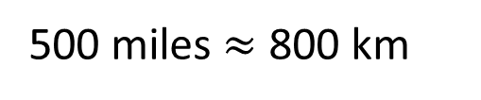




I wonder how long the flight is..
Travel
800 km per hour
400 km per $\frac{\text{1}}{\text{2}}$ hour
Manchester → Paris
200 km per $\frac{\text{1}}{\text{4}}$ hour
600 km per $\frac{\text{3}}{\text{4}}$ hour
It’s 600 km from Manchester to Paris.
The plane flies on average 500 mph.
There’s also an additional 40 minutes for take off and landing.
5 miles $≈$ 8 km
500 miles $≈$ 800 km

Slide 5


I wonder how long the flight is..
It takes 45 minutes to fly 600 km
Manchester → Paris
The flight is 1 hour 25 minutes.
It’s 600 km from Manchester to Paris.
The plane flies on average 500 mph.
There’s also an additional 40 minutes for take off and landing.
$+$ 15 mins
$+$ 25 mins
45 mins
1 hour
1 hour 25 mins

Slide 6

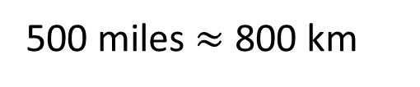

Manchester → Berlin
It’s 1,000 km from Manchester to Berlin.
The plane flies on average 500 mph.
There’s also an additional 40 minutes for take off and landing.
How long is the flight?
500 miles $≈$ 800 km
800 km per hour
The flight is 1 hour 55 minutes.
200 km per $\frac{\text{1}}{\text{4}}$ hour
Have a go
It takes 1 hour 15 minutes to fly 1,000 km

Slide 7



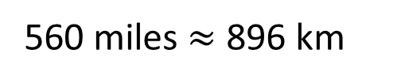

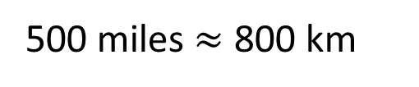
Manchester → Dublin
300 km
It’s 287 km from Manchester to Dublin.
The plane flies on average 560 mph.
There’s also an additional 35 minutes for take off and landing.
Approximately, how long is the flight?
5 miles $≈$ 8 km
900 km $÷$ 3 $=$ 300 km
500 miles $≈$ 800 km
1 hour$÷$ 3 $=$ 20 mins
60 miles $≈$ 96 km
560 miles $≈$ 896 km
The flight is approximately 55 minutes.
Have a go
It takes 1 hour to fly 896 km
It takes 1 hour to fly approximately 900 km

Slide 8
Conversions worksheet

