Slide 1

Las vacaciones
The holidays

Slide 2
Las vacaciones
Let's recap on last time
Last time, we started to look at some vocabulary that you might see or hear if you were on holiday in Spain or a Spanish speaking country. You did an activity to match the words to the pictures.
Can you remember any of the words from the activity last time?
Answers on the next slide.
Airport island
Passport swimming pool
Beach hotel
Suitcase map
Plane ferry
Boat

Slide 3
Las vacaciones
Let's recap on last time
Airport el aeropuerto Hotel el hotel
Suitcase la maleta
Ferry el ferry
Boat el barco
Island la isla
Swimming pool la piscina
Beach la playa
Passport el pasaporte
Map el mapa
Plane el avión

Slide 4
LC: Can I create a Spanish café menu?
This week, we are going to have a think about what we like to eat when we are on holiday.
What are your favourite things to eat on holiday?
The activity today is to create a café menu of the things that you might see on a Spanish café menu. There is a template of a menu in the folder to make it easier for you to do at home. Choose 4 drinks (bebidas), 5 foods (comidas) and 4 puddings/desserts (postres).
I've tried to make it easier for you to do at home. You can look up different sandwich fillings and flavours of ice-cream on Google Translate.
The structure for these would be:
A ham sandwich in Spanish would be 'a sandwich of ham'
Un bocadillo de jamon; NOT un jamon bocadillo
Chocolate ice-cream would be 'an ice-cream of chocolate'
Un helado de chocolate; NOT un chocolate helado

Slide 5
Las vacaciones
Write your menu out neatly on the sheet in Spanish, draw a picture in the next column and then you can decorate the border.
If you don't have access to a printer, you can write it straight into your home learning book or on some paper.
If you want to send me your work then I would love to see it. Send it to your class e-mail and Mr McKeown will forward it on to me.

Slide 6
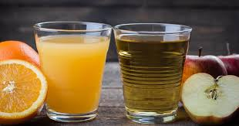
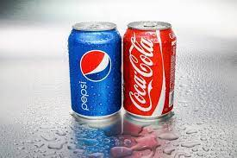
Las bebidas-drinks
Un zumo - juice
Una coca

Slide 7
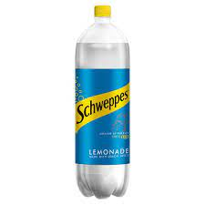
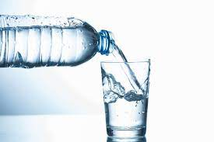
Las bebidas-drinks
Un agua - water
Una limonada

Slide 8
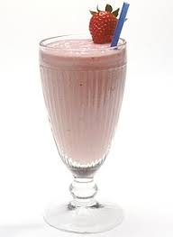
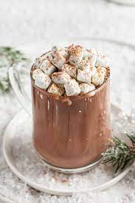
Las bebidas-drinks
Un chocolate caliente
Un batido

Slide 9
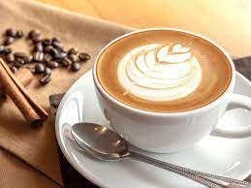
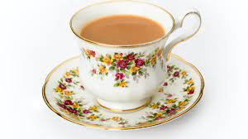
Las bebidas-drinks
Un café
Un té

Slide 10
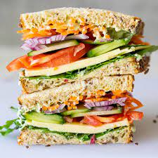
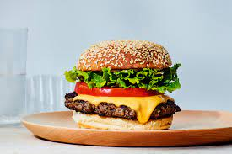
Las comidas-food
Un bocadillo
Una hamburguesa

Slide 11
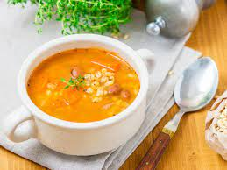
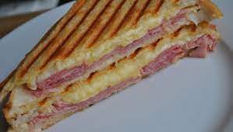
Las comidas-food
Una sopa
Un tostado

Slide 12
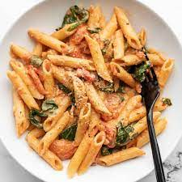
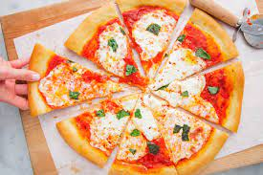
Las comidas-food
Una pizza
La pasta

Slide 13
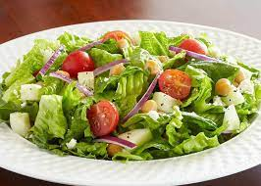
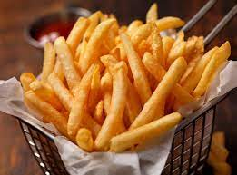
Las comidas-food
Una ensalada
Unas patatas fritas

Slide 14
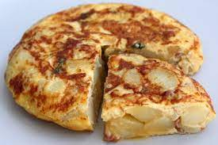
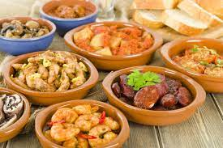
Las comidas-food
Una tortilla
Las tapas

Slide 15
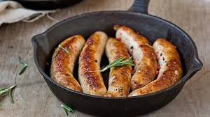
Las comidas-food
Unas salchichas

Slide 16
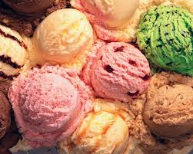
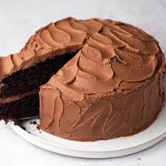
Las comidas-food
Un helado
Una tarta

Slide 17
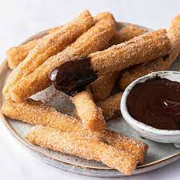
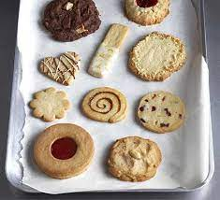
Las comidas-food
Los churros
Las galletas - biscuits

Slide 18
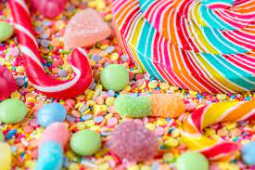
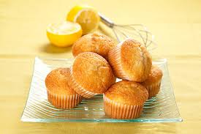
Las comidas-food
Los caramelos - sweets
Una magdelena

