Slide 1
Misconceptions about Spain

Slide 2
What is a stereotype?
What is a misconception?
Stereotype
a widely held but fixed and oversimplified image or idea of a particular type of person or thing
Misconception
a view or opinion that is incorrect because it's based on faulty thinking or understanding

Slide 3
Can you think of the stereotypical thoughts/images people sometimes have of these places and the people who live there?
France
Australia
USA
Africa
Scotland
Yorkshire

Slide 4
Can you think of the stereotypical thoughts/images people sometimes have of these places and the people who live there?
France: wear berets, striped jumpers and onions round their necks, smell of garlic and say ooh la la all the time
Australia: have BBQs every day, wear hats with corks, live in the outback and think Sidney is the capital city
USA: loud, obese, obsessed with guns, overly cheerful with the 'have a nice day' slogan
Africa: it's a country instead of a continent, everyone is really poor, no-one has access to running water, no-one goes to school, everyone has malaria
Scotland: everyone wears a kilt, can play the bagpipes, drinks whisky, eats haggis and deep fried Mars Bars
Yorkshire: wear flat caps, eat Yorkshire puddings all the time, only drink Yorkshire tea, own a whippet and say 'ee ba gum' on a regular basis

Slide 5
Today we are going to try to debunk the misconceptions that people might have about Spain
What are the stereotypical thoughts/images people sometimes have about Spain, the Spanish people and the Spanish way of life?
The task today is to write about 3 Spanish misconceptions.
What is the misconception that people have and what is the story in reality?

Slide 6
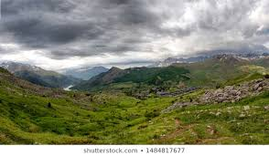
Everywhere in Spain is sunny and warm
It is only very sunny and hot in the south of Spain in the summer months
Winter can be a lot cooler eg Madrid can get very cold
The north of Spain can be cold and rainy eg in the Basque region

Slide 7
The national sport is bull fighting
Bull fighting is not considered to be a sport and it's not national
It is a cultural tradition that is on the decline because of the number of people who think it is cruel
About 25% of Spanish people still support bull fighting because of its traditional associations
Most Spanish people would say that football is their national sport

Slide 8
Spanish people are lazy
People think this because of the 'siesta' which is a time in the afternoon to rest and sleep
The siesta originates from village people taking time out from the hot afternoon sun when it is too hot to work eg on the farmland
Today, in the towns and cities, it is rare for people to have a siesta, although in more rural areas shops might still close for the afternoon, re-opening in the evening

Slide 9
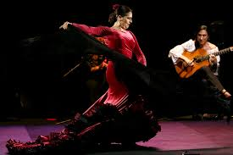
Flamenco is a dance
Flamenco is not a dance
It originates from and is more predominant in Andalusia
It is a highly skilled activity that involves guitar playing, dancing, singing and clapping and 'the cry'
The dancing is only one part of flamenco

Slide 10
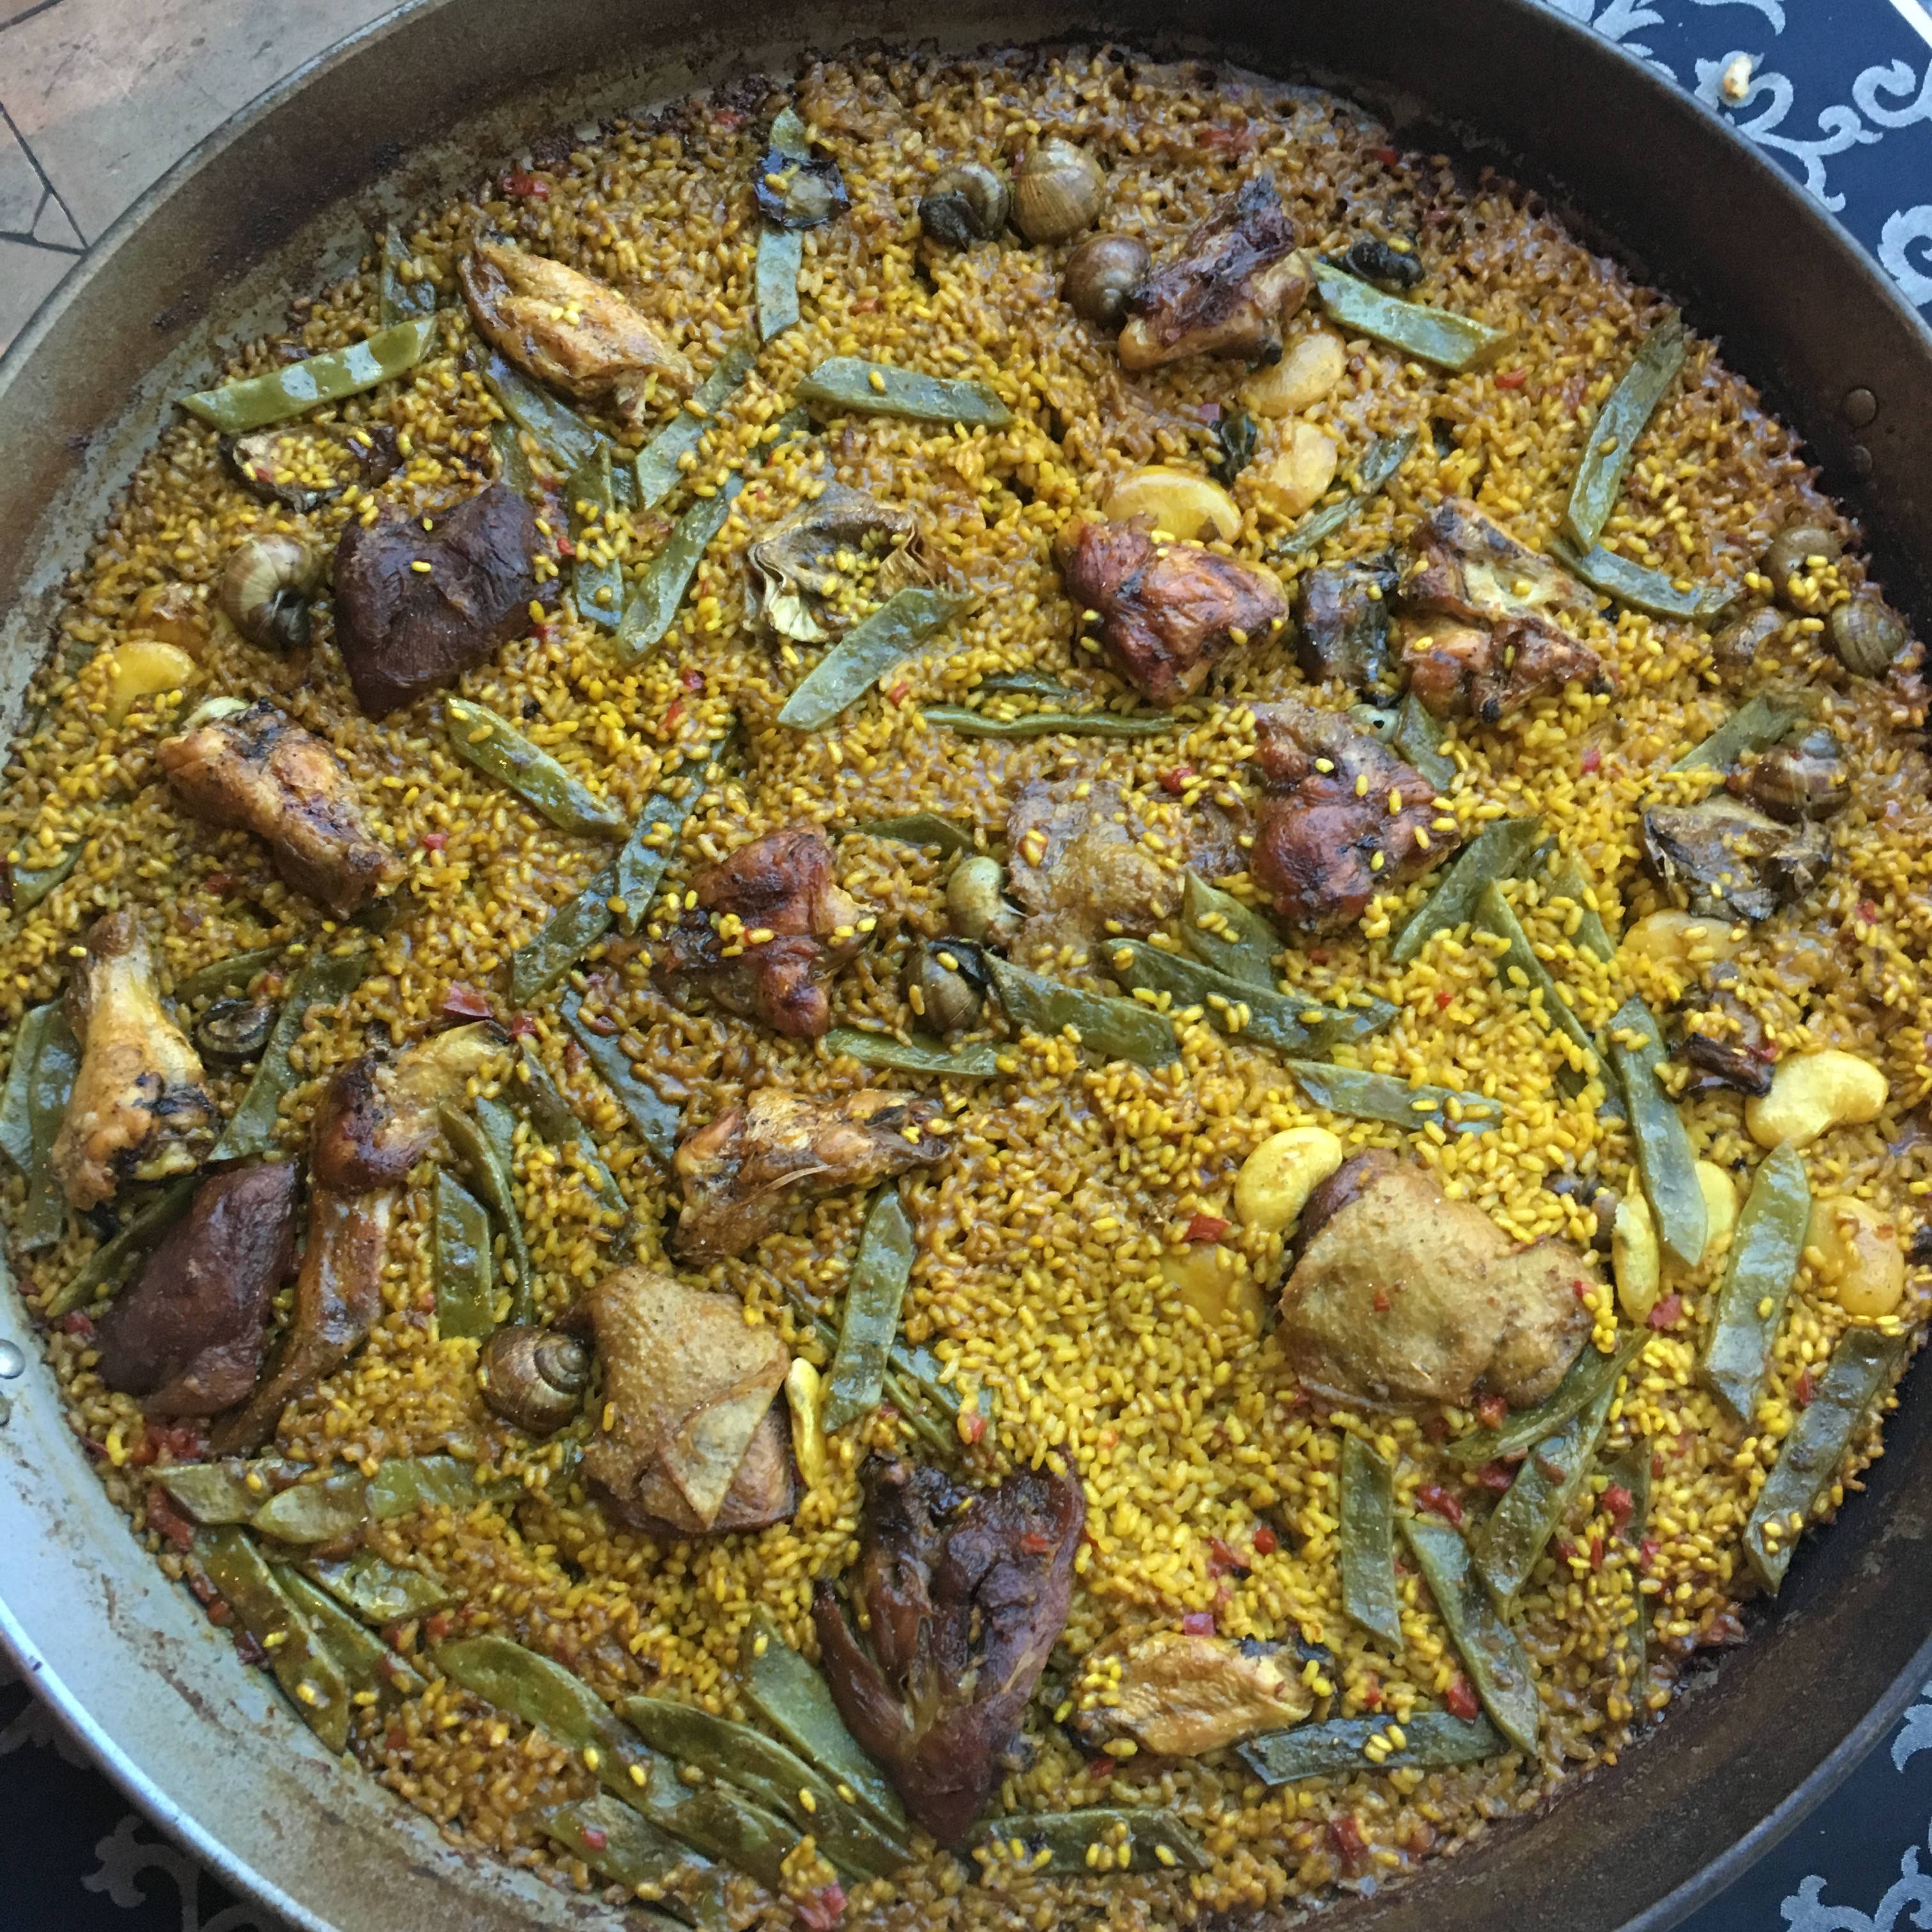
Paella is a seafood dish
Paella is the name of the pan that the food is cooked in
Paella is a rice dish
It originates from Valencia
It is traditionally made with chicken and rabbit ie from 'meat of the land'

Slide 11
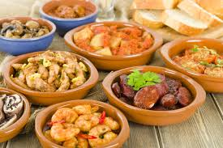
Tapas is a type of food
Una tapa means 'small plate'
It is not a type of food
To eat 'tapas' is to eat food from small plates so in real terms that means to eat a selection of food presented in small amounts

Slide 12
Spanish people sound a little bit rude/abrupt
Spanish people don't say please and thank you a lot in their own language, nowhere near as much as we do in the UK
They express politeness in the way that they speak, the intonation, the way that the pitch of their voice goes up and down as they speak
This becomes more obvious when they are speaking English which doesn't have the same intonation. So, if the speaker is not saying please/thank you and doesn't have the intonation, it comes across as rude to native English speakers

