Slide 1
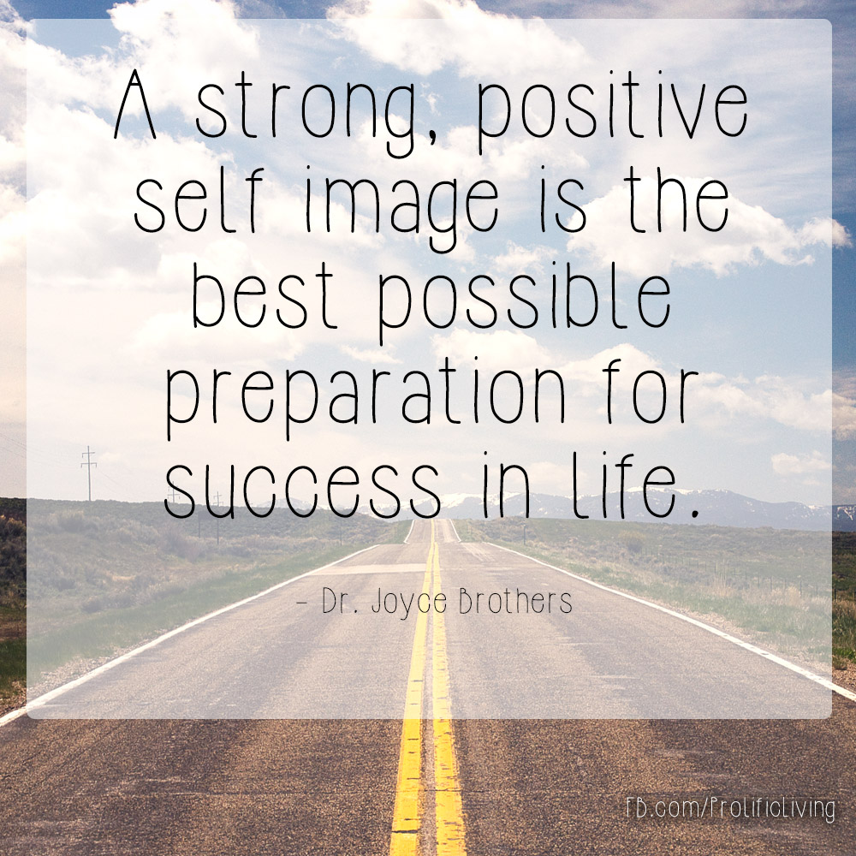
E- Safety Warm Up
Our theme for this half term is our self-image.

Slide 2
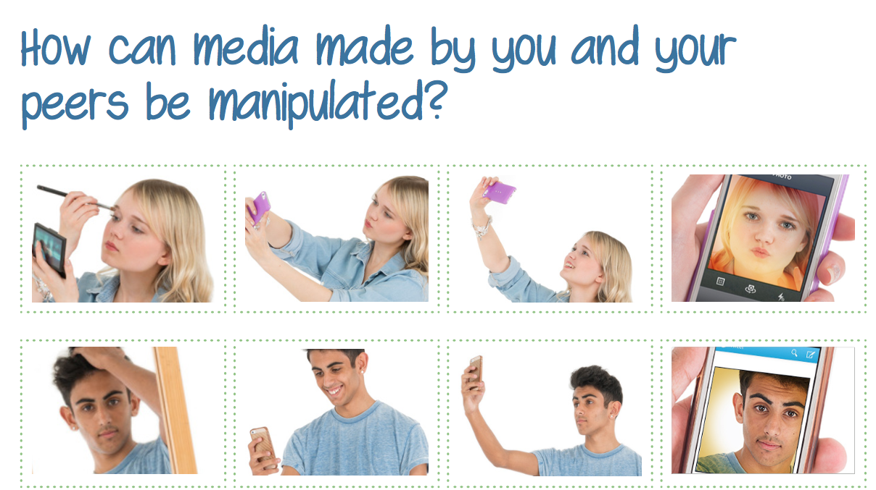
E- Safety Warm Up
Our theme for this half term is our self-image.

Slide 3
We are now going to watch a short video
I’m not going to explain what it is for, we shall discuss this after watching the clip
https://www.youtube.com/watch?v=iYhCn0jf46U

Slide 4
What surprised you about the clip?
Think how the image of the model has been changed from reality. How does seeing these unrealistic changes make you feel?
Why do you think the unrealistic images you see in the are unfair and misleading?
Does it make you feel differently when you might compare yourself to images online?

Slide 5
Do any of your use special filters or images when you are on your devices?
Why do you use them?
Why do you think they might be good?
Why do you think they might be unhelpful?

Slide 6
LC: Can I identify why images online might be misleading?
Can you draw a poster to highlight risks of comparing ourselves to images online?
Can you draw a mind map to show some of the ways images are manipulated online?

Slide 7


