Slide 1

LC: Can I identify who I might tell if I am upset by something online?
Our theme for this half term is our self-image.
Last week, we spoke about some of the problems we might come across online.
This can affect how we feel about ourselves and our confidence.

Slide 2
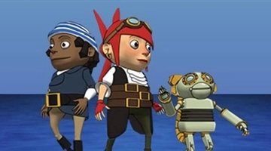
Today, we are going to look at how other people can affect our confidence online by saying or doing unkind things.
Let’s have a look at what can happen when people are unkind.
Unkindness online - Cara and the Smart Crew

Slide 3
What do you need to do, if someone says something that is unkind or makes you feel sad online?
Think about the actions of Cara and The Smart Crew.
Who could you tell?

Slide 4


Recap Ceop
CEOP is a support agency. They are there to help and give you advice, and you can make a report directly to them if something has happened online which has made you feel unsafe, scared or worried. This might be from someone you know in real life, or someone you have only ever met online.

Slide 5
LC: Can I identify who I might tell if I am upset by something online?
Using the helping hand on the table – Can you identify who you would tell that might be able to help you if you had a problem online.
Second Activity: Work through the dilemma worksheets to see how you might solve some of the problems on them. We can then discuss as a class.

