Slide 1
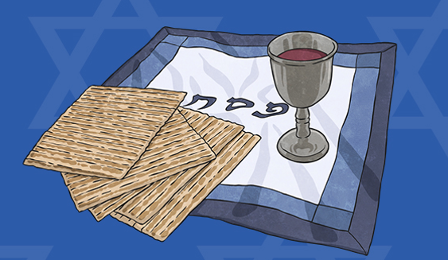
LC: Can I find out about the Jewish festival of Passover?
Today you will:
Learn why this is celebrated
Learn when this is celebrated
Learn how this is celebrated

Slide 2
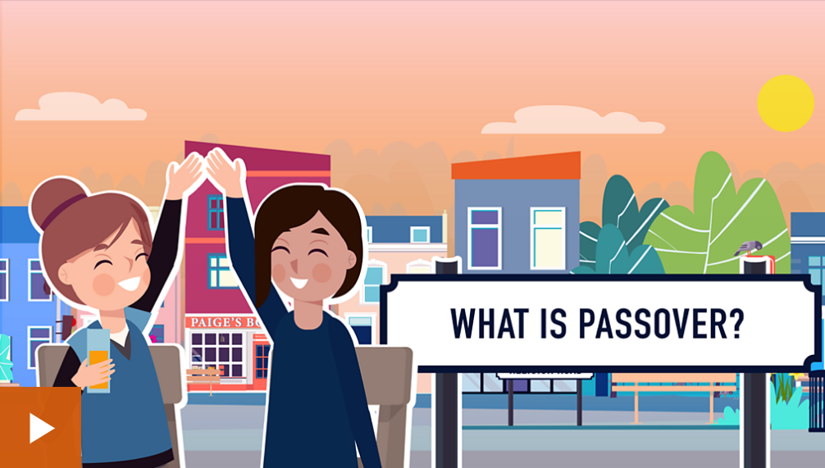
In 2021, Passover will be celebrated on Saturday 27th March.

Slide 3
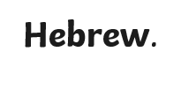

What is Passover?
Passover is an important festival in the Jewish year. It is also known as Pesach in
Jewish people follow the religion of Judaism. They believe in one God. Their holy book is the Torah, which contains many rules to help them live well. It also contains many stories about the first Jews – the Israelites – including the story of the first Passover.
Jewish
Judaism
Hebrew - an ancient language that is the official language of Israel
Jewish - a person whose religion is Judaism
Judaism - one of the world’s oldest religions

Slide 4
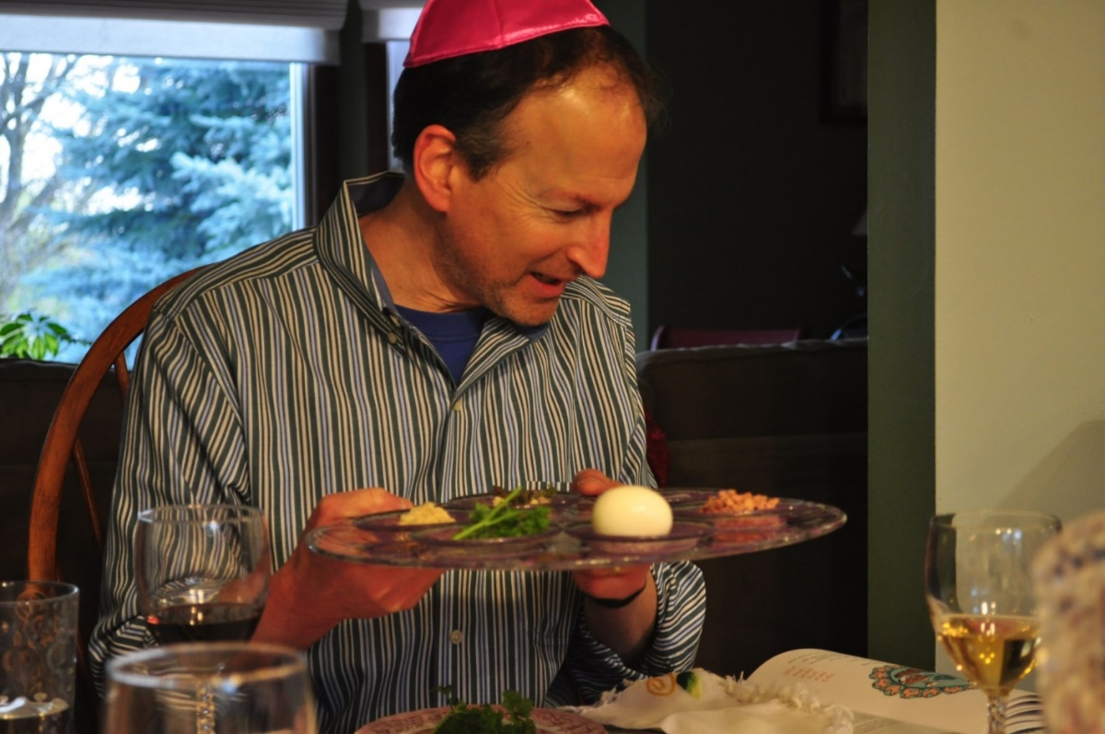
When Is Passover?
Passover is celebrated by Jewish people in Spring. Christians celebrate Easter at a similar time.
Photo courtesy of danbruell(@flickr.com) - granted under creative commons licence - attribution

Slide 5
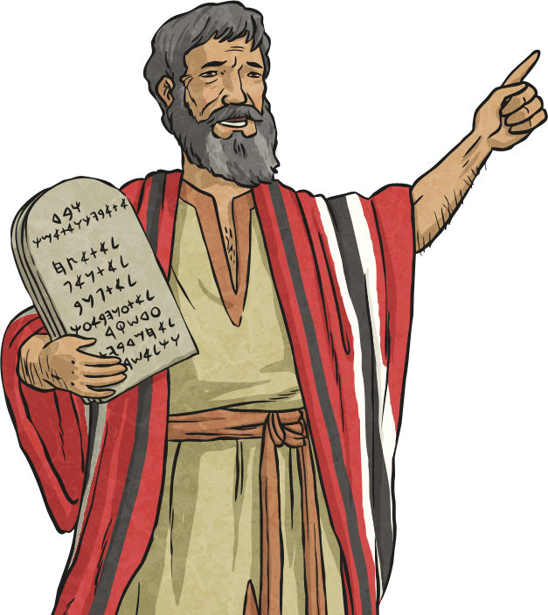
Why Is Passover Celebrated?
Passover is a time when Jews remember the Israelites’ freedom from slavery in Egypt. Moses, an important figure in the Jewish faith, led the Israelites to freedom over 3,000 years ago.

Slide 6
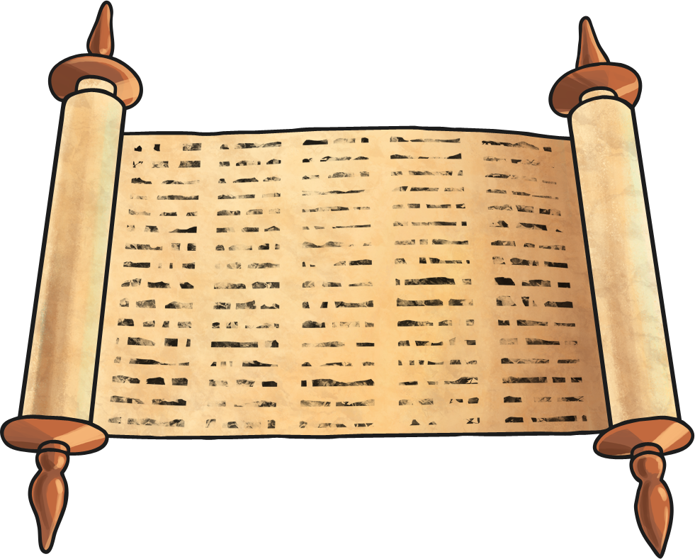
The Story of the First Passover
According to the Torah, the Israelites were God’s chosen people. They observed Jewish law and believed in one God. However, they were enslaved in Egypt, where they were forced to work in difficult conditions, building pyramids and other great buildings.

Slide 7
The Story of the First Passover
Moses had been born into a Jewish family at a time when Jewish baby boys were in danger. To save him, his mother put him in a basket and sent him down the river, with his sister watching close by. He was found by the Pharaoh’s family and raised in the palace.
As he grew older, Moses wanted to learn more about his Jewish heritage. He left the palace, and whilst tending sheep God spoke to him through a burning bush. God chose him to lead His people, the Israelites, to freedom.
It was a long and difficult struggle, but Moses succeeded and led the Israelites to freedom. God even made a miracle happen and parted a sea for His people to walk through!

Slide 8
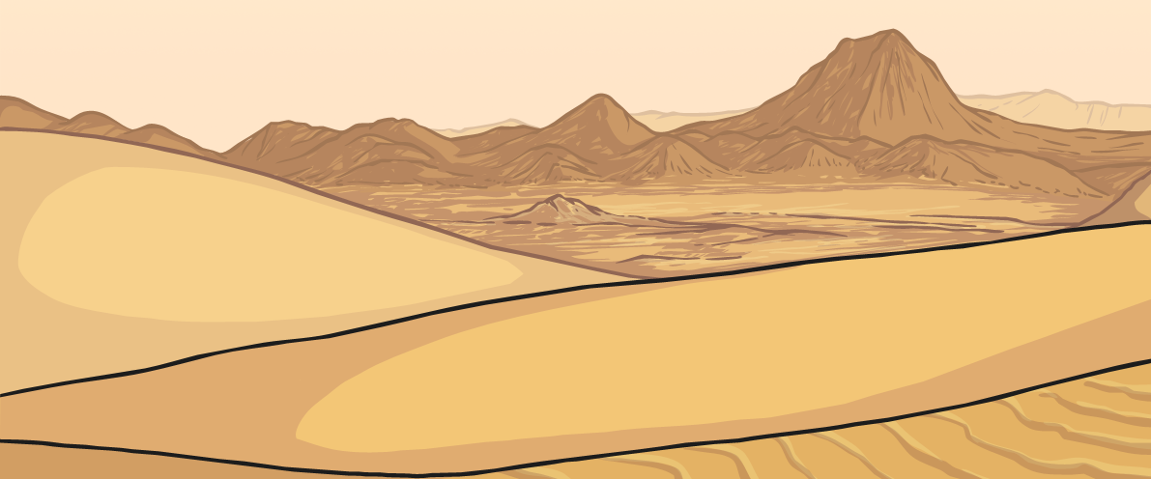
The Story of the First Passover
Moses and the Israelites spent many years travelling through the desert to reach the land God had promised them. Often, they had little to eat or drink. But the Torah says that God watched over them, provided for them and protected them.

Slide 9
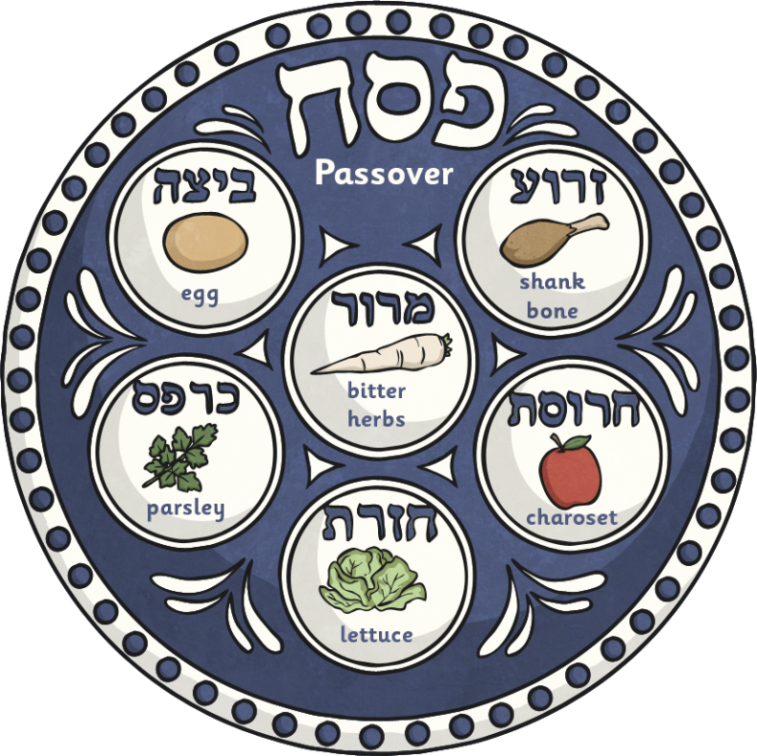
How Is Passover Celebrated?
Passover is celebrated for seven or eight days. Some Jewish families clean their house before the festival begins.
A special service called Seder happens on the evening before Passover begins.
Seder
This takes place with family and friends over a special meal, called the seder meal.
At the seder meal, a special plate called the seder plate is used.
Seder - ‘order’ in Hebrew.

Slide 10
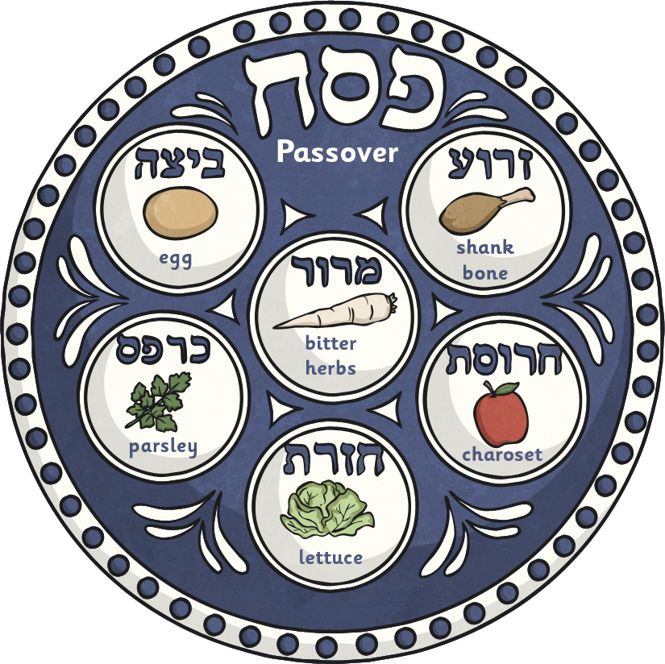
How Is Passover Celebrated?
The Seder Plate
Seder plate - an important part of the Seder meal, this plate has five sections to hold some special Seder foods

Slide 11
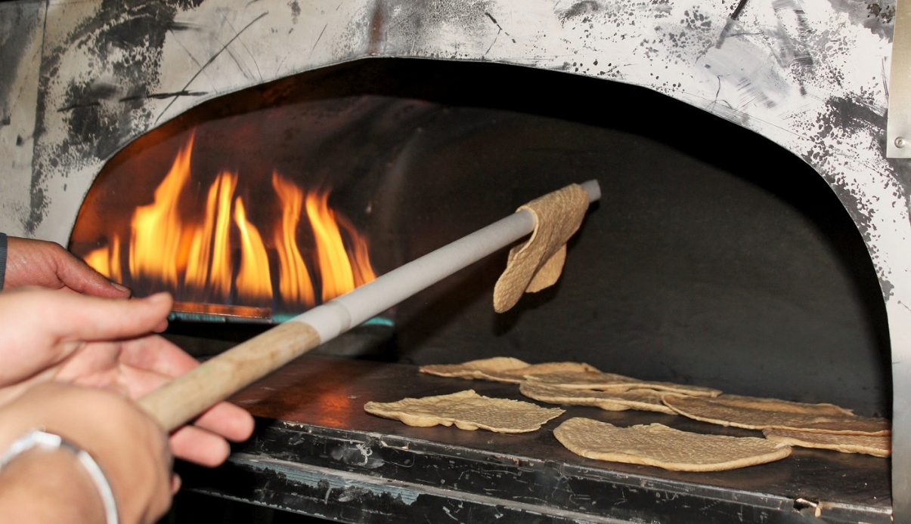
How Is Passover Celebrated?
At the Seder meal, three matzot breads are placed on top of each other.
The middle matzah is broken and the biggest piece is hidden. Children hunt for the matzah to win a prize.
matzot
Matzot - an unleavened bread

Slide 12

How Is Passover Celebrated?
Four small glasses of wine are drunk at the seder meal. Although there are different ideas about what these glasses of wine symbolise, it is believed that they are representative of the freedom the Israelites felt after being brought out of slavery. They can also represent joy and happiness.
Other believers think the glasses of wine remind Jews of the promises God made to the Israelites, promises to protect and save them.
seder
Seder - ‘order’ in Hebrew.

Slide 13
How Is Passover Celebrated?
The story of the first Passover is told during celebrations.
The story is told from a book called the Haggadah.
The retelling of the story is something everyone can join in with. Songs are sung and the youngest child in the family asks questions.
Haggadah
Haggadah - a special book containing the story of the Israelites fleeing Egypt

Slide 14
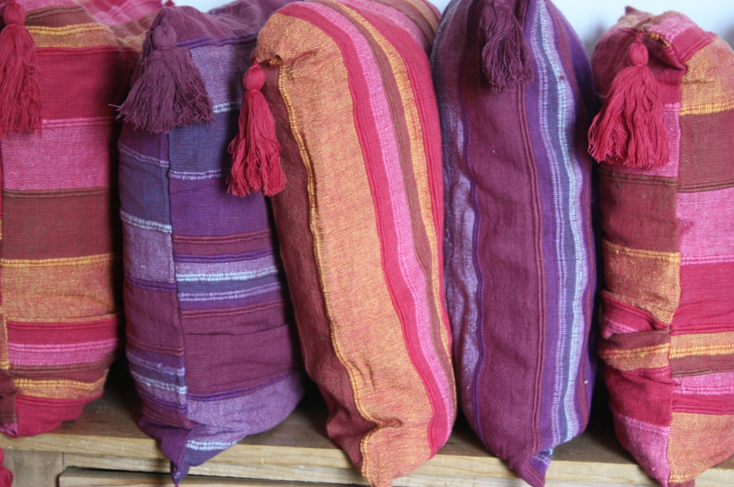
How Is Passover Celebrated?
Everyone at the Seder has a cushion to lean on. This is to remind them that the Israelites were freed from slavery to live a more comfortable life.

Slide 15
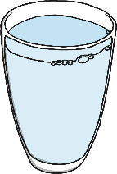
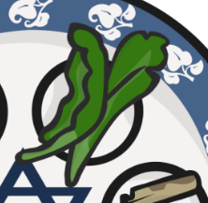

Try It!
Match the Pesach symbols to the descriptions.
A symbol of the freedom and comfort of the Israelites when they were released from slavery
Salt water
A symbol of the bitterness of slavery
Maror
A symbol of the sweat and tears shed during slavery
Cushion

Slide 16
Task
Choose between:
Complete the Seder plate activity by explaining the meaning of each food that is eaten at Passover.
Complete a mind map with as much information as you can about Passover.
You can use this PowerPoint
You can use the BBC website https://www.bbc.co.uk/bitesize/topics/znwhfg8/articles/zn22382

Slide 17
Glossary
Haggadah - a special book from which the story of the Israelites fleeing Egypt is read
Hebrew - an ancient language that is the official language of Israel
Jewish - a person whose religion is Judaism
Judaism - one of the world’s oldest religions
Maror - a bitter herb eaten as part of the Seder meal
Matzot - an unleavened bread
Seder - means ‘order’ in Hebrew.
Seder plate - an important part of the Seder meal, this plate has five sections to hold some special Seder foods
Symbol - something that represents or reminds you of something else
Torah - Jewish holy book

