Slide 1


The ratio of yellow to red counters is 1 : 3
If there are 4 yellow counters, how many red counters are there?
2) The ratio of bees to spiders is 2 : 1
There are 15 bees and spiders altogether.
How many bees are there?

Slide 2
The ratio of yellow to red counters is 1 : 3
If there are 4 yellow counters, how many red counters are there?
2) The ratio of bees to spiders is 2 : 1
There are 15 bees and spiders altogether.
How many bees are there?
12 red counters
10 bees

Slide 3
L.C. Can I calculate ratio?
Toolkit

Slide 4


A basket holds 6 bread rolls.
For every ___ basket, there are ____ bread rolls.
If I have 3 baskets, how many bread rolls do I have?
1
6
6
12
18
1
2
3
18
Bread rolls: _____

Slide 5
A basket holds 6 bread rolls.
For every ___ basket, there are ____ bread rolls.
If you have 24 bread rolls, how many baskets will you need?
1
6
6
12
18
24
1
2
3
4
4
Baskets: _____

Slide 6



For every 2 ladybirds, there are 3 spiders.
If there are 6 ladybirds, how many spiders are there?
2
3
4
6
Have a think
6
9
9
Spiders: _____

Slide 7
For every 2 ladybirds, there are 3 spiders.
If there are 6 spiders, how many ladybirds are there?
2
3
4
6
Have a think
4
Ladybirds: _____

Slide 8
For every 2 ladybirds, there are 3 spiders.
If there are 20 insects altogether, how many spiders and how many ladybirds are there?
2
5
3
5
8
Ladybirds: _____
Spiders: _____
10
12
15
20

Slide 9


The ratio of ladybirds to spiders is 2 : 6
Complete the ratio table.
Have a think
Ladybirds | Spiders
1
2 | 6
4
 | 18
20
 | 144
$×$2
$×$2
12

Slide 10




The ratio of ladybirds to spiders is 2 : 6
Complete the ratio table.
Ladybirds | Spiders
1
2 | 6
4
 | 18
20
 | 144
3
$÷$2
$÷$2
$×$3
12
$×$3
6

Slide 11
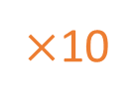

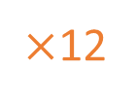
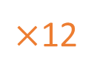
The ratio of ladybirds to spiders is 2 : 6
Complete the ratio table.
Ladybirds | Spiders
1
2 | 6
4
 | 18
20
 | 144
3
12
$×$10
$×$10
6
$×$12
$×$12
60
48

Slide 12
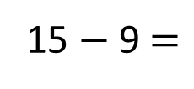
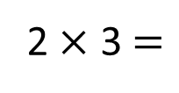
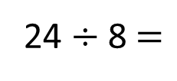
Dexter and Rosie share 24 sweets in the ratio 3 : 5
How many more sweets will Rosie get than Dexter?
Dexter
?
3
3
3
9
24
Rosie
3
3
3
3
3
15
24 $÷$ 8 $=$
3
15 $−$ 9 $=$
6
2 $×$ 3 $=$
6
6
Rosie gets ____ more sweets than Dexter.

Slide 13
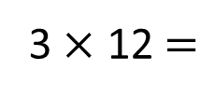
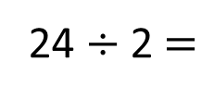
Dexter and Rosie share some sweets in the ratio 3 : 5
Rosie gets 24 more sweets than Dexter.
How many sweets does Dexter get?
?
Dexter
24
12
12
12
24 $÷$ 2 $=$
12
Rosie
3 $×$ 12 $=$
36
12
12
12
12
12
36
Dexter gets ____ sweets.

