Slide 1
L.C. Can I explain why journeys are special to Christians?
Toolkit

Slide 2
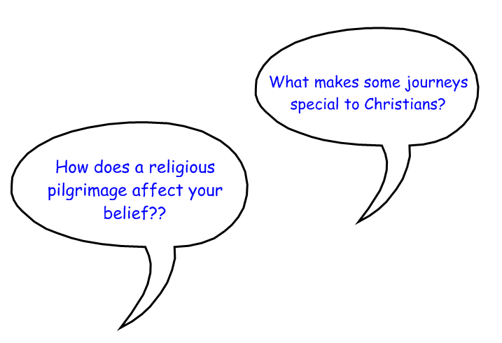
Discuss…………….

Slide 3
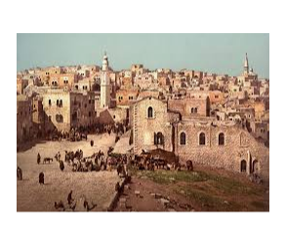
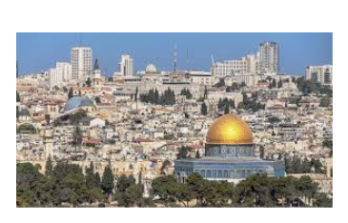
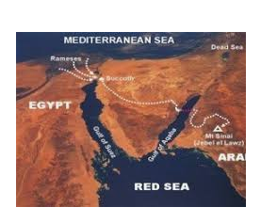
What do you know about these places?
Have you heard of them?
Where have you heard / seen / read about them?
Bethlehem Jerusalem The Red Sea

Slide 4
Discussion
These are all special places which are mentioned in the Bible.
Which do you think is most important and why?
The Red Sea - where Moses led the children of Israel to safety away from the Egyptians.
Bethlehem -
birthplace of Jesus.
Jerusalem - where Jesus died.

Slide 5
Diamond 9
Cut out the pictures of the different Christian pilgrimages and recounts of why they are important.
Rank them in a Diamond 9. Think about why you have ranked them in this way.
Stick them into your book. Write an
explanation about why and where you have chosen to place each one.

Slide 6
Final thoughts…………….
How would a Christian benefit from taking such a pilgrimage?
How does this compare with a Muslim visiting Makkah, or a Jew visiting the Western Wall?

