Slide 1
L.C. Can I spell homophones?
Spelling Toolkit:

Slide 2
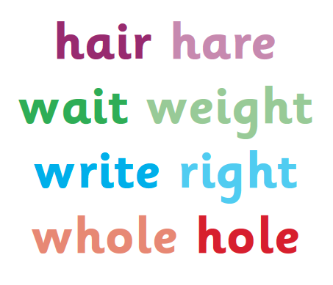
What are homophones?
Pairs or sets of words that sound the same but we spell them differently, such as their, they're and there and they do not mean the same.

Slide 3
Quick Spell
How many pairs or sets of homophones can you write in one minute?

Slide 4
How do you pronounce these two words?
isle / aisle
Can you add each word to the correct sentence?
1) The gangway between seats on a train, bus or plane is called the .......................
2) She lives on the ........................ of Wight.
Write your own sentences using each homophone.

Slide 5
How do you pronounce these two words?
allowed / aloud
Can you add each word to the correct sentence?
1) You mustn't go in there because we're not .........................
2) Come on, let's all sing ..................
Write your own sentences using each homophone.

Slide 6
How do you pronounce these two words? practice / practise
What do you notice?
Add each word to the correct sentence:
1) I need to ………… my spellings for Friday's test.
2) I've not been to a dance ………….. since last year.

Slide 7
What do you notice?
1) I need to practise my spellings for Friday's test.
2) I've not been to a dance practice since last month.

Slide 8
Look at these pairs of words.
What do you notice about how they are written or pronounced?
Do you notice anything about which word class they belong to?
device/devise
licence/license
practice/practise
prophecy/prophesy

Slide 9
Look at these pairs of words.
With these words, nouns end –ce and verbs end –se.
Advice and advise provide a useful clue as the word advise (verb) is pronounced with a z sound – which could not be spelt with a c.
device/devise
licence/license
practice/practise
prophecy/prophesy

Slide 10
Look at these pairs of words.
Write each word in a sentence of your own.
device/devise
licence/license
practice/practise
prophecy/prophesy

Slide 11
How can you remember whether to use practice or practise?
Do you have any other ways to remember which homophone to use?

