Slide 1

Lesson 10

Slide 2
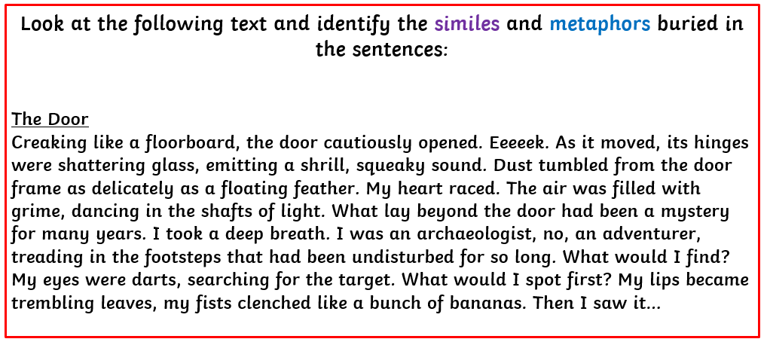
SPAG warm up

Slide 3
DADWAVERS daily challenge
D is for description – sentences filled with imagery and adjectives​​​
A is for action – detailing what is happening in a sentence​​​
D is for dialogue – something a characters says out loud or a conversation​​​
W is for where – indicating the location of the action (adverb of place)​​​
A is for adverb – usually an adverb / adverbial phrase of manner​​​
V is for verb – single word or phrase e.g Walking, / Walking across the country​​​
E is for estimation of time e.g Momentarily, At midday, As the tide turned​​​
R is for rhetorical question to draw in the reader, can use more than one​​​
Simile is for simile (or metaphor) – allows the writer to ‘paint’ an image

Slide 4
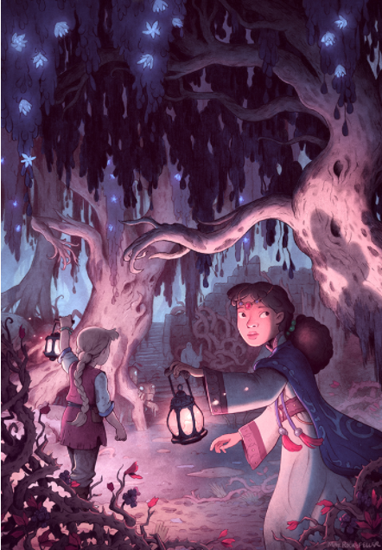
DADWAVERS – ​
60 secs to write…
S is for simile or metaphor​
Eg. Running towards the canyon, he leapt like a hunted stag and rolled as he landed.
Eg The light was a beacon of hope among the gloomy trees.

Slide 5
LC: Can I infer a character's feelings and emotions?

Slide 6

Yesterday, the family arrived at the border after a long journey.
How would they have been feeling at this point?

Slide 7

BUT, OH NO!
“You are not allowed to cross the border. Go back!”
shouts an angry guard.
We have nowhere to go and we are very tired.
What can you see?
Why might the author have drawn the guard big and looming and the family small and looking up?
Can you think of a metaphor or simile to describe the guard?

Slide 8
BUT, OH NO!
“You are not allowed to cross the border. Go back!”
Shouts an angry guard.
We have nowhere to go and we are very tired.
Why do you think they are not allowed to cross the border?
Should they be upset?
What do you think the mother will do next?

Slide 9
What do you understand about these terms:
Refugee
Internally displaced person
Asylum seeker
Migrant

Slide 10
What do you understand about these terms:
Refugee – are people fleeing conflict / war. Their situation is so perilous that they cross national borders to seek safety in nearby countries.
Internally displaced person - people are seeking safety in other parts of their country.
Asylum seeker – people claiming refugee status but whose claim hasn’t been officially evaluated.
Migrants - people moving to another country for other reasons beyond conflict and persecution.

Slide 11
The family in our story are seeking asylum and are looking for safety by trying to cross an international border. If they succeed and are granted asylum, they will be classed as refugees.
There are currently 68 million people in the world who are displaced because of war and conflict.

Slide 12
TASK
Think back to the letter of persuasion that you wrote on earlier in the week. This was quite informal as it was from a letter from one friend to another friend.
You are now going to write another letter of persuasion but this time as the mother writing to persuade the border guard to let them pass.
You will need to write more formally.
Use persuasive techniques such as:
Emotive language (powerful verbs) - make it personal
Rhetorical questions
Modal verbs (must / will / should)
There are some resources on the next slides to help you.

Slide 13
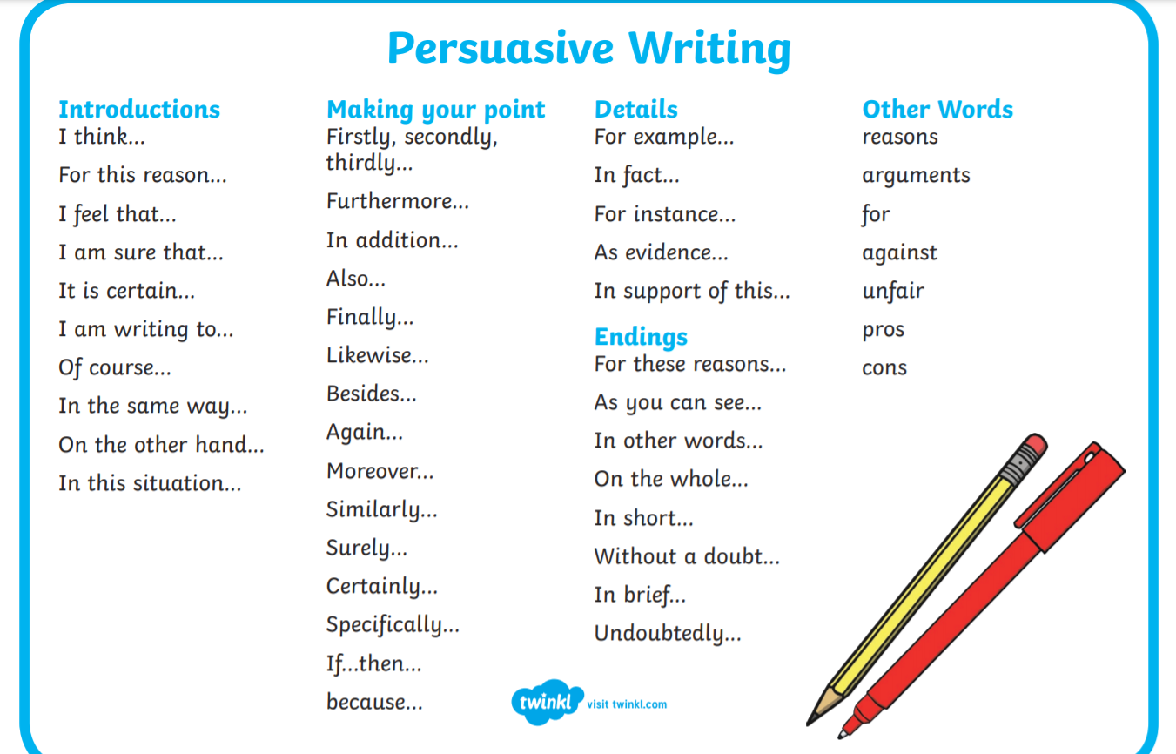

Slide 14


