Slide 1
1) What is half of 9,000?
2) Sally has £250 and Oscar has £800
How much more money does Oscar have?
3) What is the difference between 1,935 m and 2,936 m?
4) Complete the sequence
____ 14 ____ 26 ____

Slide 2
4,500
1) What is half of 9,000?
2) Sally has £250 and Oscar has £800
How much more money does Oscar have?
3) What is the difference between 1,935 m and 2,936 m?
4) Complete the sequence
____ 14 ____ 26 ____
£550
1,001 m
8
20
32

Slide 3
L.C. Can I read and interpret line graphs?
Toolkit

Slide 4
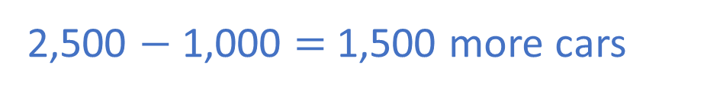
Car sales
3,500
3,000
2,500
2,000
Cars sold
1,500
1,000
500
0
Jan
Feb
Mar
Apr
May
Month
1) How many more cars were sold in March than January?
Mar = 2,500
Jan = 1,000
2,500 $−$ 1,000 = 1,500 more cars

Slide 5

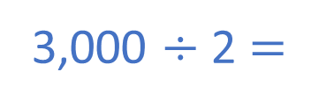
Car sales
Have a think
3,500
3,000
2,500
2,000
Cars sold
1,500
1,000
500
0
Jan
Feb
Mar
Apr
May
Month
Car sales in June are half the car sales in April.
How many cars are sold in June?
3) How many cars are sold from January to May altogether?
3,000 $÷$ 2 $=$
1,500 cars
10,500 cars

Slide 6
Heart Rate During Exercise
120
100
80
60
Heart Rate
40
Have a think
20
0
0
1
2
3
4
5
6
7
8
9
10
Time (minutes)
Time (mins) | 0 | 1 | 2 | 3 |  |  |  | 7 |  | 9 | 10
Heart rate | 61 | 70 | 77 |  |  |  | 110 |  |  | 98
4
6
4
5
8
82
100
110
110
102
96

Slide 7
Heart Rate During Exercise
120
100
80
60
Heart Rate
40
20
0
0
1
2
3
4
5
6
7
8
9
10
Time (minutes)
Estimate the athlete’s heart rate after 2 and a half minutes of exercise.
80 beats per minute

Slide 8
Heart Rate During Exercise
120
100
80
60
Heart Rate
Have a think
40
20
0
0
1
2
3
4
5
6
7
8
9
10
Time (minutes)
By how many beats per minute does the athlete’s heart rate fall between minutes 8 and 9?
8 minutes = 102
9 minutes = 98
Fall of 4 bpm

Slide 9
Rainfall in Cape Town and Helsinki
= Cape Town
130
120
= Helsinki
110
100
1) In which month is rainfall closest in both cities?
90
80
70
Rainfall (mm)
September
60
50
2) In which two months is rainfall the same in Helsinki?
40
30
20
10
0
February and March
Jan
Feb
Mar
May
Jul
Apr
Jun
Oct
Dec
Aug
Nov
Sep
Month

Slide 10
Rainfall in Cape Town and Helsinki
= Cape Town
130
120
= Helsinki
110
3) In how many months is there more than 90 mm of rainfall in Cape Town?
100
Have a think
90
80
70
Rainfall (mm)
51 mm
3 months
60
50
4) How much more rainfall is there in Helsinki than Cape Town in October?
40
30
34 mm
20
10
0
17 mm
Jan
Feb
Mar
May
Jul
Apr
Jun
Oct
Dec
Aug
Nov
Sep
Month

Slide 11

Rainfall in Cape Town and Helsinki
= Cape Town
130
120
= Helsinki
110
There is more rainfall in Helsinki in 7 out of 12 months so Helsinki receives more rainfall in a year than Cape Town.
100
90
80
70
Rainfall (mm)
60
50
40
30
Do you agree?
20
No
10
0
Jan
Feb
Mar
May
Jul
Apr
Jun
Oct
Dec
Aug
Nov
Sep
Month

