Slide 1


1) What is the ratio of cookies to donuts?
2) The ratios show shaded parts to non-shaded
parts. Match the ratios to the bar models.
3 : 5
1 : 3
3 : 1

Slide 2
1) What is the ratio of cookies to donuts?
2) The ratios show shaded parts to non-shaded
parts. Match the ratios to the bar models.
7 : 5
3 : 5
1 : 3
3 : 1

Slide 3
L.C. Can I calculate ratio?
Toolkit

Slide 4
For every 2 red counters, there’s 1 yellow counter.
If there are 6 red counters, how many yellow counters are there?
3
2
1
4
2
6
3
If there are 7 yellow counters, how many red counters are there?
14

Slide 5

Activity 1
Have a think
For every 3 yellow counters, there’s 2 red counters.
If there are 6 red counters, how many yellow counters are there?
If there are 18 yellow counters, how many red counters are there?

Slide 6
Activity 1
For every 3 yellow counters, there’s 2 red counters.
If there are 6 red counters, how many yellow counters are there?
9
If there are 18 yellow counters, how many red counters are there?
3
2
6
4
9
6

Slide 7
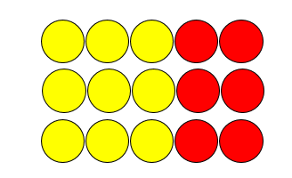
Activity 1
For every 3 yellow counters, there’s 2 red counters.
If there are 6 red counters, how many yellow counters are there?
If there are 18 yellow counters, how many red counters are there?
12 red counters

Slide 8

The ratio of red to yellow counters is 3 : 1
There are 16 counters in total.
How many counters are yellow?
R
4
4
4
16
Y
4
16 $÷$ 4

Slide 9
Activity 2
Have a think
The ratio of red to yellow counters is 4 : 2
There are 18 counters in total.
How many counters are red?

Slide 10
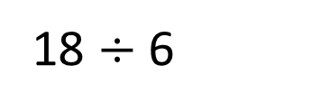
Activity 2
The ratio of red to yellow counters is 4 : 2
There are 18 counters in total.
How many counters are red?
3
3
3
3
R
18
3
3
Y
18 $÷$ 6

Slide 11



Dora is practising her shooting skills.
In total she takes 24 penalties.
For every 5 penalties she scores, she misses 3
15
How many penalties does Dora score?
S
3
3
3
3
3
24 $÷$ 8
24
M
3
3
3
How many more penalties does Dora score than miss?
6

Slide 12
Activity 3
Have a think
Tommy has a packet of sweets.
For every 2 red sweets there are 3 green sweets.
If there are 30 sweets in the packet in total, how many of each colour are there?

Slide 13


Activity 3
R
6
6
30
G
6
6
6
30 $÷$ 5
12 red sweets and 18 green sweets.

