Slide 1
Year 2 Maths Revision
LC: Can you add three 1-digit numbers?

Slide 2


Slide 3
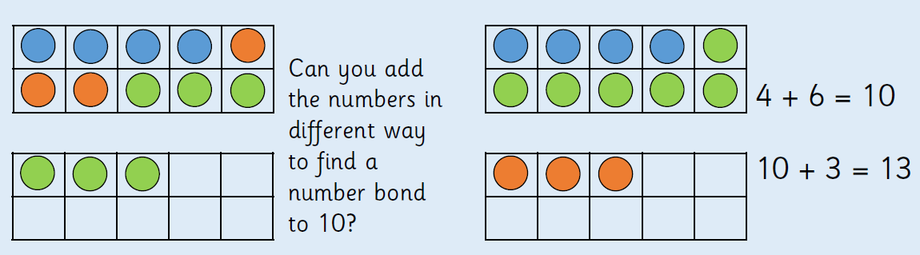

Slide 4
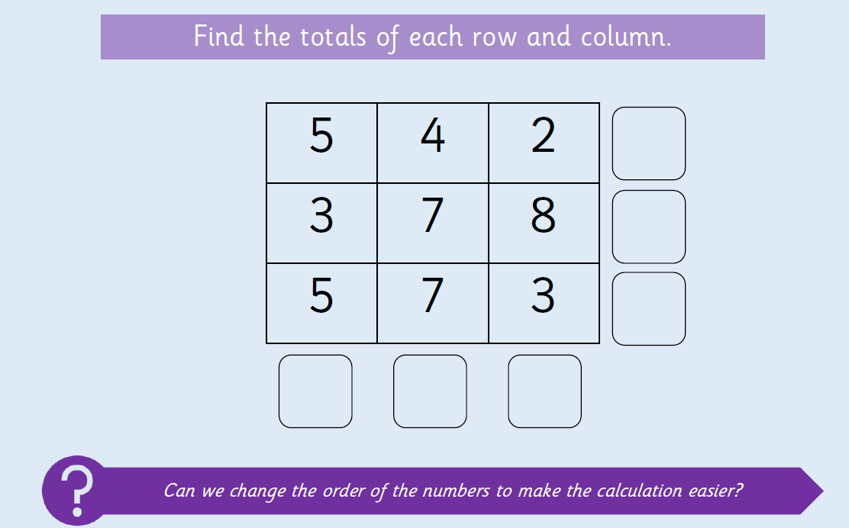

Slide 5
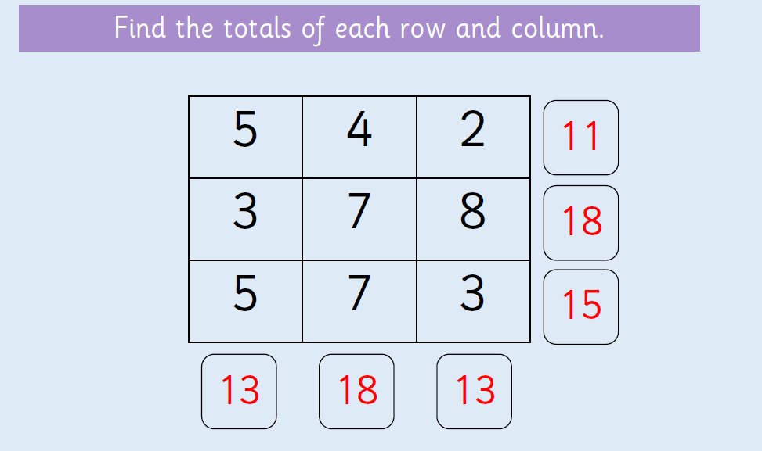
Did you make bonds to 10?
Did you spot where you could double numbers?

Slide 6
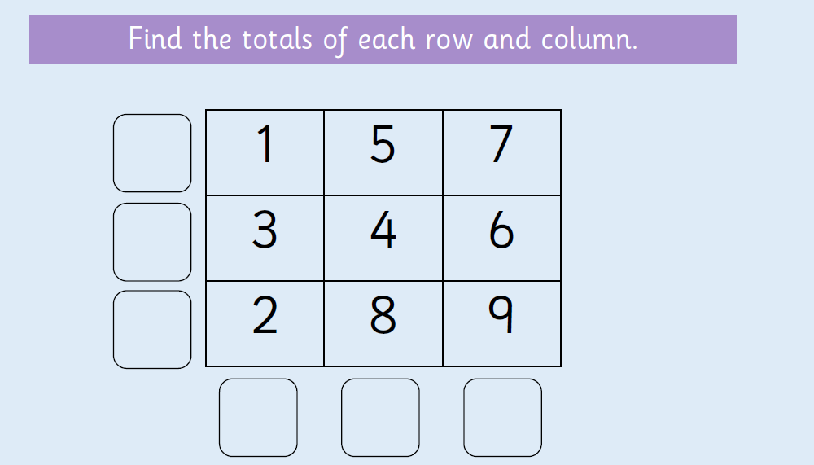
On paper or a whiteboard, can you find the answers?

Slide 7
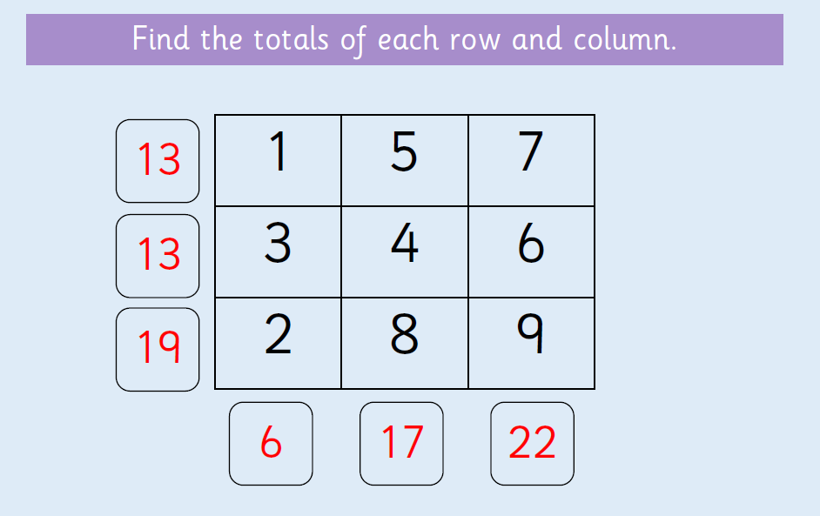

Slide 8
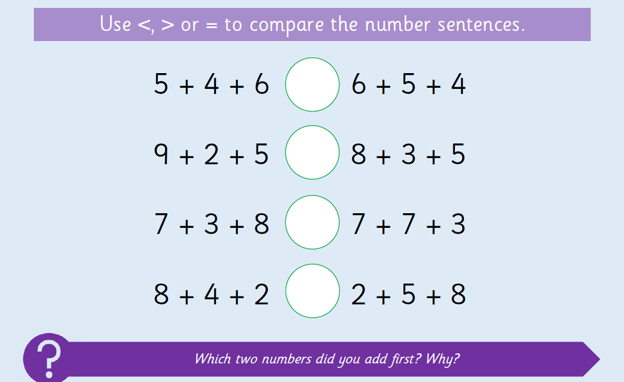
On paper or a whiteboard, can you find the answers?

Slide 9
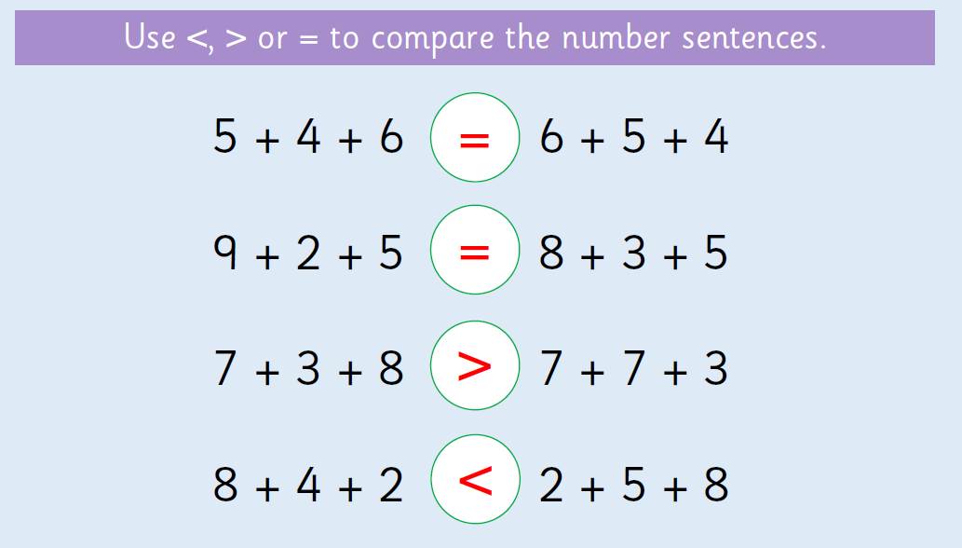

Slide 10
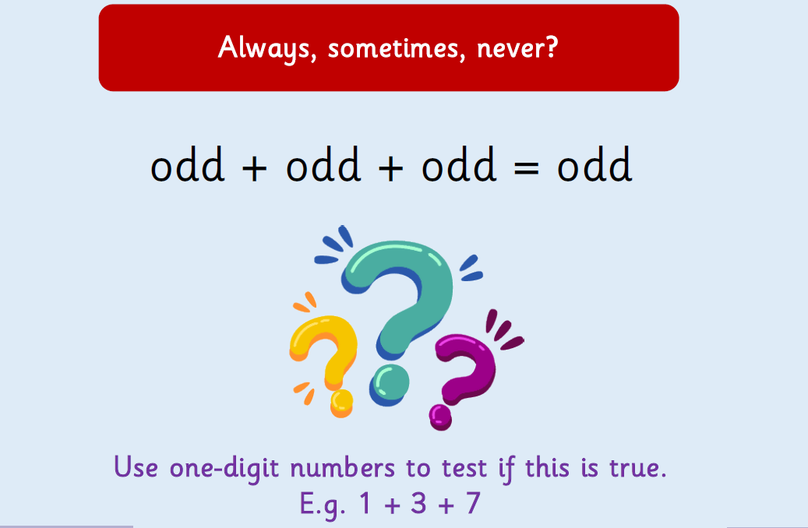

Slide 11
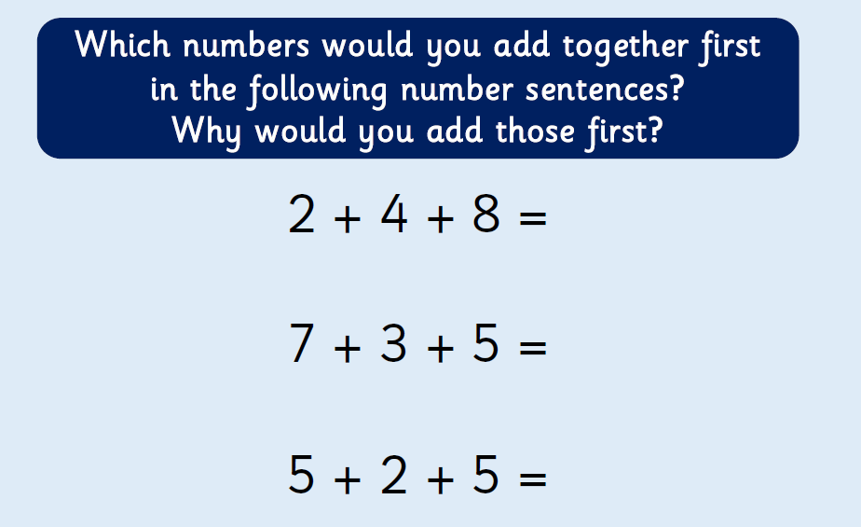

Slide 12
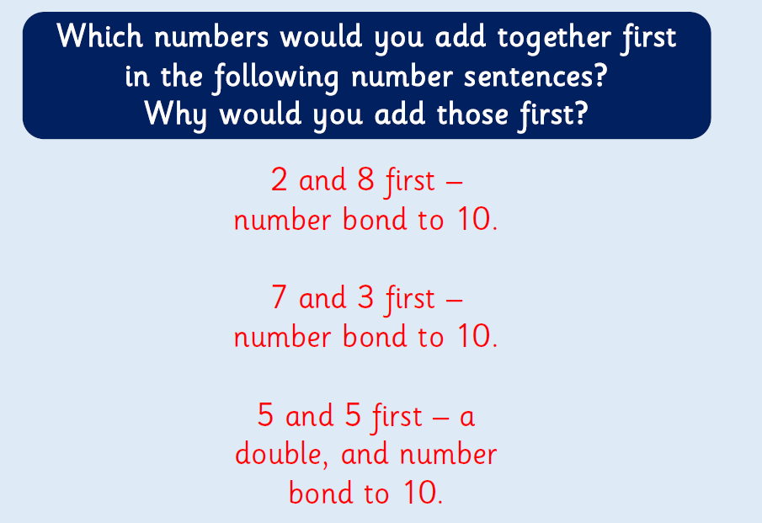

Slide 13
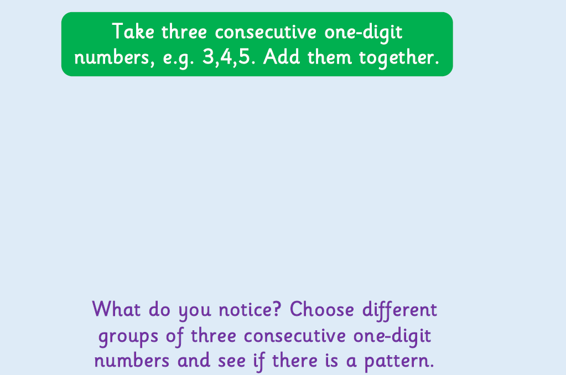

Slide 14


