Slide 1
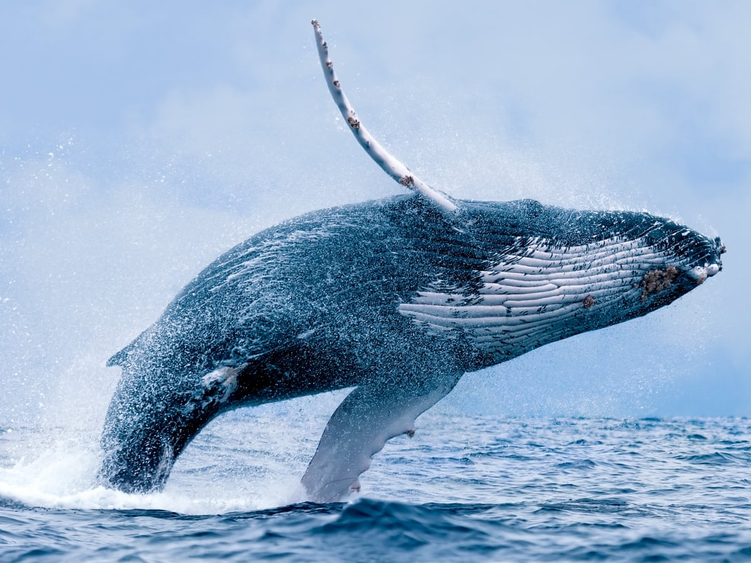
During the last lesson, we thought about plastic pollution and the dangers to whales
and other sea creatures.

Slide 2
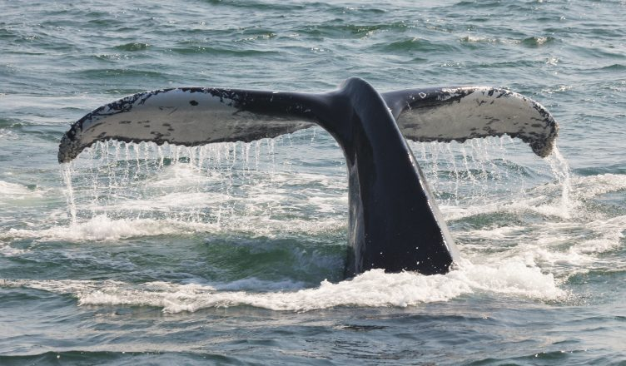
What were the main dangers of plastic to whales?

Slide 3
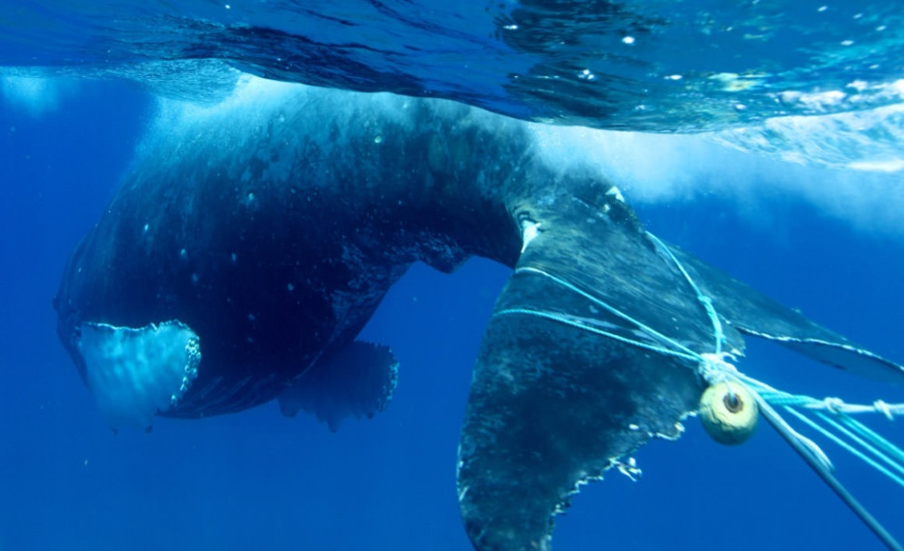
Entanglement
Whales can become physically entangled in plastic in the ocean, usually in the form of fishing nets and rope, but also discarded plastic like bags.

Slide 4
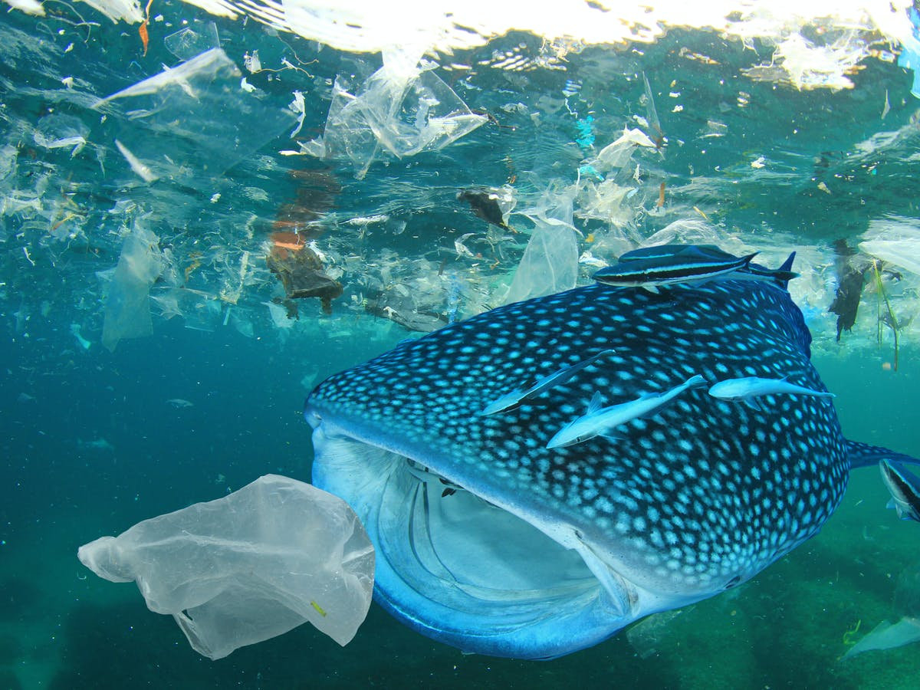
Ingestion
Plastic may be ingested by whales mistakenly while feeding on prey, or may enter their digestive system from inside of prey that has previously fed on plastic.
Microplastics, plastic pieces of 5mm or less, are of particular concern for baleen whales, as these giant creatures can end up ingesting the tiny plastic along with krill or other prey while filter feeding.
One dead pilot whale was found to
contain 80 plastic bags in his stomach.

Slide 5
LC 2: ​
To understand ways in which we can reduce the use of plastic and minimise plastic pollution.​
​
To write a personal pledge about plastic pollution.​

Slide 6
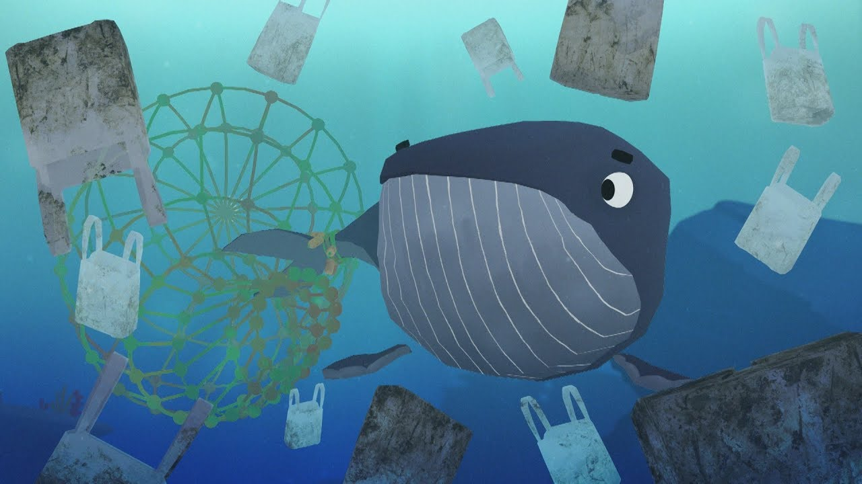
A Whale’s Tale
A Whale’s Tale

Slide 7
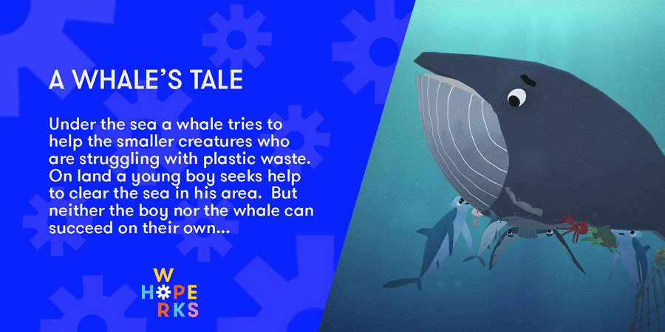
Watch this powerful animation:
https://www.youtube.com/watch?v=xFPoIU5iiYQ

Slide 8
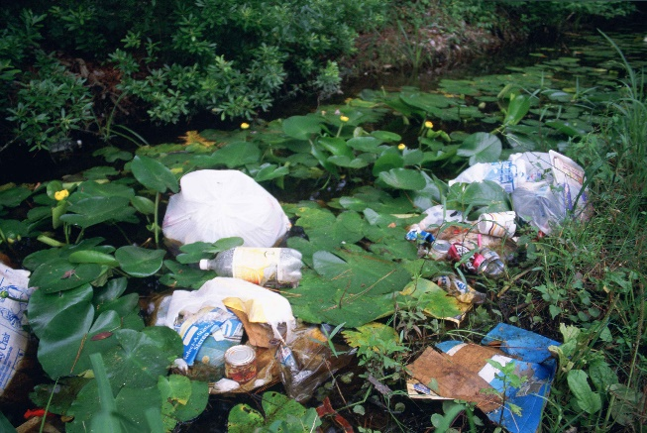
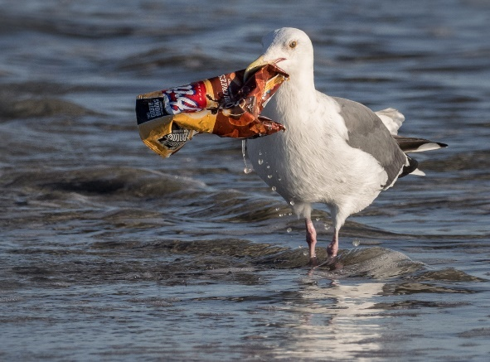
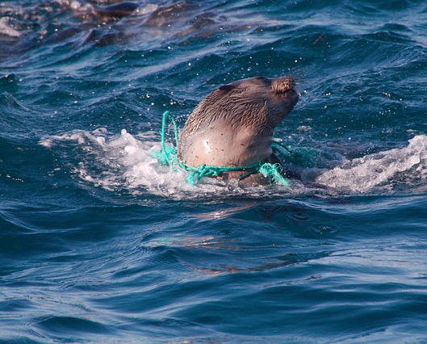
Plastic Pollution
Think about it
What do you think about these pictures?
All living things should be able to live free from pollution and harm from plastics.
Photo courtesy of Ingrid Taylar (@flickr.com) - granted under creative commons licence - attribution

Slide 9
But what can we
do about it?
https://www.youtube.com/watch?v=73sGgmZoMBQ
Watch this video link.
What were some of the changes at the end of the clip?
What other changes could we make?

Slide 10
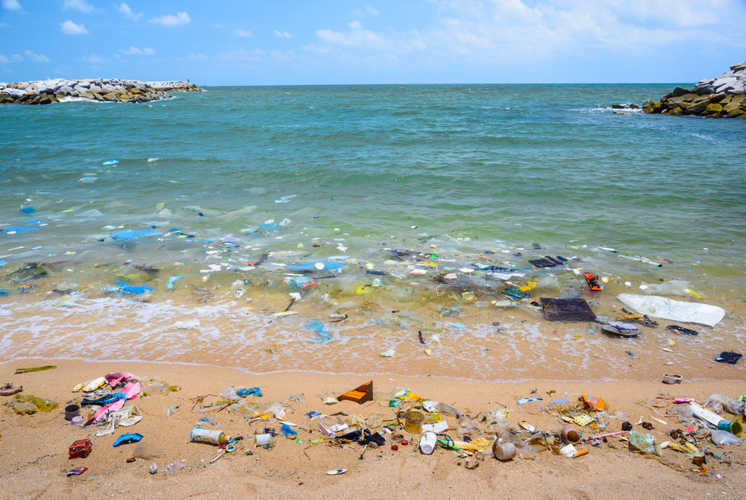
How can we take action against plastic in the ocean?

Slide 11
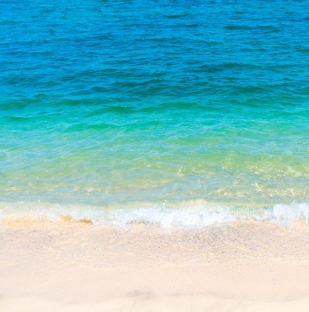
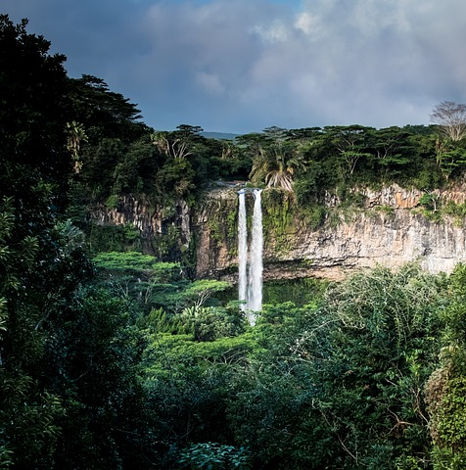
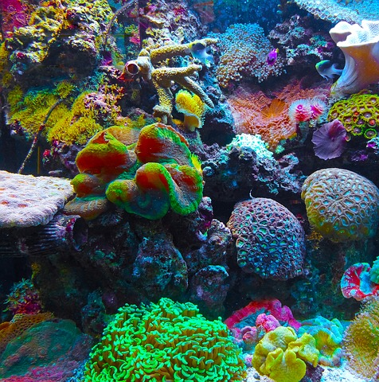
Our Responsibility
By making small changes, we can all make a difference. Let’s all work together to make the Earth a healthier and cleaner place for everything.

Slide 12
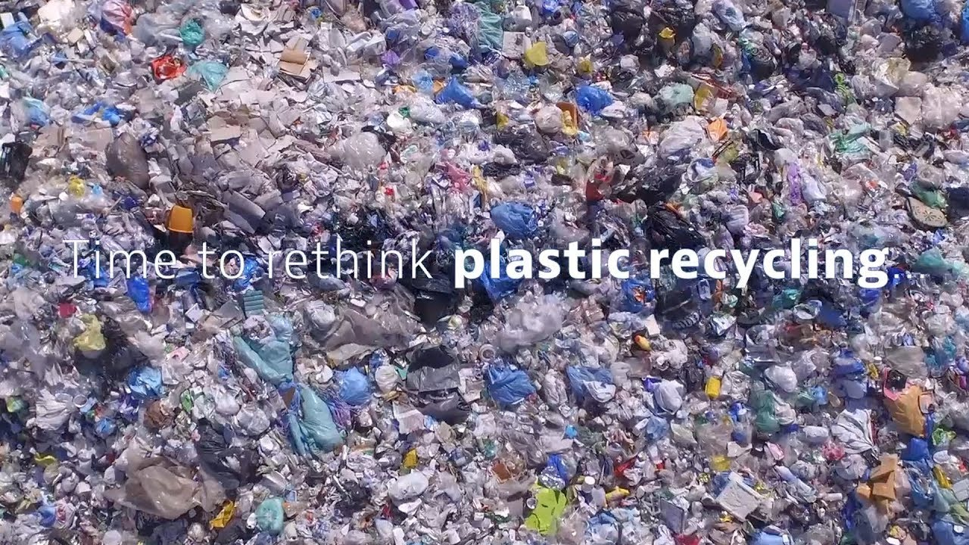

Slide 13
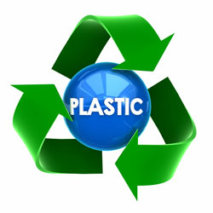
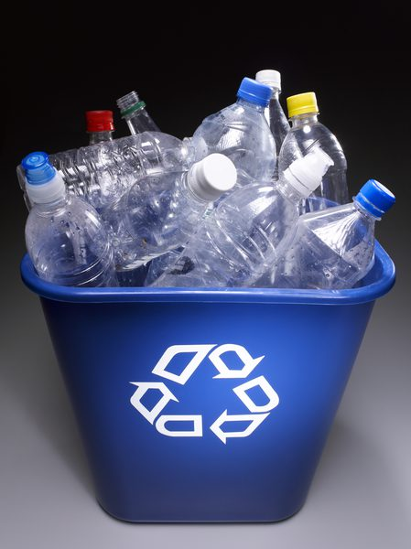
Reduce, Reuse, Recycle
Eliminating or reducing the use of plastics, especially single-use plastic, in your daily life is a critical step in reducing marine debris. The ways that the world processes recyclables are changing, and one of our best preventions against marine debris is choosing not to purchase plastic to begin with.
Repurpose

Slide 14
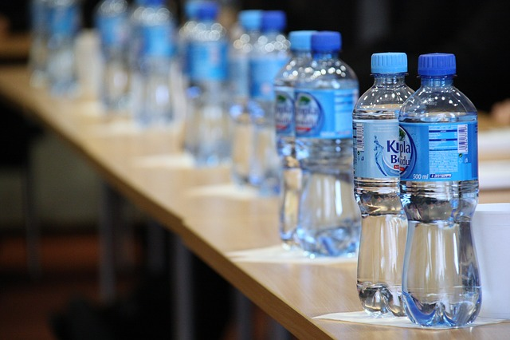
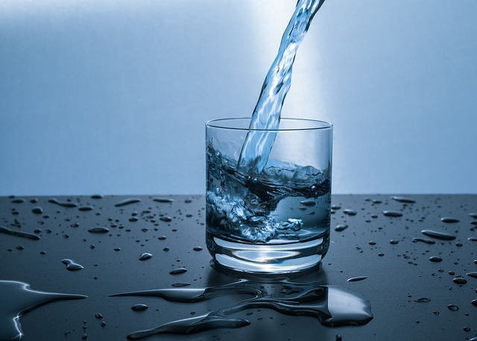
What You Can Do
Look at these two pictures. Which do you think is the right thing to use, to help the environment?
Water bottles are one of the main causes of environmental pollution. Instead of using lots of water bottles and throwing them away, have a glass or mug of water.
Not only is it environmentally-friendly, it is also cheaper!

Slide 15
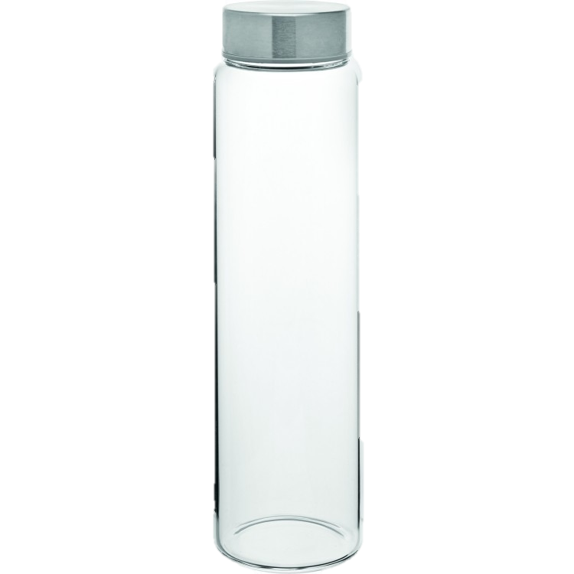
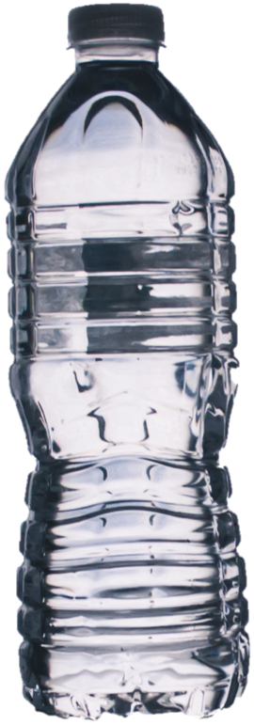
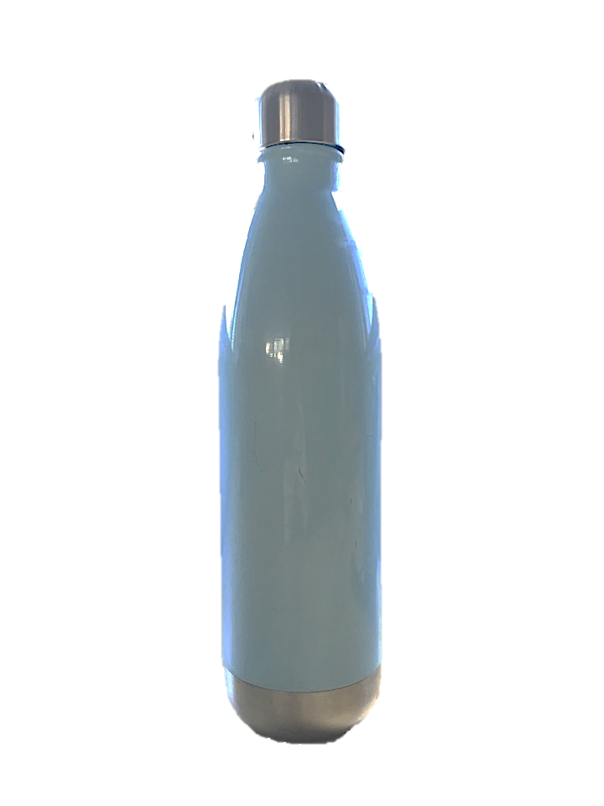
What could be used instead?

Slide 16
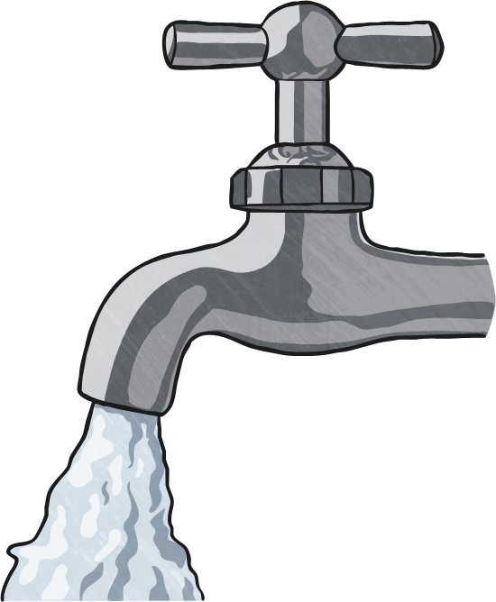
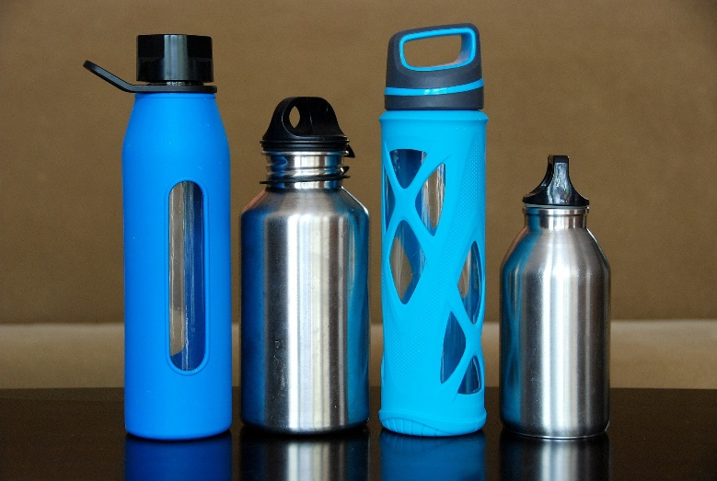
Refillable Water Bottles
People are trying to reduce the amount of plastic that they use. One easy way to do this is to use refillable water bottles instead of disposable ones.
Some shops now allow people to refill their own water bottles for free.

Slide 17
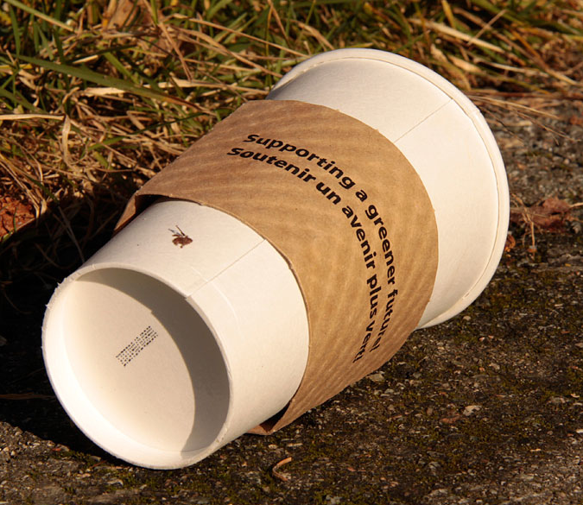
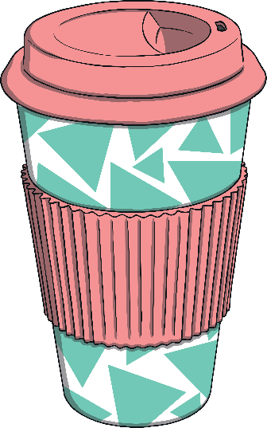
Reusable Mugs
Nowadays, it is very popular to buy hot drinks at coffee shops. At first sight, the cardboard cups might seem environmentally friendly. However, the lids are plastic and the inner layer of these cups is a type of plastic that is difficult to recycle. In the UK, 2.5 billion disposable coffee cups are thrown away each year. They end up in landfills or littering areas.
To help this problem, people are being encouraged to take their own reusable cups to coffee shops when they are going to be ordering a takeaway hot drink. Some coffee shops give customers a discount for using their own cup.

Slide 18
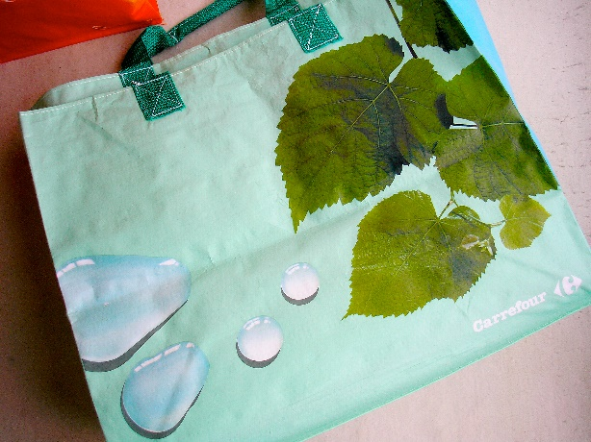
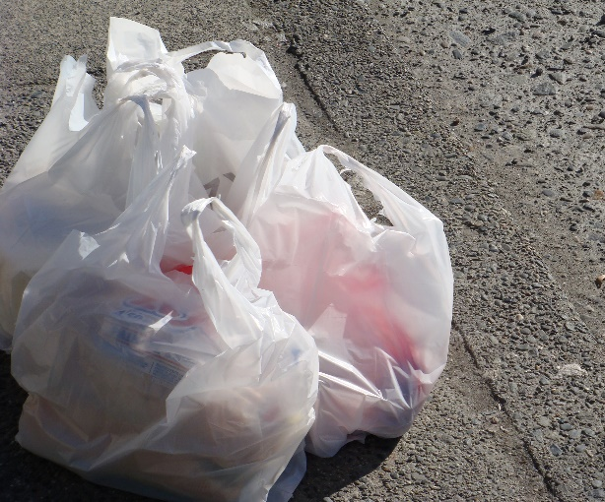
What You Can Do?
Look at these two bags.
Which do you think is the more environmentally-friendly bag?
Carrier bags are often used once and thrown away. Instead, buy a bag for life and keep using it. Since many shops charge 5p per bag, a reusable one is cheaper too!
Photo courtesy of Michael Francis McCarthy, velkr0 (@flickr.com) - granted under creative commons licence - attribution

Slide 19
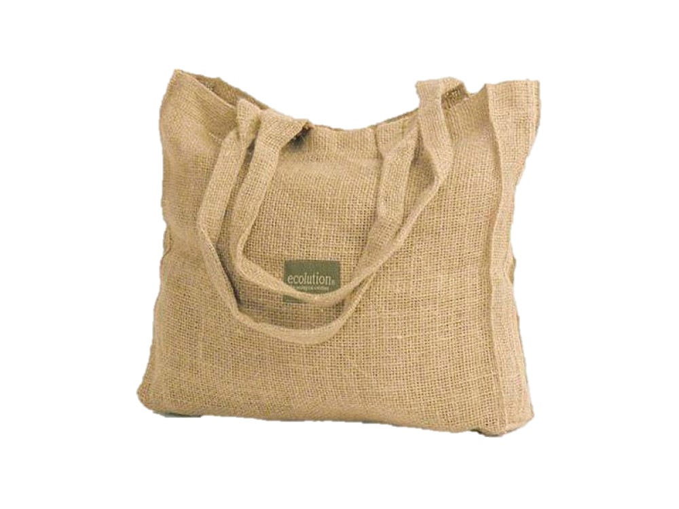
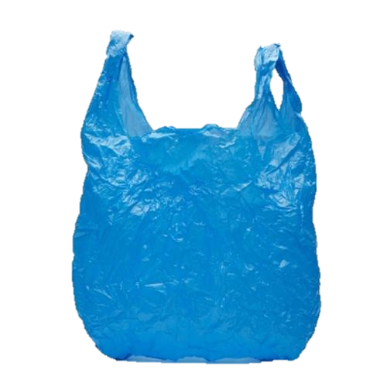
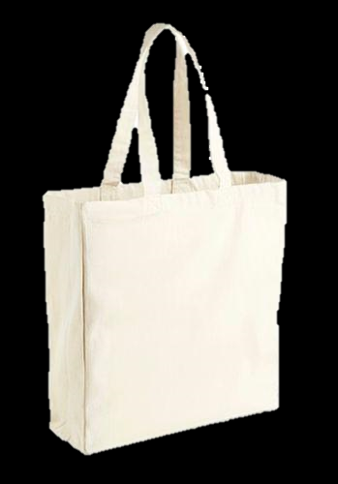
What could be used instead?

Slide 20
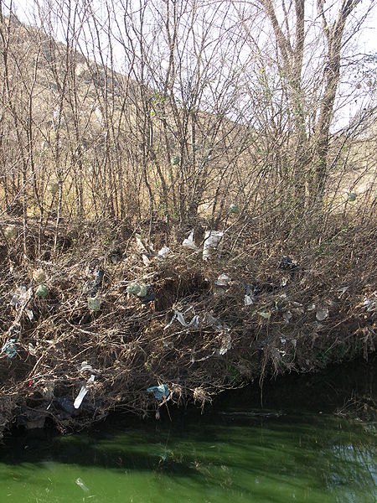
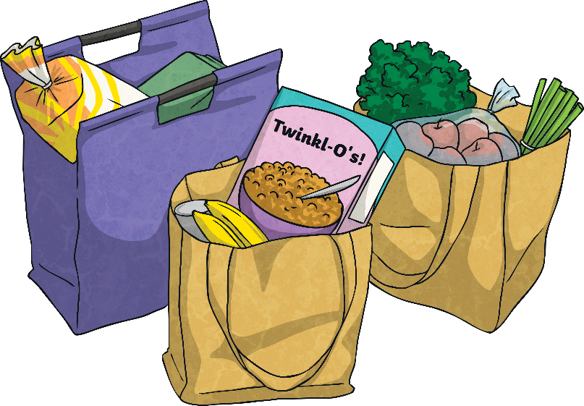
Plastic Bag Charge
Plastic bags damage the environment in many ways. Wildlife both in sea and on land can eat these bags, which damages them internally. Bags can clog drains and cause flooding. They also cause visual pollution.
Since October 2015, all large shops in England have to charge 5p for shopping bags. This is to encourage shoppers to reuse these bags, or use a ‘bag for life’, or bags made of jute or string. Shops in Wales and Scotland already charged for these bags.
Glossary
internally: On the inside.
visual pollution: When an area doesn’t look nice.

Slide 21
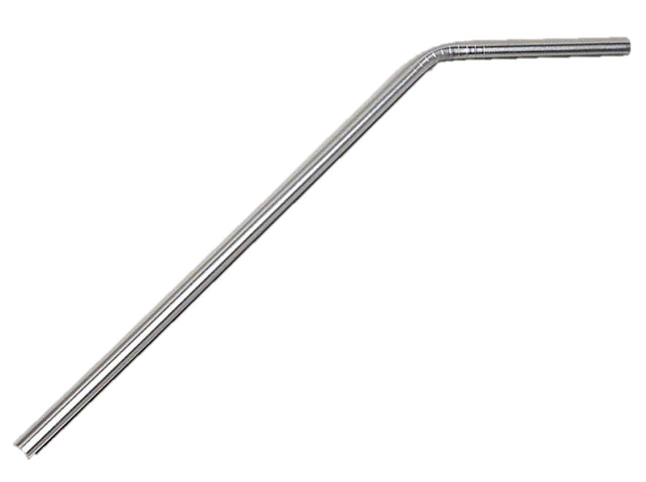
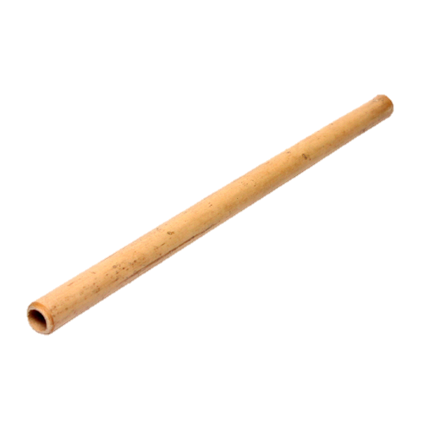

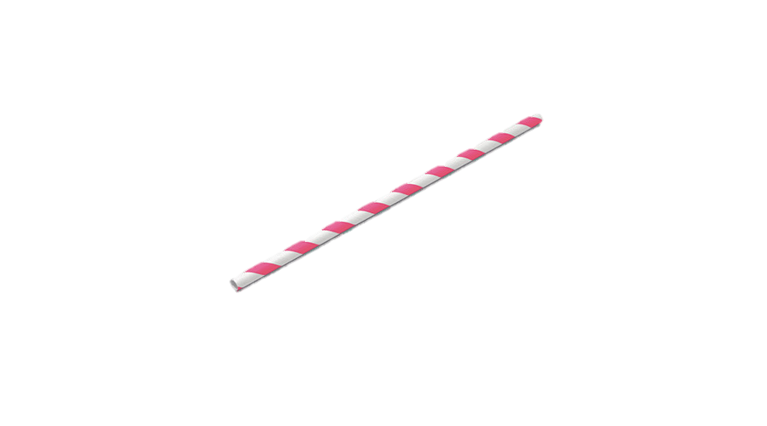
What could be used instead?

Slide 22
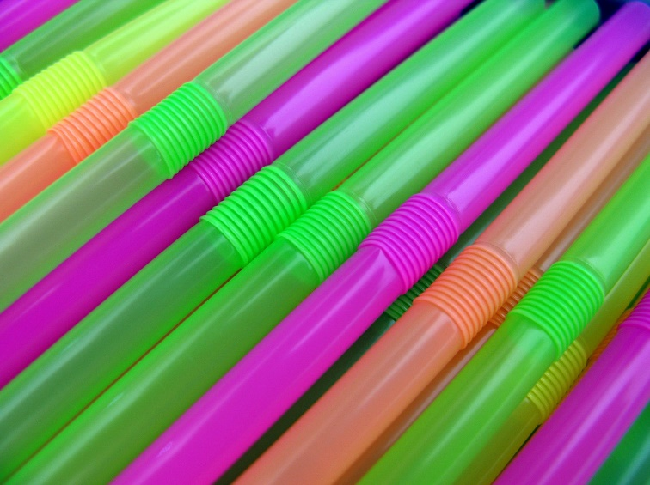
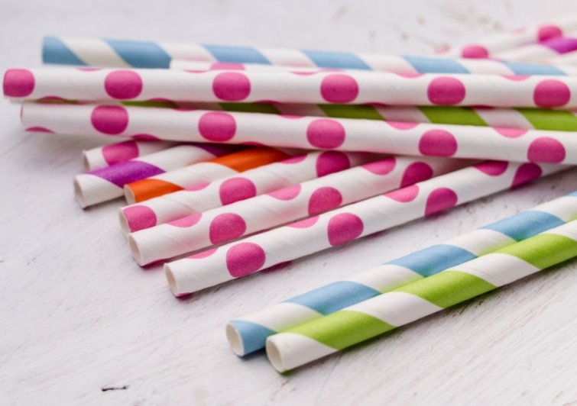
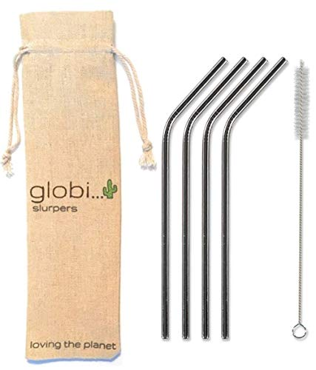
Plastic Straw Ban
500 million plastic straws were being used every single day. That is enough to fill a sports stadium nine times every year! As they are so small, they are difficult to recycle, so most straws end up as rubbish.
Following a campaign to ban the use of plastic straws, shops now provide recyclable, cardboard straws and some customers opt to use their own reusable straws.

Slide 23
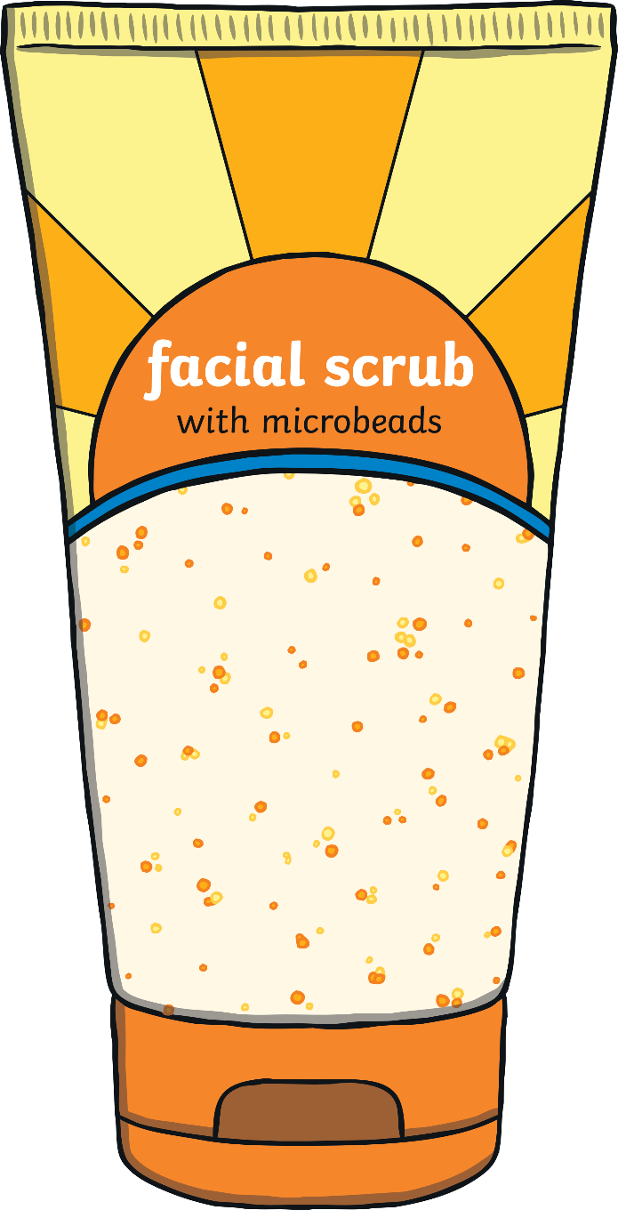
Microbeads
Many toiletries such as toothpaste, shampoos and face scrubs once contained microbeads. Microbeads are tiny pieces of plastic, almost too small to see. The microbeads were washed down drains and would end up in lakes, rivers and seas. These tiny pieces of plastic are toxic to creatures.
In January 2018, a ban on microbeads in these toiletries came into place in the UK. Some environmental campaigners claim that the ban doesn’t go far enough, as microbeads are still allowed in other products.

Slide 24
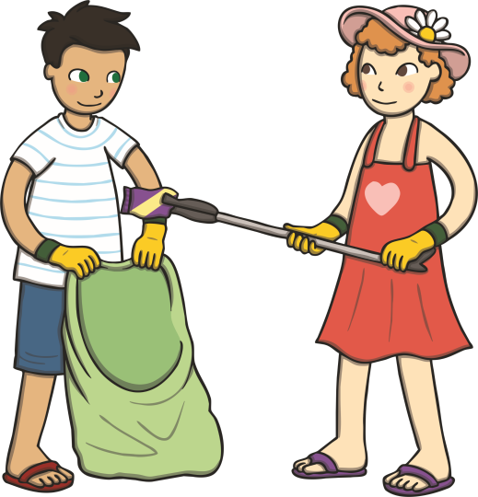
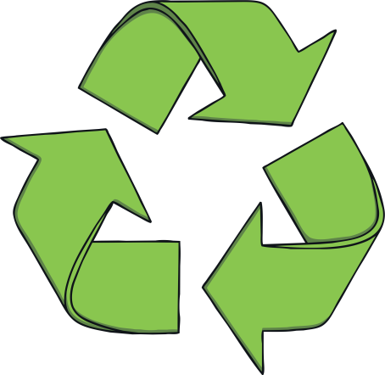

What Can You can Do
Go on a litter-pick with your grown-up. Some councils give out free litter-picking equipment to volunteers and will collect the rubbish that you pick up.
Reject, reduce, reuse and recycle plastics. Think about all the rubbish thrown away in your house. Can you stop buying some plastic items? Can you reuse single-use plastics as something else (a bird feeder or plant pot, for example)? Can you give old plastic toys to a charity shop or a friend?
Always put your rubbish in a bin or take it home with you to recycle. If litter is left on the ground, it may hurt wildlife.

Slide 25
What Can I Do to Reduce Plastic Pollution
in the World's Oceans?
There are many ways we can all make a difference in reducing plastic pollution in our oceans.
Do not buy plastic carrier bags – take a reusable bag instead.
Get involved in beach clean-ups.
Carry a reusable bottle of water.
Understand what the recycling symbols mean on packages and recycle where possible.
Persuade your friends and family to do the same.

Slide 26
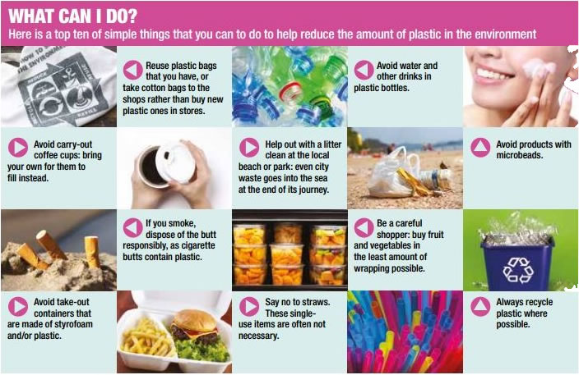

Slide 27
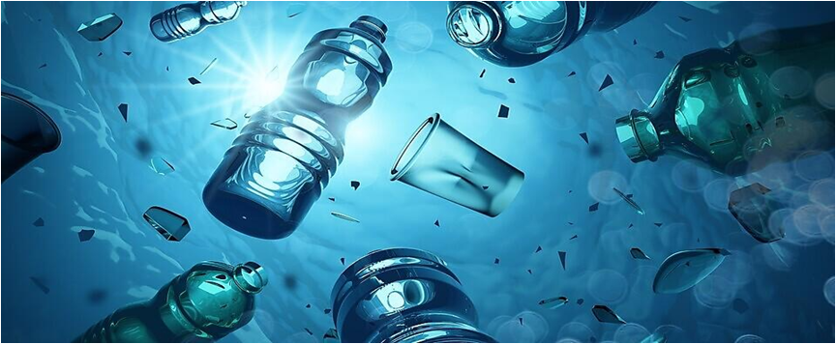
Together, we can make plastic pollution
a thing of the past.​

Slide 28
Task: Can you write a pledge?
A pledge is when you make a promise
or agreement to do something.
I pledge to reduce plastic pollution by...
I pledge to reduce plastic pollution by...
You may wish to write more than one pledge. Try to choose something realistic that you are going to aim to commit to.

