Slide 1
Year 2 Maths Revision
LC: Can you calculate number bonds to 100?

Slide 2
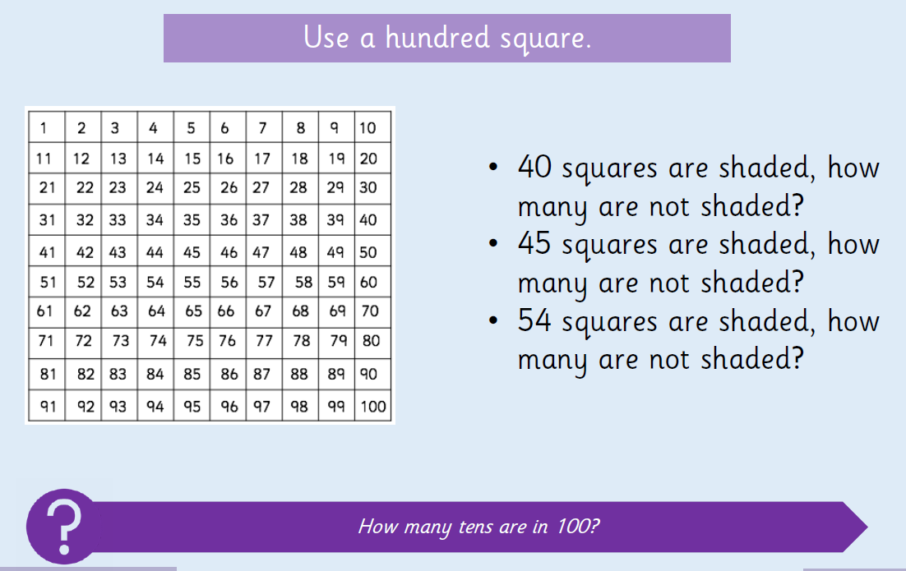

Slide 3
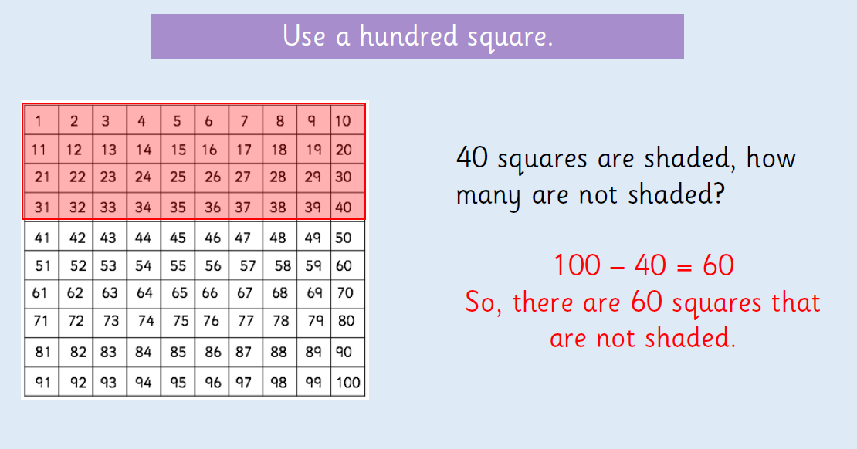

Slide 4
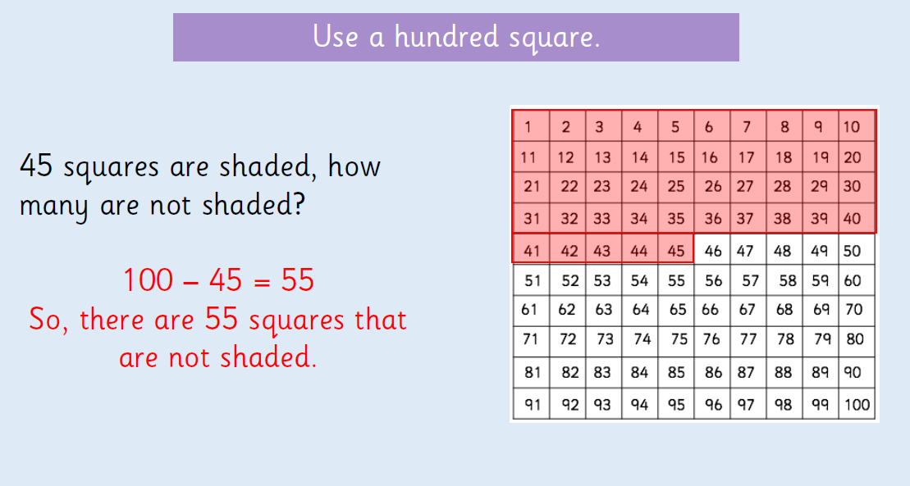

Slide 5
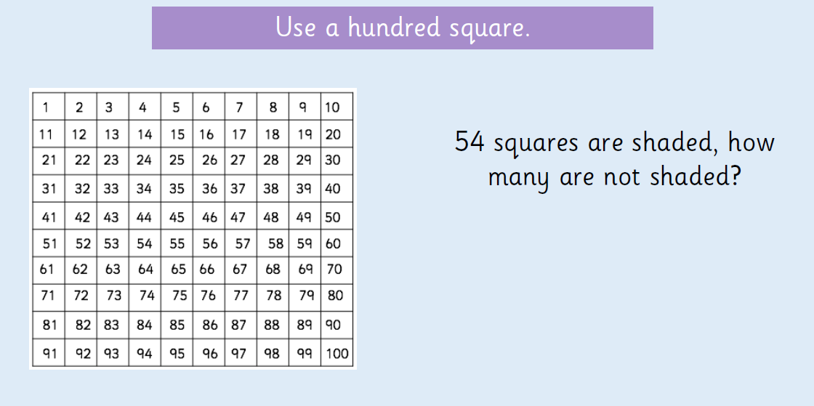

Slide 6
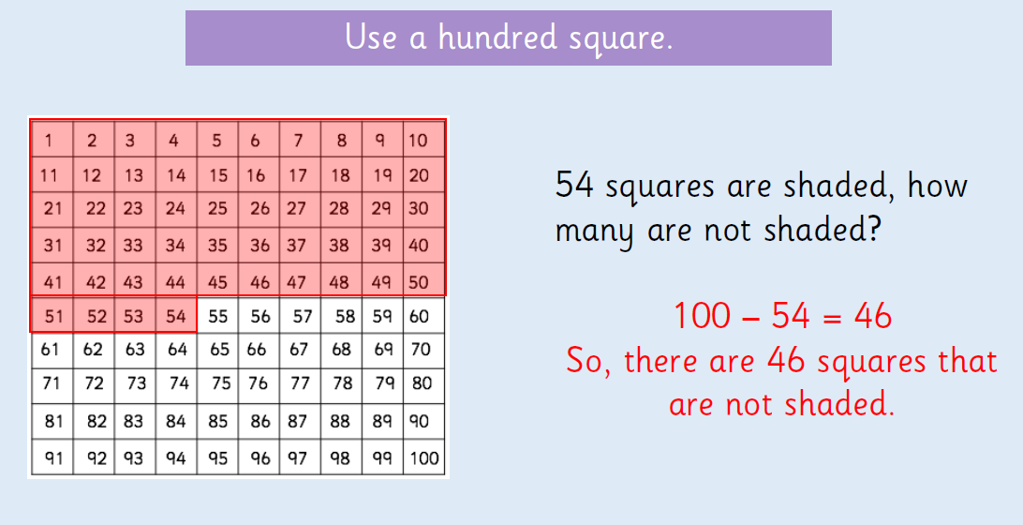

Slide 7

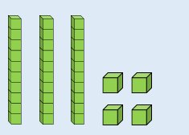

Slide 8
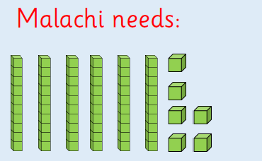

Slide 9
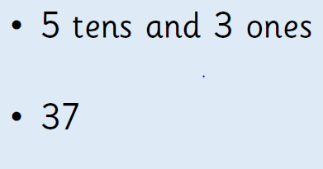
Now draw sticks (tens) and dots (ones) to help you to solve the next two problems. How many more does Malachi need to make 100 if he has:

Slide 10


Slide 11

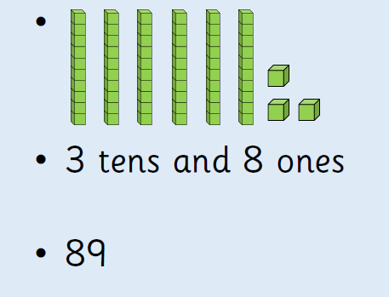
On paper/whiteboards, now try these:

Slide 12
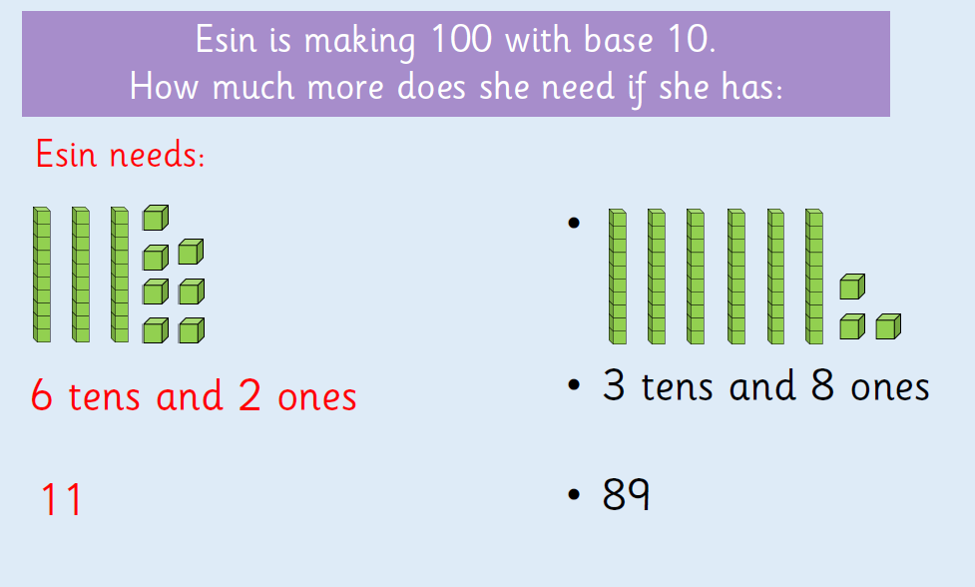

Slide 13
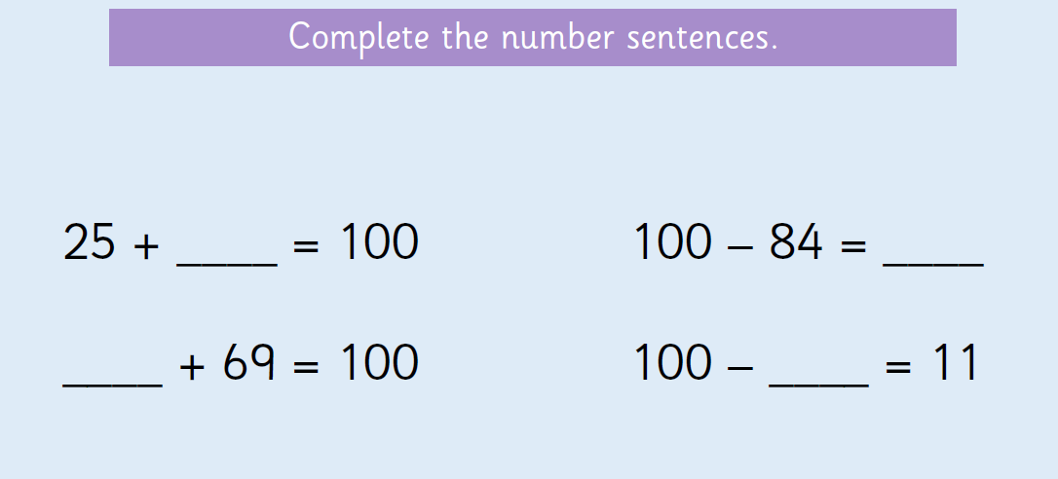
Problem Solving:

Slide 14
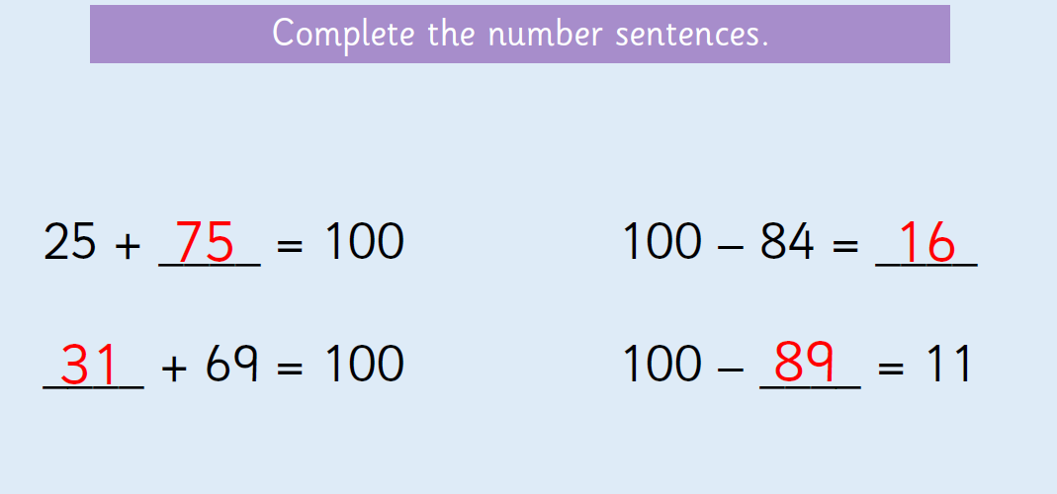

Slide 15
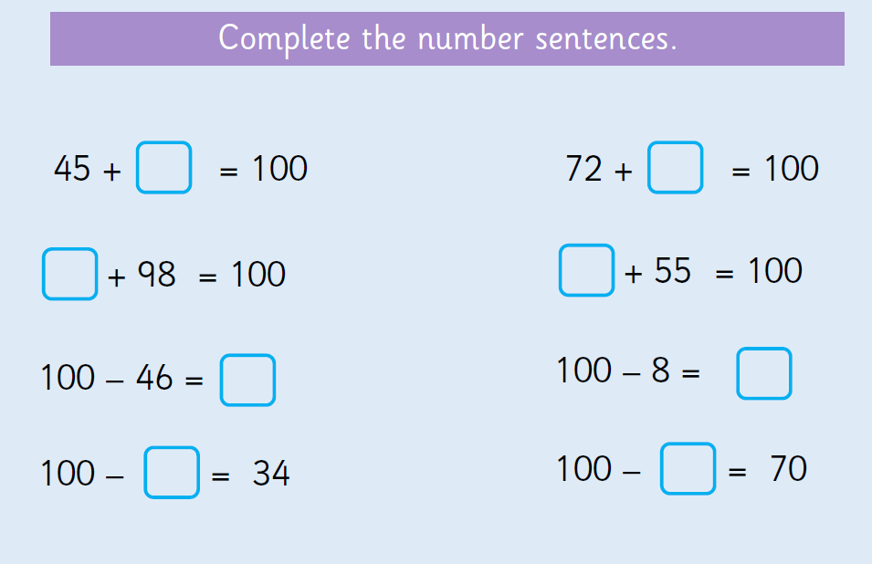

Slide 16
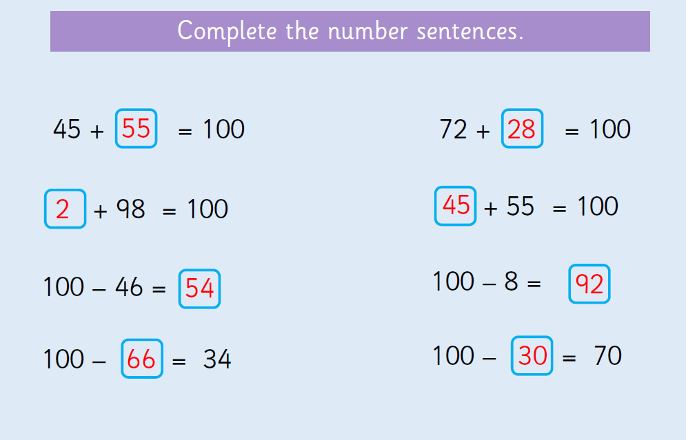

Slide 17
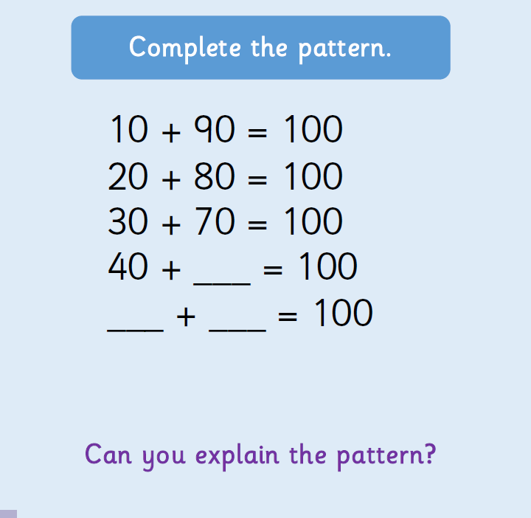
Problem Solving:

Slide 18
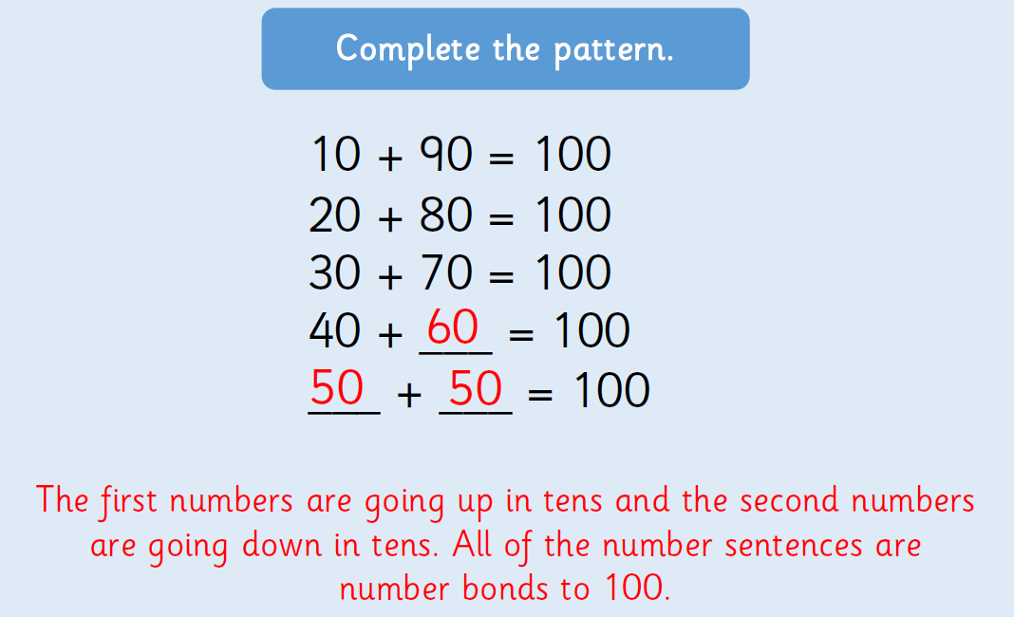

Slide 19
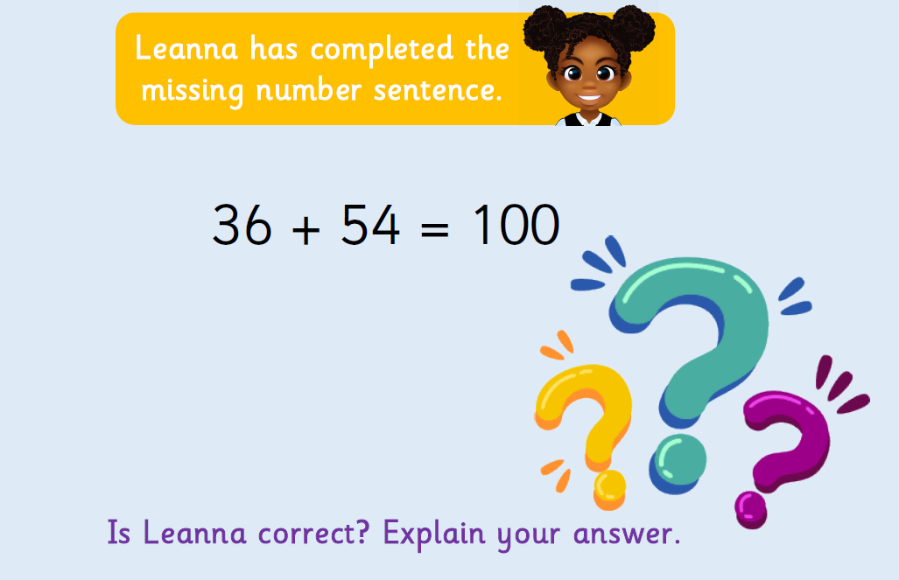
Problem Solving:

Slide 20


