Slide 1
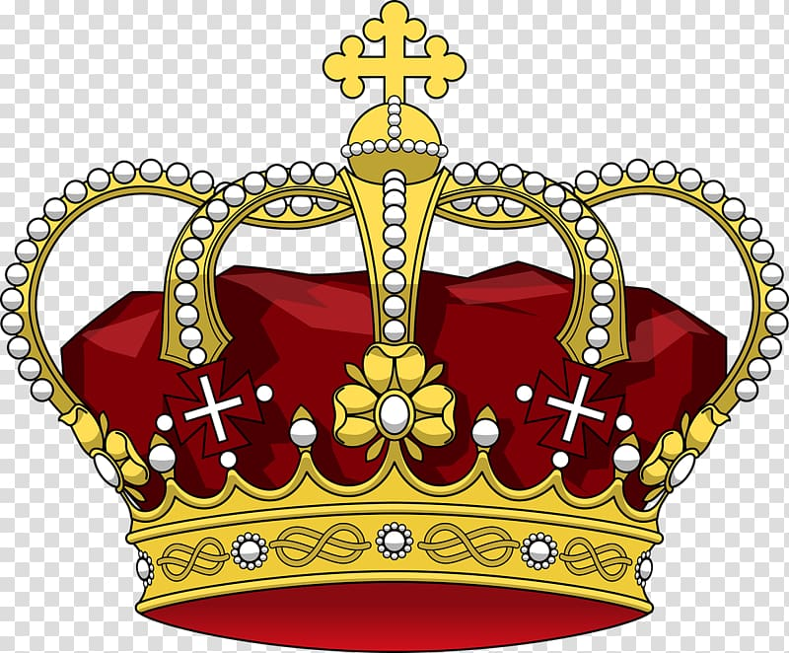
What is a monarch?
a sovereign head of state, especially a king, queen, or emperor.

Slide 2
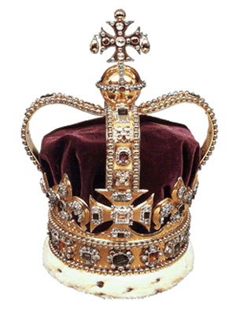
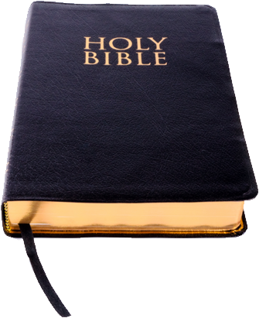
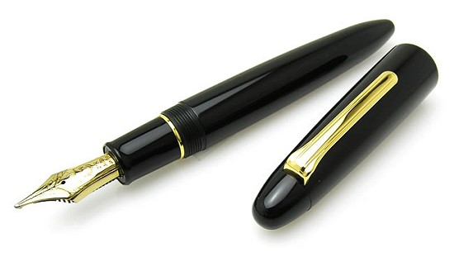
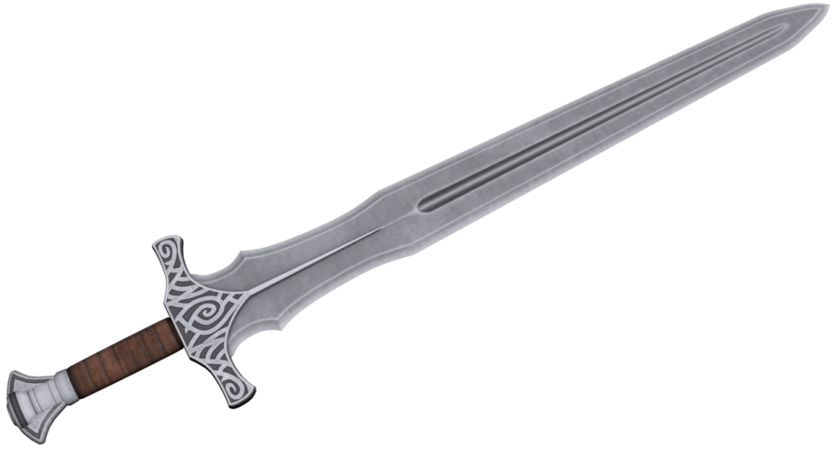
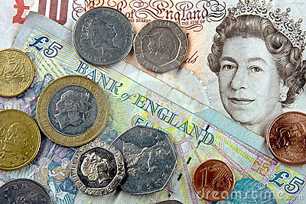

What is a Monarch?

Slide 3
Crown
Represents the monarchs position.

Slide 4
Sword
Represents the monarch needs to be able to defend their kingdom from enemies who might want to take it over.

Slide 5
Money
Money is needed to pay for things their people need.

Slide 6
Bible
A Bible or religious book is to help the monarch to do the right thing.

Slide 7
Pen
The monarch needs to be able to draw up rules and laws.

Slide 8
Book
The monarch needs to be able to read the letters and documents.

Slide 9
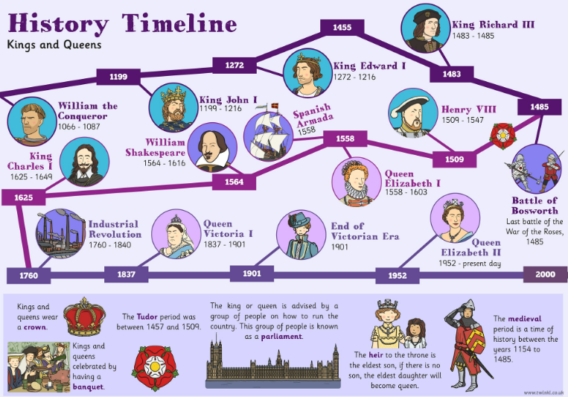

Slide 10
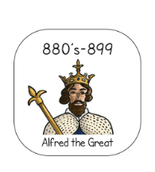
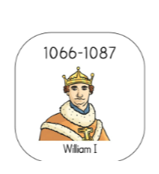
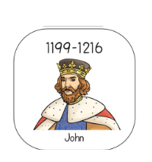
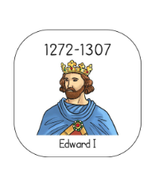
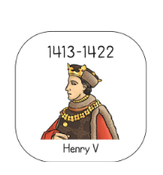
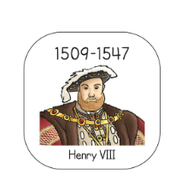
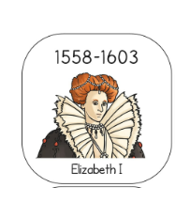
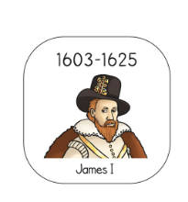
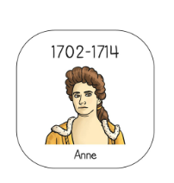
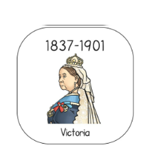
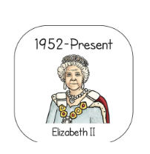
X
A Timeline of some of the British Monarchs
X
X

Slide 11
Your tasks this week
Have a go at putting the monarchs on the timeline (see additional document uploaded). Some of the dates are a bit tricky to order so you may need a little help.
Research your chosen Monarch in British history. There are many videos and links online to help you with your research and we have also added a little bit of information below to get you started if you need some help. Choose how you would like to record your findings – a poster, an information leaflet, a fact file or a PowerPoint presentation are just a few suggestions.

Slide 12
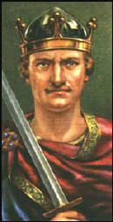
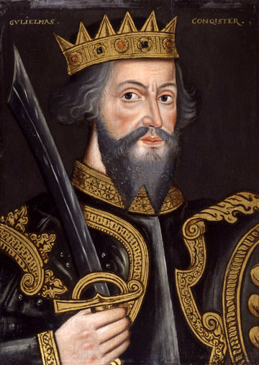
William I
William the Conqueror

Slide 13
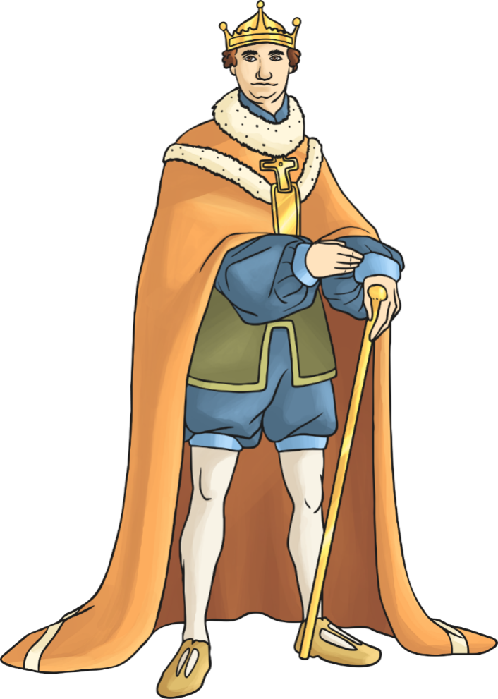
Who was he?
William I is known as William the Conqueror and was the first Norman king of England.
He reigned from 1066 until his death in 1087.
He was the Duke of Normandy before he became king.
He is famous for battling and killing Harold Godwinson for the English throne in the Battle of Hastings in 1066.

Slide 14
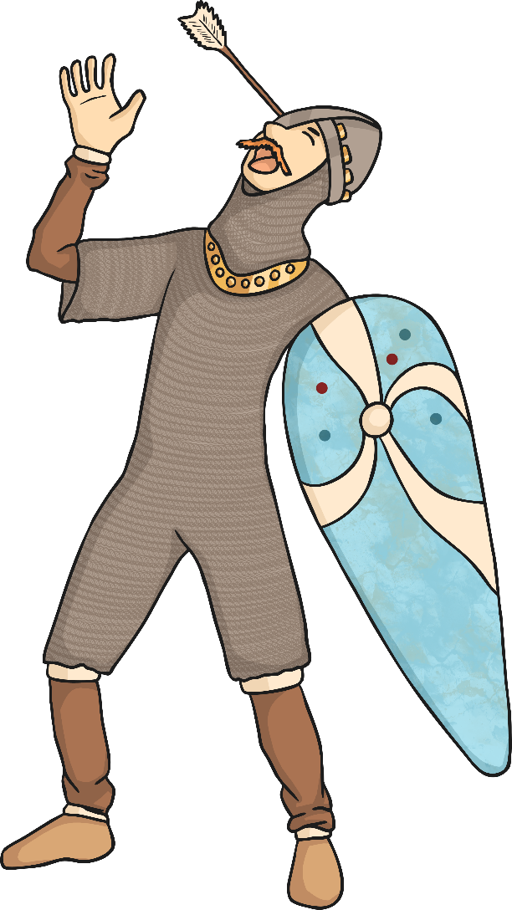
Interesting Facts
William and his army defeated Harold Godwinson in the battle of Hastings.
It is said that Harold was shot in the eye, which is shown in the famous Bayeux Tapestry.
William was crowned King of England on Christmas Day in 1066.
It is thought that William was about 5”10, which was quite tall back then.
He ordered the Domesday book to be created in 1085. This was a survey of all the landholdings in England at the time.

Slide 15
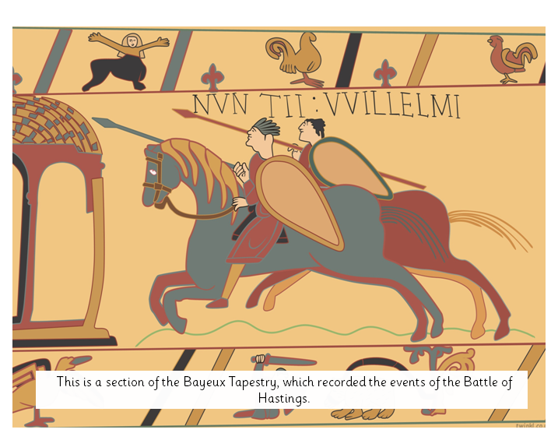

Slide 16
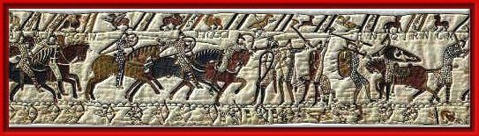
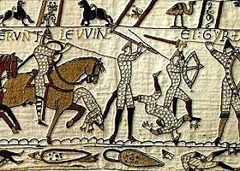
https://www.youtube.com/watch?v=jhqrpTpoGHk

Slide 17
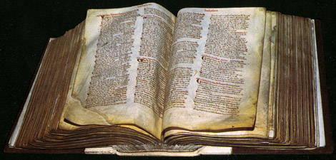
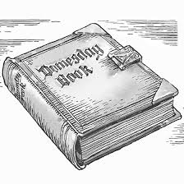
Domesday Book
https://www.youtube.com/watch?v=om_BIzXaVwU

Slide 18

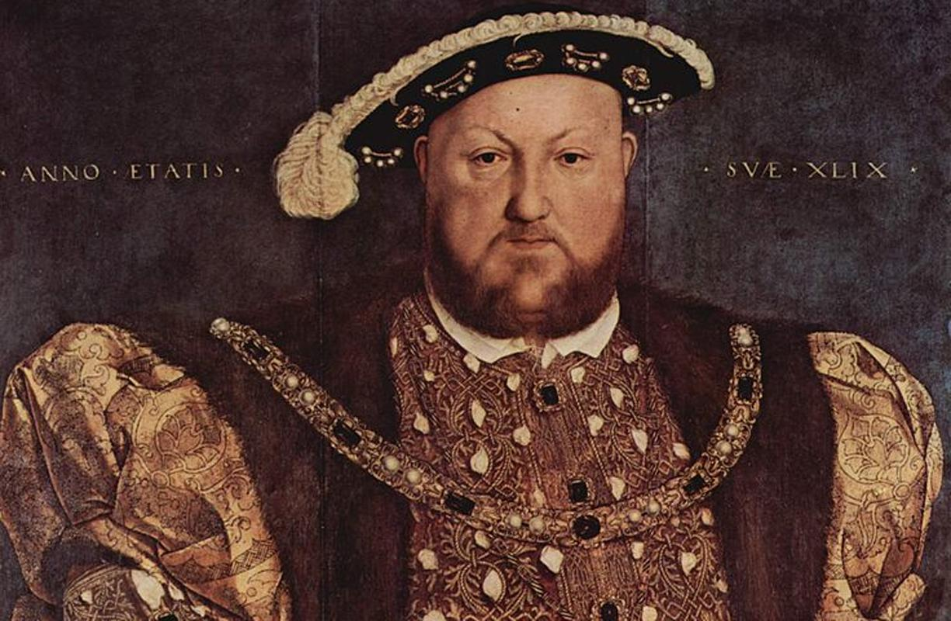
Henry VIII

Slide 19
In English history, the time when Henry and his family lived is known as the Tudor age. Tudor was Henry's family name.
As a young man, Henry was handsome and clever. He was good at sport, music and dancing. He wanted to be a soldier and a famous king.

Slide 20
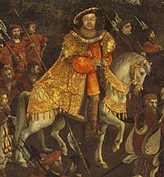

Slide 21
Henry’s father was King Henry VII. He had won a battle to become king.
Henry's older brother Arthur died in 1502. So Henry was next in line to be king. Henry's mother died in 1503.
When Henry's father died in 1509, Henry became king. He was crowned King Henry VIII (the 8th English king named Henry).

Slide 22
When Henry became a king (King Henry VIII) he was a very powerful and fierce monarch.
He wanted to make England strong.
Henry wanted to look rich and powerful so he built lots of castles and spent lots of money on feasts including rich foods like swans and peacocks. He also wore expensive clothes made from satin, velvet and fur and with jewels sewn on them.

Slide 23
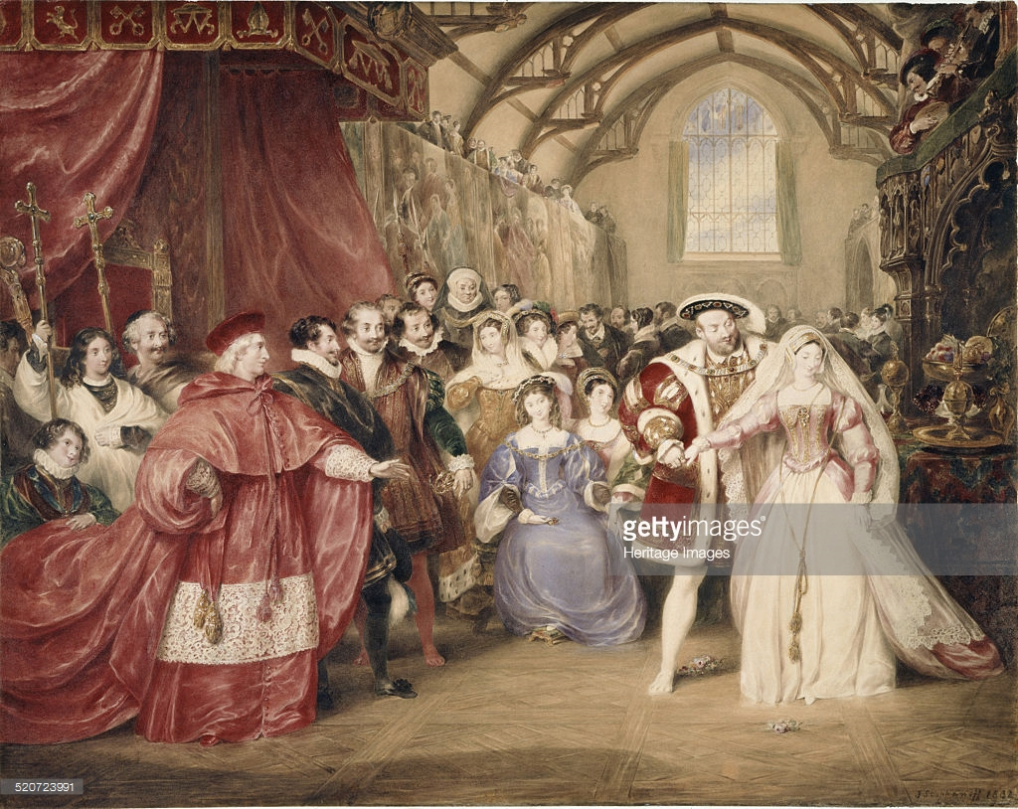

Slide 24
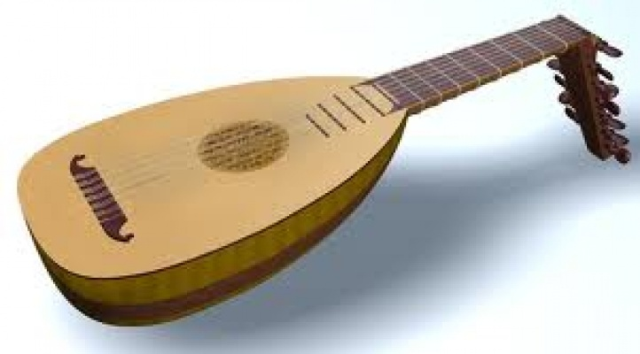
Henry liked music, and played the lute and the harp.
Henry liked to be
outdoors, hunting
and hawking. He liked wrestling and he played tennis.
Most of all, he wanted a son to be king after him.

Slide 25
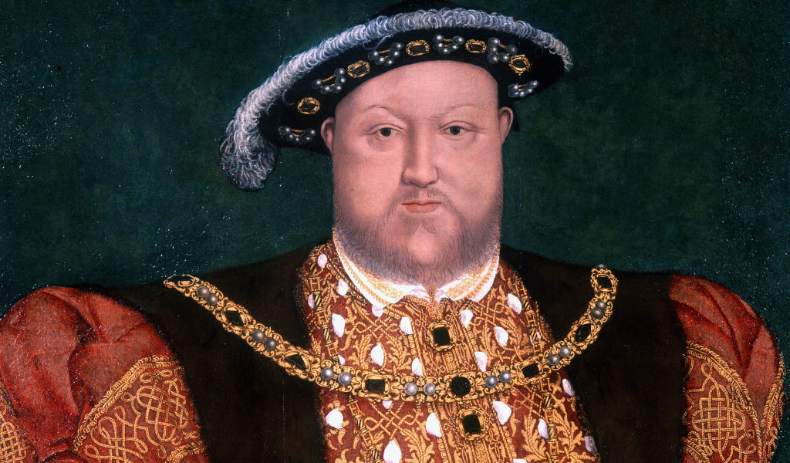
Paintings of Henry VIII show a big, fierce-looking man in fine clothes. He looks scary, and many people were scared of him. If the King did not get his way, he got cross. People who made him
cross risked having
their heads
chopped off!

Slide 26
Henry lived at a time of changes. People had new ideas in art, science and religion. They sailed off to explore new lands.
Henry is famous for his break with the Roman Catholic Church (because he broke the rules by getting divorced).

Slide 27
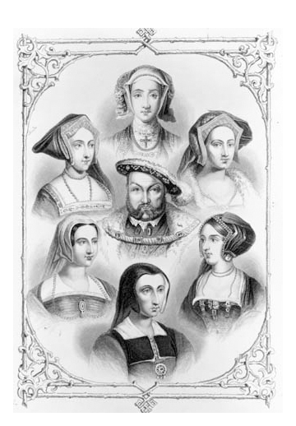
Henry VIII is particularly famous for having 6 wives
DIVORCED
BEHEADED
DIED
DIVORCED
BEHEADED
SURVIVED

Slide 28
Wife 1: Catherine of Aragon, a Spanish princess. Catherine had a son, but the baby died. Catherine and Henry had a daughter, Mary. But no son so Henry decided to divorce Catherine, so he could marry someone else in the hope of having a male heir.
Wife 2 : Anne Boleyn. She had a daughter, Elizabeth. Henry turned against Anne because it was believed she was unfaitful, and she was beheaded
Wife 3 : Jane Seymour. She had a son, Edward, but she died two weeks later. Henry was very sad.
Wife 4 : Anne of Cleves, from Belgium. Henry had never seen her until she came to England for the wedding. He had just seen a portrait and he didn’t think she looked much like it in reality and he didn’t like her so he divorced her after six months.
Wife 5 : Kathryn Howard. She was only 19 (he was 49). She was beheaded because she had quite a few affairs!
Wife 6: Katherine Parr. She was secretly in love with another man but Henry died so she survived and was a widow. She looked after his children.

Slide 29
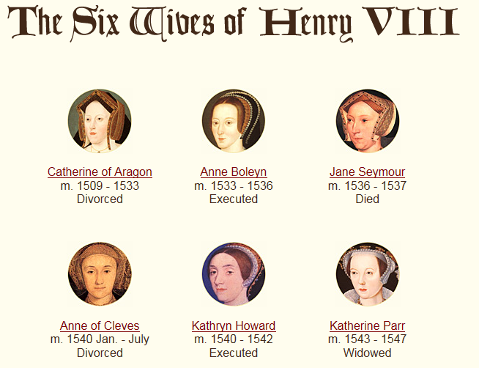

Slide 30
After Henry died, 3 of his children ruled England after him.
Henry VIII of England had several children. The best-known are the three legitimate children who survived Henry and succeeded him as monarchs of England successively, Edward VI, Mary I and Elizabeth I.

Slide 31
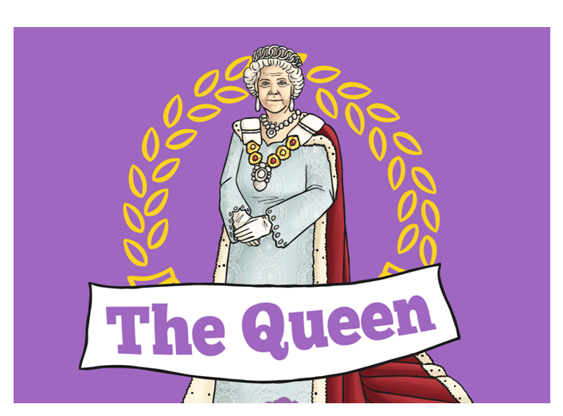
Queen Elizabeth II

Slide 32
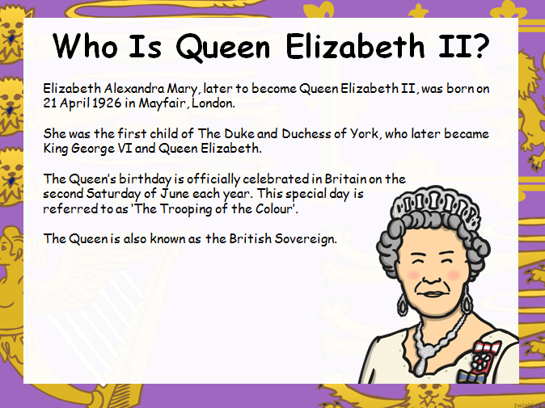

Slide 33
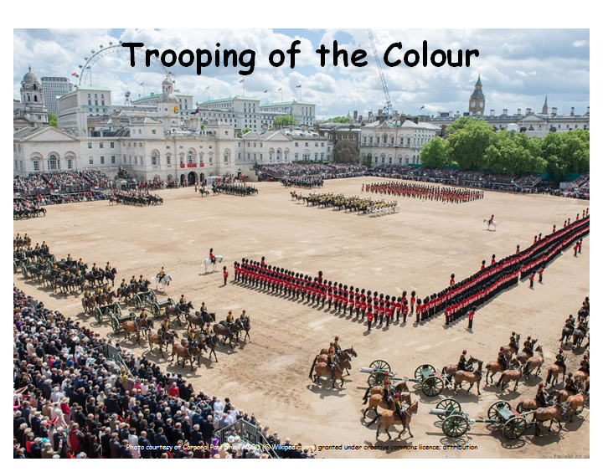
http://www.bing.com/videos/search?q=British+Anthem+God+Save+the+Queen&&view=detail&mid=264D0612C88D7B576E1B264D0612C88D7B576E1B&FORM=VRDGAR

Slide 34
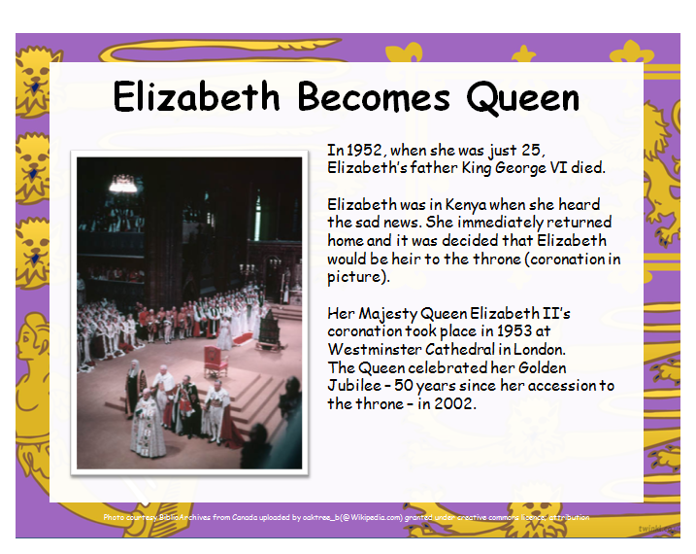

Slide 35
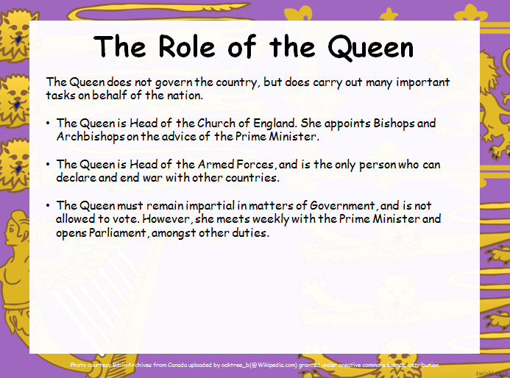

Slide 36
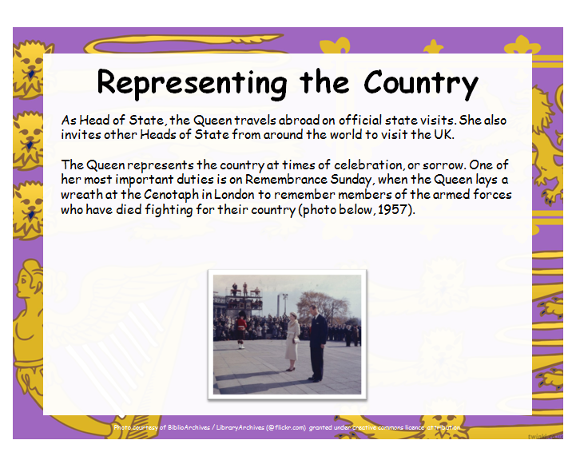

Slide 37
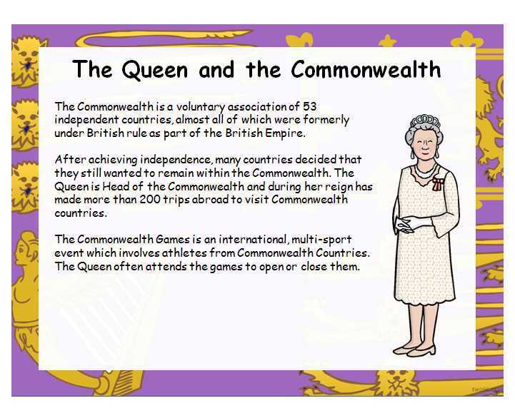

Slide 38
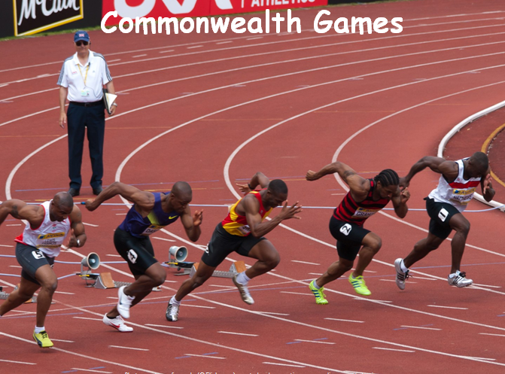

Slide 39
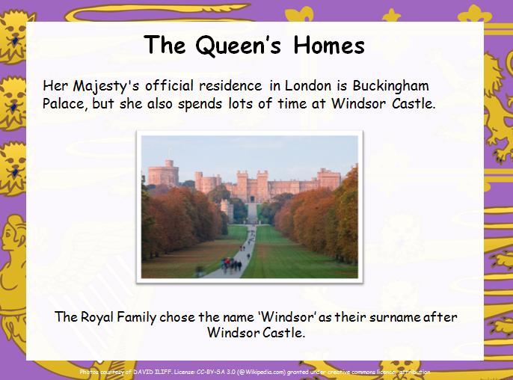

Slide 40
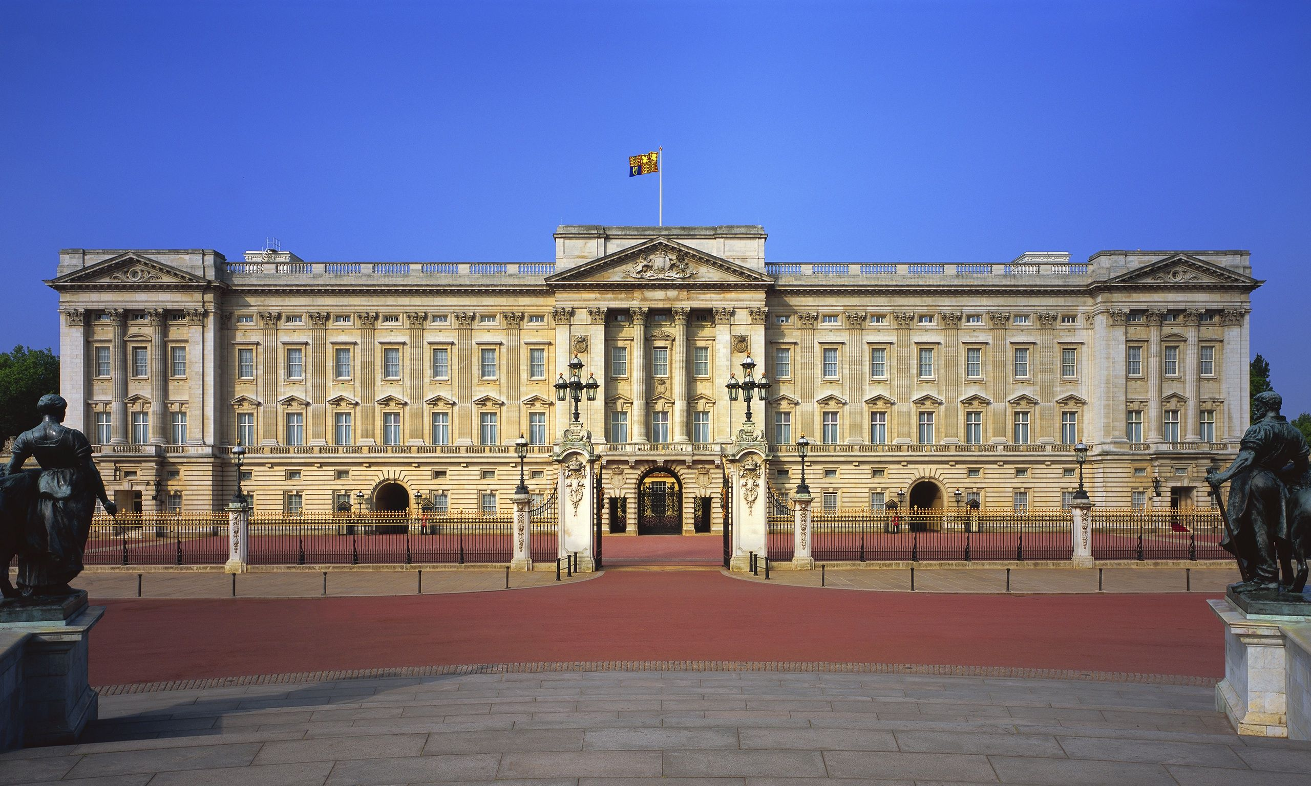
Buckingham Palace

Slide 41
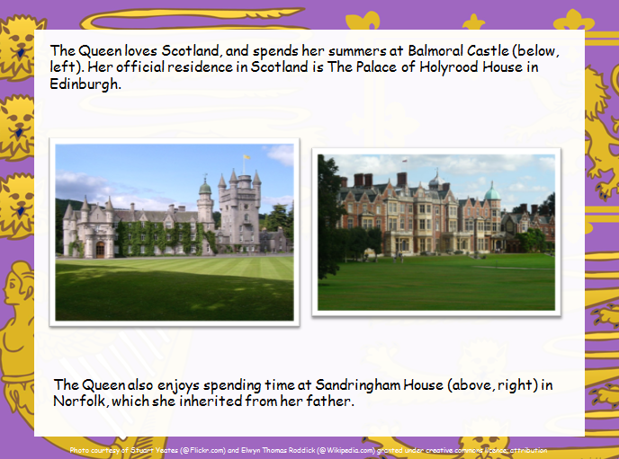

Slide 42
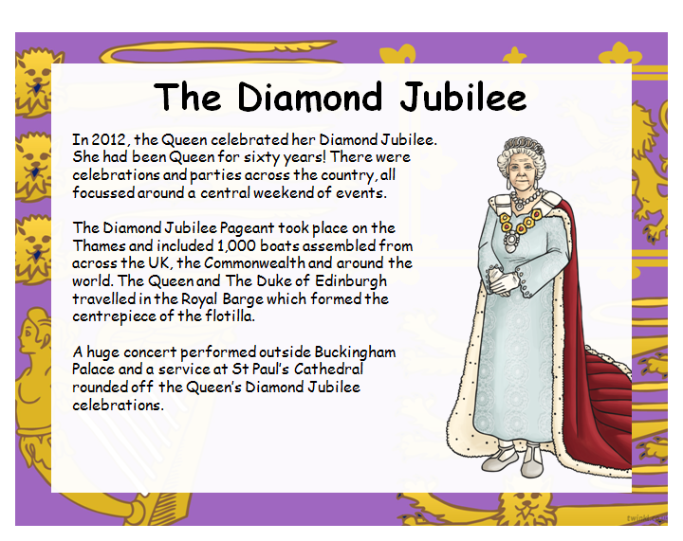

Slide 43
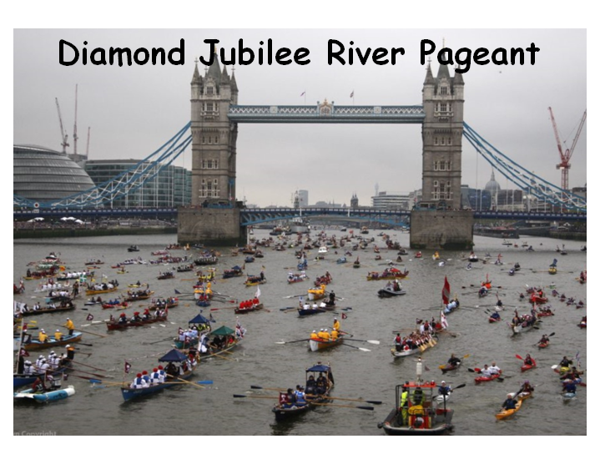

Slide 44
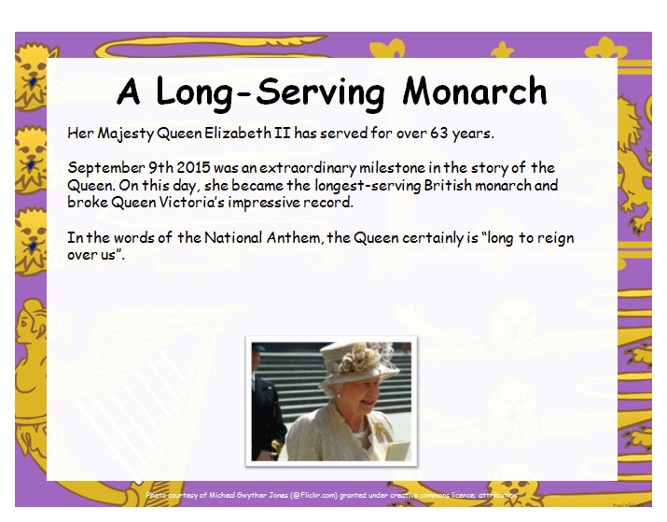

Slide 45
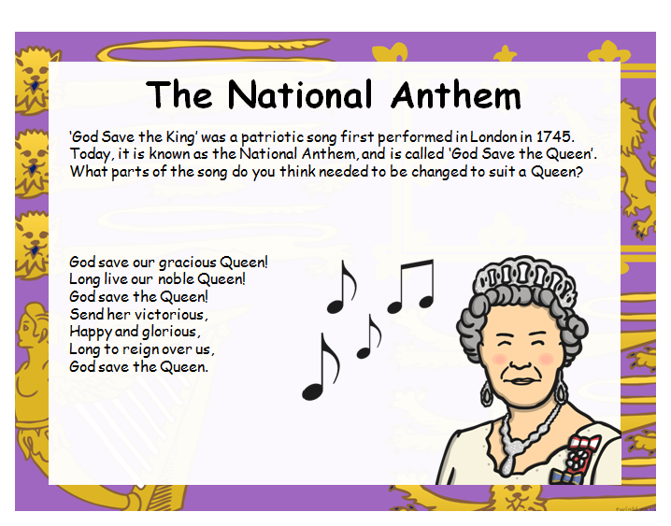
https://www.bing.com/videos/search?q=national+anthem+god+save+our+queen+youtube&&view=detail&mid=B58D012A696E93D491BBB58D012A696E93D491BB&&FORM=VDRVRV
https://www.youtube.com/watch?v=D3dR7u7TPNo

Slide 46
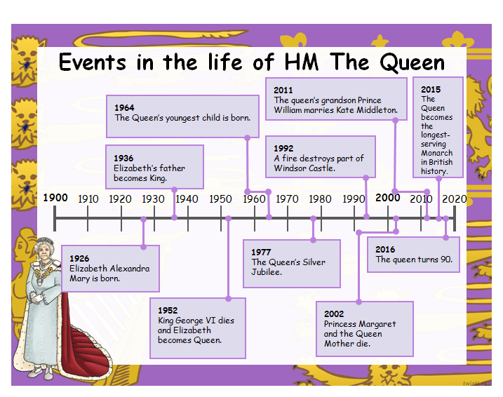

Slide 47


Slide 48





