Slide 1
Spelling
Adding ‘ing’ and ‘ed’
https://www.bbc.co.uk/bitesize/articles/zp74vwx

Slide 2
Adding ‘ing’
Look how easy it is to add ‘ing’ to these words.
see
+ ing
seeing
go
+ ing
going
eat
+ ing
eating
look
+ ing
looking
say
+ ing
saying

Slide 3
Have a go at adding ing to these words.
help
helping
say
saying
meet
meeting
walk
walking
Did you get them right ?
Well done !

Slide 4
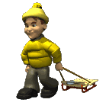
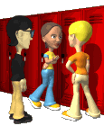
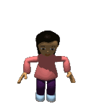

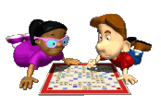
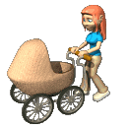
Here are some more words that end with ‘ing’.
talking
pulling
jumping
buying
pushing
playing
Can you think of any more ?

Slide 5
Let's
move on...
Adding ‘ing’ to verbs that end in an e

Slide 6
Words ending in e are a bit more tricky !
make
+ ing
mak
e
ing
take
+ ing
tak
e
ing
Can you see what is happening ?
If a word ends in an e you must drop the e before adding ‘ing’.

Slide 7



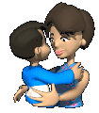
Have a go at adding ‘ing’ to these words.
write
writing
smile
smiling
come
coming
love
loving
Did you get them right ?
Well done !

Slide 8
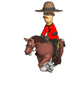

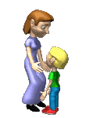



Here are some more words that have an e before you add ‘ing’.
drive
driving
ride
riding
care
caring
like
liking
hate
hating
decide
deciding
Can you think of any more ?

Slide 9
Let's
move on...
Adding ‘ing’ to verbs that have a short vowel

Slide 10
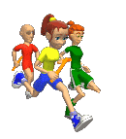

These words have a short vowel sound in the middle. Watch what happens!
run
+ ing
run
n
ing
shop
+ ing
shop
p
ing
Can you see what is happening ?
If the word has a short vowel, then you must add a double letter before the ‘ing’.

Slide 11
Have a go at adding ing to these words. Remember the short vowel !
shut
shutting
slip
slipping
win
winning
sit
sitting
Did you get them right ?
Well done !

Slide 12
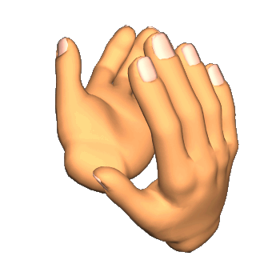
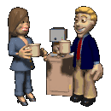
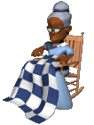

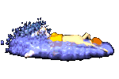

Here are some more words that need a double letter before adding ‘ing’.
clap
clapping
chat
chatting
knit
knitting
plan
planning
swim
swimming
hop
hopping
Can you think of any more ?

Slide 13
Using the suffix ‘ed’.

Slide 14
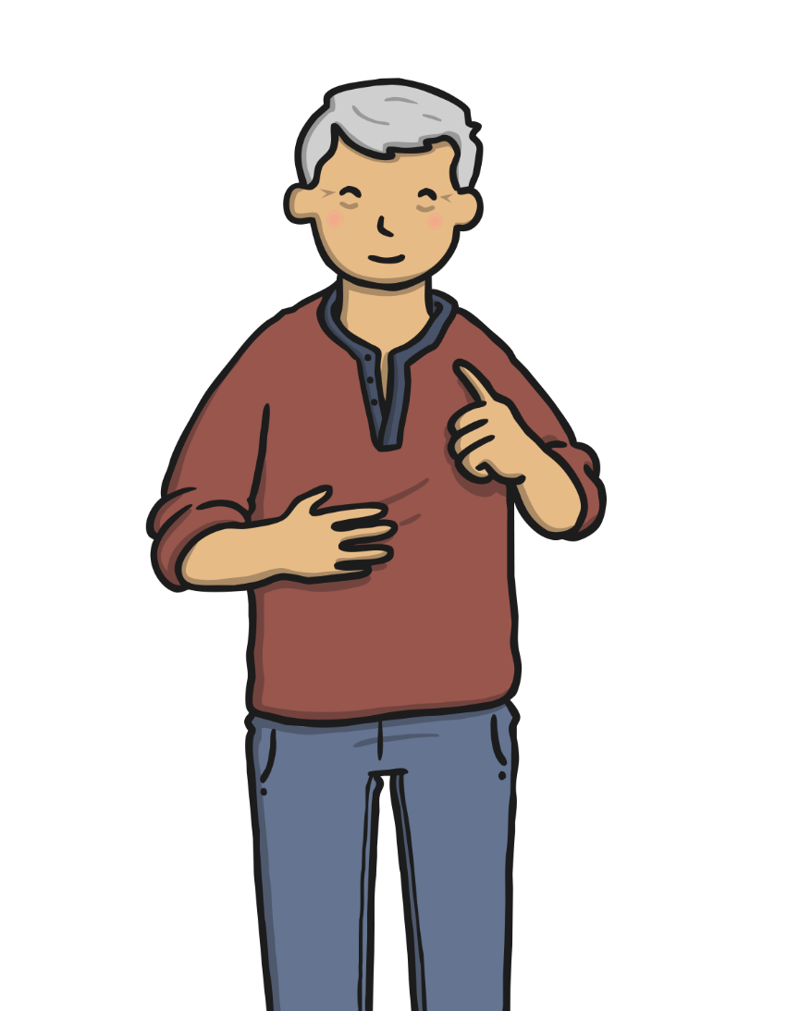
When we write in the past tense, we add ‘ed’ to most verbs.
Here is an easy way to help you remember this…

Slide 15
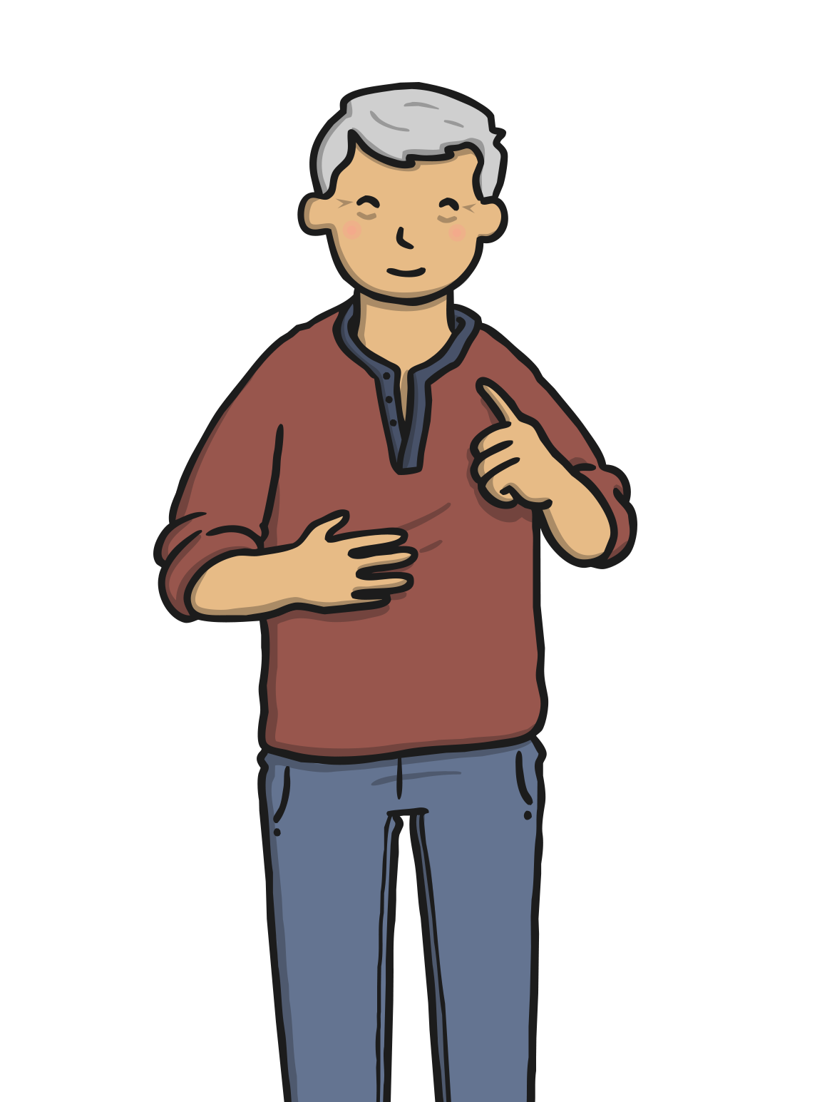
Uncle Ed is very old.
He likes to remember things that happened in the past.
With most verbs, we can add Uncle Ed’s name to change the verb to the past tense.

Slide 16


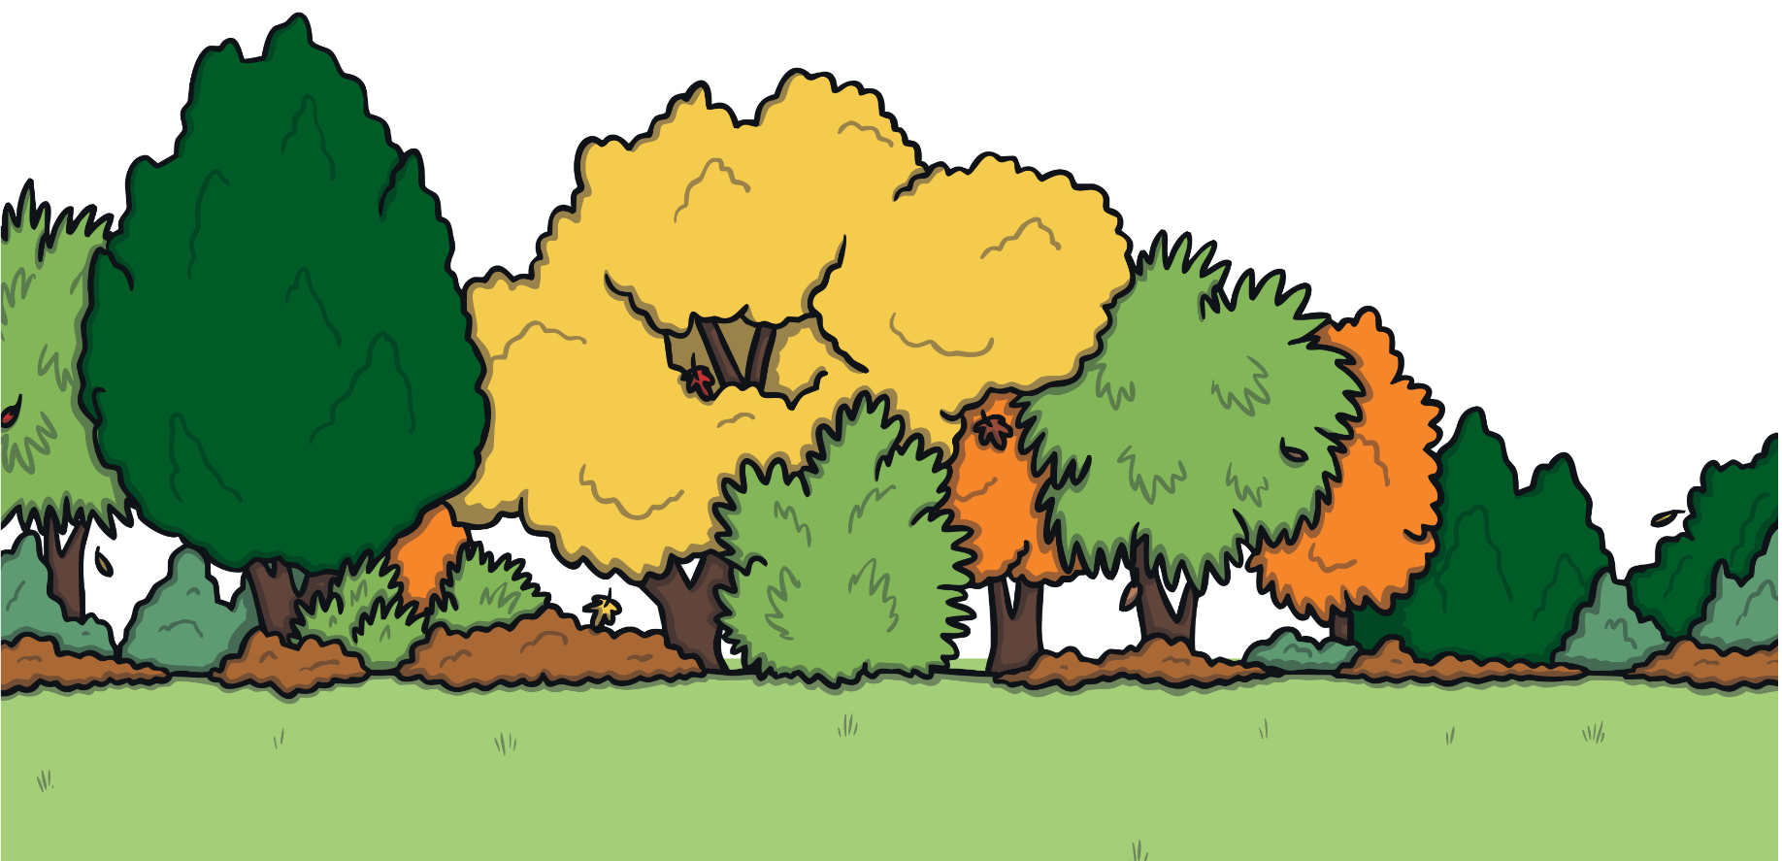
I walked in the park.
We added ‘ed’ to walk because Uncle Ed did this in the past!

Slide 17
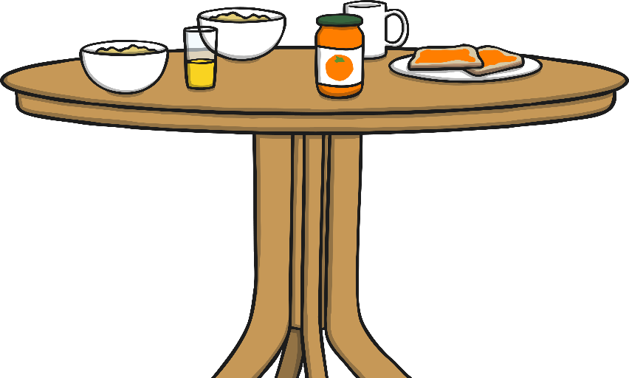
I poured the milk on my cereal.
We added ‘ed’ to pour because Uncle Ed did this in the past!

Slide 18
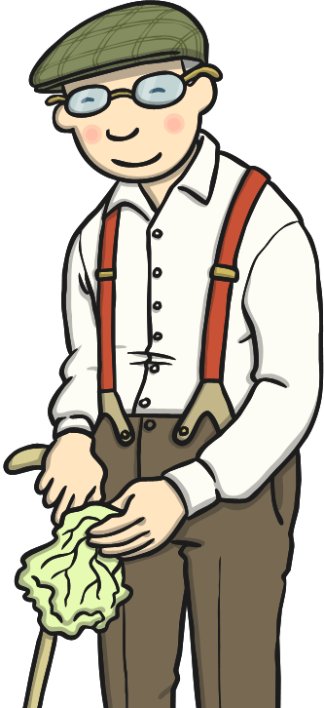
I talked to my friend Bert.
We added ‘ed’ to talk because Uncle Ed did this in the past!

Slide 19
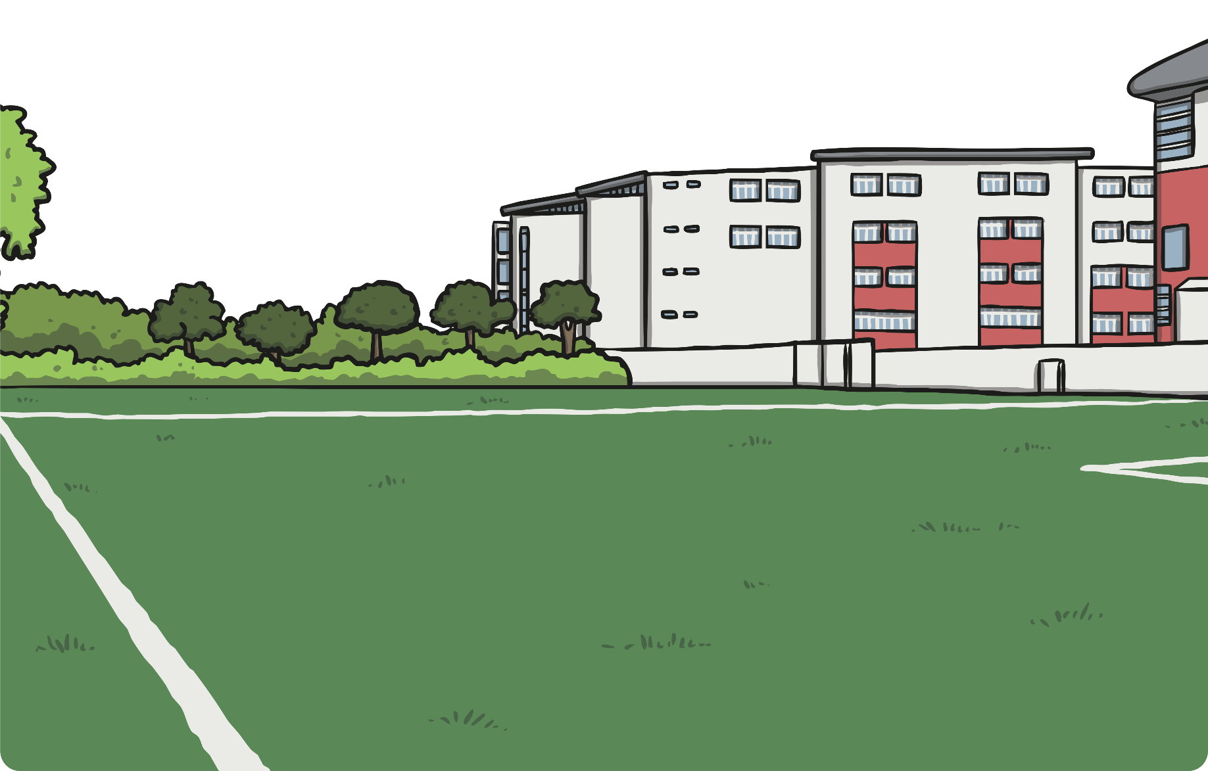

I played football.
We added ‘ed’ to play because Uncle Ed did this in the past!

Slide 20

Now it’s your turn!
Add ‘ed’ to the end of these verbs to show that Uncle Ed did them in the past!
jump
climb
finish
play
fold
open
Can you write a sentence to go with each one?

