Slide 1

Week 2 – Lesson 7

Slide 2
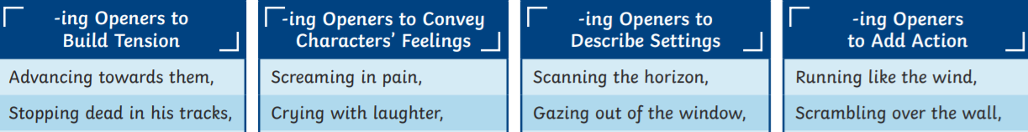
SPAG Warm up – verbs ending _ing
Take one of the openers below, and make a full sentence

Slide 3
Daily DADWAVER challenge
D is for description – sentences filled with imagery and adjectives​
A is for action – detailing what is happening in a sentence​
D is for dialogue – something a characters says out loud or a conversation​
W is for where – indicating the location of the action (adverb of place)​
A is for adverb – usually an adverb / adverbial phrase of manner​
V is for verb – single word or phrase e.g Walking, / Walking across the country​
E is for estimation of time e.g Momentarily, At midday, As the tide turned​
R is for rhetorical question to draw in the reader, can use more than one​
Simile is for simile (or metaphor) – allows the writer to ‘paint’ an image

Slide 4
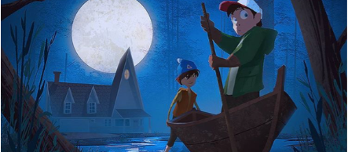
DADWAVER 60 secs to write
V is for verb – try a verb beginning with ing​
Eg. Fighting through the almost impenetrable undergrowth, they made it to the safety of the temple.​
Eg. Stumbling, he emerged filthy and covered in dust.

Slide 5
LC: Can I develop empathy for characters?
Toolkit:

Slide 6
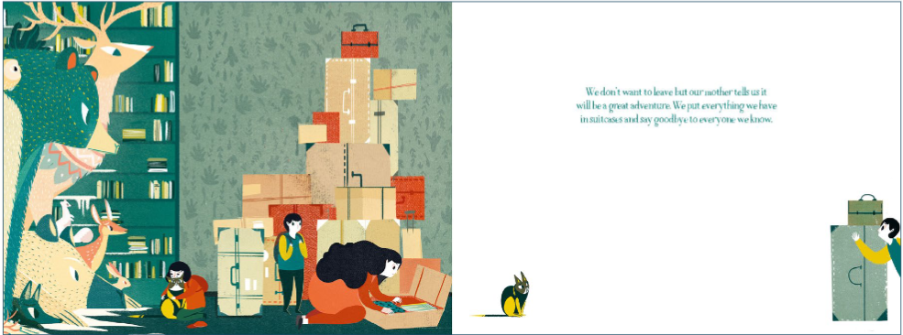

Spend some time exploring these pictures.
What do you see?
How do you think the mother feels about packing everything they have?
How do you think the children feel about saying goodbye?
If you were one of the children, how would you feel about what you have to leave behind?

Slide 7
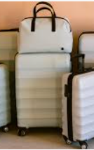
Take a moment to think about what you would pack and what you would leave behind if you were in that same position.
Make notes on your whiteboard / in your book

Slide 8
The journey might be very long, and potentially dangerous.
Do you need to revise your list?

Slide 9
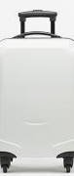
Here is a bag which can only fit in it 3 things. What would your 3 things be? They have to fit into this bag.
Along the way you are likely to lose 2 things - which one item on your list is the most important to you and why.

Slide 10
Task
Draw your important item and compose a poem inspired by your item and its sentimental value.
If you are doing your poem at home, you could include a photograph of your special item.
Rhyme, or free verse
Acrostic
List poem

