Slide 1

LC: Can I describe the life process of asexual plants?
Toolkit:
Week 2

Slide 2
Working scientifically this week we are:
Planning different types of scientific enquiries to answer questions.
Identifying scientific evidence that has been used to support or refute ideas or arguments.

Slide 3
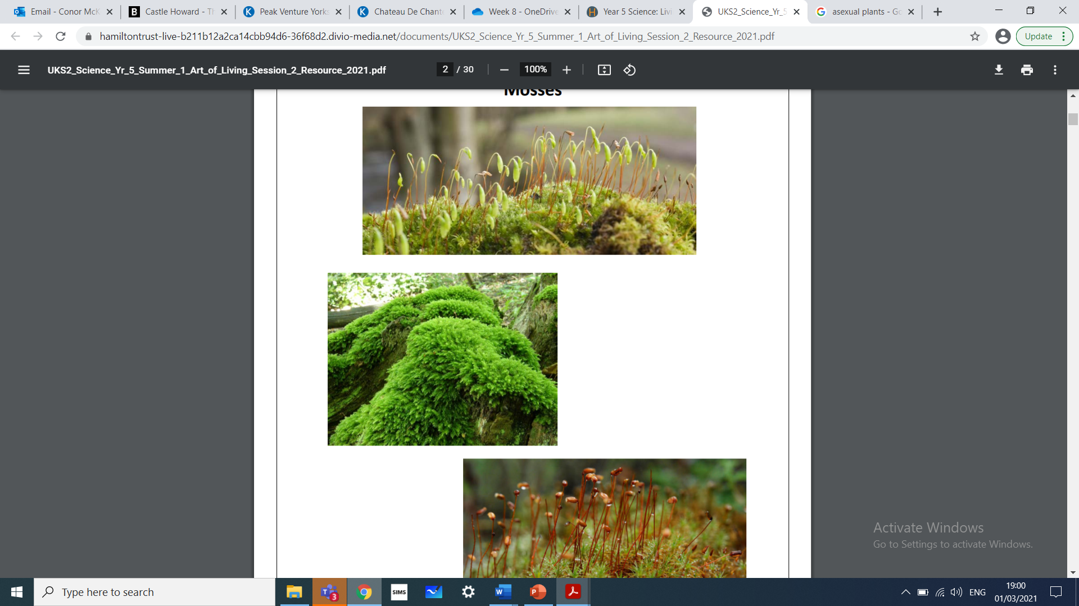
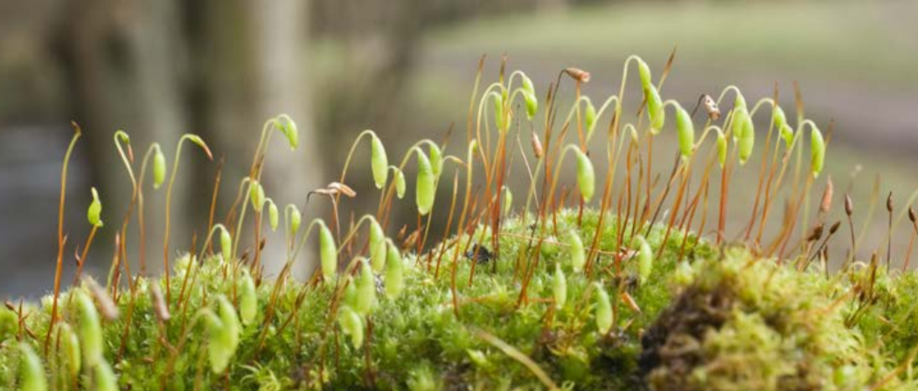
Mosses

Slide 4
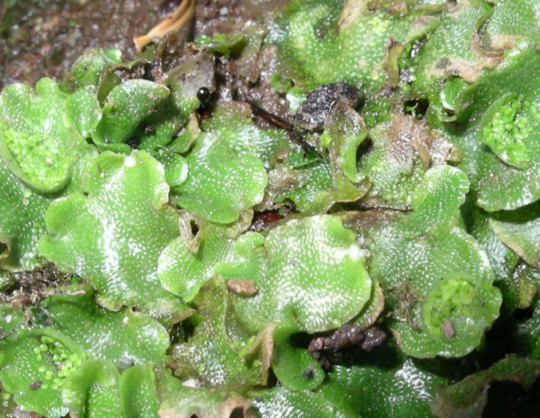
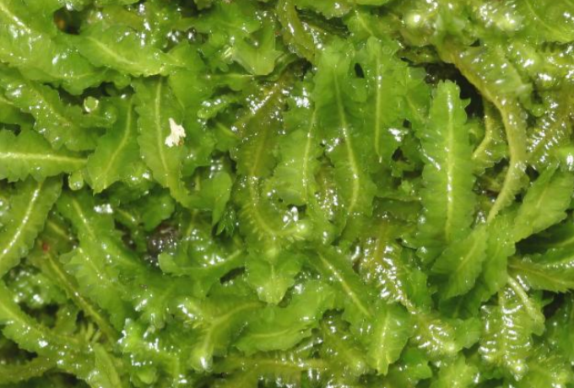
Liverworts

Slide 5
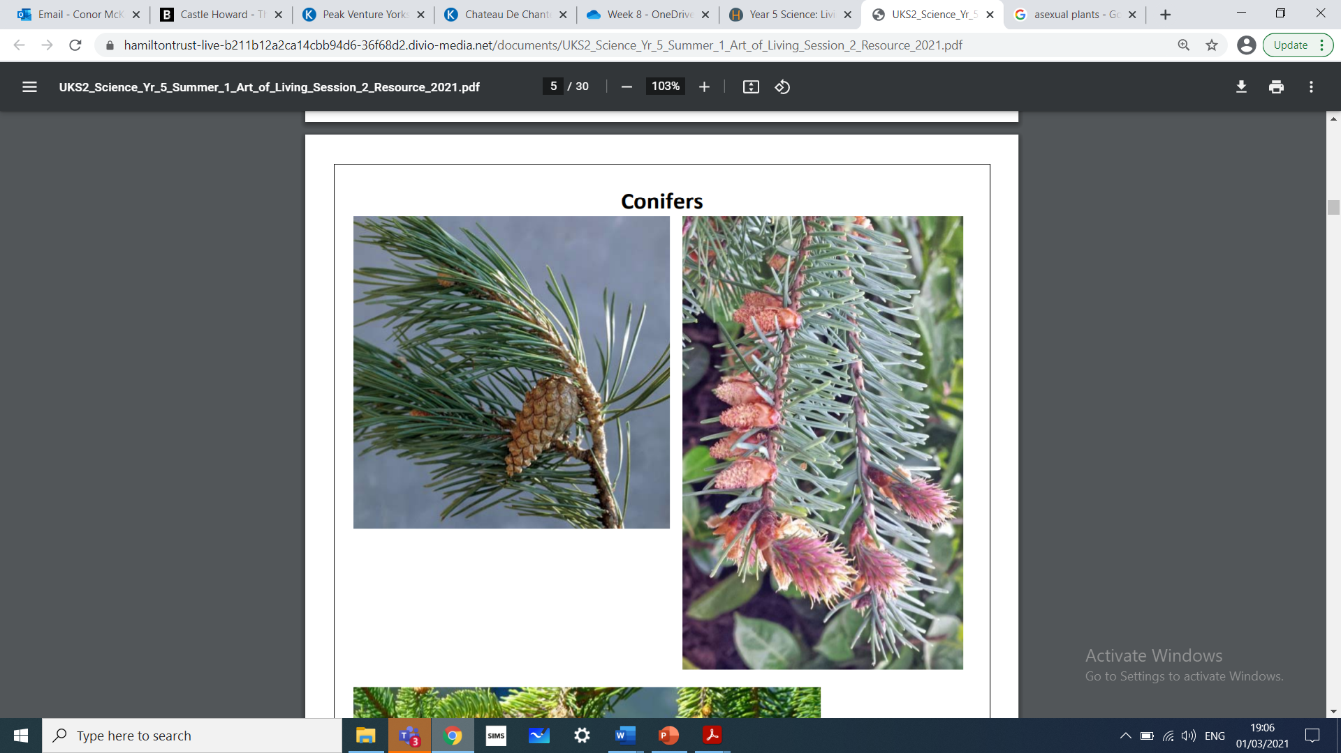
Conifers

Slide 6
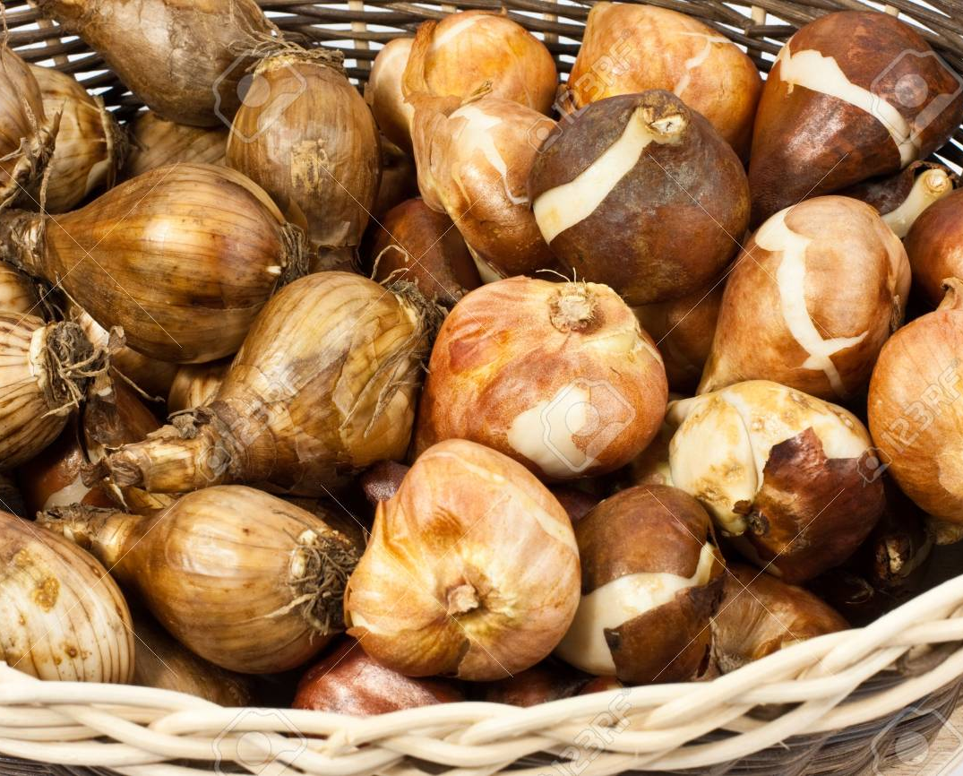
The plants this week follow a different life cycle
Some plants can also reproduce without an egg cell being fertilised to produce a seed. Instead, these plants produce an identical copy of themselves. This type of reproduction is known as asexual reproduction.
Plants can reproduce asexually in a number of different ways. Some plants produce bulbs, like daffodils and snowdrops. Others, like potatoes produce tubers. These sit under the soil and develop into new plants the next year.

Slide 7
https://www.youtube.com/watch?v=K0SNi5yCtvU
Click the link for further explanation of the previous slide

Slide 8
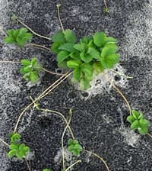
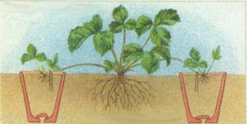
Parent plant
New offspring
Runners

Slide 9
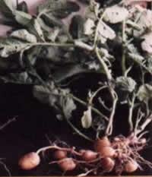
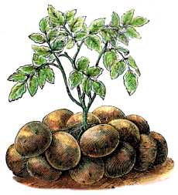
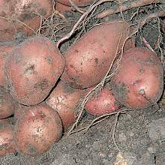
Parent plant
Young tubers
Stems growing underground

Slide 10
Asexual reproduction
Gardeners use asexual reproduction to create new plants that are identical to the parent plants
They cannot create new varieties this way
But they can produce required plants much quicker than growing them from seeds produced in sexual reproduction

Slide 11
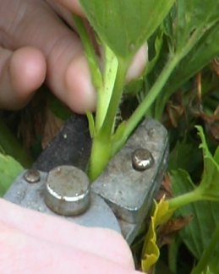
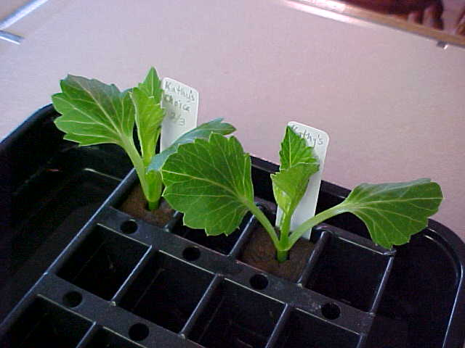
The most common way for gardeners to create new plants asexually is by taking cuttings and growing them
These cuttings will develop their own roots and grow into an identical new plant

Slide 12
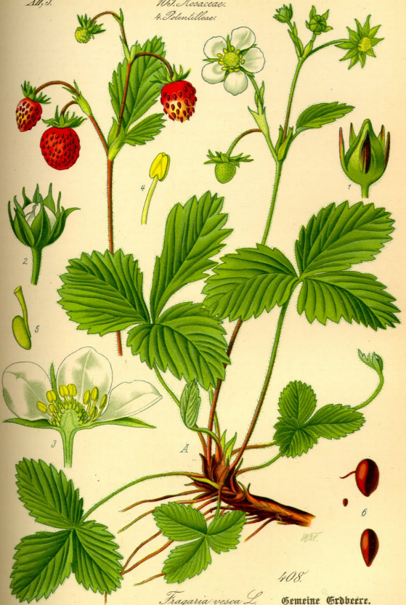
Botanical drawings
What can you see in the illustration?
2. Do you think that this illustration represents the plant at a single moment in time?
3. Why do you think so many different structures have been included in the picture?
4. What do you think the artist has had to do to the plant in order to see and draw all the structures?

Slide 13
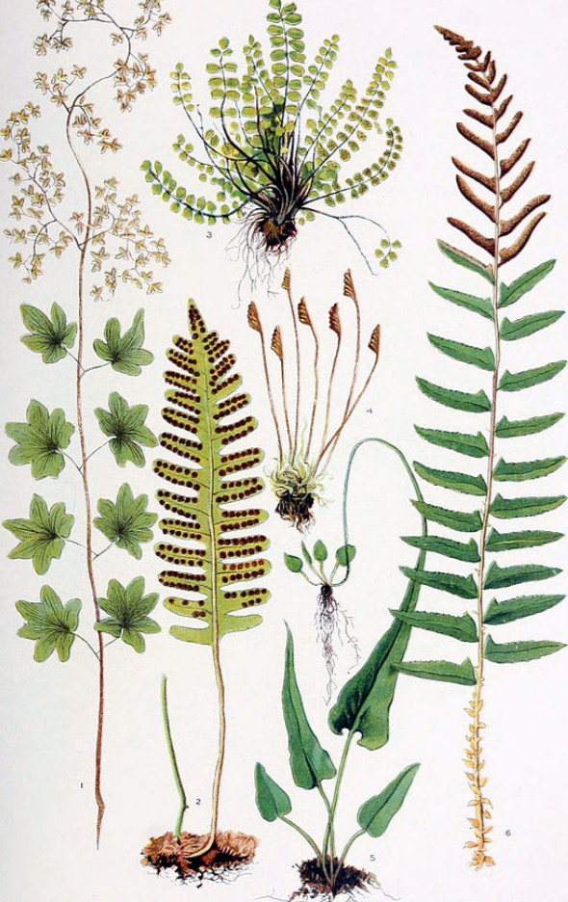
Botanical drawings
What can you see in the illustration?
2. Do you think that this illustration represents the plant at a single
moment in time?
3. Why do you think so many different structures have been included in
the picture?
4. What do you think the artist has had to do to the plant in order to see and draw all the structures?

Slide 14
For today’s science you should complete a double page spread covering the required tasks.
Labelling parts of a flowering plant.
Drawing a plant reproduction cycle for a strawberry, potato or a tulip.
Plant a cutting optional

Slide 15
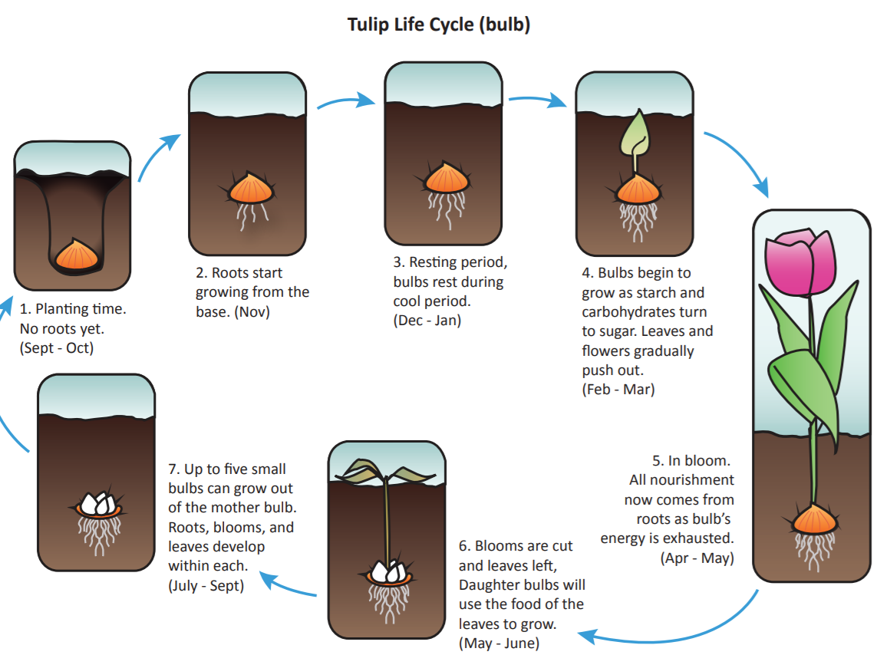
The lifecycle of a tulip

Slide 16
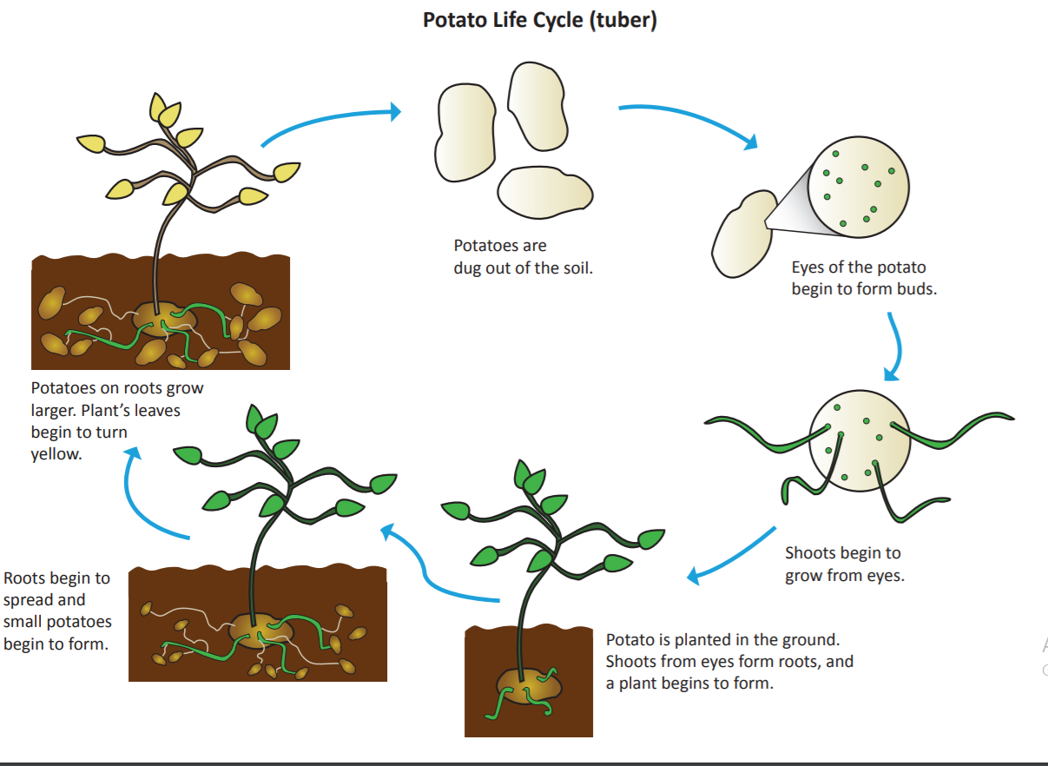
Potatoes follow a similar life cycle

Slide 17
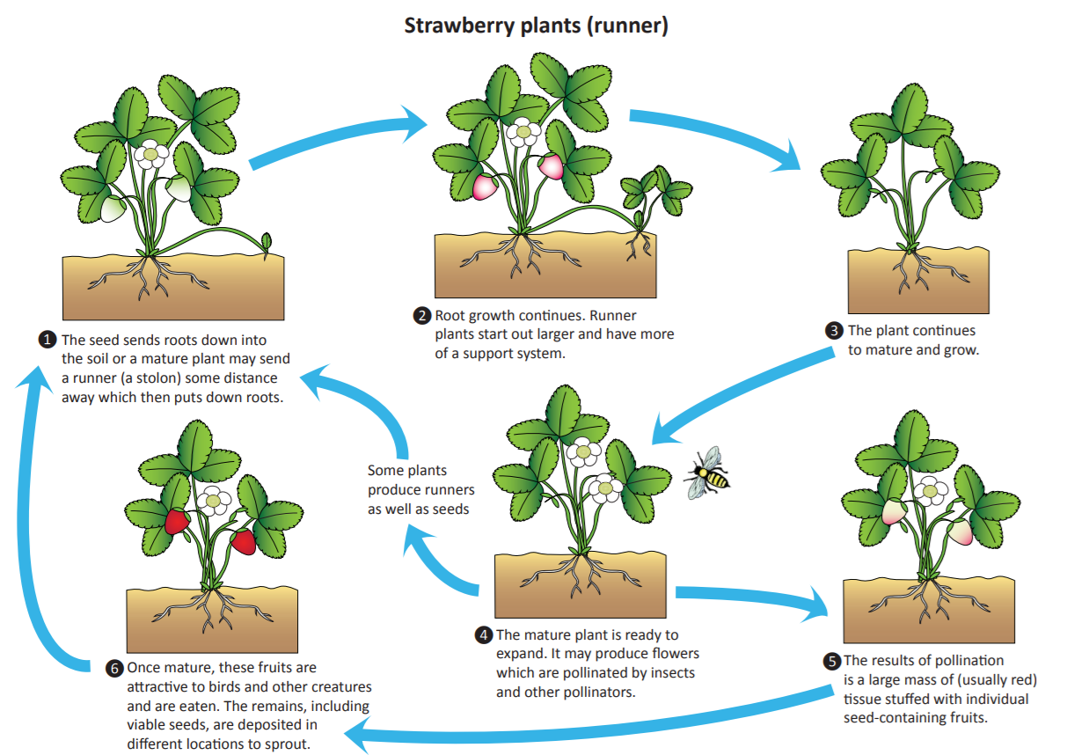

Slide 18
|Task
Choose one of the life cycles and create a copy in your book.

Slide 19
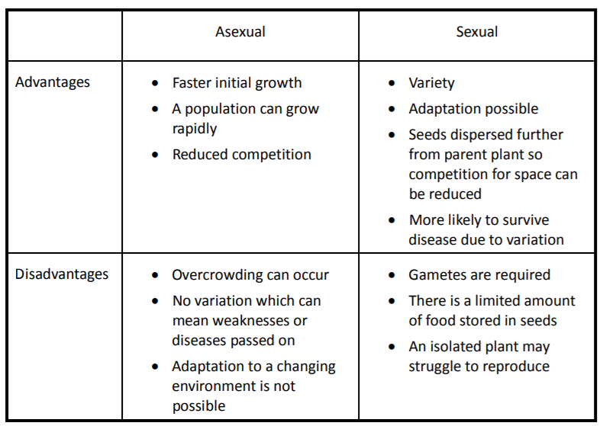
There are advantages to both sexual and asexual plant reproduction

Slide 20
|Task
We are going to plant our own cuttings and predict what might happen.
Method:
1. Place compost in the pot, leaving enough room for watering
2. Using a sharp pair of scissors, cut off a shoot tip from the geranium plant that is
about 5cm long. Cut just below a leaf node (the point where the leaf joins the
stem) as this is where the new roots will grow from
3. Carefully remove all the lower leaves, leaving one or two at the top of the cutting
4. Use a pencil to make a hole in the compost and put the cutting in. Lightly press
the soil back against the stem. (To ensure good growth you can dip the stem into
a rooting powder before potting or use a product like Groovy Roots
(http://www.nugel.co.uk/groovy-roots#g_1_0)
5. Label the cutting with the date and your name
6. Water the cutting
7. Place the pot in a plastic bag and secure with an elastic band to keep the air
around the cutting moist
8. Place the pot on a windowsill in the light

Slide 21
Stem cuttings
You will need:
• pot
• compost
• scissors
• geranium plant
• pencil
• water
• label
• plastic bag and elastic band

Slide 22
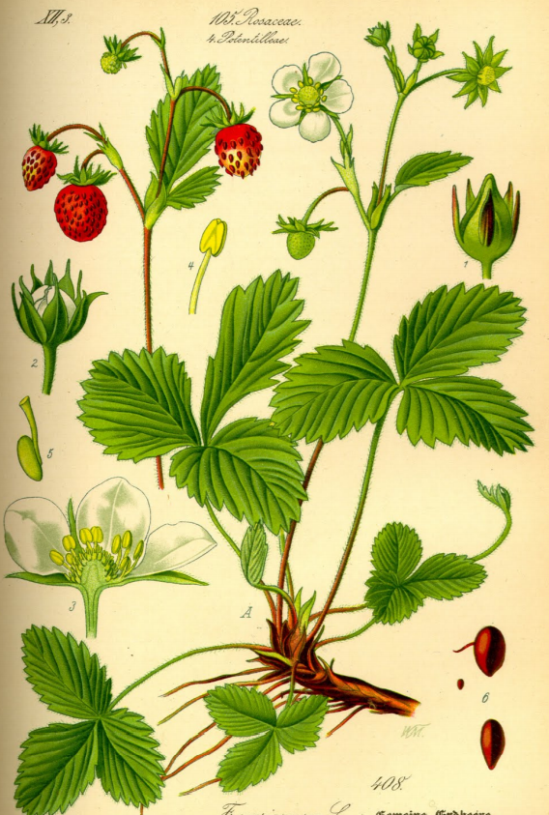
|Optional task
Why don’t you create your own botanical drawing using a strawberry or potato plant.

