Slide 1
Leonard Bernstein
Mambo

Slide 2
Lesson outcomes
After this lesson, pupils will be able to:
• listen and reflect on a piece of orchestral music
• create their own Latin inspired rhythmic ostinatos
• learn rhythms from Bernstein’s ‘Mambo’ and structure them into a piece
• perform as an ensemble
• learn musical language appropriate to the task

Slide 3
Curriculum checklist
Learners will:
• play and perform in ensemble contexts, using voices and playing musical instruments
• improvise and compose music for a range of purposes using the interrelated dimensions of music
• listen with attention to detail and recall sounds with increasing aural memory

Slide 4
Glossary of music terms
Term | Definition
Glissando | a ‘slide’ between notes, i.e. when a beater is swiped over the notes of a xylophone. (The most famous glissandos are played by trombones)
Jam | a quick, informal and instant way of putting musical ideas together
Pitched percussion | percussion instruments that can play different pitches – xylophones, glockenspiels, chime bars etc.
Pulse | the steady ‘beat’ under much music made up of notes of the same length (like a ticking clock)
Unpitched percussion | percussion instruments that can only make a limited number of sounds – drums, shakers woodblocks, tambourine etc.

Slide 5
Lesson 1
Watching and listening
Copyright Rachel Leach & BBC
Notes:
Activities: Listen and describe a piece of music
Watch the film and discuss
Curriculum link: Listen with attention to detail and recall sounds with increasing aural memory
Appreciate and understand a wide range of high-quality live and recorded music drawn from different traditions and from great composers and musicians
Develop an understanding of the history of music

Slide 6
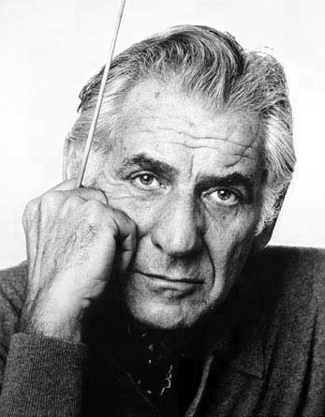
Background – the composer
Leonard BERNSTEIN
(1918 - 1990)
American composer, pianist, conductor, educator
Wrote musicals, operas, songs, symphonies and film scores
Had a popular TV show in which he explained music to children

Slide 7
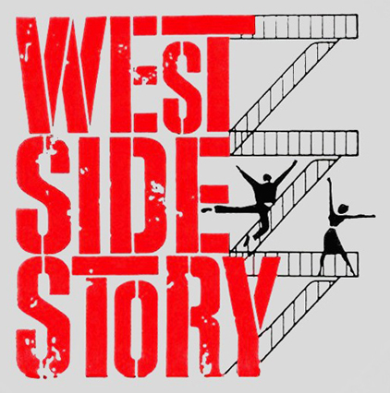
Background – the music
‘Mambo’ from West Side Story
    Written in 1957 for a musical re-telling of Romeo & Juliet
    The story is set in New York and about rival gangs – the Jets and the Sharks
    Much of the music is inspired by Central American (Latin) rhythms

Slide 8
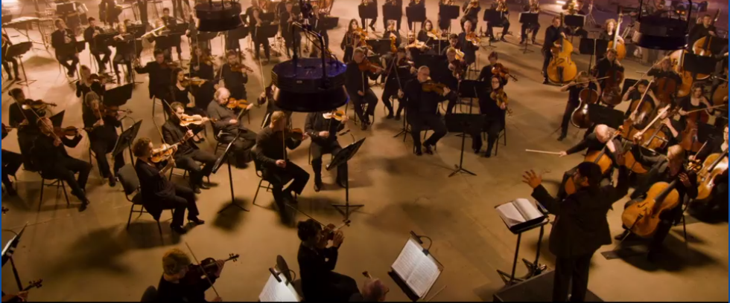
Watch the orchestral performance
https://www.bbc.co.uk/programmes/p03bvq37

Slide 9
Did you like the film?
What was your favourite part?
What might the music be describing?
Response
Notes:
Listen to Mambo (or watch the orchestra performance film) and afterwards have a discussion about what you have seen. You might like to ask the following questions –
Did you like the film?
What was your favourite part?
What might the music be describing?
Explain that the music is called ‘Mambo’ and is from a musical version of Romeo and Juliet. Check that your class know Shakespeare’s story and explain further that this version takes place in New York in the 1950s with Romeo and Juliet now called Tony and Maria. The Montagues and Capulets are now the Jets and the Sharks, rival gangs. (You could watch the film with Pixie Lott at this point to reinforce these ideas)
Listening task
Give out sheets of paper to everyone and as they listen again, ask them to draw the section of the story it might be describing. Give them three options to choose from. Does it describe:
Tony and Maria falling in love?
The Jets and the Sharks fighting?
Everyone dancing at a party?
There is no ‘correct’ answer for this, it actually describes all three things. In the original show and film, the Mambo happens during a dance. Everyone is dancing but the two gangs are pitted against one another. At the end Tony and Maria meet for the first time.
Play a recording of Mambo in full. Its better if there are no images to look at now, we just want them to listen and draw. Perhaps play the recording two or three times to give them time to finish their pictures.
Discuss their artwork and show some to the class. Tell them that all of their efforts are correct because it is what they imagined whilst they listened. Then explain what happens in the show and film at this point
FINALLY, if you have time left in your lesson and space in your classroom, encourage your class to have a go at dancing to the Mambo too. By now, they should at least be able to shout ‘Mambo’ at the right time!

Slide 10

Make your own Latin dance music!

Slide 11
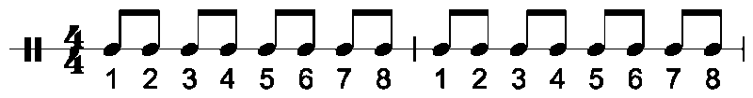

Choose a special beat number

Slide 12

Let’s start with the pulse…

Slide 13

Remember this?

Slide 14
Bernstein’s rhythmic patterns

Slide 15
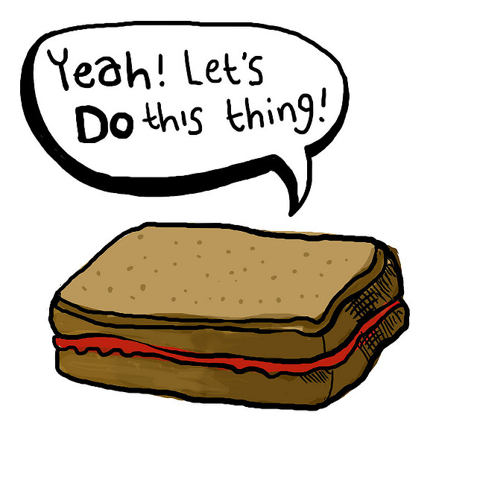
Let’s jam!

Slide 16
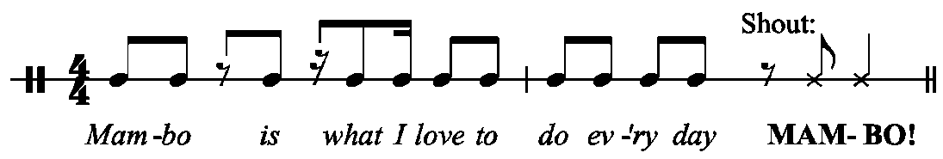
Remember to shout!

Slide 17
Now try performing the rhythm like this:

Slide 18
We only need 4 notes to make Bernstein’s tune

Slide 19
Do you remember?
Pulse
Rhythm
Tune
Notes:
Can you define what pulse, rhythm and tune mean. Write a sentence down to describe each musical term.

