Slide 1




For every 8 green sweets there are ____ red sweets.
For every 4 green sweets there are ____ red sweets.
2) For every 3 spiders there are ____ bees.
For every 3 bees there is ____ spider.

Slide 2
For every 8 green sweets there are ____ red sweets.
For every 4 green sweets there are ____ red sweets.
2) For every 3 spiders there are ____ bees.
For every 3 bees there is ____ spider.
4
2
9
1

Slide 3
L.C. Can I understand ratio and fractions?
Toolkit

Slide 4


7
There are ___ counters altogether.
4
There are ___ yellow counters.
3
There are ___ red counters.
$\frac{\text{4}}{\text{7}}$
What fraction of the counters are yellow?
$\frac{\text{3}}{\text{7}}$
What fraction of the counters are red?
4
3
For every ___ yellow counters there are ___ red counters.
4
3
The ratio of yellow counters to red counters is ___ to ___

Slide 5



Have a think
7
There are ___ shapes altogether.
5
There are ___ squares.
2
There are ___ circles.
$\frac{\text{5}}{\text{7}}$
What fraction are squares?
$\frac{\text{2}}{\text{7}}$
What fraction are circles?
5
2
For every ___ squares there are ___ circles.
5
2
The ratio of squares to circles is ___ to ___

Slide 6


$\frac{\text{2}}{\text{5}}$
What fraction of the bar is shaded?
$\frac{\text{3}}{\text{5}}$
What fraction of the bar not shaded?
Write the ratio of shaded to non-shaded parts.
2
3
For every ___ shaded parts there are ___ non-shaded parts.
2 to 3
Write the ratio of non-shaded to shaded parts.
3 to 2

Slide 7



1 to 2 to 4
For every 1 blue part, there are 2 yellow parts and 4 green parts.
$\frac{\text{1}}{\text{7}}$
What fraction of the bar is shaded blue?
$\frac{\text{2}}{\text{7}}$
What fraction of the bar is shaded yellow?
$\frac{\text{4}}{\text{7}}$
What fraction of the bar is shaded green?
Have a think

Slide 8



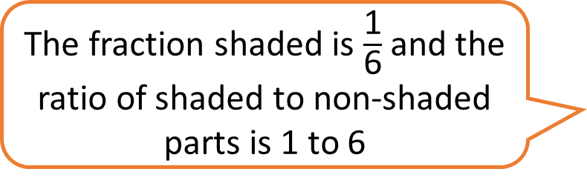
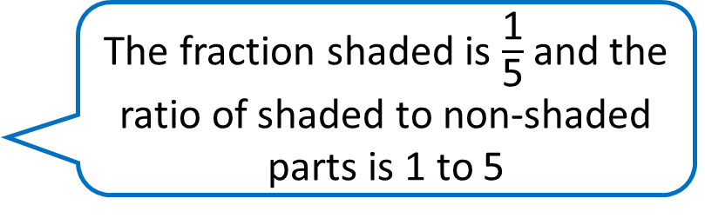
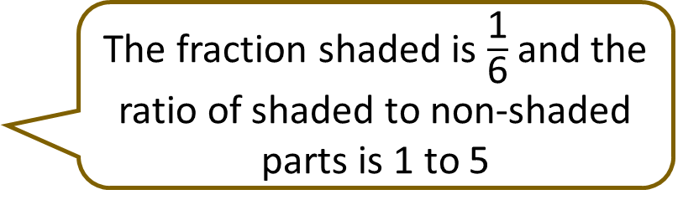
The fraction shaded is $\frac{\text{1}}{\text{5}}$ and the ratio of shaded to non-shaded parts is 1 to 5
The fraction shaded is $\frac{\text{1}}{\text{6}}$ and the ratio of shaded to non-shaded parts is 1 to 6
The fraction shaded is $\frac{\text{1}}{\text{6}}$ and the ratio of shaded to non-shaded parts is 1 to 5
Have a think

Slide 9

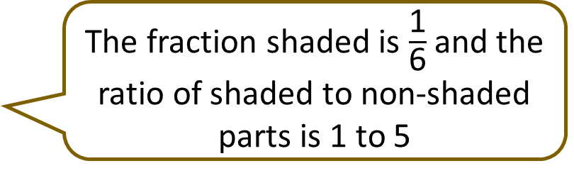
The fraction shaded is $\frac{\text{1}}{\text{5}}$ and the ratio of shaded to non-shaded parts is 1 to 5
The fraction shaded is $\frac{\text{1}}{\text{6}}$ and the ratio of shaded to non-shaded parts is 1 to 6
The fraction shaded is $\frac{\text{1}}{\text{6}}$ and the ratio of shaded to non-shaded parts is 1 to 5
For every 1 shaded part there are ___ non-shaded parts.
5

Slide 10



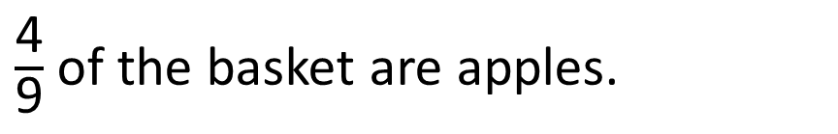
A fruit basket contains apples and pears.
$\frac{\text{4}}{\text{9}}$ of the basket are apples.
Apples
Pears
What is the ratio of pears to apples?
For every ___ pears there are ___ apples.
5
4
5 to 4
Have a think

