Slide 1
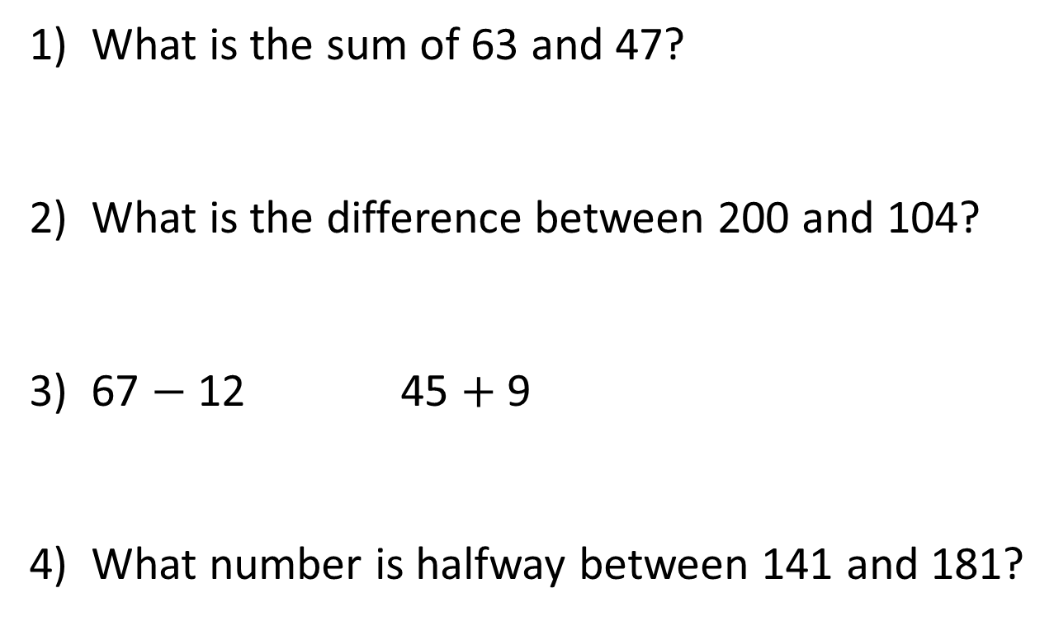
1) What is the sum of 63 and 47?
2) What is the difference between 200 and 104?
3) 67 $−$ 12 45 $+$ 9
4) What number is halfway between 141 and 181?

Slide 2
110
1) What is the sum of 63 and 47?
2) What is the difference between 200 and 104?
3) 67 $−$ 12 45 $+$ 9
4) What number is halfway between 141 and 181?
96
>
161

Slide 3
L.C. Can I use comparisons?
Toolkit

Slide 4

8
6
4
Hours of sunshine
2
0
Mon
Tues
Weds
Thurs
Fri
Day
How many more hours were there on Tuesday than Friday? ____ hours
1
Have a think
What was the difference between the hours for Wednesday and Monday? ____ hours
2

Slide 5
8
Have a think
6
4
7
Hours of sunshine
5
4
2
3
0
0
Mon
Tues
Weds
Thurs
Fri
Day
What is the total number of hours for Monday to Friday? ____ hours
19
7 + 4 + 5 + 0 + 3 =
7 + 3 + 5 + 4 =
19
There were three times as many hours on Saturday than Friday. How many hours of sunshine were on Saturday? ____ hours
9
3 × 3

Slide 6




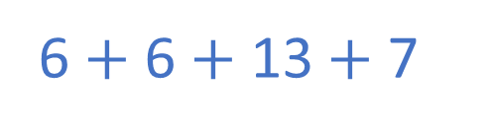

Team | Rounders scored
A
B
C
D
Key $=$ 4 rounders
6
6
13
Have a think
1) A and B C
4) How many rounders are scored in total? ___ rounders
$$<$$
$$=$$
32
2) B A
6 $+$ 6 $+$ 13 $+$ 7
3) D A
$$>$$
4 $×$ 8

Slide 7
How could we sort these shapes?
3
Orange
Blue
Total
Circles | Squares | Total
6
5
4
9
9

Slide 8
How could we sort these shapes?
 | Circles | Squares | Total
Orange
Blue
Total
Orange | 3
Blue | 6
Total | 9
Circles | Squares | Total
5 | 4 | 9
2
1
3
3
3
6
5
4
9

Slide 9







Have a think
 | Boys | Girls | Total
School uniform | 2 | 2
PE kit | 1 |  | 3
Total
4
2
7
3
4
14

Slide 10
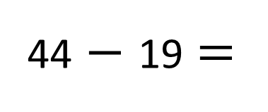
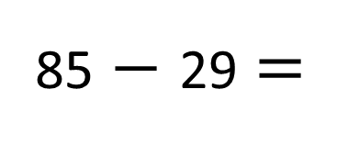
 | Boys | Girls | Total
School dinner | 31
Packed lunch | 10 | 19
Total |  | 44 | 85
56
25
56
29
41
41
29
56
85
44
31 + 10 =
10 + 19 =
44 $−$ 19 =
29
41
25
25
10
19
31
31
25
19
29
10
56
31 + 25 =
56
85 $−$ 29 =
56

