Slide 1
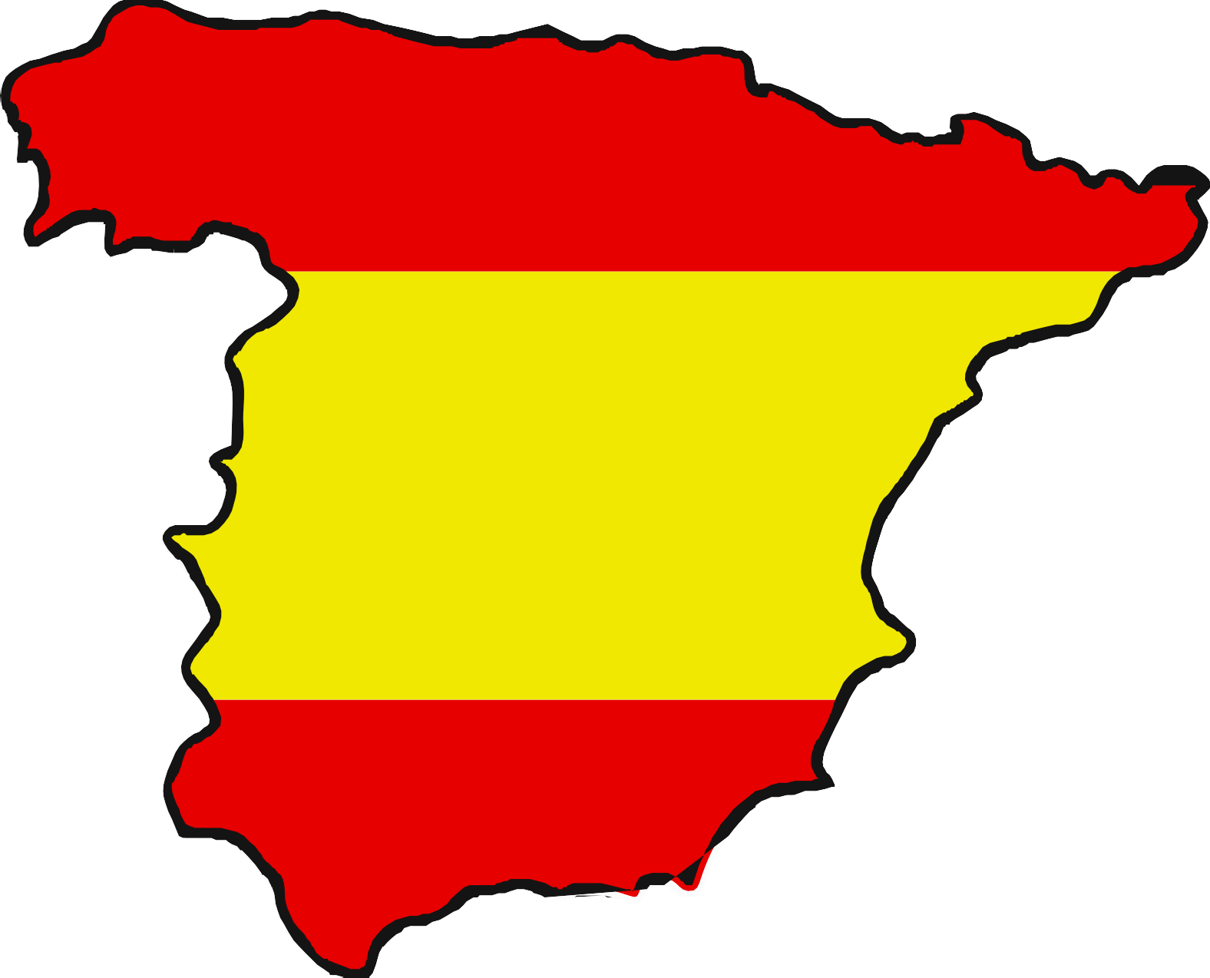
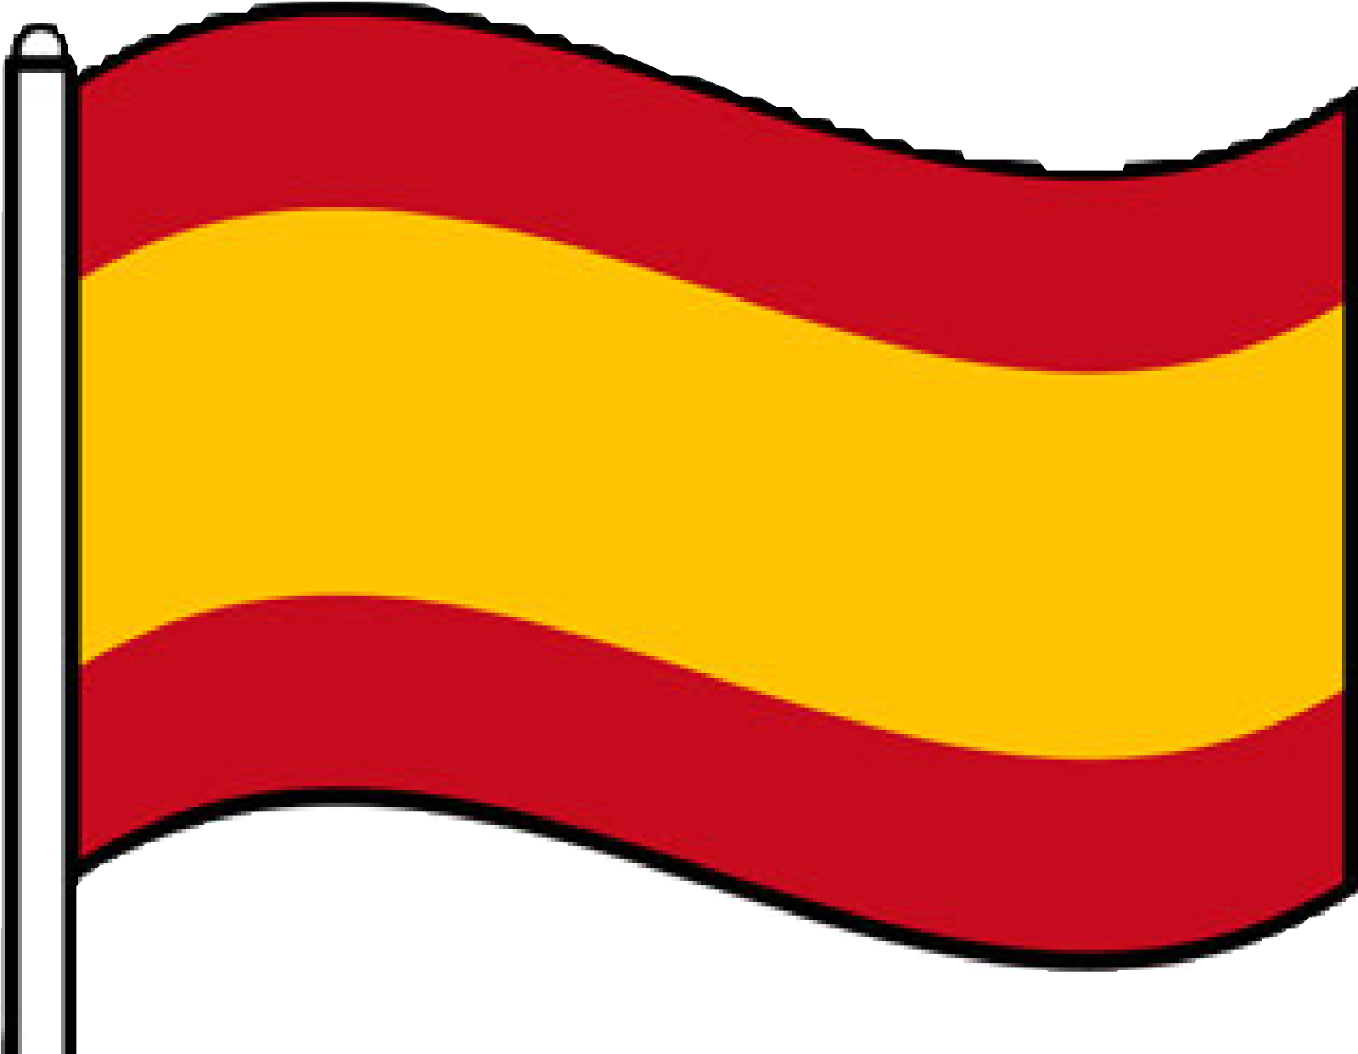
Spain and Catalonia
LC: Can I explain where Spain is in the world?

Slide 2
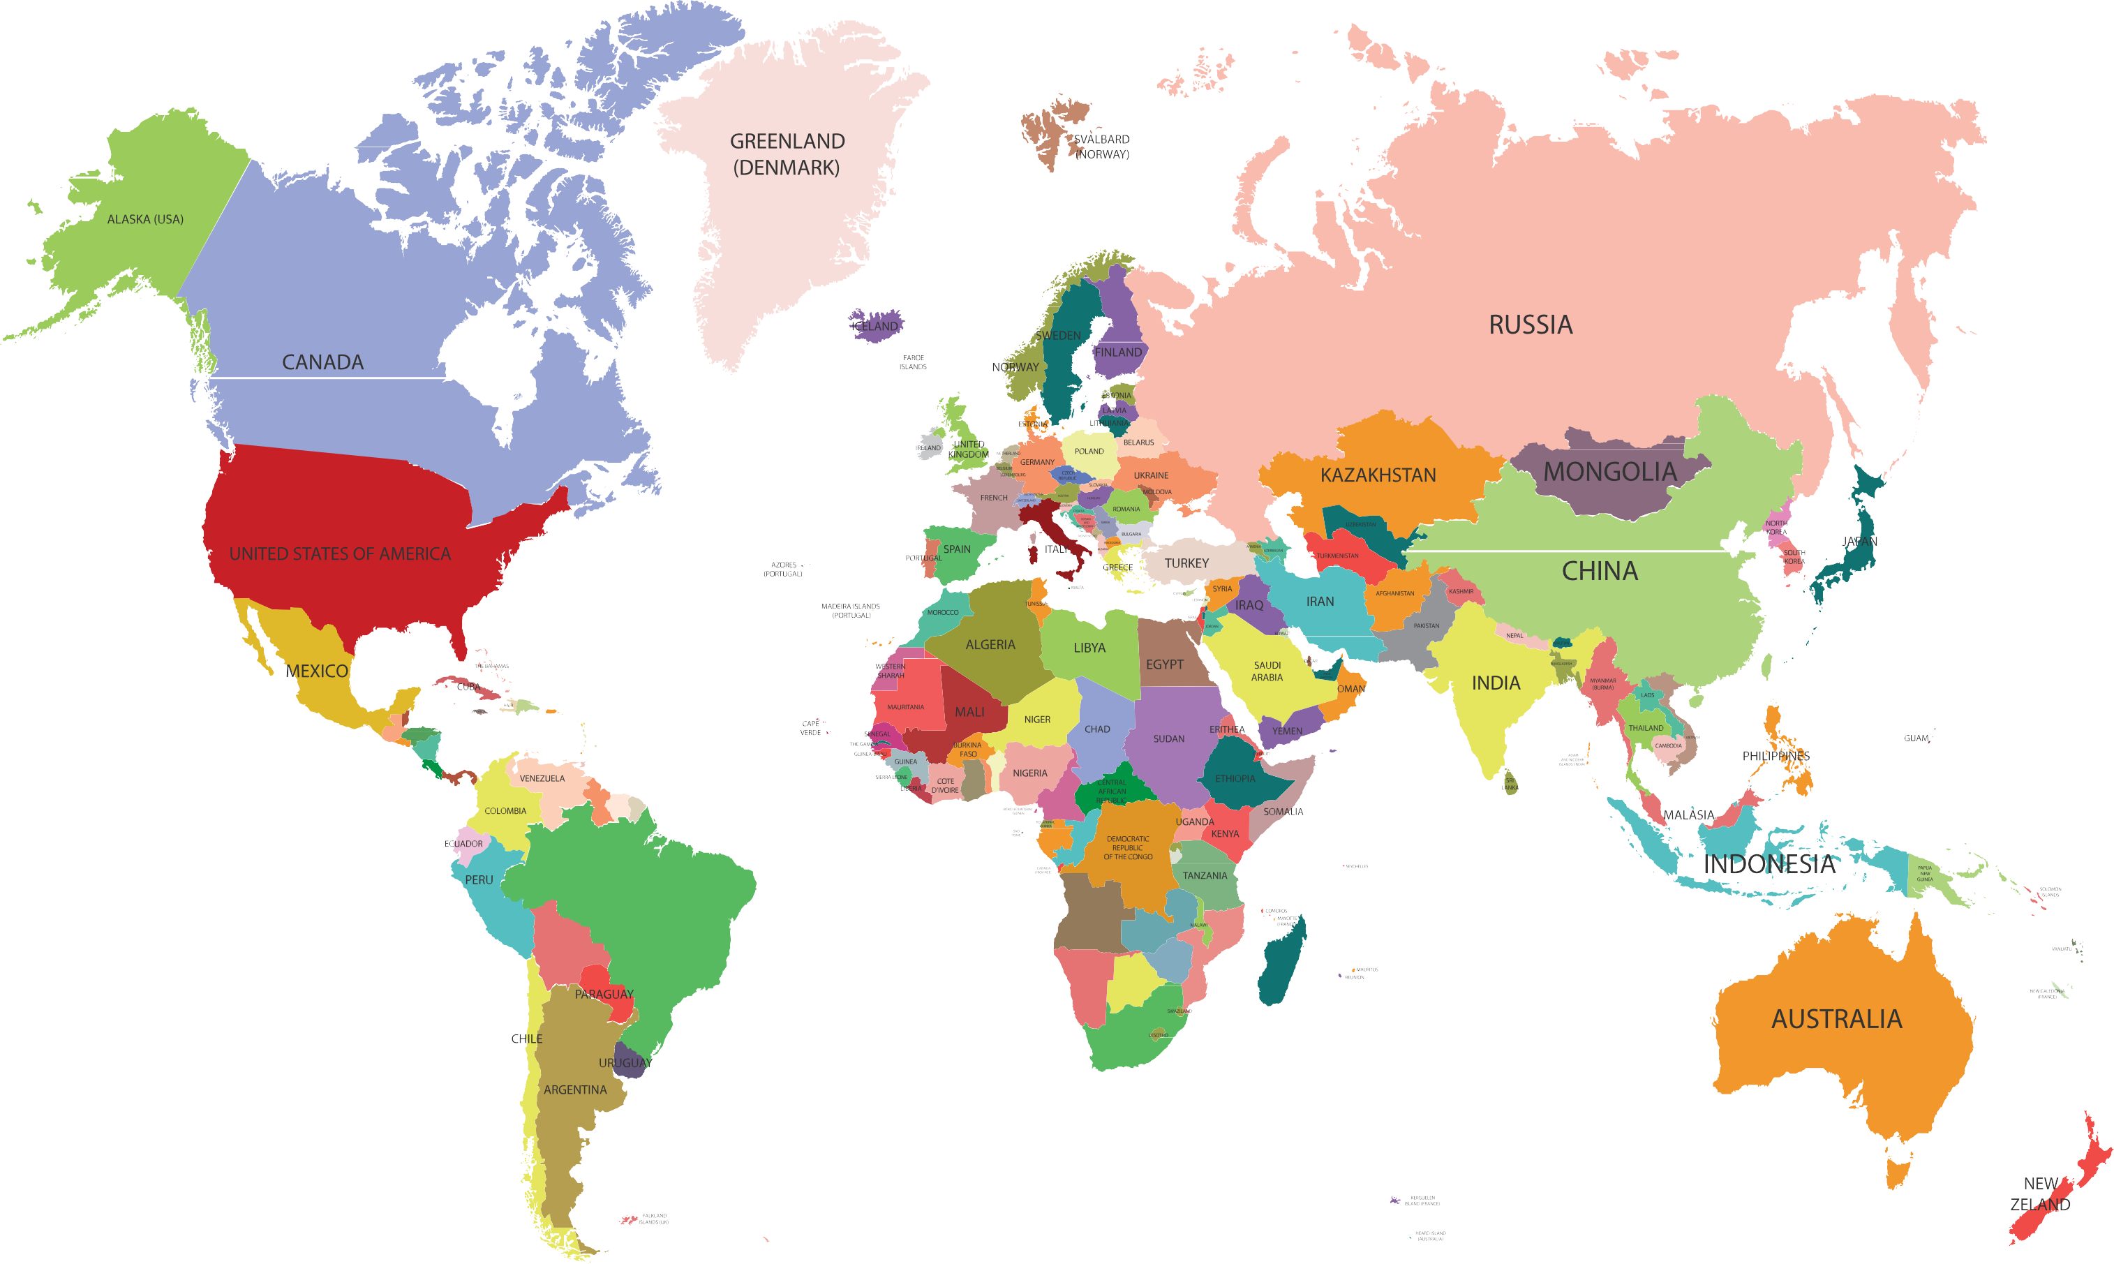



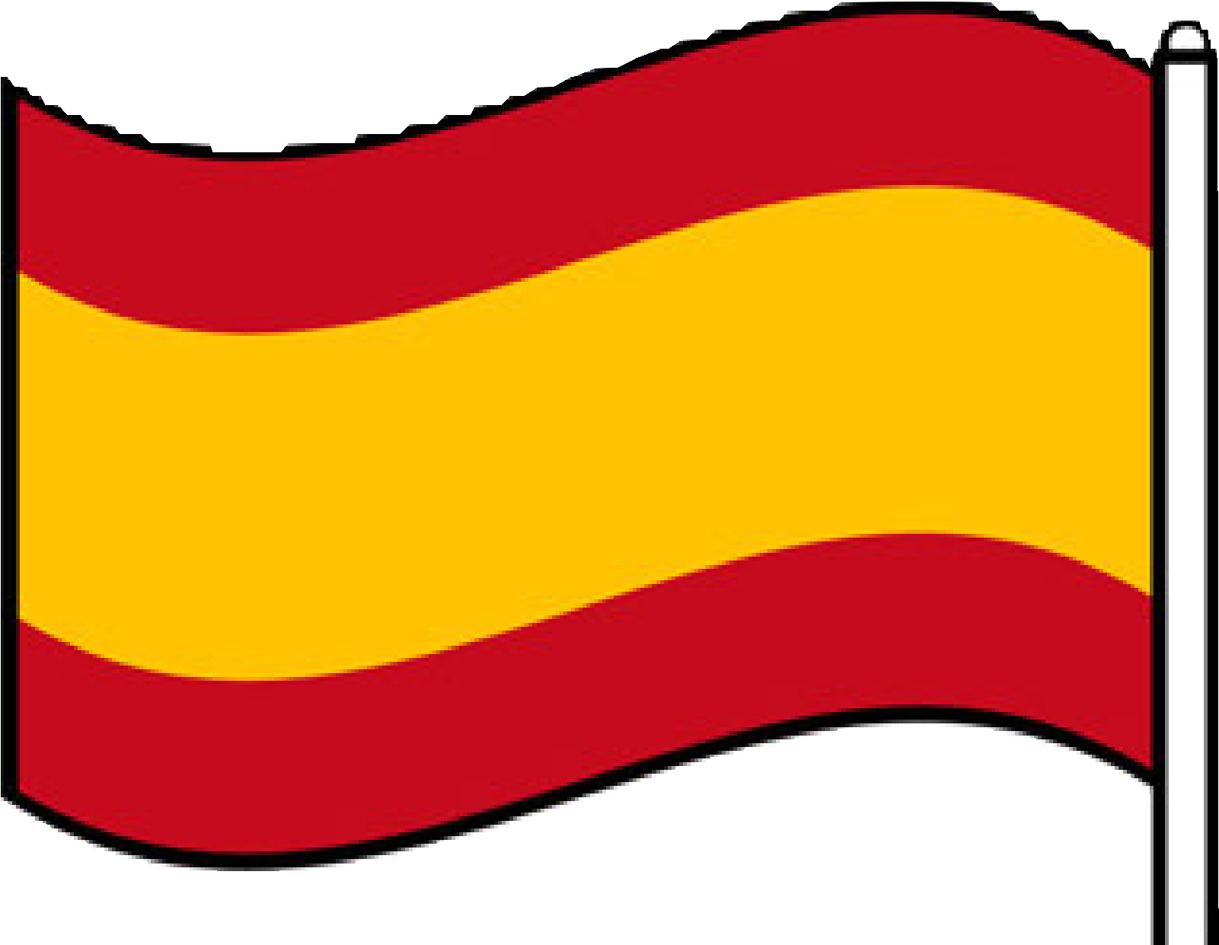
This is a map of
Can you locate
the world.
Spain?
Do you know which continent both of these countries are
Can you locate
the UK?
part of?

Slide 3
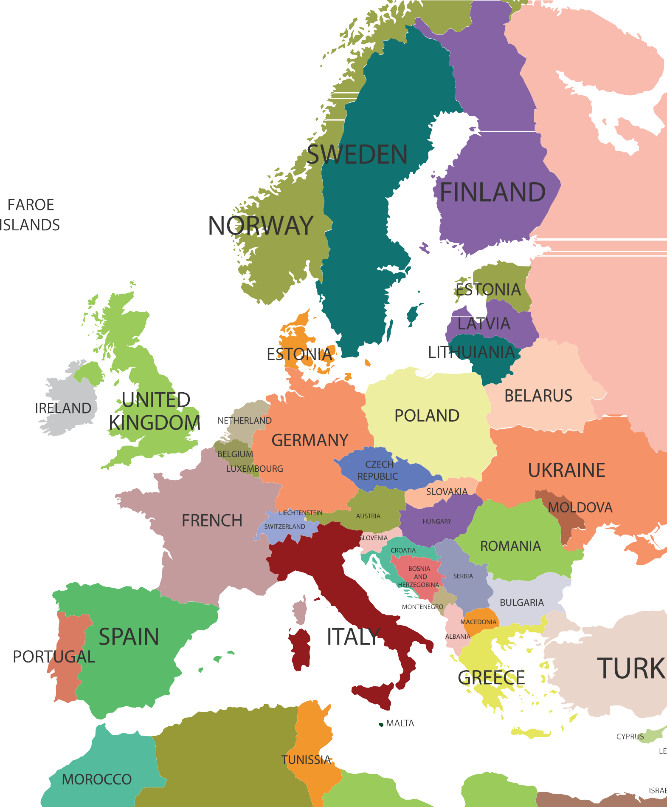





The UK and Spain are both part of the continent of Europe.
Altogether, there are 44 countries in Europe.

Slide 4
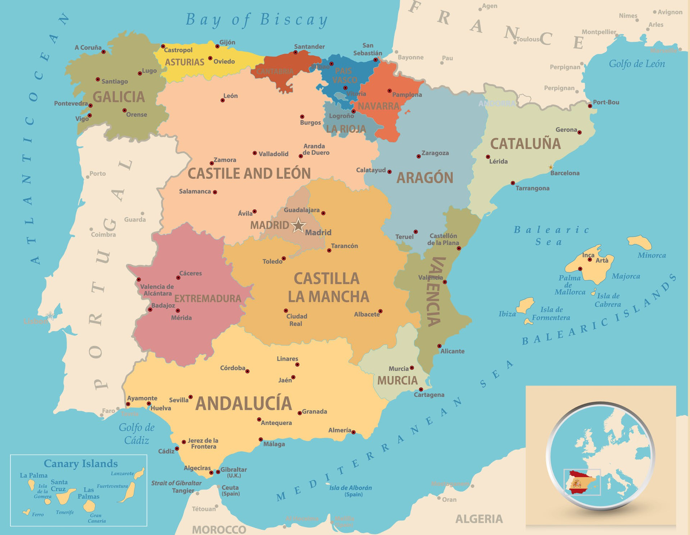
Here is a map of Spain. Can you see where the star is in the centre?
This marks where Madrid, the capital city of Spain, is located.

Slide 5
Just like in the UK, Spain is divided into regions. In the UK they are called counties, but in Spain they are called ‘autonomous communities’.
They have their own regional government, flag and capital city. There are 17 autonomous communities altogether.
(One of these is Catalonia, or Cataluna in Spanish, which we will be finding out more about in a later lesson!)

Slide 6
Spain has land borders with three other countries: Portugal, France, and Andorra. It also borders the British Overseas Territory of Gibraltar. Can you spot all of these on the map?
(Hint: Andorra is very small!)

Slide 7
Spain is surrounded by the Atlantic Ocean to the west, the Bay of Biscay to the north, the Mediterranean Sea to
the south and the Balearic Sea to the west. There is also a small strip of water, called the Strait of Gibraltar, that separates Spain from the country of Morocco. Can you find it?

Slide 8
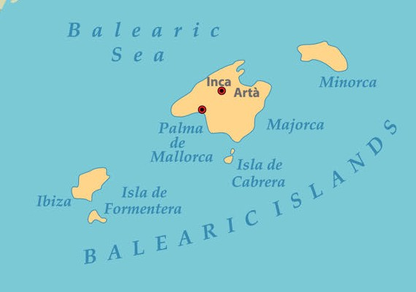
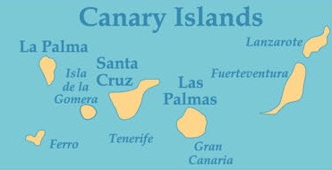
The Canary Islands include seven isles altogether. The largest is Tenerife, on which there is an active volcano, called Mount Teide. Together, the islands are one of the 17 autonomous communities of Spain. (They are actually much further south-west, off
the coast of Morocco, than this map shows.)
The Balearic Islands consist of four major isles, with Mallorca being the largest.
There are buildings by the famous architect Antonio Gaudi, including a cathedral and a royal palace.

Slide 9
You are now going to complete your own maps of Spain.

Slide 10
Quiz:
How
many autonomous communities are
there?
What is the capital city of Spain?
How many countries
share a border with Spain?
How many groups of islands are
part of Spain?
How many of these questions can you answer?
Which continent is Spain in?
Which sea is to the south of Spain?
Which ocean surrounds part of Spain?
Which is the largest Canary Island?

Slide 11
The capital city of Spain is MADRID.
There are 17 autonomous communities.
THREE countries share a border with Spain.
There are TWO groups of islands that are part of Spain.
Did you know the answers to them all?
Spain is in the continent of EUROPE.
The MEDITERRANEAN
sea is to the south of Spain.
The ATLANTIC
ocean surrounds part of Spain.
The largest Canary Island is TENERIFE.

