Slide 1

Week 2 – Lesson 8

Slide 2
SPAG warm up – prepositions of time
Prepositions of time are words such as:
before, after, during and until.
They give information about when or for how long something happens.
Identify the prepositions of time in this paragraph:
The humans were relaxing after a lovely meal. No one
was looking at the cat: perhaps his big chance had come at last.

Slide 3
SPAG warm up
Write a comma after the fronted adverbials of time in these sentences:
As soon as I had packed all my things I ran from the house.
After darkness fell the wind whistled and the wolves howled.
Finally we sheltered from the rain.

Slide 4
SPAG warm up
Write a comma after the fronted adverbials of time in these sentences:
As soon as I had packed all my things, I ran from the house.
After darkness fell, the wind whistled and the wolves howled.
Finally, we sheltered from the rain.

Slide 5
DADWAVERS daily challenge
D is for description – sentences filled with imagery and adjectives​
A is for action – detailing what is happening in a sentence​
D is for dialogue – something a characters says out loud or a conversation​
W is for where – indicating the location of the action (adverb of place)​
A is for adverb – usually an adverb / adverbial phrase of manner​
V is for verb – single word or phrase e.g Walking, / Walking across the country​
E is for estimation of time e.g Momentarily, At midday, As the tide turned​
R is for rhetorical question to draw in the reader, can use more than one​
Simile is for simile (or metaphor) – allows the writer to ‘paint’ an image

Slide 6
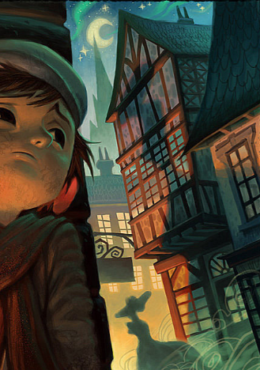
DADWAVERS 60 sec write
E is for estimation of time – use adverbials of time​
Eg. One week before, they had been enjoying time on the beach.​
Eg. In the dead of night an owl hooted and a mouse darted across the floor.

Slide 7
LC: Can I use appropriate vocabulary to write in role as a character?
Toolkit:
Look at the next four pages of the book slowly, making observations.

Slide 8
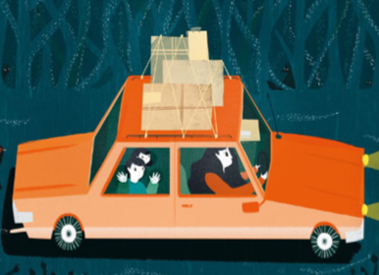
What do you see?

Slide 9
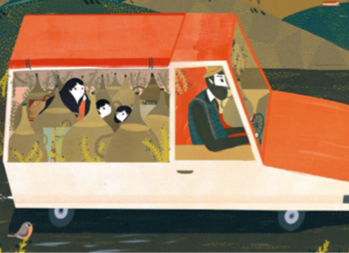
What do you see?

Slide 10
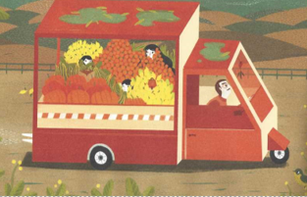
What do you see?

Slide 11
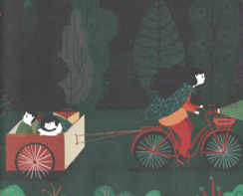
What do you see?

Slide 12
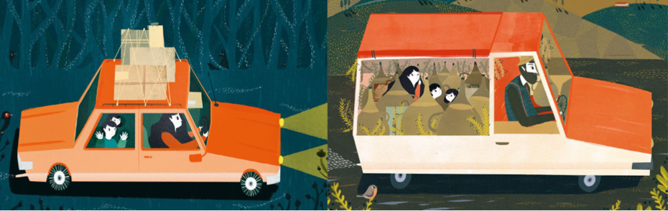
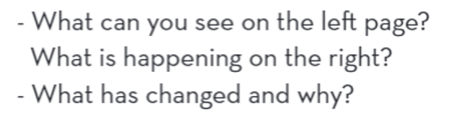
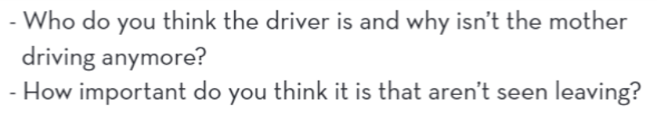

Slide 13
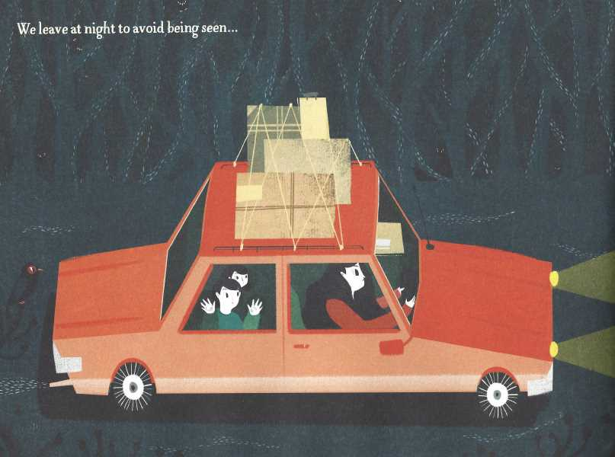
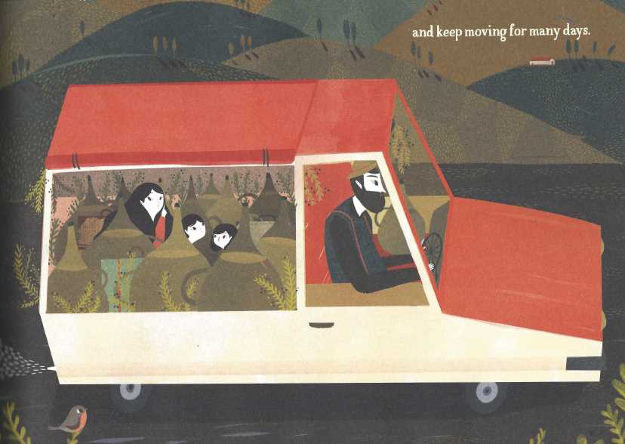
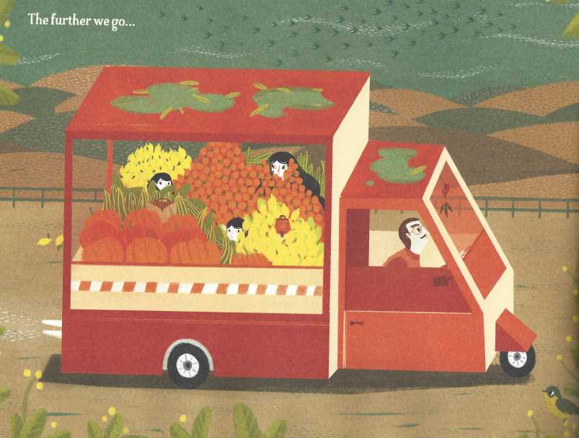

How do you think the mother is feeling during each stage?

Slide 14
Can you write a sentence for each image that you feel would most appropriately complement each illustration.
Then compare what you have written to the actual text on the following pages.

Slide 15
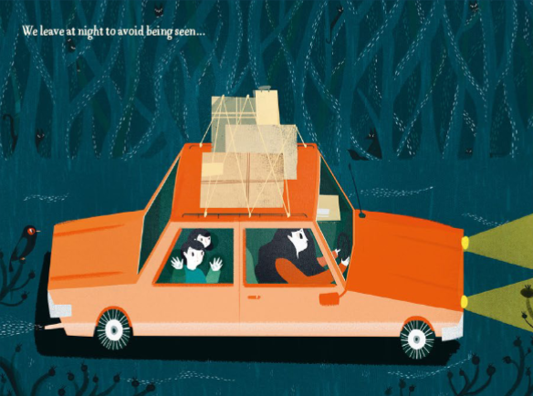
‘We leave at night to avoid being seen…

Slide 16
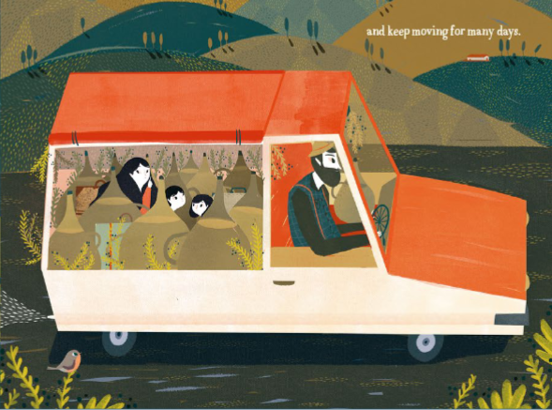
and keep moving for many days…

Slide 17
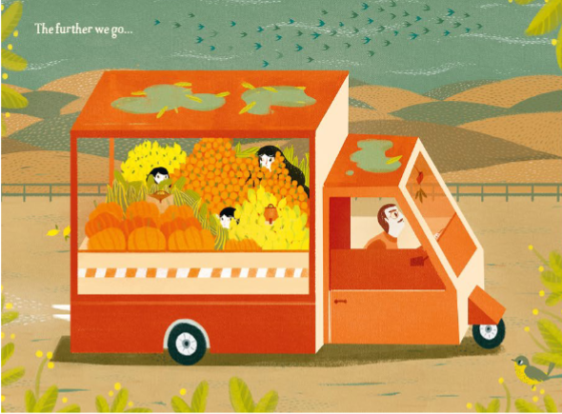
The further we go

Slide 18
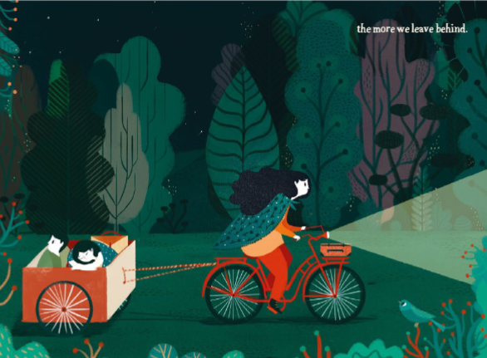
the more we leave behind

Slide 19
How does what you wrote compare with the actual text?

Slide 20
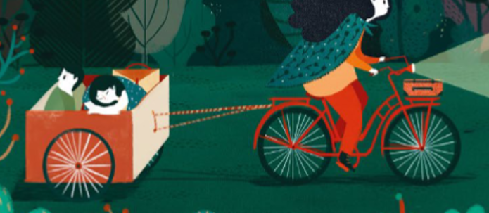
Task
Can you write a paragraph in the role of the mother describing your thoughts and feelings a this stage of the story?
Can you then write a paragraph in the role of the child describing their thoughts and feelings? Think of what items the child has had to leave behind along the way....

