Slide 1


Chicken Soup- A story about sharing

Slide 2

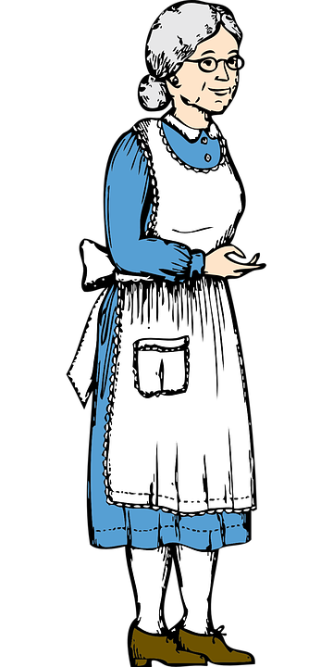
Once there was an old woman who lived on her own.
She decided to make her favourite meal- chicken soup.
2
© Young Citizens

Slide 3






She gathered together the ingredients she needed: carrots, barley, leeks, onions, parsley, dill and of course a nice fresh chicken.
3
© Young Citizens

Slide 4

The old lady cooked her ingredients, added water and left it all to simmer gently in the pot.
After a few hours she added her special dumplings, and then left them to take on all the wonderful flavours.
4
© Young Citizens

Slide 5

Meanwhile, her next door neighbour was looking through her kitchen cupboards to see what she could have for dinner.
There was nothing! Not a thing!
5
© Young Citizens

Slide 6


Her nose started to twitch as she smelt the wonderful aroma coming from the kitchen next door.
‘Mmmmm, chicken soup!’ she cried.
‘I think I’ll pop in to see my neighbour.’ she thought. ‘I’m sure she will offer to share her soup with me.’
6
© Young Citizens

Slide 7

The old women was just about to serve her delicious soup when her neighbour knocked on the door.
‘Have you been cooking?’ enquired the neighbour.
‘There are delicious smells coming from your kitchen.’
‘Oh no, I’ve not been cooking. The smells must be coming from someone else’s house.’ replied the old woman.
7
© Young Citizens

Slide 8
‘Really? But the smell seems to be coming from that pot that you have on your stove.’ said the neighbour.
‘That’s not chicken! That’s just my washing on the stove. I’ve had to boil some clothes to get the stains out of them.’ responded the old woman.
8
© Young Citizens

Slide 9

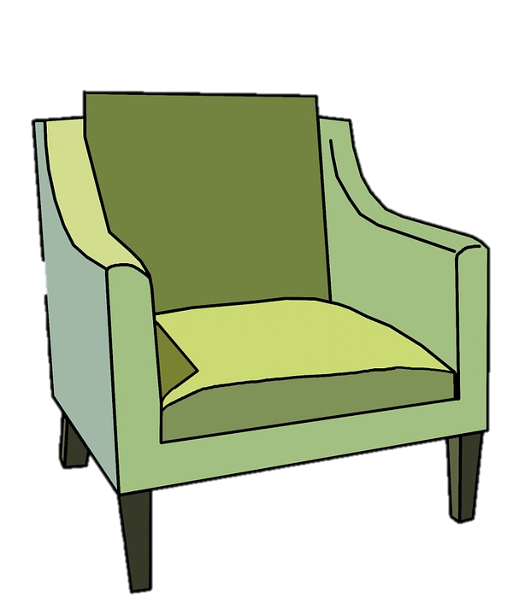
The neighbour knew that the old woman was lying, but she simply shrugged her shoulders and said, ‘Oh well, now that I am here it would be lovely to stay for a chat.’
She walked into the old woman’s living room and sat down.
9
© Young Citizens

Slide 10
Z
Perhaps it was the warmth of the house or maybe it was the neighbour talking on and on, but the old woman found her eyelids were starting to feel heavy.
Soon she nodded off, and after a few minutes she was in a deep sleep.
Z
Z
Z
Z
10
© Young Citizens

Slide 11

And what do you think happened next?
11
© Young Citizens

Slide 12

The neighbour tiptoed across the kitchen and lifted the lid on the pot to see what was inside.
‘I was right! A delicious chicken soup with soft dumplings, not washing at all!’ she exclaimed.
12
© Young Citizens

Slide 13


Silently the neighbour helped herself to a bowl of soup. It was soooo tasty.
She helped herself to another bowl…
and another…
and another!
13
© Young Citizens

Slide 14

Soon there was nothing left except a few bones at the bottom of the pot.
14
© Young Citizens

Slide 15

With her stomach full, she crept back to her own house and collected a pile of dirty washing.
She crept back to the old woman’s kitchen, filled the empty pot with water and stuffed all her clothes in it before placing the lid back on top.
15
© Young Citizens

Slide 16
Much later the old woman woke up.
‘Thank goodness she’s gone’ she muttered to herself. ‘Now I can have some tasty soup.’
She went to the pot and lifted the lid. What did she find?
16
© Young Citizens

Slide 17




A whole load of dirty washing of course!
17
© Young Citizens

Slide 18
Talking Time
Q: Do you think the neighbour should have
eaten the soup and then filled the pot with ///dirty washing?
Q. Imagine the old woman had shared her soup
instead of lying. How might the story have
changed?
Q: How could the neighbours become friends ///again?
18
© Young Citizens

Slide 19
Talking Time
Q. Why can sharing be hard?
Q: What are some of the things you find hard to
share?
Q: What things could you share with others?
Now go and try some of our sharing challenges
19
© Young Citizens

