Slide 1

KS1 PSHE
LC: What makes a good friend?

Slide 2

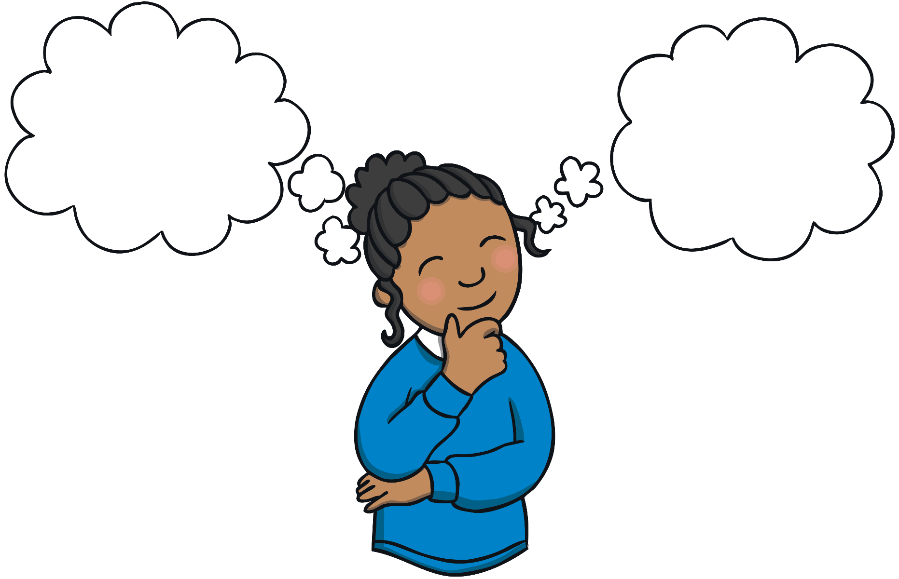
What makes a good friend?
How can we be a good friend?

Slide 3
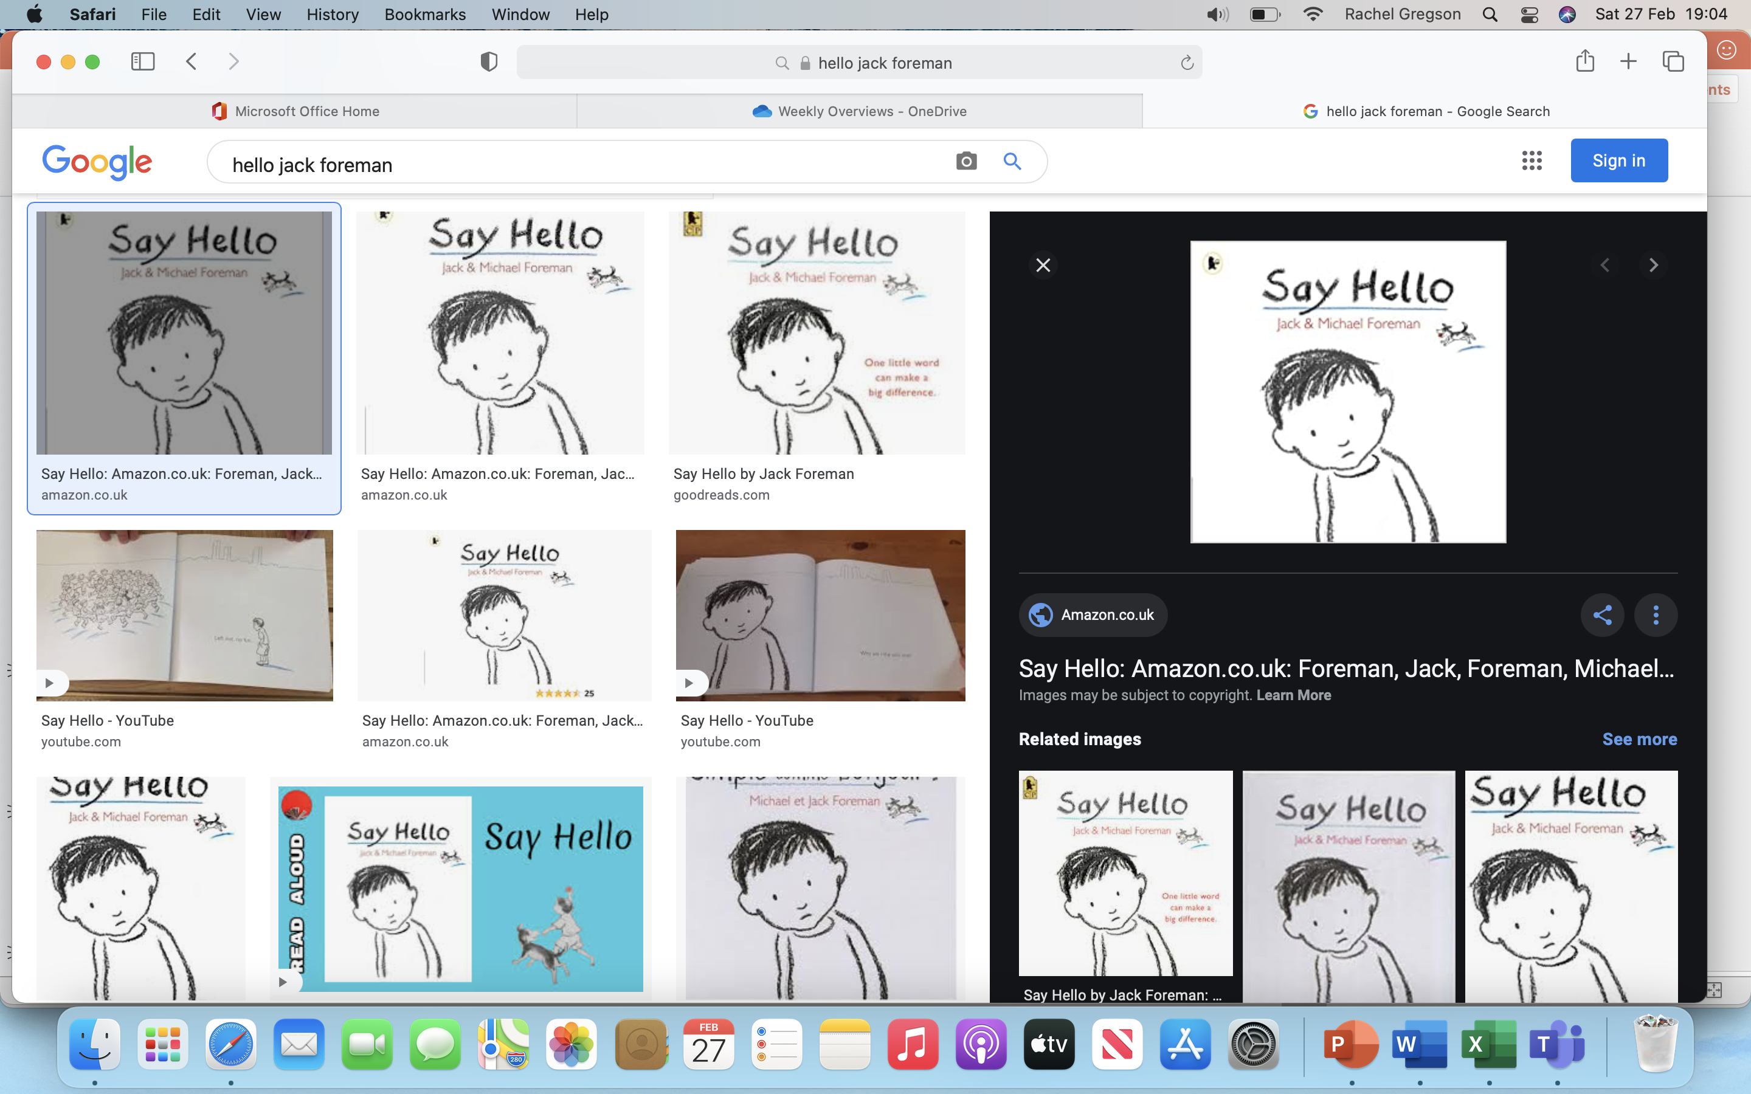
Let’s watch the video about the book ‘Hello’ by Jack Foreman.
A picture book reminding us that when someone looks lonely and in need of a friend, one little word can help.
https://www.youtube.com/watch?v=hbB7RS47VE0

Slide 4


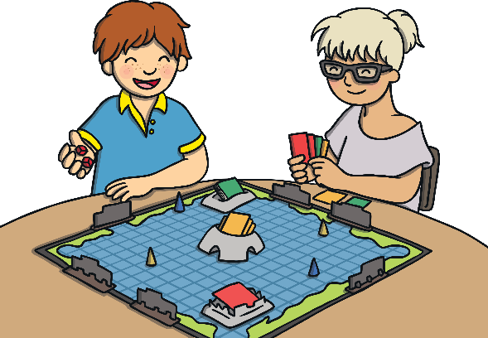
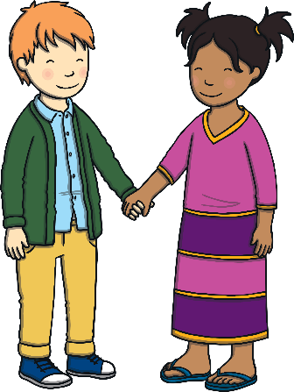
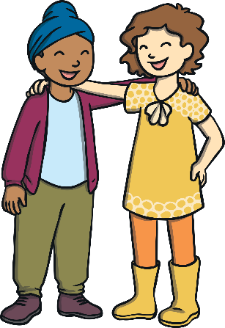
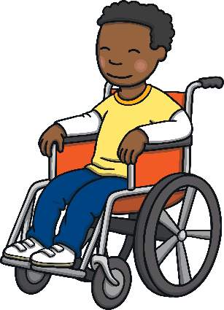
Friends
Friends are people we like a lot and who we know well. They are people who we enjoy spending time with. Think quietly about your friends.
What do you like about them?
Having friends in our lives is important as they can help us to feel good and have happy times as well as support us when we are facing more
challenging situations.

Slide 5
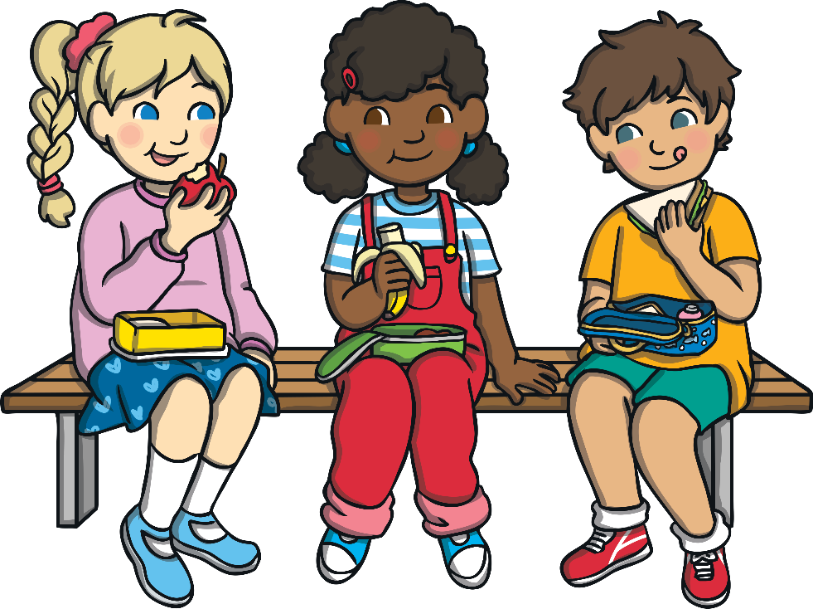
Friendship Qualities
Friends can sometimes make us feel sad, as well as happy.
This is all part of our learning about friendship.
The important thing is that we know the qualities that make a good friend. We can then try our hardest to show these qualities to our friends and chose friends who show these qualities to us.
Why do these qualities make someone a good friend?

Slide 6
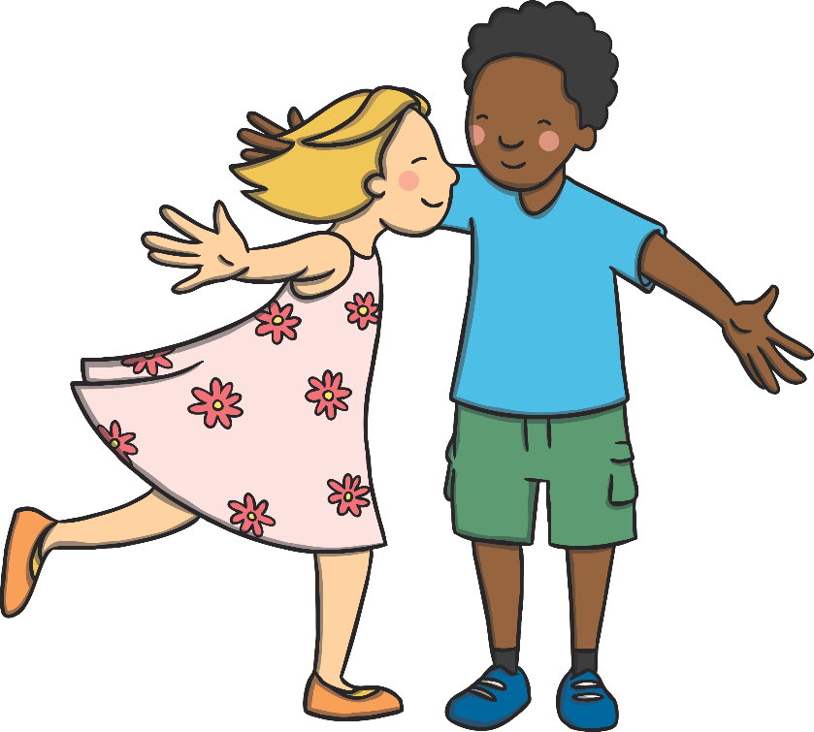
Friendship Qualities
a good listener
caring
kind
helpful
trustworthy
honest
Good friends treat us with kindness and respect and are people we trust. Friends are people who like and accept us for who we are and don’t try to make us do things that we are uncomfortable with.

Slide 7

Good Friends
Why do we need good friends in our life?
Friends shape how we see ourselves and the things we do. If the friends we have are not good friends, we could end up getting hurt or doing something we might not want to.
Part of being a good friend is to help and support our friends with being good friends too. This can include letting them know, in a kind way, if we disagree with them, respecting different opinions and asking for
adult help.

Slide 8
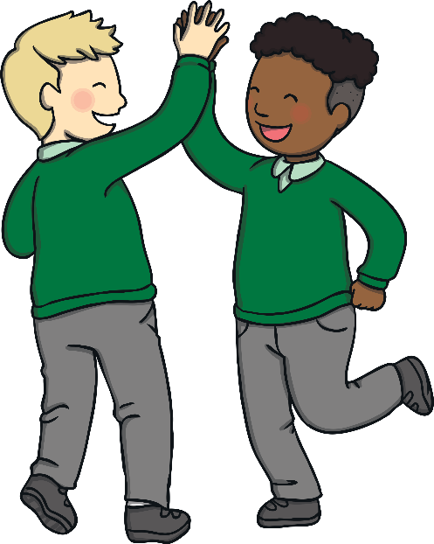
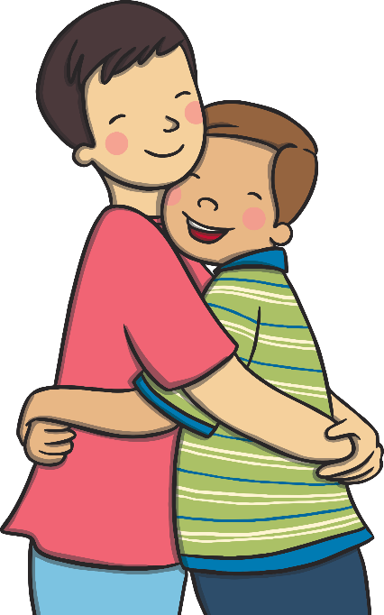
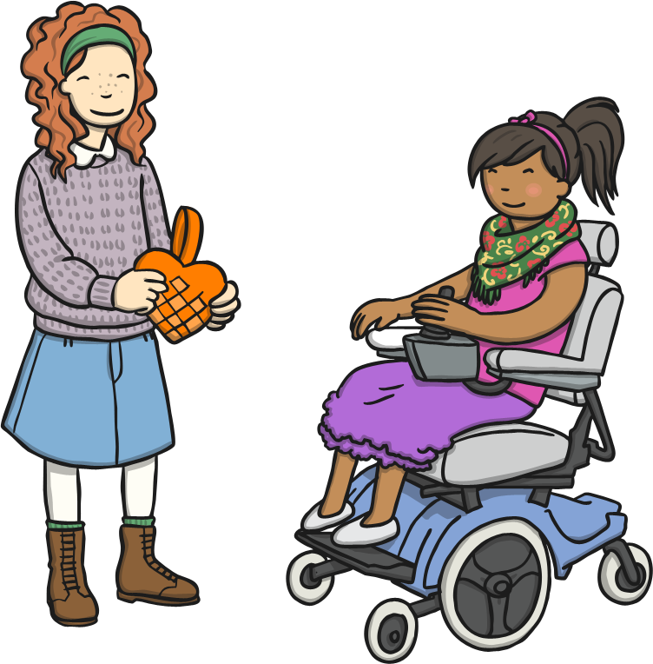
Saying Thank You
We can be a good friend by saying thank you to our friends when they do something which is kind, caring or helpful – something which makes us feel good inside.
Sit quietly and think of a friend you would like to say thank you to.
Let’s all try our hardest to be a good friend to others!

Slide 9

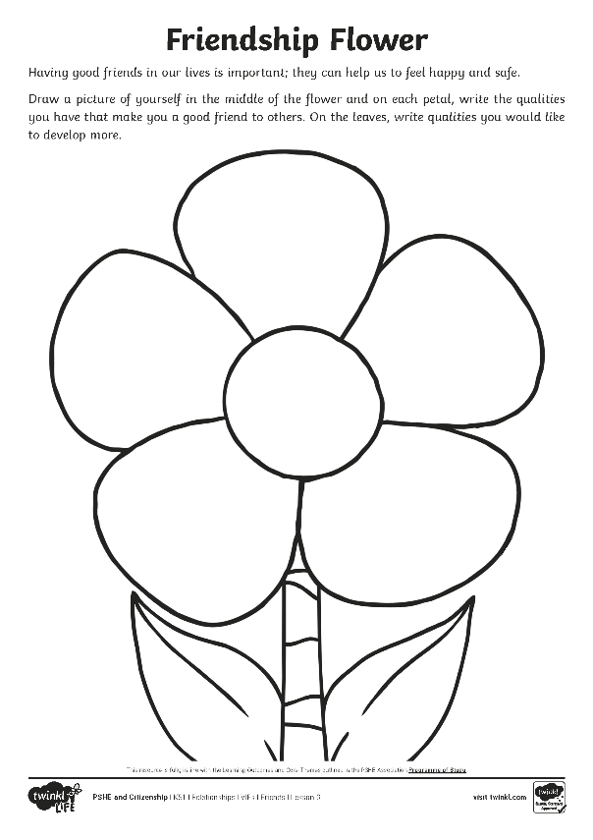
LC: How can I be a good friend?
Reflecting
It is important we all try our hardest to be a good friend to others. Friendship and how to be a good friend are things we learn about throughout our lives.
What qualities do you have that make you a
good friend?
What qualities would you like to develop
even more?
Write your thoughts on your friendship flower.

Slide 10
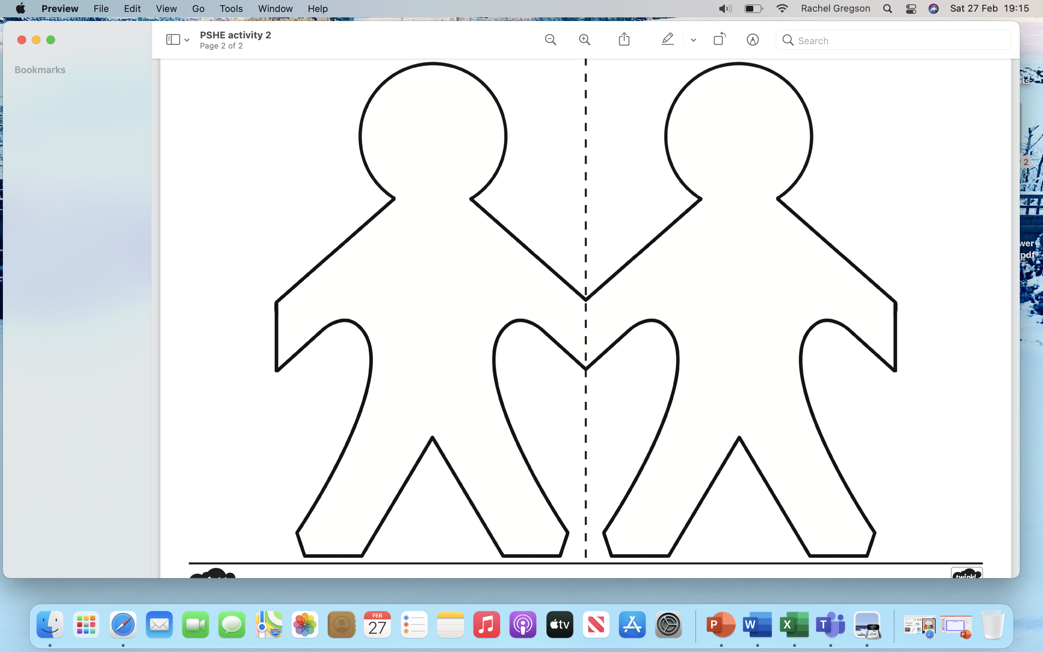
Activity 2
Make a paper people chain!

Slide 11
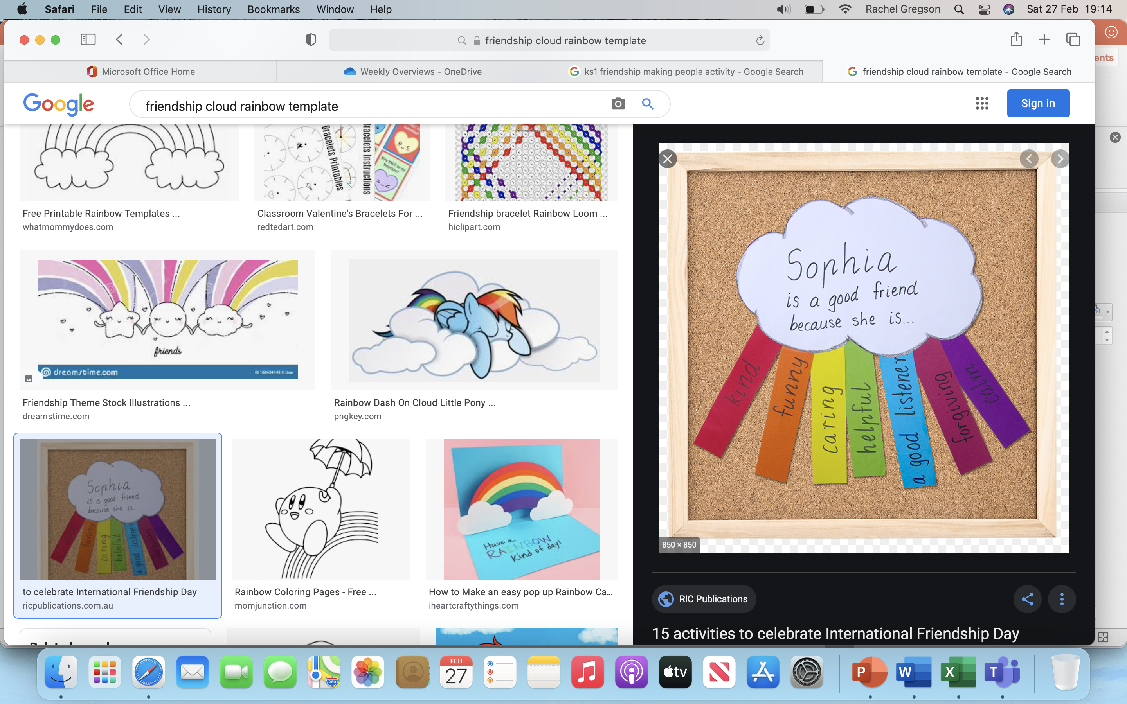
Activity 3
Make your own kindness cloud.

