Slide 1
El tiempo
The weather

Slide 2
El tiempo
For the next couple of weeks, we are going to look at words and phrases that describe the weather.
¿Qué tiempo hace?
What's the weather doing?
The word 'hace' is pronounced 'athay', we don't pronounce the 'h' in Spanish.

Slide 3
El tiempo
This week, I want you to look through the slides and see if you can remember some of the words for the different types of weather. This video might help you with some of the pronunciation.
https://www.youtube.com/watch?v=g7mXGT-KkC8
The activity today is to draw a picture in each of the boxes to show what the weather is.

Slide 4

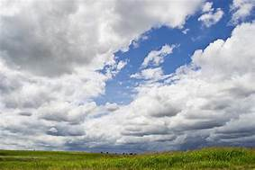
It is sunny
Hace sol
It is cloudy
Está nublado

Slide 5
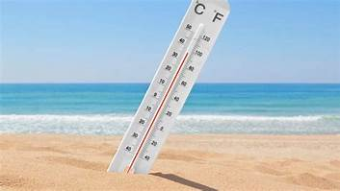
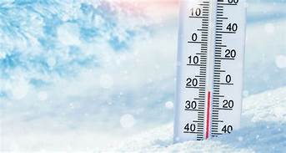
It is warm
Hace calor
It is cold
Hace frío

Slide 6
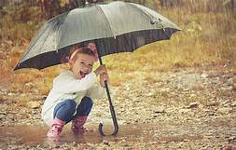
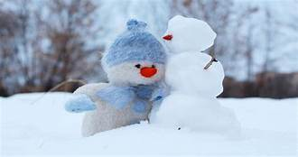
It is raining
Está lloviendo
It is snowing
Está nevando

Slide 7
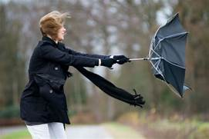
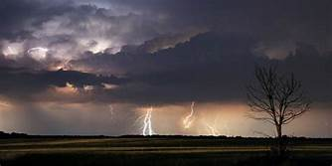
It is windy
Hace viento
It is stormy
Hay tormenta

