Slide 1
El tiempo
The weather

Slide 2
El tiempo
For the next couple of weeks, we are going to look at words and phrases that describe the weather.
¿Qué tiempo hace?
What's the weather doing?
The word 'hace' is pronounced 'athay', we don't pronounce the 'h' in Spanish.

Slide 3
El tiempo y las estaciones
This week, we are going to recap the weather phrases and learn vocabulary for the seasons. Watch the video about the seasons.
https://www.youtube.com/watch?v=U7W5oKx6g2I
The activity today is to draw the trees as they would look in each season and to write a weather phrase underneath to go with that season.

Slide 4

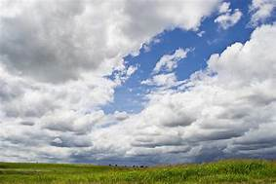
It is sunny
Hace sol
It is cloudy
Está nublado

Slide 5
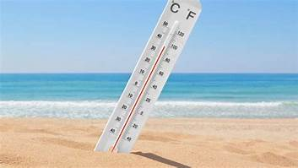
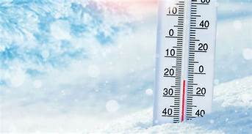
It is warm
Hace calor
It is cold
Hace frío

Slide 6
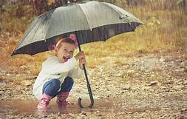
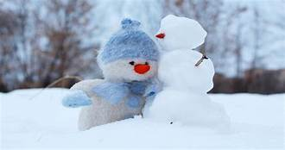
It is raining
Está lloviendo
It is snowing
Está nevando

Slide 7
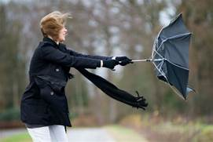
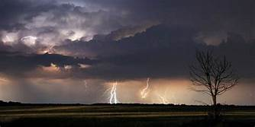
It is windy
Hace viento
It is stormy
Hay tormenta

Slide 8
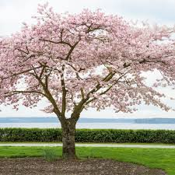
La estación - season
La primavera
Spring
Hace sol
Está nublado

Slide 9
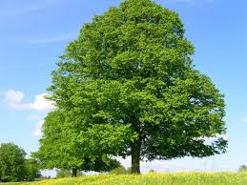
El verano
Summer
Hace sol
Hace calor

Slide 10
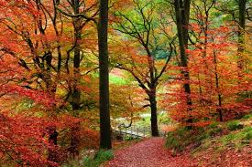
El otoño
Autumn
Hace viento
Está lloviendo

Slide 11
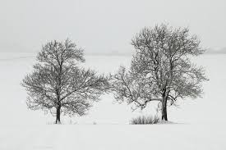
El invierno
Winter
Hace frío
Está nevando

