Slide 1
Year 2 Maths Revision
LC: Can you subtract two 2-digit numbers (crossing 10)?

Slide 2
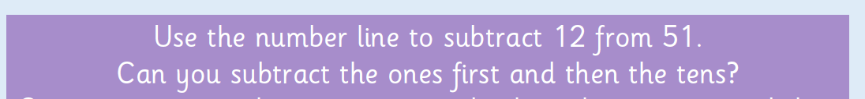
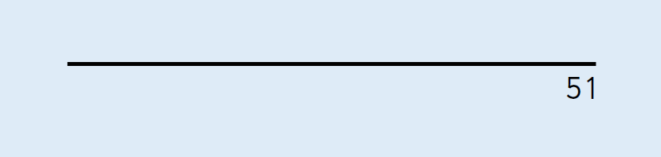
Let’s learn:

Slide 3
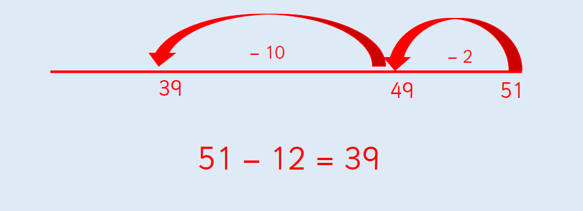

Slide 4

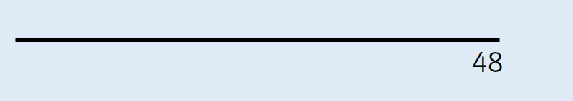
On paper/whiteboard, draw a number line to solve:

Slide 5
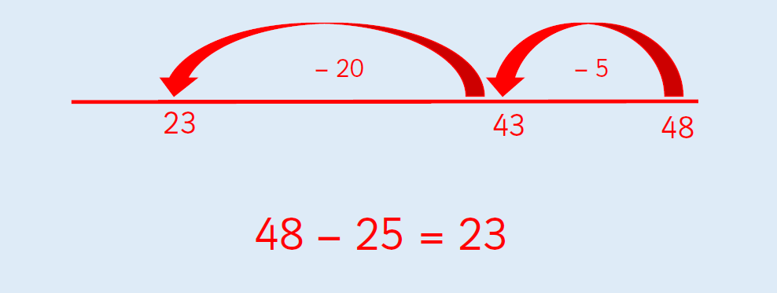

Slide 6

Now let’s see how partitioning numbers helps us to solve:
What do you notice about the 1s?

Slide 7
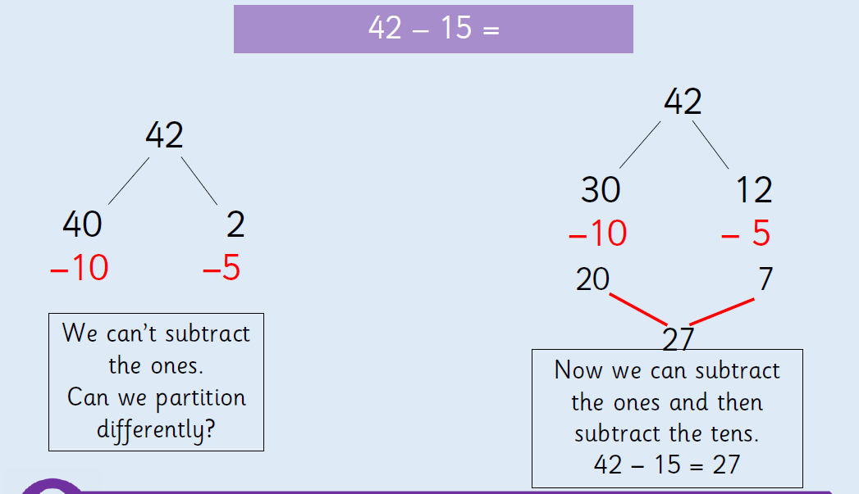

Slide 8

On paper/whiteboards, use partitioning to solve:

Slide 9
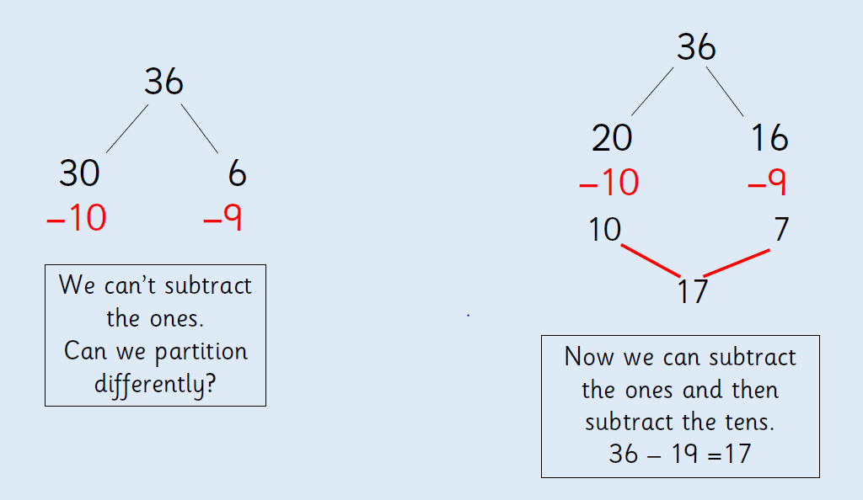

Slide 10

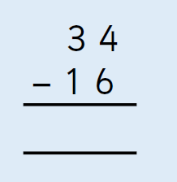
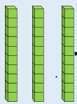

Now let’s look at column subtraction and show it with base 10:
Can we take away 6 ones from 4 ones?

Slide 11
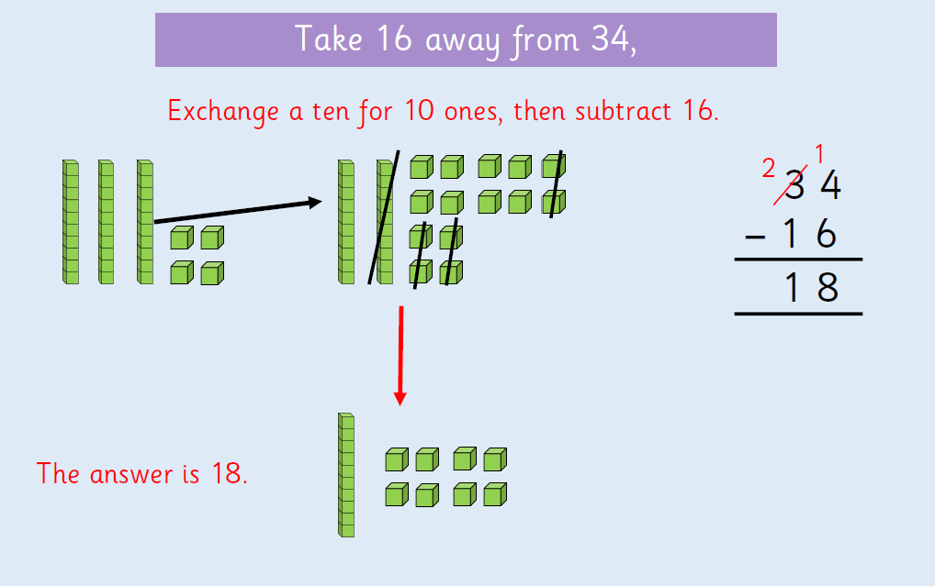

Slide 12

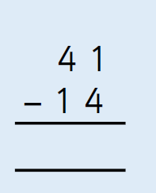
On paper/whiteboards show how to solve:

Slide 13
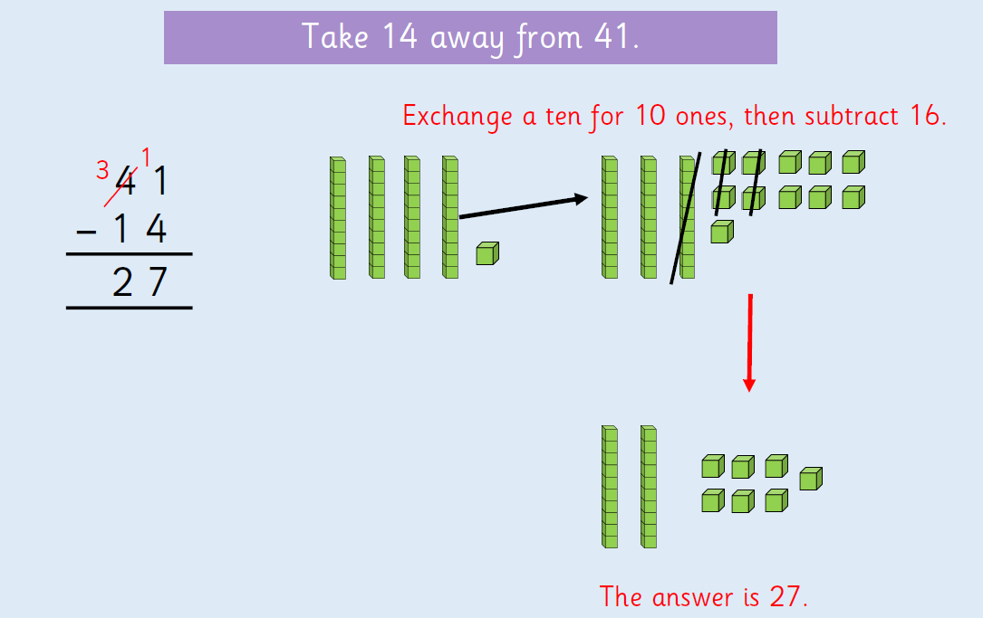

Slide 14
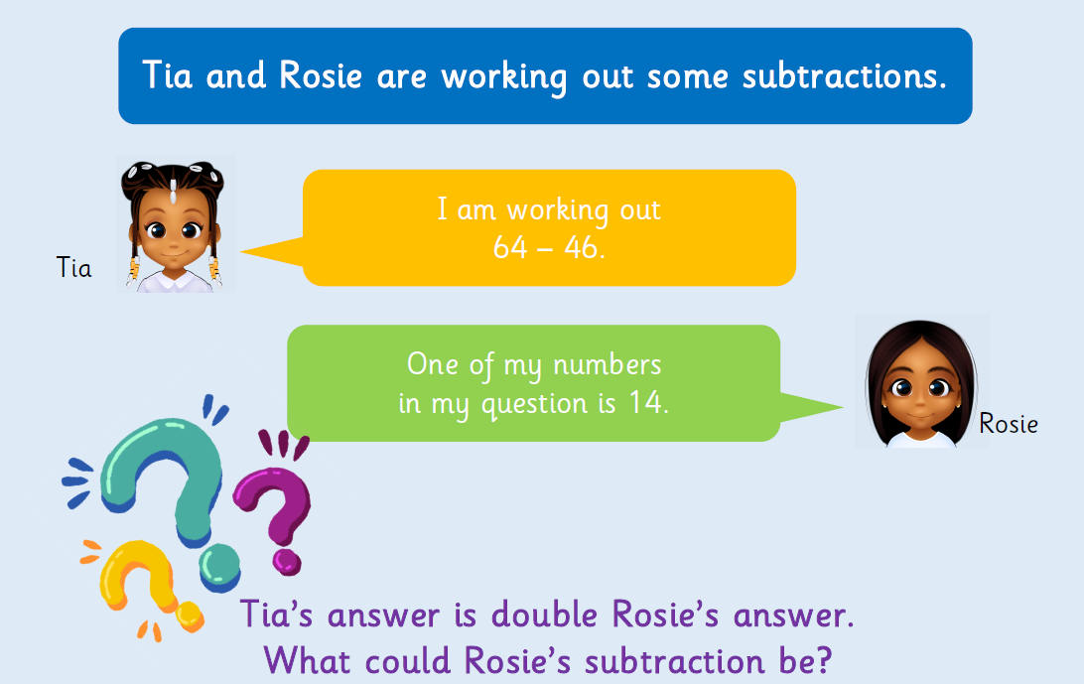
Problem solving:

Slide 15
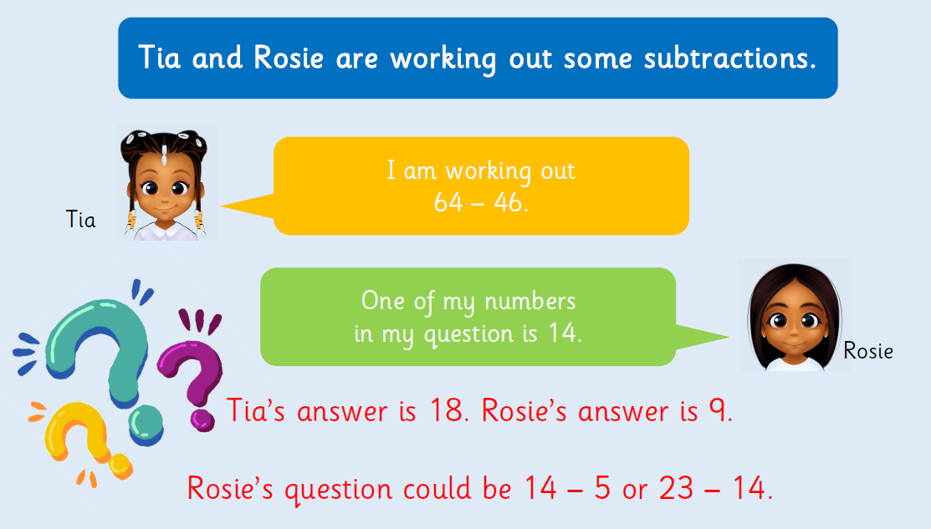

Slide 16
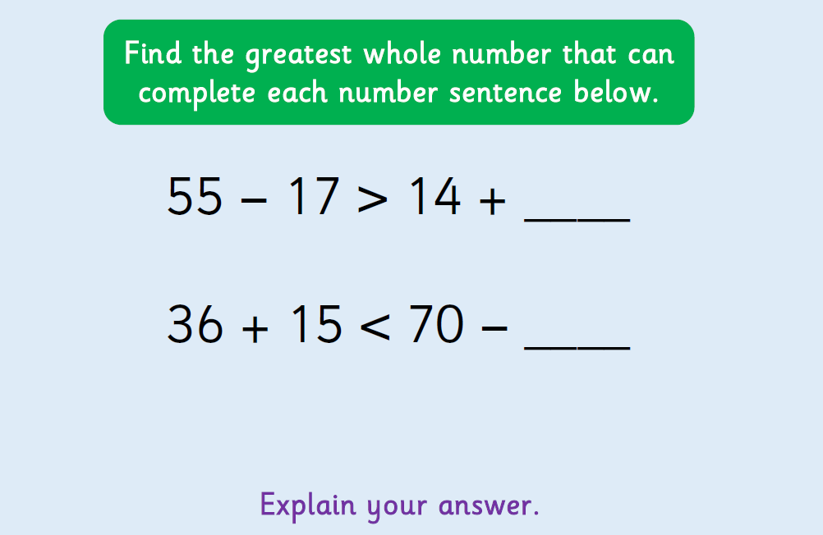

Slide 17


