Slide 1
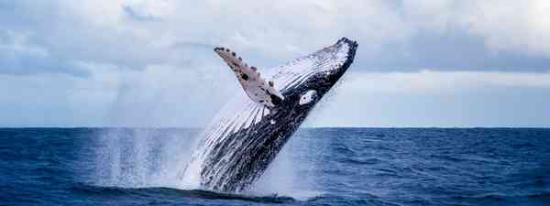
ENGLISH

Slide 2
This week, our focus continues to be non-fiction
Lesson 1
We are going to be writing a report.
Last week, we spent a lot of time researching our topic 'Whales'. We gathered a lot of information via note-taking.
You can't write a good quality, informative report about a topic we don't know lots about.

Slide 3
All about Whales
Lesson 1

Slide 4
-a short report all about whales
-a short report all about a specific type of whale
-a non-chronological report, with subheadings and paragraphs, about a variety of whales or key features about a specific whale e.g habitat, diet.
Lesson 1
Over the next couple of days, you are going to write an information report about whales (non-fiction).
You might write:
Your teacher will discuss this on Teams with you and help you to decide.

Slide 5

Why do we read and write reports?
Lesson 1
Let's recap:
Reports organise and store information.
We read them to find out information.
We write them to give information to others.
A non-chronological reports means that information does not need to be organised in a special order.

Slide 6

Why did I need to plan my report before I started to write it?
Lesson 1
Let's recap:
To help me plan and organise my ideas and information I have researched or collected.
To organise the information into subject areas using sub-headings so that it is easier for the reader to follow.
To organise what I will include in each section to help make my writing clearer.

Slide 7
As you should have discussed in your Teams meeting, there are 2 different Learning Challenges for you to choose from.
They are very similar – the difference is more in the outcome and Success Criteria expectation which will be explained in the next slides.
Lesson 1
LC Can you write a non-fiction report? (about whales)
LC Can you write a non-chronological report? (about whales)

Slide 8
Lesson 1
Expectations for:
LC Can you write a non-fiction report? (about whales)
Success Criteria:
- Statement sentences (clear, key facts about whales)
- ToolKit (especially focus on capital letters, full stops and conjunctions)
This is the task most likely to be chosen by Year 1.
For this task, you will write 'statement sentence' after 'statement sentence' in one big paragraph all about whales ( or your chosen species of whales).
You might choose to use the whale shaped sheet provided.
It is still a good idea to keep your sentences about the same theme e.g. size, food, actions, together in adjoining sentences.

Slide 9
Lesson 1
Expectations for:
LC Can you write a non-chronological report? (about whales)
Success Criteria:
- Statement sentences (clear, key facts about a whale).
- ToolKit (especially focus on capital letters, full stops and conjunctions).
- Sub-headings (with key information sorted into categories).
- An introduction and a conclusion paragraph.
This is the task most likely to be chosen by Year 2.
For this task, you will also write 'statement sentences' but this should be arranged in short paragraphs linked to a different focus.
Each of your paragraphs will need a sub-heading to say what the focus is.
Sometimes people choose to make the sub-heading a question and then the paragraph of information answers
the question.
A non-chronological report would usually also have an opening/introduction paragraph and a conclusion.
You would find it tricky to arrange a non-chronological report into the whale shape sheet so lined paper is a better option.

Slide 10
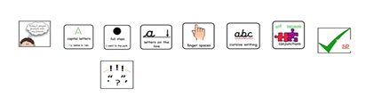
The ToolKit is an important
part for either option of writing.
A Reminder:
Think about the sentence you intended to write. Say it in your head (or out-loud if that helps you.) Does it make sense? Write it down and then read it back to yourself to check is still makes sense.
Have you remembered to use capital letters – at the start of a sentence, for names/places etc?
Have you clearly marked the ending of a sentence with a full stop? Have you then followed it with a capital letter? When you have written a few sentences, read them and check you are taking a pause/breath in the correct places.
Have you used other punctuation?
  In this piece of writing, you may want to use a question mark for 'Did you know..?' type sentences and for sub-headings.
  You may choose to use some exclamation marks for the really amazing 'wow' facts.
  Apostrophes could be used for contractions (is not – isn't ) and possession ( the whale's tail – the tail belonging to the whale).
  You are unlikely to need speech marks as this is not a story with characters speaking.

Slide 11
ToolKit continued...
Handwriting – Are your letters cursive? Are your letters sitting on the line? Are they joined (fully if you are ready/ Year 2) or having a go at the digraphs and trigraphs you have learnt for Year 1. ​
Think carefully about the size of each letter and also the use and size of your finger spaces. We use the term 'finger space' but we often refer to fitting a letter 'o' between words so that the space corresponds with the size of your letters.
Conjunctions – to expand your information sentences and to provide some reasons e.g. so that, because, until.​
Spelling Check – sound-out, proof-read to check and refer back to your sources of information and notes for tricky 'whale related' vocabulary.​
​

Slide 12
Make your writing exciting.
Try to add a little variety to your sentence structure and openers.
Avoid overuse of: A whale is... A whale can... A whale has...
Did you know.... ?
It may come as a surprise to you that ...
Not many people know that...
Something unusal about the.... is...
Another interesting fact is ...

Slide 13
Today's Task: Let's get writing!
By now you should have chosen which L.C. you will complete.
Therefore, you should have decided which paper to use.
Don't forget to have your notes out in front of you at all times. You may choose to highlight or tick off the different facts as you include them.
For those opting to do the non-chronological report with sub-headings, there are some sample non-chronological reports on different topics you may wish to look at first.
There is also an optional checklist which could support you today, in your writing, and tomorrow when you self-assess and edit.

Slide 14
ENGLISH

