Slide 1


All about Plants
LC: Can you identify and describe garden plants?

Slide 2
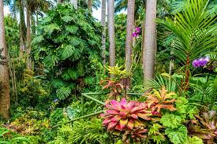
Last week, we began our new topic about plants. What did we learn?
Plants are living things. Can you remember what living things do?
We found out that plants provide habitats and food for other living things.
We also learnt that plants can be found all over the world.
Plants can look very different, but they all share a common structure.

Slide 3
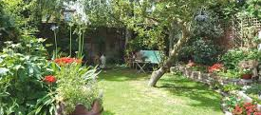
Today, we will be learning about plants found in gardens.

Slide 4
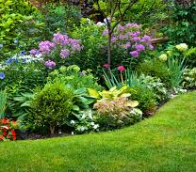
Gardens
Gardens are places where people can grow plants.
Some people grow plants because they are nice to look at.
Some people like to grow plants which they can eat.
Do you have a garden?
Do you know any names of plants which grow in your garden?

Slide 5
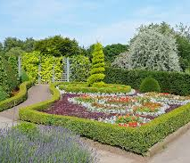
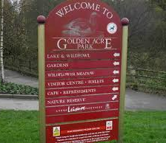
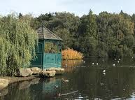
A park is a public garden which we can all enjoy!

Slide 6
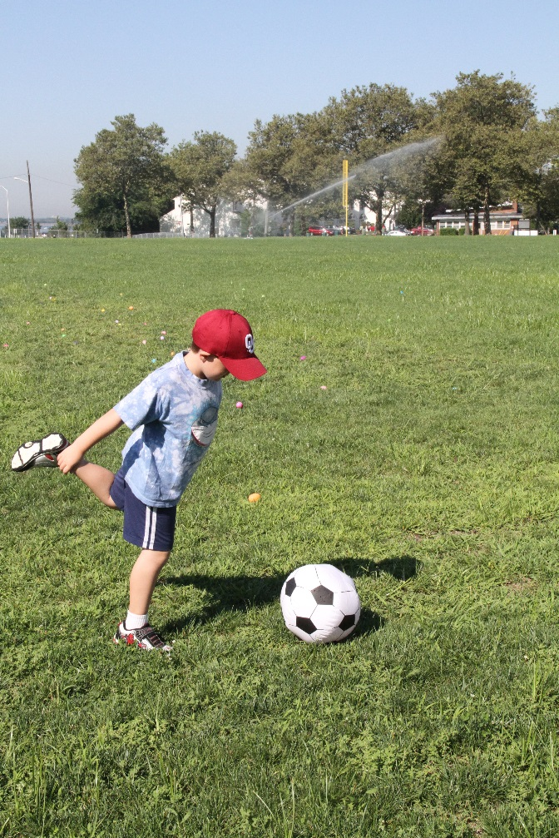
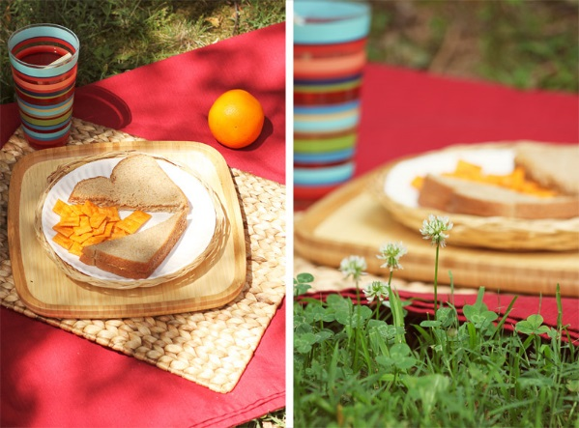
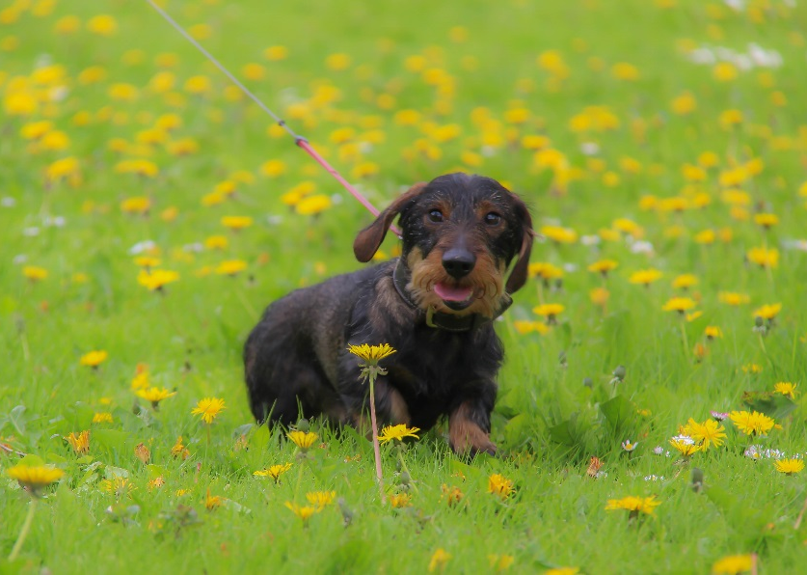
What plants can be found in our gardens? Grass.
Grass is a special kind of plant that looks good and is comfortable to walk on and sit on.
You can play games on the grass.
You can have a picnic on the grass.
You can go for a walk on the grass.
https://www.bbc.co.uk/bitesize/clips/zn89wmn

Slide 7
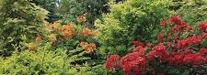
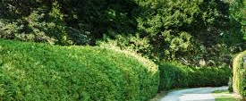
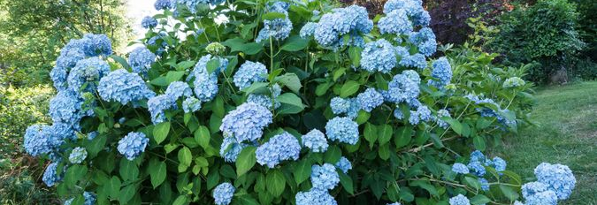
What plants can be found in our gardens? Shrubs.
A shrub or a bush is a category of plant.
Unlike trees which have one stem (trunk) which grows from the ground, shrubs have many woody stems which grow from the ground.
Shrubs do not grow as tall as trees.
A garden area which is planted with many shrubs is called a shrubbery.
Shrubs also are used to make hedges.

Slide 8
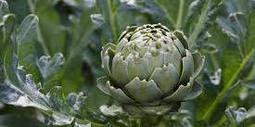
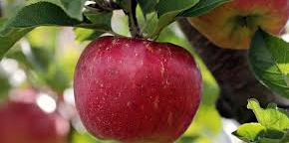
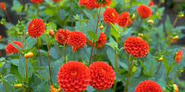
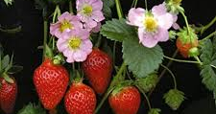
What plants can be found in our gardens? Perennial plants.
A perennial is a plant that grows leaves and perhaps flowers every year.
Most trees and shrubs are perennial plants.
Many fruit plants are perennial: apple and pear trees, raspberries and blackberries.
Some vegetable plants are also perennial plants, especially in warmer places: asparagus, artichokes and chives are some examples.

Slide 9
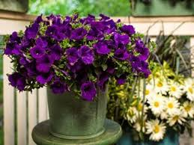
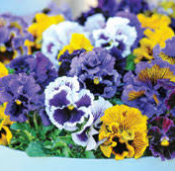
What plants can be found in our gardens? Annual plants.
An annual plant is one which starts to grow from a seed, flowers and dies within the same year.
In gardening, an annual often refers to a plant grown outdoors in the spring and summer and surviving just for one growing season.
Annuals are often used in gardens to provide colour, as they tend to have a longer season of bloom than perennials.

Slide 10
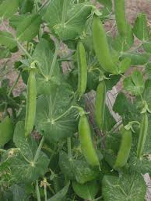
What plants can be found in our gardens? Annual Plants.
Many food plants are annual plants.
Grains such as wheat, barley, oats and rice are all annual plants. These are usually grown by farmers.
In our gardens we can plant annual vegetables such as lettuce, peas, beans and corn.

Slide 11
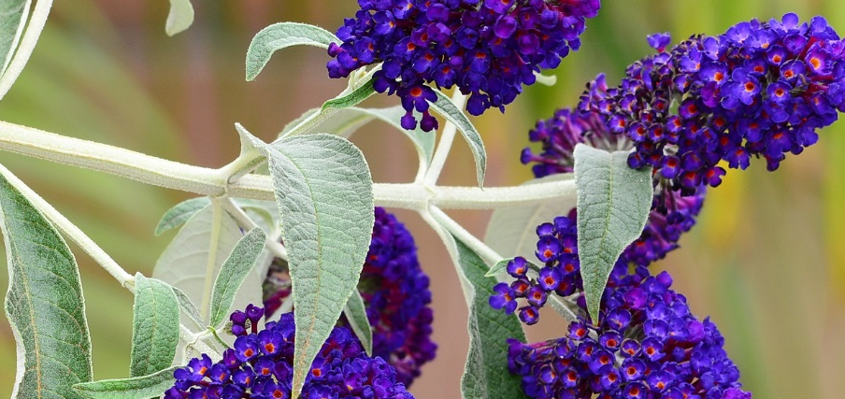
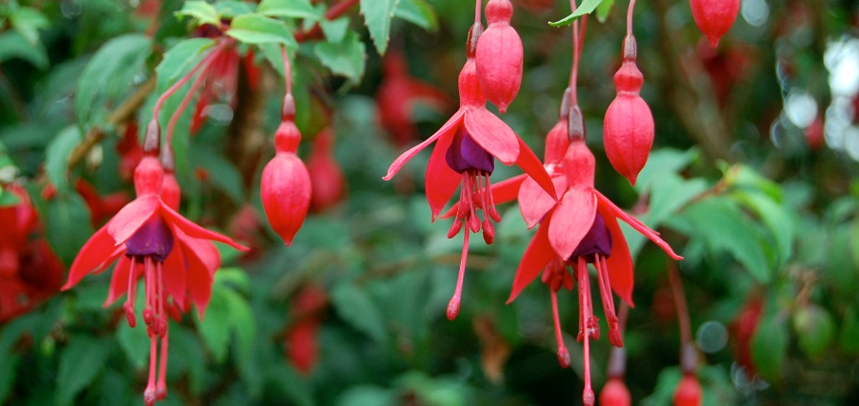
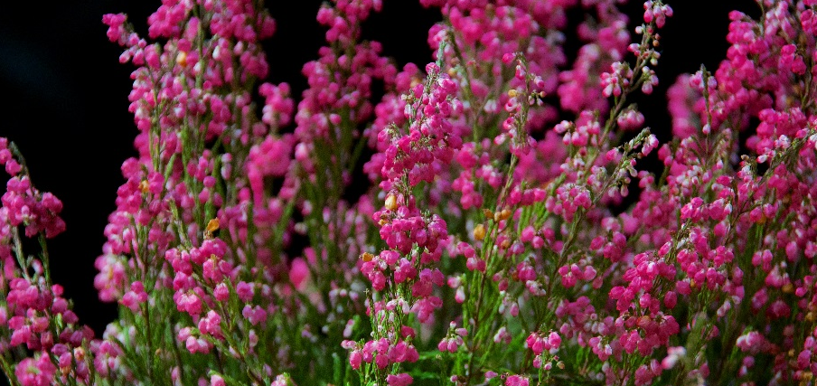
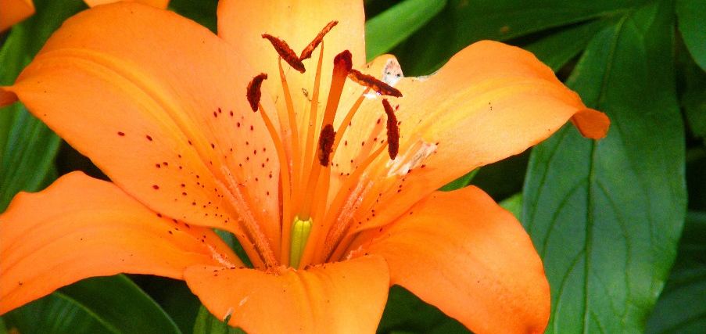
Here are some examples of garden plants. Do you recognise any of them?
Buddleia
Fuschia
Heather
Lily

Slide 12
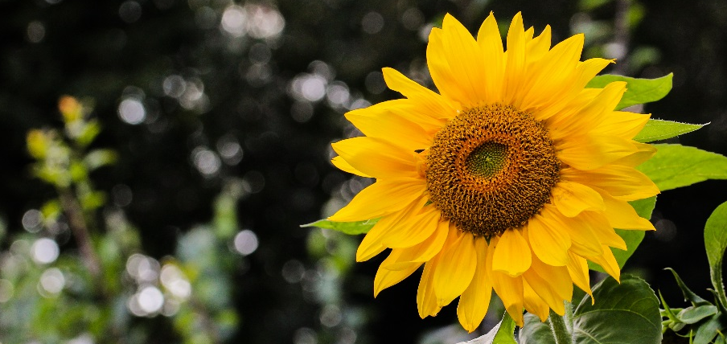
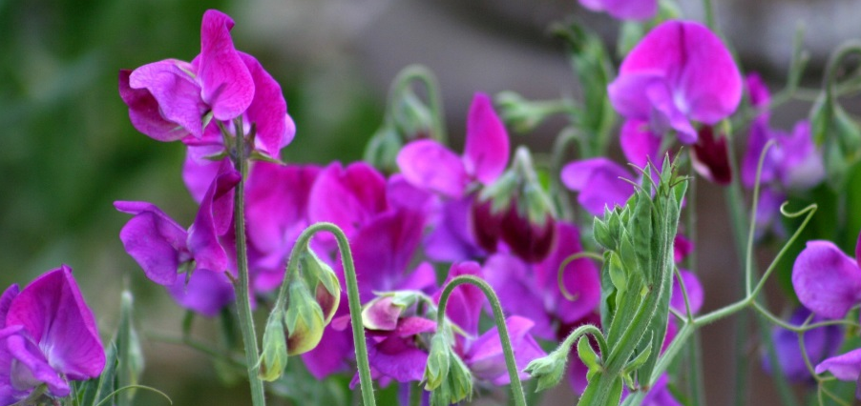
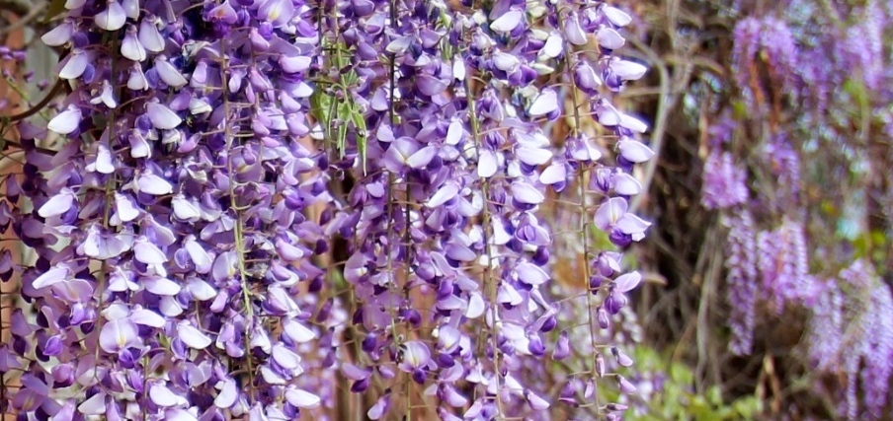
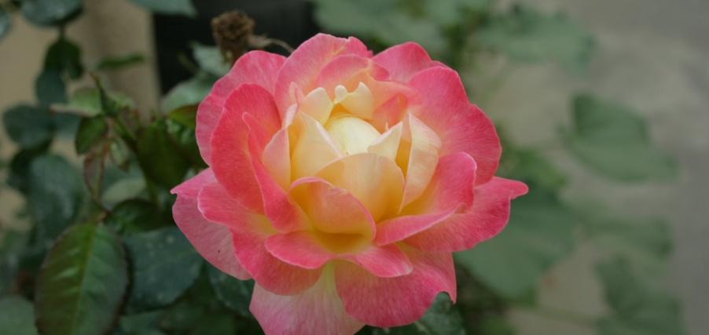
Here are some examples of garden plants. Do you recognise any of them?
Sunflower
Sweet Peas
Wisteria
Rose

Slide 13
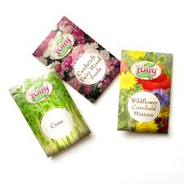
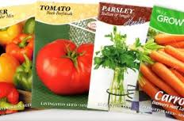
Growing garden plants.
In the next few weeks, why not try planting some seeds in your garden.
Courgettes, carrots, beans and tomatoes are good vegetables to try.
Sunflowers, daisies, sweet peas and marigolds are great flowers to grow.

Slide 14
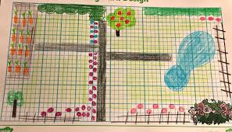
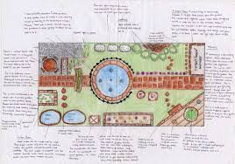
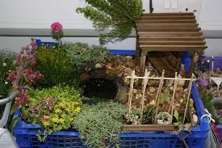
Activity: Can you design a garden or draw your own garden?
Label the areas, name some of the plants and consider paths and hedges.
Or, you could make a model!! Make sure to list some of the plants you include.

