Slide 1
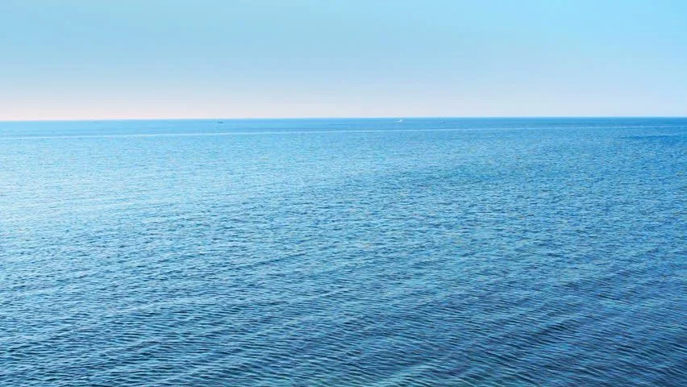
Today we will be looking at the digraph 'ea'
sea

Slide 2
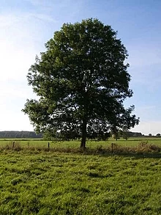
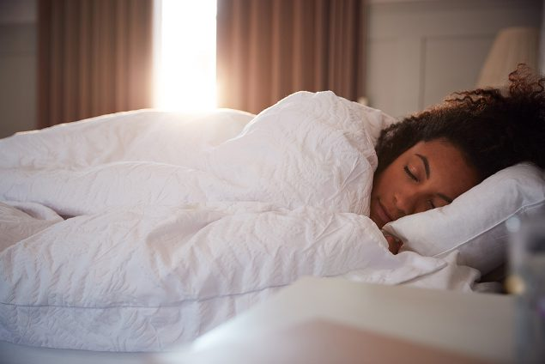
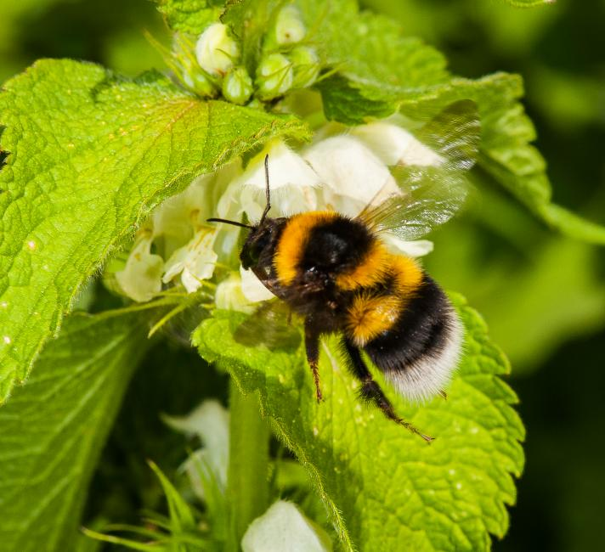
We have already learnt about the 'ee' digraph which makes the same sound
bee
sleep
tree

Slide 3
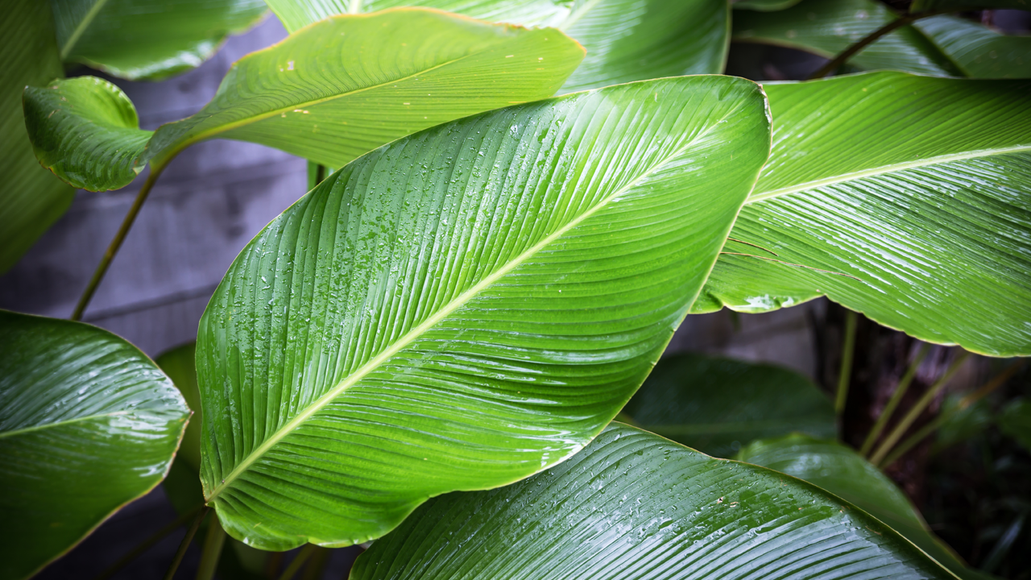
Today we are focussing on:
‘ea'
​
leaf
Start today’s learning by watching this teaching video:
https://www.youtube.com/watch?v=bLr4TXq58jw

Slide 4
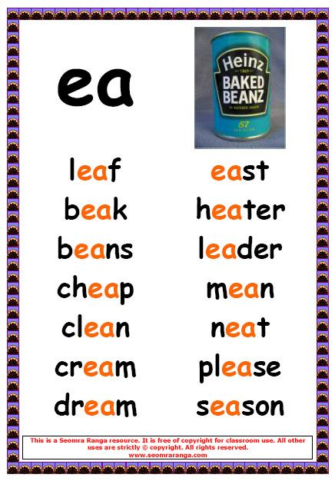
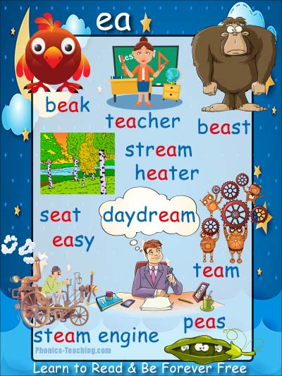

Slide 5
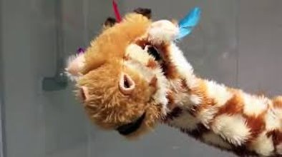
Here's a fun video you may enjoy to help you to learn the ‘ea' sound
Geraldine Giraffe:
https://www.youtube.com/watch?v=L6F4KRdhqak

Slide 6
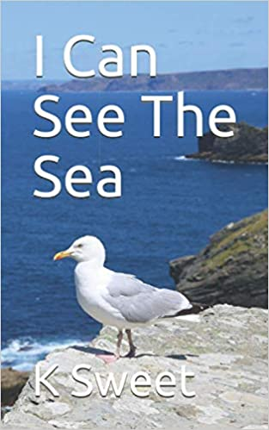
ee and ea comparison
https://www.youtube.com/watch?v=3PJGqbCeRU4

Slide 7
Have a go at reading these ‘ea’ words.
Can you identify where the different sounds are to help you to sound out?
ea
The different colours on the next slides help to show the different sounds (and where you would put sound buttons).

Slide 8
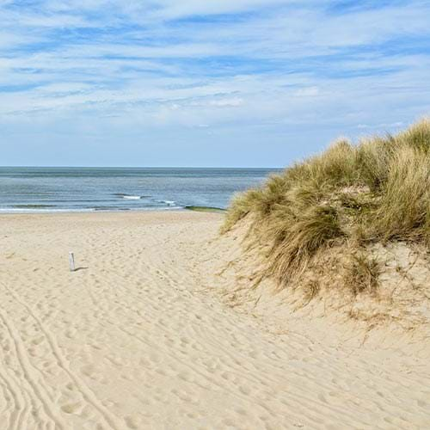
beach

Slide 9
beach

Slide 10
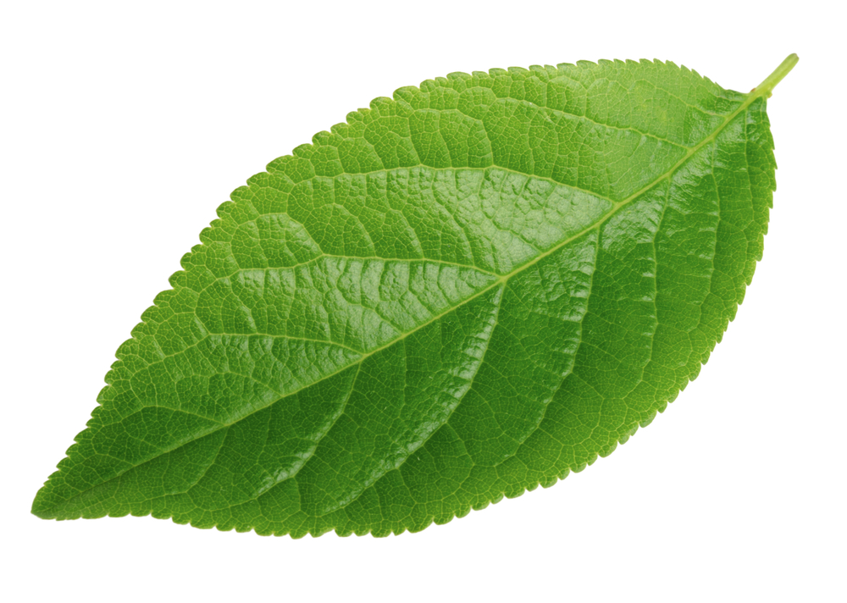
leaf

Slide 11
leaf

Slide 12
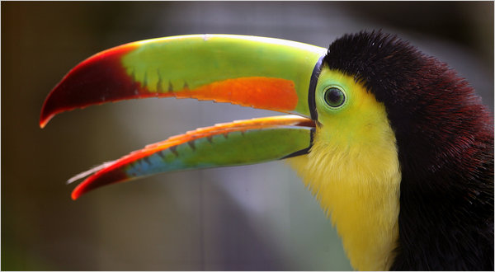
beak

Slide 13
beak

Slide 14
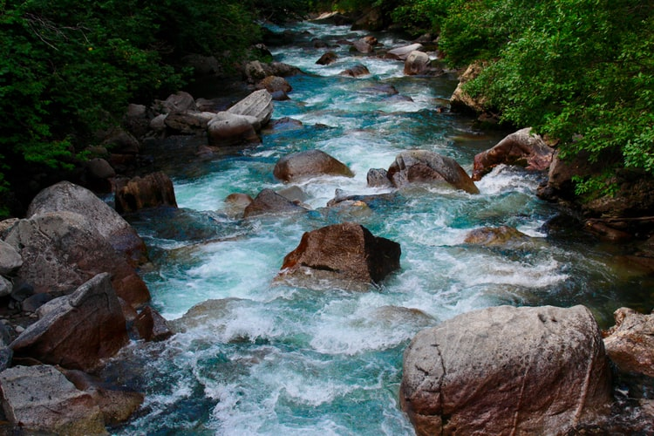
stream

Slide 15
stream

Slide 16

dream

Slide 17
dream

Slide 18
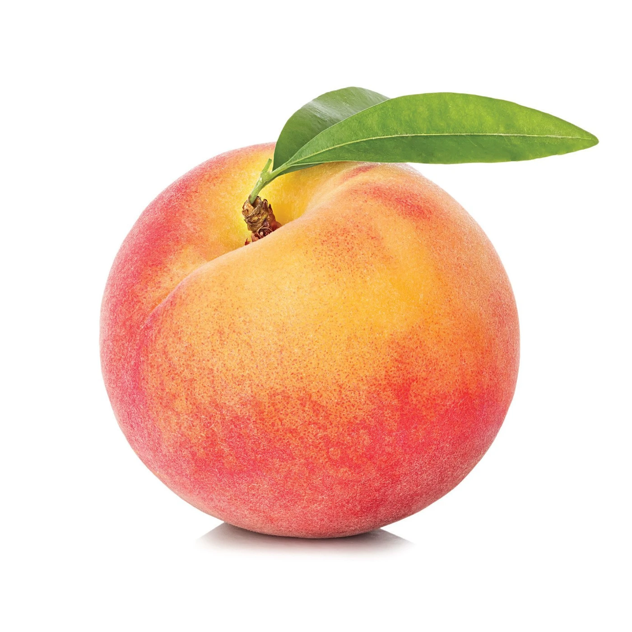
peach

Slide 19
peach

Slide 20
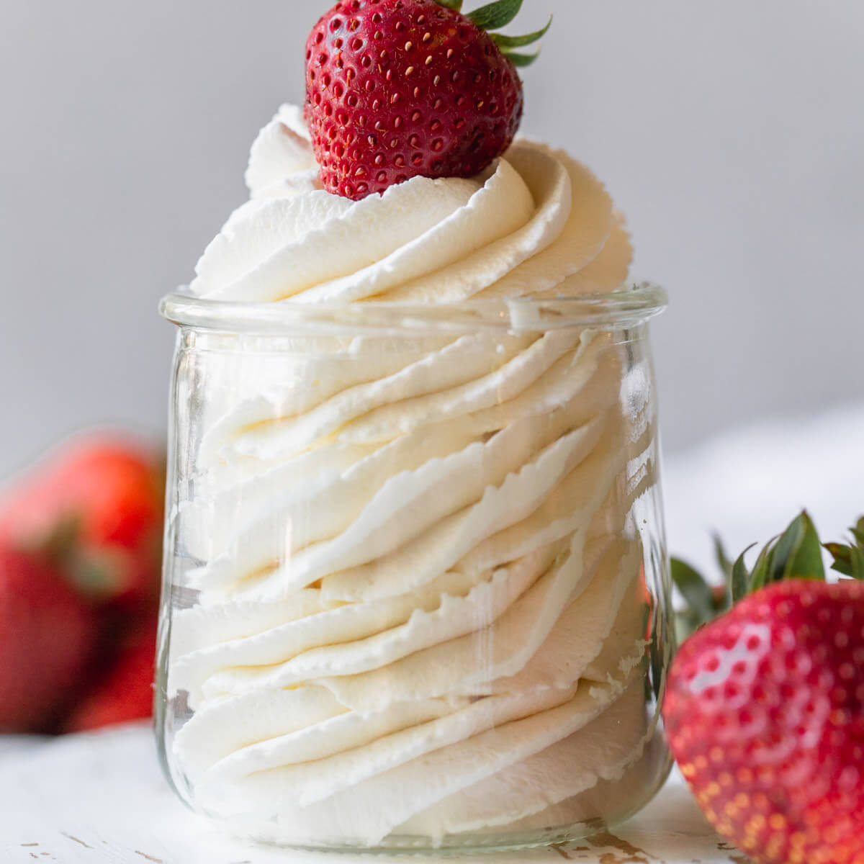
cream

Slide 21
cream

Slide 22
Now have a go at spelling these words.
Remember to really ‘sound out’ each sound
Remember cursive letter formations
Think about your pencil grip
Have a try at joining the digraph ‘ea’

Slide 23
Can you spell this word?

Slide 24
beach

Slide 25
Can you spell this word?

Slide 26
leaf

Slide 27
Can you spell this word?

Slide 28
beak

Slide 29
Can you spell this word?

Slide 30
stream

Slide 31
Can you spell this word?

Slide 32
dream

Slide 33
Can you spell this word?

Slide 34
peach

Slide 35
Can you spell this word?

Slide 36
cream

Slide 37
Tasks...
Select from:
Practise writing the words using neat, cursive writing. Have you joined the digraph ‘ea'?
Can you apply these words in a sentences?
Can you add sound buttons to the words?
Have you completed the activities in the folder?
Can you find items around your house that match the sound just like Geraldine Giraffe does?

