Slide 1
Year 2 Maths Revision
LC: Can you subtract two 2-digit numbers? (Not crossing 10)

Slide 2
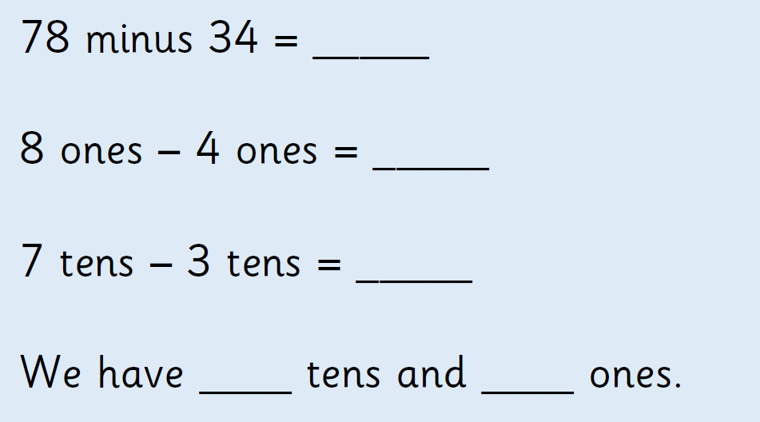
Remember, when we are doing a calculation with 2-digit numbers, we add/subtract the ones first, then the tens.

Slide 3
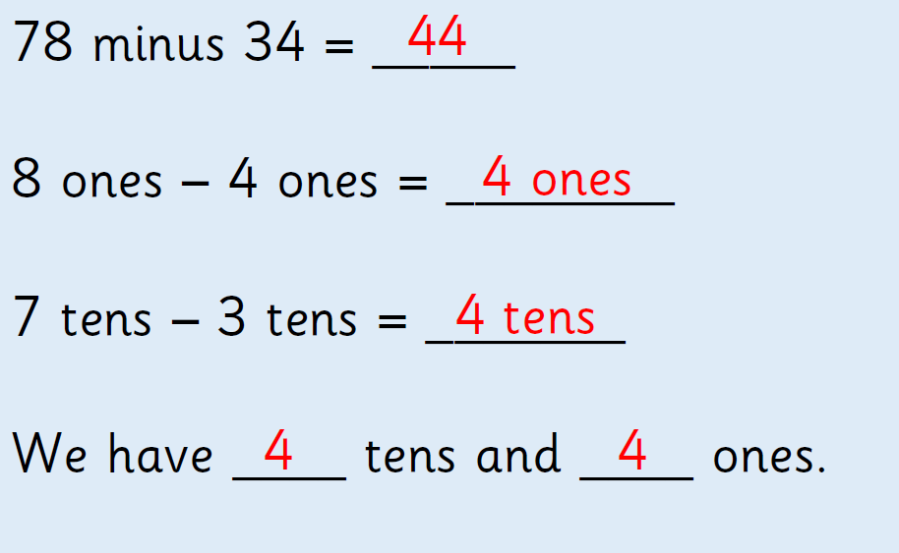

Slide 4
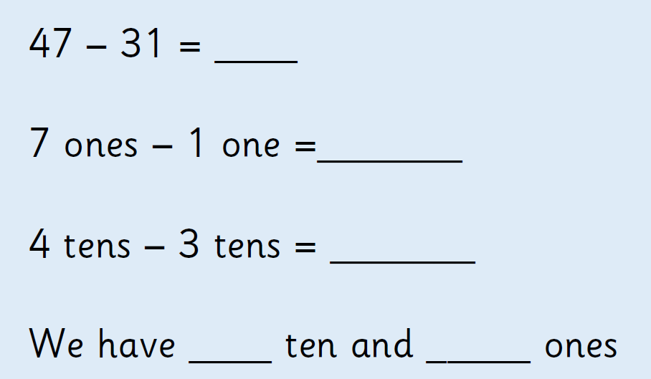
On paper/whiteboards, try to solve:

Slide 5
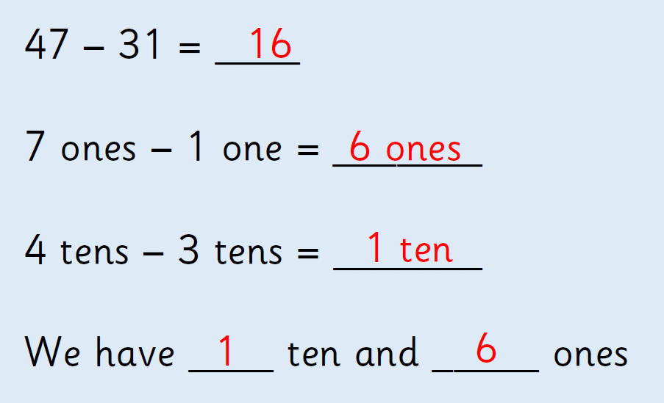

Slide 6
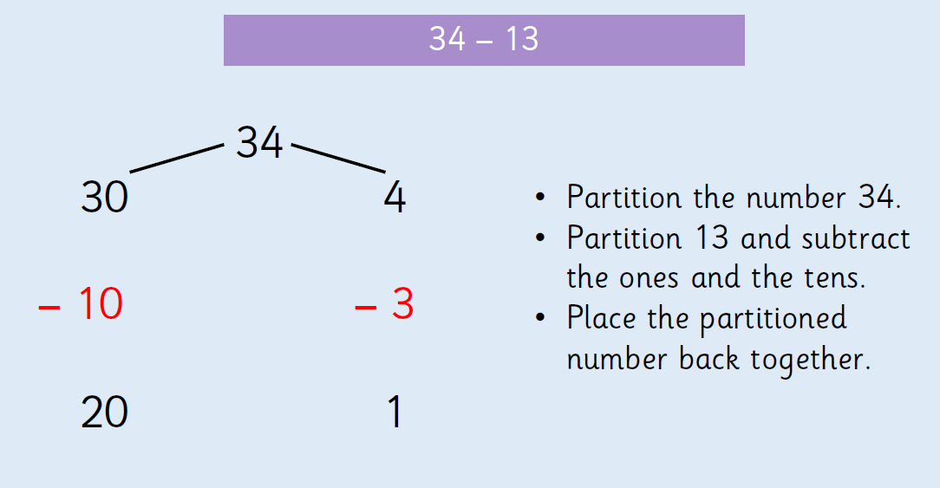
We can also use partitioning of the numbers to help to solve:

Slide 7
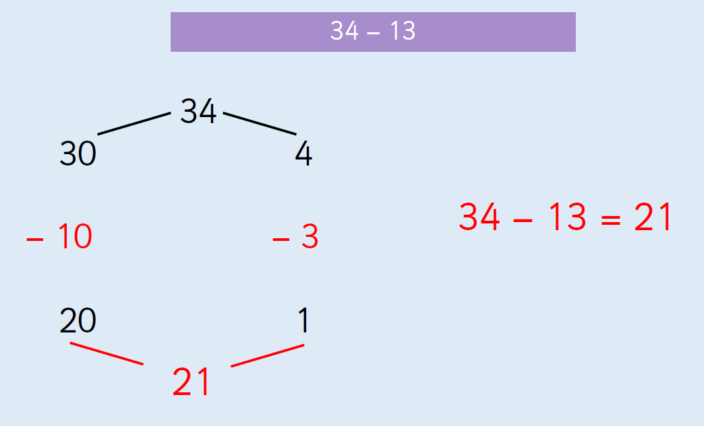

Slide 8

On paper/whiteboard use partitioning to solve:

Slide 9
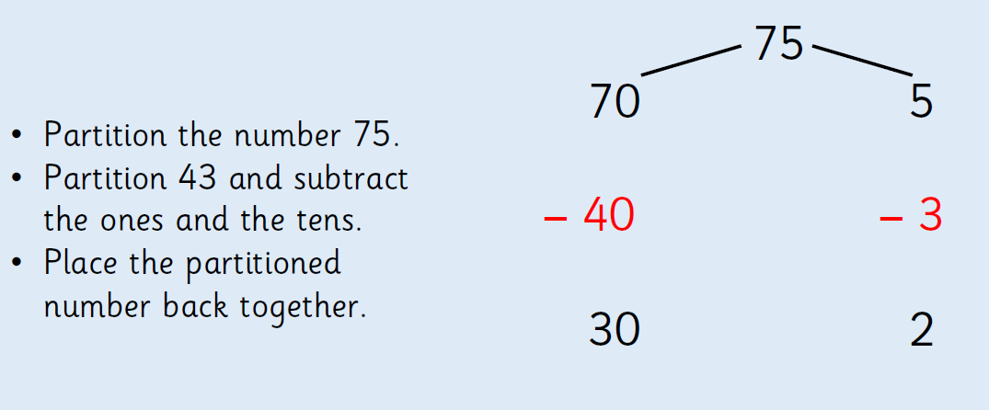

Slide 10
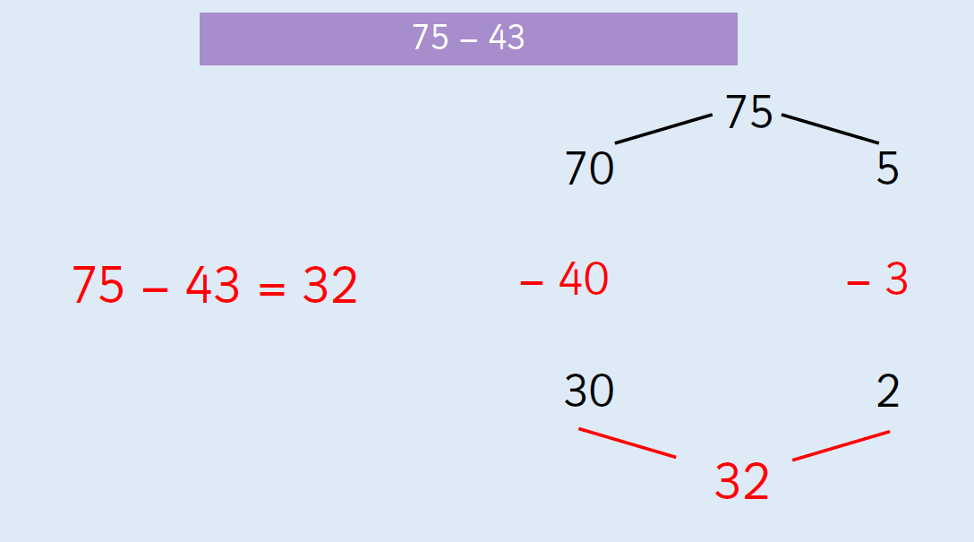

Slide 11
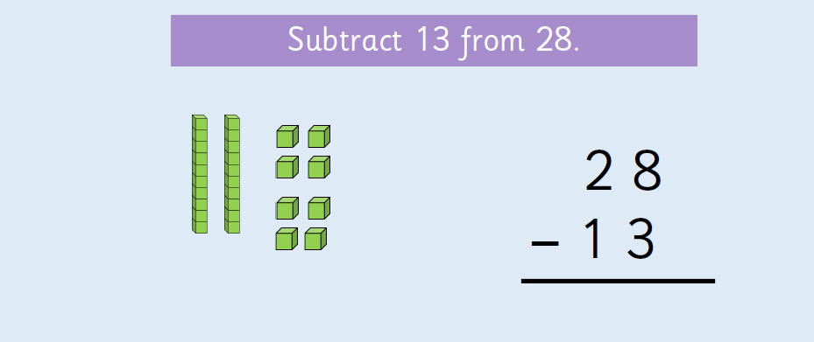
We can also use base 10 or draw sticks (10s) and dots (1s):

Slide 12

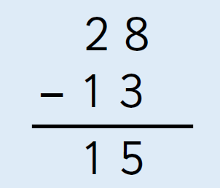
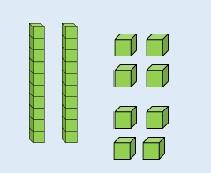
Cross out the 1s, cross out the 10s.

Slide 13

On paper/whiteboards, solve the following by drawing sticks and dots and writing the column subtraction:

Slide 14
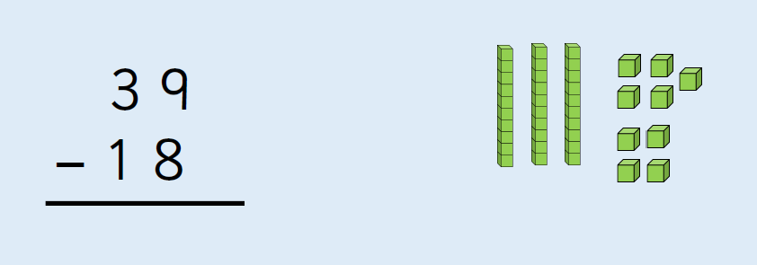
2 1

Slide 15
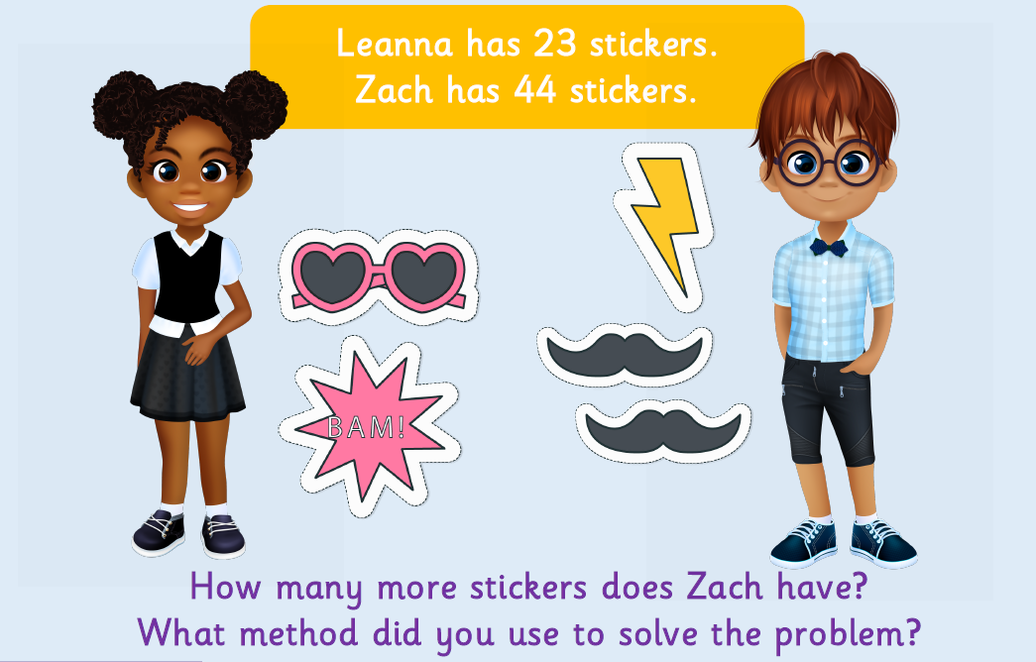
On paper/whiteboards solve:

Slide 16
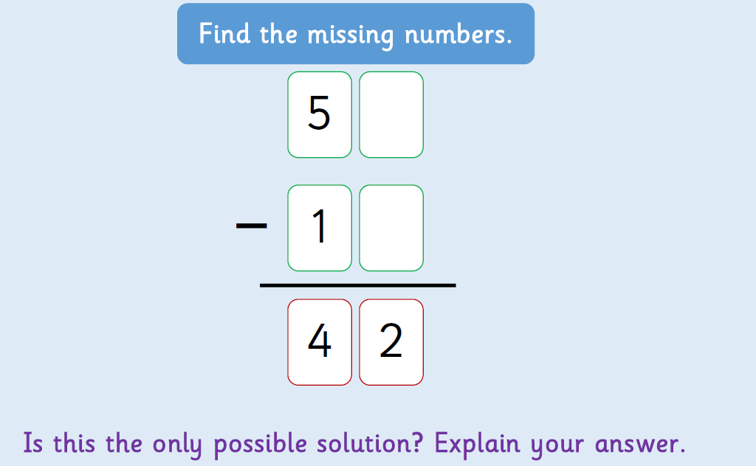
On paper/whiteboards solve:

Slide 17


