Slide 1
Today we are learning to add ‘er’ and ‘est’ to adjectives.
https://www.youtube.com/watch?v=2fQb7_KUs3A&feature=emb_title

Slide 2
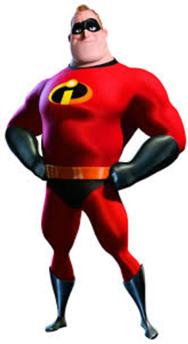
What has changed about this adjective?
Small
Smaller
Smallest

Slide 3
We add ‘er’ and ‘est to adjectives to help make them even better!
bright
brighter
brightest
strong
stronger
strongest
taller
tallest
tall

Slide 4
How can these adjectives be changed to make them even better?
high
small
slow

Slide 5
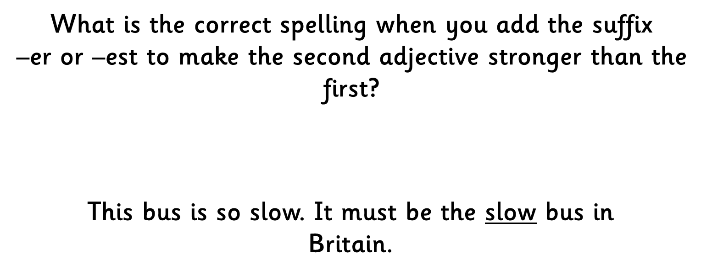
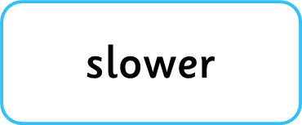


Slide 6
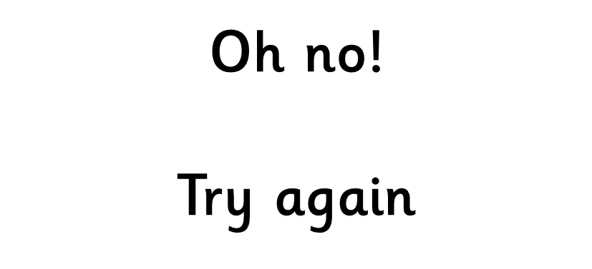

Slide 7
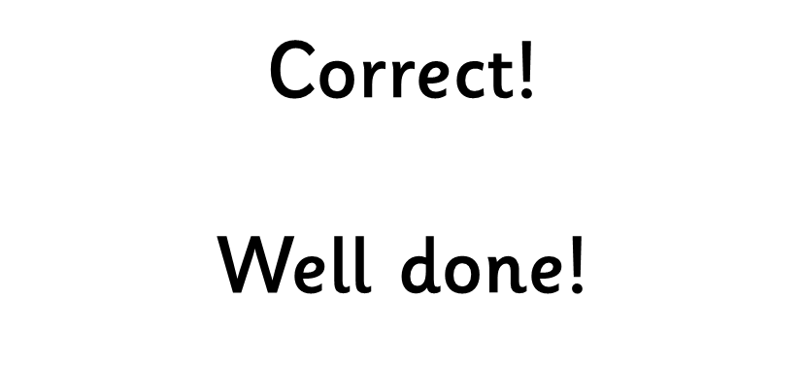

Slide 8
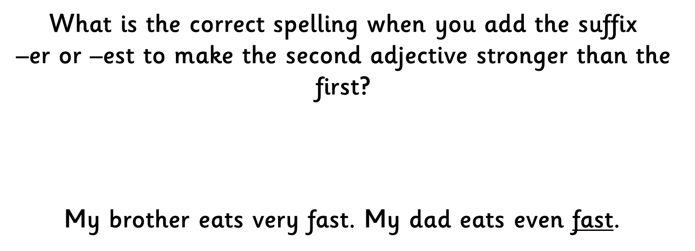



Slide 11
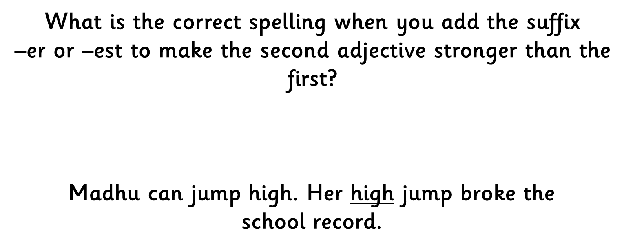



Slide 14
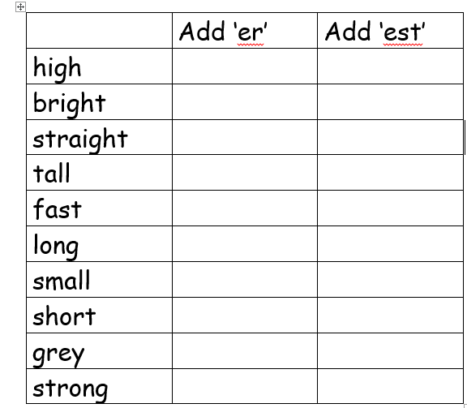
Complete the table by adding ‘er’ and ‘est’ to adjectives.

