Slide 1

Week 2 – Lesson 6

Slide 2
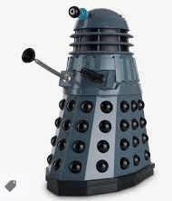
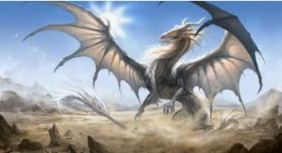
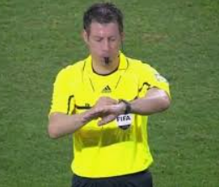
SPAG Warm up
Can you add fronted adverbials of manner (how the action is taking place?)
The Daleks emerged.
The dragon awoke.
The final whistle blew.

Slide 3
SPAG warm up
Fronted adverbials of manner tell us how something was done.
Where would you place a comma after the fronted adverbials in these sentences:
As fast as my legs could carry me I ran from the house.
With a piercing din the wind whistled and the wolves howled.
Shivering we sheltered from the rain.
Without a moment's hesitation she replied.

Slide 4
SPAG warm up
Fronted adverbials of manner tell us how something was done.
Where would you place a comma after the fronted adverbials in these sentences:
As fast as my legs could carry me, I ran from the house.
With a piercing din, the wind whistled and the wolves howled.
Shivering, we sheltered from the rain.
Without a moment's hesitation, she replied.

Slide 5
Daily DADWAVER challenge
D is for description – sentences filled with imagery and adjectives
A is for action – detailing what is happening in a sentence
D is for dialogue – something a characters says out loud or a conversation
W is for where – indicating the location of the action (adverb of place)
A is for adverb – usually an adverb / adverbial phrase of manner
V is for verb – single word or phrase e.g Walking, / Walking across the country
E is for estimation of time e.g Momentarily, At midday, As the tide turned
R is for rhetorical question to draw in the reader, can use more than one
Simile is for simile (or metaphor) – allows the writer to ‘paint’ an image

Slide 6

DADWAVERS – 60 secs to write…
A is for adverb of manner
Eg Cautiously, he stepped around the corner.
Eg Rapidly sprinting through the undergrowth, they made their escape.

Slide 7

Let's recap the story so far
I LIVE WITH MY FAMILY IN A CITY CLOSE TO THE SEA​
Every summer we used to spend many weekends at the beach​
But we never go there anymore, because last year, our lives changed forever…

Slide 8


Let's recap the story so far
‘The war began. Every day bad things started happening around us and soon there was nothing but chaos’

Slide 9
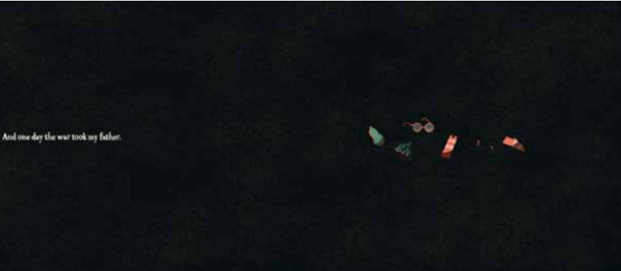
Let's recap the story so far
‘AND ONE DAY THE WAR TOOK MY FATHER’

Slide 10
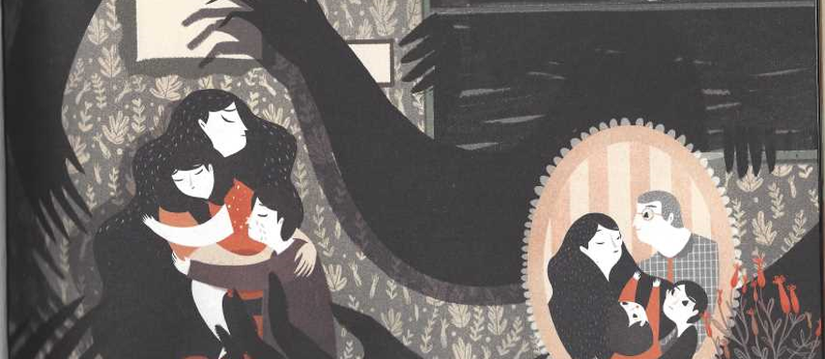
Let's recap the story so far
‘Since that day everything has become darker and my mother has ​become more and more worried.’

Slide 11
LC: Can I write a persuasive letter?
Toolkit:

Slide 12


What strikes you as interesting about this picture?
What can you see?
What choices has the author made?
Why use light colours for the mountains?
Why do you think the people are running?

Slide 13


Slide 14
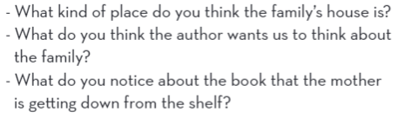

Slide 15


Slide 16

Looking at the pictures of the animals, where could the new place be?
Watch this link (watch it more than once so you can digest the detail).
Think about and make notes on the words / phrases that stand out to you?
http://www.bbc.co.uk/programmes/p0037825

Slide 17
The task today is to write a persuasive letter. You are going to write a letter from the friend to the mother to persuade her to leave the country with her family for a place of safety.
Consider all the options which are available to the mother and the challenges she faces between staying and going and offer her some advice.

Slide 18
As you are writing to a friend, your letter will be informal in style.
Remember to use persuasive techniques – such as:
Rhetorical questions
Emotive language / vocabulary
Imperative verbs
Modal verbs for example: must / will
Description (expanded noun phrases)

