Slide 1
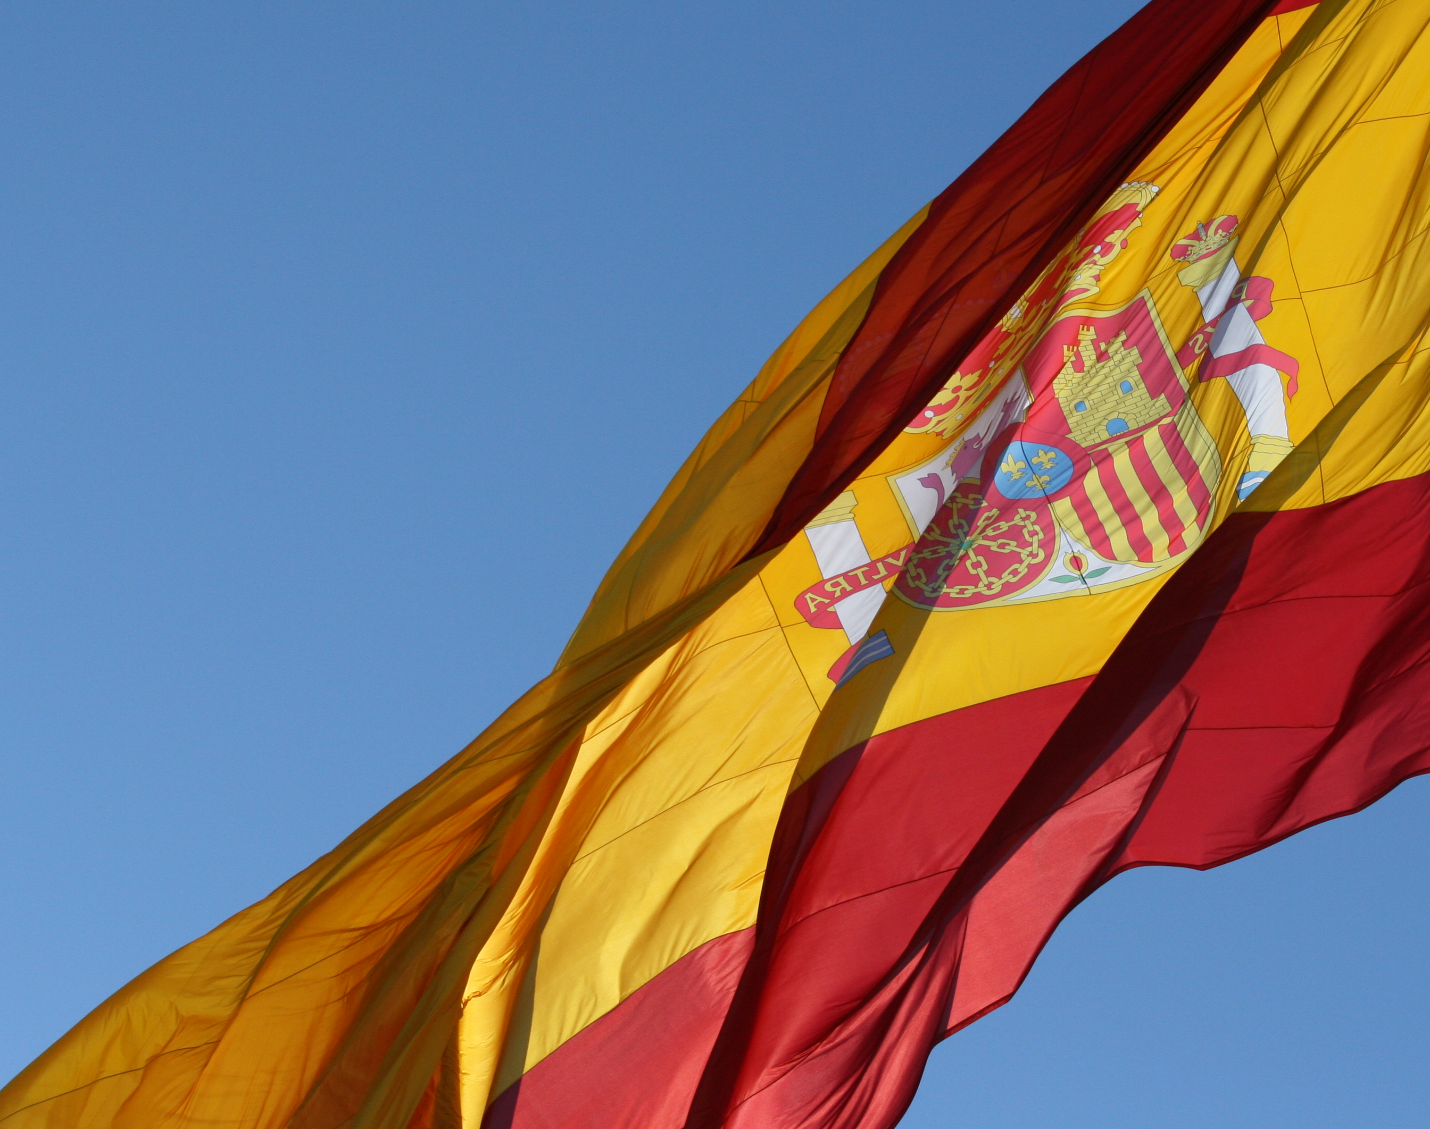
España
Spain
This Photo by Unknown author is licensed under CC BY-SA.

Slide 2
España
This half term our geography topic is all about Spain and the region of Catalonia.
In Spanish we are going to learn vocabulary to go alongside what you are learning in geography.
This week I want you to read through the slides and try to learn some of the vocabulary. There are some cognates which will help you to remember the words. Remember a cognate is a word that sounds the same or similar in different languages.
There is a worksheet for you to do. I have written a short paragraph about Spain in English and you've got to fill in the blanks in Spanish using the powerpoint and the word bank to help you.

Slide 3
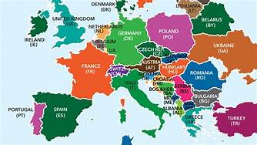
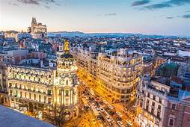
Europe
La Europa
Capital
La capital, Madrid

Slide 4
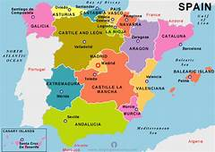
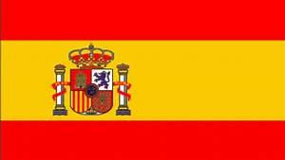
map
el mapa
flag
la bandera

Slide 5
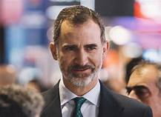
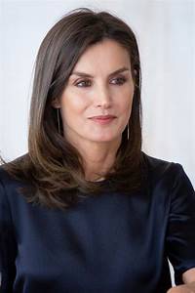
The King
El rey, Felipe VI
The Queen
La reina, Letizia

Slide 6
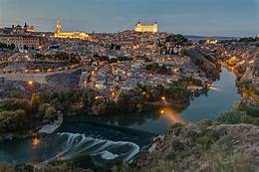
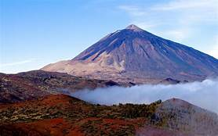
river
el río, el Tajo in Madrid
mountain
la montaña, el Teide in Tenerife

Slide 7
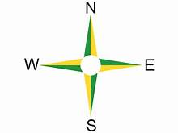
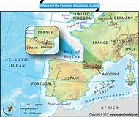
north, south, east and west
el norte, el sur, el este y el oeste
France, Portugal, Andorra and the Pryenees
Francia, Portugal, Andorra y los Pirineos

