Slide 1


The Rule of Law

Slide 2

Learning Objectives
By the end of this lesson I will be able to explain:
What parliament, the government and the justice system do.
What the rule of law means and why it is important
Who has the power to make and change laws;
How I can take part in our democracy.
2
© Young Citizens

Slide 3
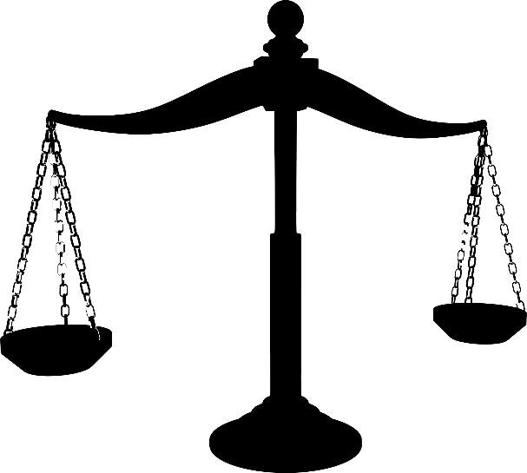
The rule of law
3
© Young Citizens

Slide 4
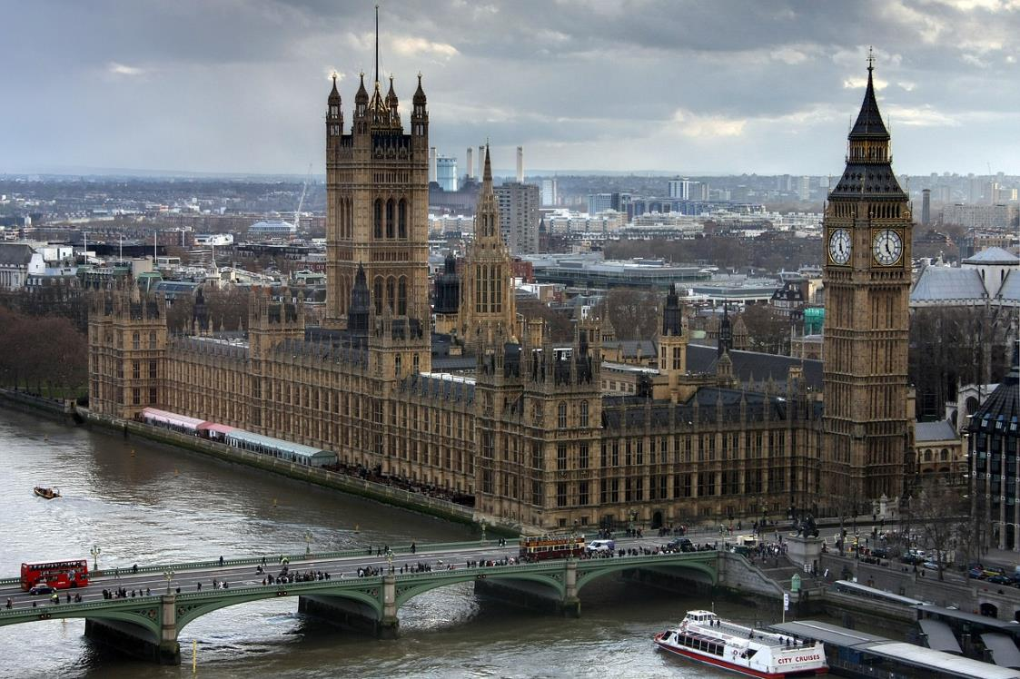
What are laws?
Laws are rules that are made by people in power to order the way society behaves.
4
© Young Citizens

Slide 5
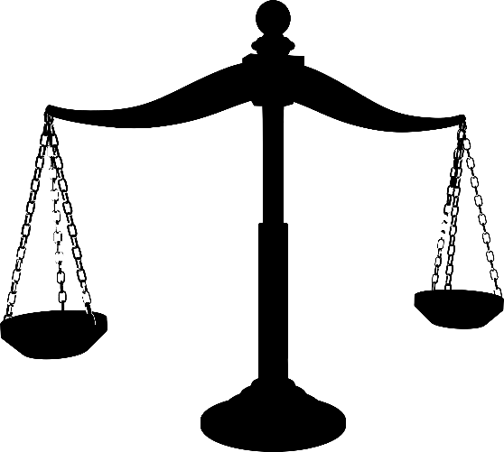
Why do we need laws?
To keep us safe.
To make sure things are fair.
To limit the power of the Government.
5
© Young Citizens

Slide 6
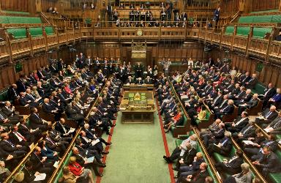

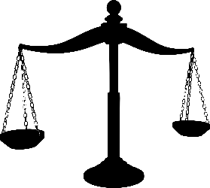
In the UK, power is split between three groups:
Parliament
The Government
The Justice System
Makes and
changes laws
Puts laws into
practice and
makes policy
Upholds
the law
6
© Young Citizens

Slide 7

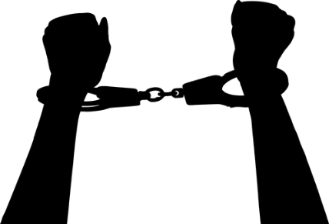
The rule of law
The rule of law means that the Government cannot do whatever it likes.
For example:
The Government cannot send people to prison.
The Government cannot take money from the people to make themselves rich.
7
© Young Citizens

Slide 8

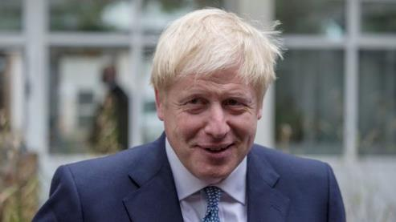
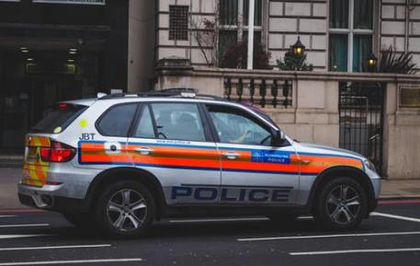
Everyone has to obey the law
Even…
The Prime Minister Celebrities The police
7
8
© Young Citizens
© Young Citizens

Slide 9

The police
An organised force that maintains order, preventing and detecting crimes and enforcing laws.
Do they have the power to make or change the law?
No, the police keep the law.
9
© Young Citizens

Slide 10
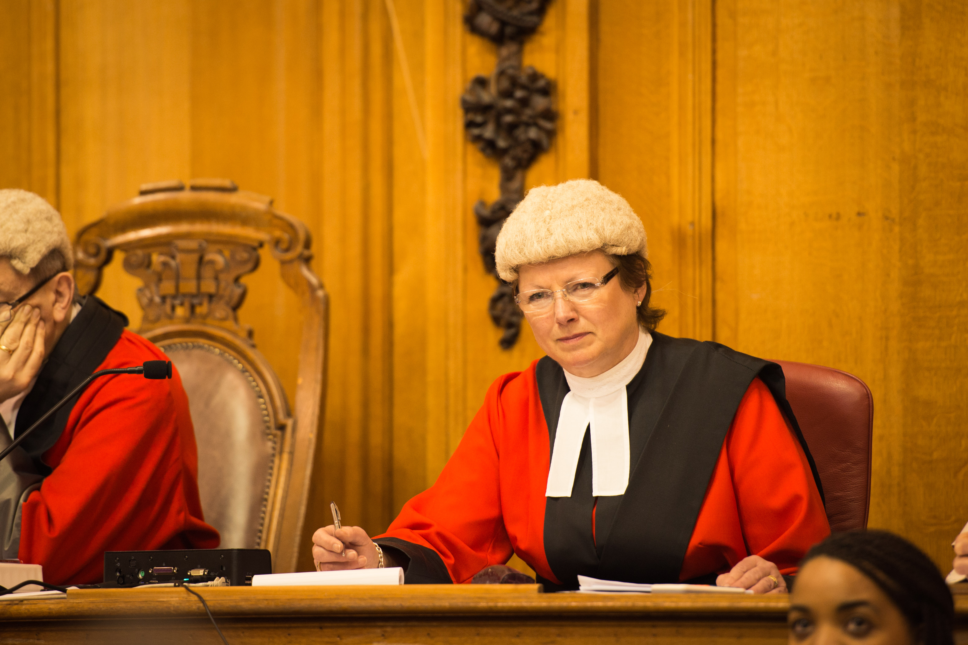
A judge
A person who oversees a court of law and decides on sentencing.
Do they have the power to make or change the law?
No, a judge acts on the law.
10
© Young Citizens

Slide 11
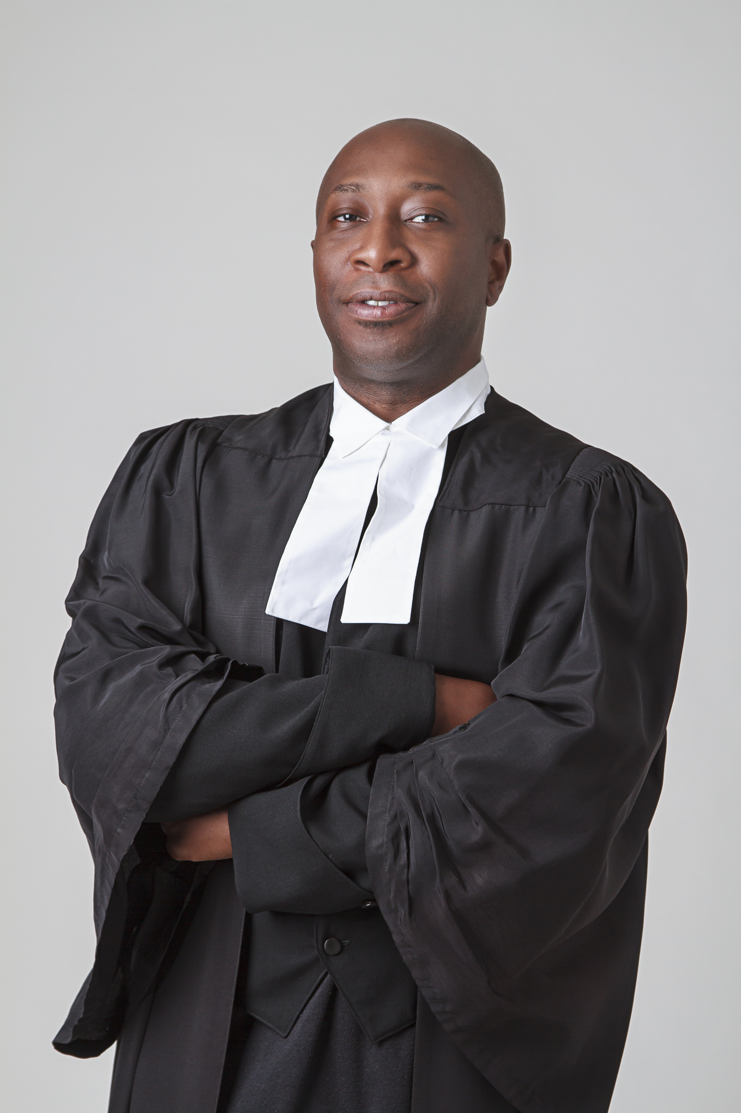
A lawyer
Someone who is qualified to advise on legal matters and represent people in court.
Do they have the power to make or change the law?
No, lawyers advise on the law.
11
© Young Citizens

Slide 12
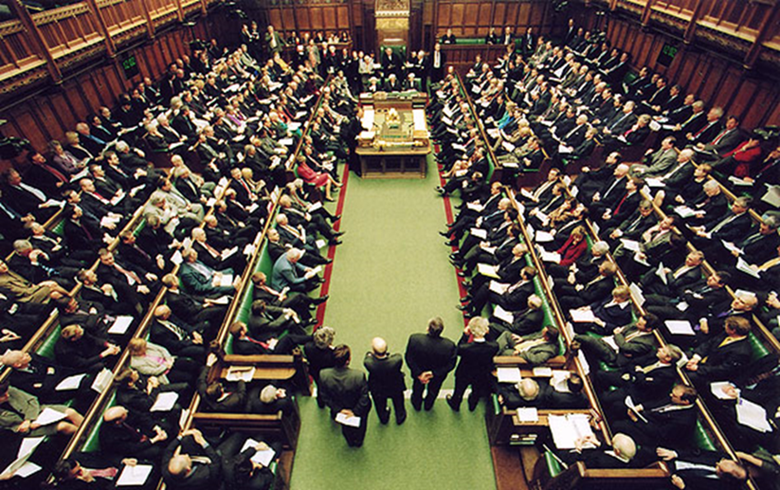
Parliament
A group of elected and appointed people who make and change laws in the House of Commons and the House of Lords.
Do they have the power to make or change the law?
Yes, members of the House of Commons and the House of Lords make and debate laws.
12
© Young Citizens

Slide 13
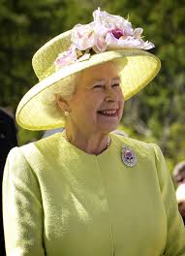
The Queen
The Head of State. This person gives royal assent to any new laws.
Do they have the power to make or change the law?
Sort of! The Queen has to give Royal Assent to any new laws.
However, this is really a formality. The last time a King or Queen said no was in 1707!
13
© Young Citizens

Slide 14
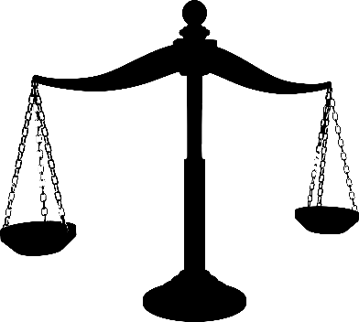

In an ideal world
Your challenge is to create a law that you think would improve the lives of children in the UK.
First decide which area you will focus on.
For example:
Environment
Health
Education
Safety (in our communities and/or online)
14
© Young Citizens

Slide 15
In an ideal world
Think about the type of change you want to see. Do you want to:
Ban certain behaviour
For example, smoking is banned in most public spaces.
Set age restrictions
For example, it is against the law to sell cigarettes to a person who is under 18 years old.
Enforce behaviours
For example, a person must wear a seatbelt when in a car.
15
© Young Citizens

Slide 16
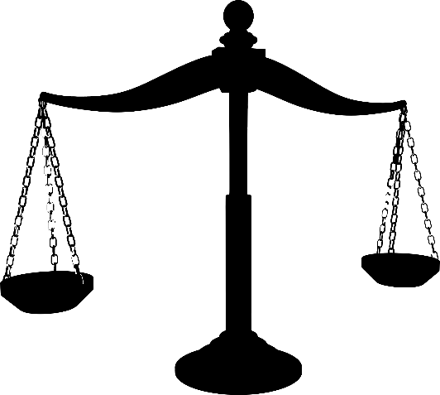
Plenary
Look back at what we wrote down at the start of the lesson about the rule of law.
Did we write anything that we now know isn’t true?
Is there any new information we can add?
16
© Young Citizens

