Slide 1

Week 2 – Lesson 6

Slide 2
SPAG warm up

Slide 3
Daily DADWAVER challenge
D is for description – sentences filled with imagery and adjectives
A is for action – detailing what is happening in a sentence
D is for dialogue – something a characters says out loud or a conversation
W is for where – indicating the location of the action (adverb of place)
A is for adverb – usually an adverb / adverbial phrase of manner
V is for verb – single word or phrase e.g Walking, / Walking across the country
E is for estimation of time e.g Momentarily, At midday, As the tide turned
R is for rhetorical question to draw in the reader, can use more than one
Simile is for simile (or metaphor) – allows the writer to ‘paint’ an image

Slide 4

DADWAVERS – 60 secs to write…
A is for adverb of manner
Eg Cautiously, he stepped around the corner.
Eg Rapidly sprinting through the undergrowth, they made their escape.

Slide 5
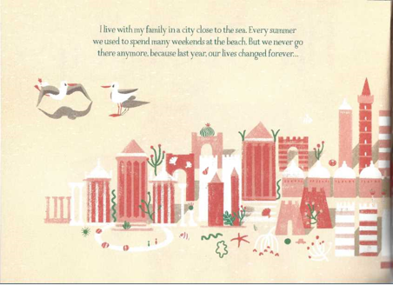


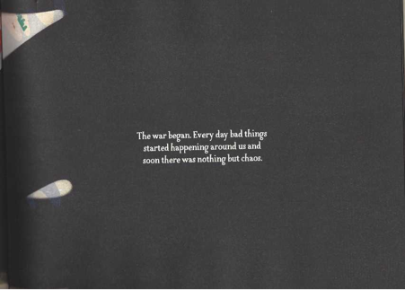


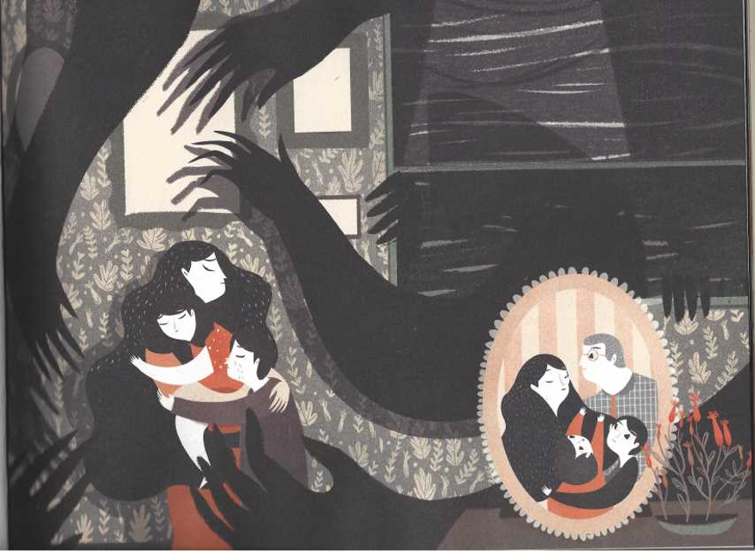
Let's recap the story so far

Slide 6
LC: Can I write a persuasive letter?
Toolkit:

Slide 7
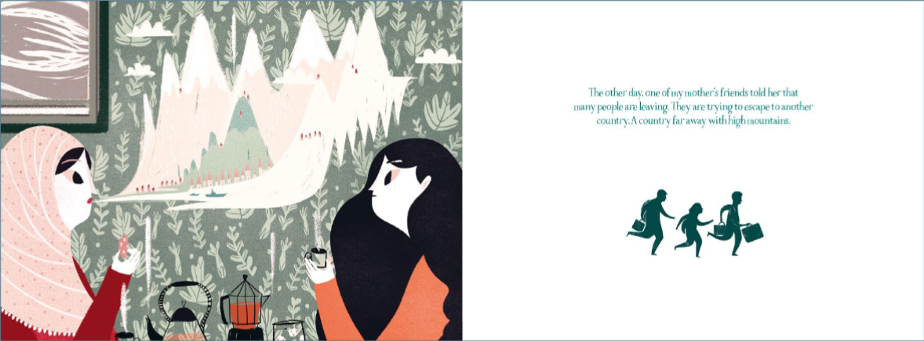
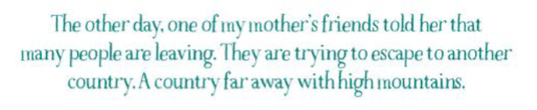
What strikes you as interesting about this picture?
What can you see?
What choices has the author made?
Why use light colours for the mountains?
Why do you think the people are running?

Slide 8

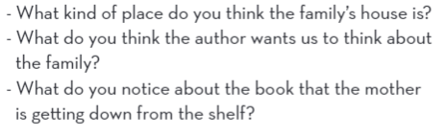

Slide 9


Slide 10

Looking at the pictures of the animals, where could the new place be?
Watch this link (watch it more than once so you can digest the detail).
Think about and make notes on the words / phrases that stand out to you?
http://www.bbc.co.uk/programmes/p0037825

Slide 11
The task today is to write a persuasive letter. You are going to write a letter from the friend to the mother to persuade her to leave the country with her family for a place of safety.
Consider all the options which are available to the mother and the challenges she faces between staying and going and offer her some advice.

Slide 12
As you are writing to a friend, your letter will be informal in style.
Remember to use persuasive techniques – such as:
Rhetorical questions
Emotive language / vocabulary
Imperative verbs
Modal verbs for example: must / will
Description (expanded noun phrases)

