Slide 1

LC: Can I make inferences about a text?

Slide 2
What do you think the book might be about?​​​
​​​
What genre do you think the book is?​​​
​​​
What key information might you find in this book?​

Slide 3
The latest instalment of P G Bell’s Train to Impossible Places delivers its dose of excitement and adventure impeccably (as you’d expect in a book starring some of the most efficient and dedicated postal operatives you could ever hope to meet). In previous episodes, as crew member of the Impossible Postal Express, Suzy has befriended ghosts, battled a giant robot and saved an entire city from destruction. Now, in spite of the best efforts of her parents, who know what’s been going on and are, understandably, more than a little worried, she’s back on board with another challenging delivery to make: a book needs to be returned to its library. This being the Impossible Places, that’s a lot less simple and a lot more magical than it sounds, and the task will see Suzy sucked into a void storm, trapped at the bottom of the ocean - and almost eaten by a giant frog. PG Bell’s books overflow with invention and thrills and I defy anyone not to want to climb onboard with Suzy and her extraordinary friends. By the end of the story, our own world has been made just a bit more magical, and readers will feel that too as they close the book.

Slide 4
Vocabulary
Dilapidated - in a state of disrepair or ruin as a result of age or neglect.
Dozen - 12
Ejecting - force or throw (something) out in a violent or sudden way.
Dismay - concern and distress caused by something unexpected.

Slide 5

What do we know about the ‘Impossible Places’ from reading this in class?
Can you remember some of the key characters or events?
Today we are reading pages 1-4.

Slide 6
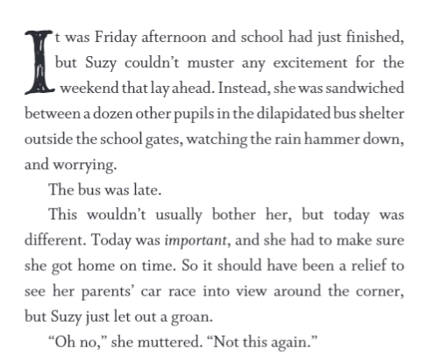
Question: Did Suzy want her parents to pick her up?
Use clues/examples from the text to help you explain your answer. What inferences can you make?

Slide 7
Answer: She did not want her parents to pick her up. She let out a groan when she saw her car and even though she had somewhere important to be she was still not relieved when she saw them.
What examples from the text did I use in my answer?

Slide 8
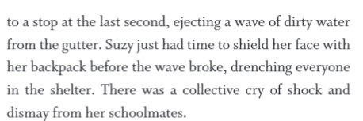
Question: How wet did Suzy get?

Slide 9
Answer: The water that hit Suzy was described as a wave which suggests a lot of water and she was 'drenched' so she will have been very wet.
What examples have been used from the text here?

Slide 10
Read pages 1 – 4.
Questions – Retrieval:
What was Suzy not looking forward to?
What was she waiting for?
What happened to Suzy when the car pulled up?
What had Suzy’s mum told her to take in the morning?
Inference:
How do you know that Suzy was annoyed with her mum?
How do we know something has changed between Suzy and her parents?
Explain why Suzy’s parents are keeping a close eye on Suzy.
Describe what Suzy is like as a person.

Slide 11
Answers – Retrieval:
The weekend
The bus
She got drenched by a puddle when the car pulled up
An umbrella
Inference:
She hissed at her mum and said ‘Look what you’ve done!’. The exclamation mark showed that she was angry.
They never used to drive her anyway and they have started doing it all the time. They also now ring school to check up on her.
Suzy’s parents are keeping a close eye on her because they discovered her secret and trips to the Impossible Places which placed her in great danger.
Answers could include: adventurous, sneaky, brave, rulebreaker (add examples)

Slide 12

Extra activity!
Draw a map of what you imagine the Impossible Places to be like.
What other worlds and what kind of creatures would Suzy maybe meet on her journey?

