Slide 1

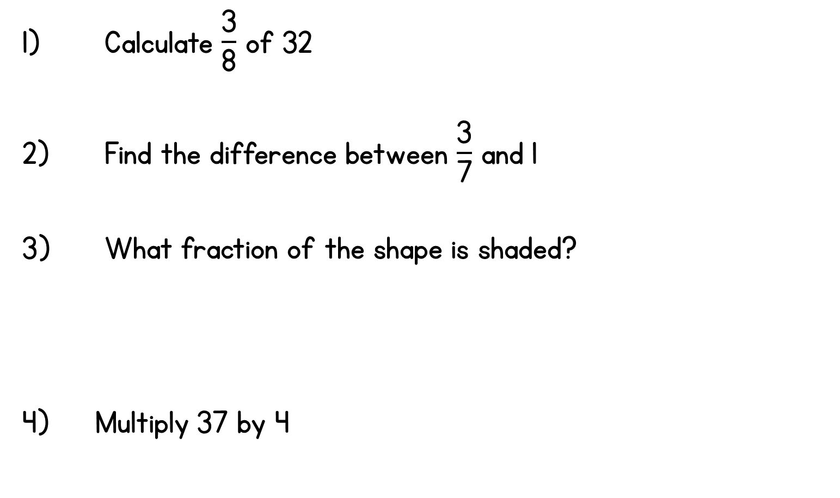
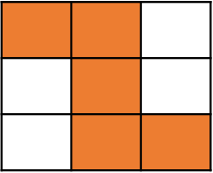

Year 4 | Week 8 | Day 3

Slide 2




Year 4 | Week 8 | Day 3

