Slide 1



Recapping identifying and name common wild
and garden plants and types of trees?

Slide 2
Recap on previous knowledge.
What do plants need to survive?
Warmth
Sunlight
Water
Cold Air
Carbon Dioxide
To be wrapped up in blankets
Shelter

Slide 3
No.
Can plants survive without sunlight?
Can you explain why plants need sunlight to survive?
Plants rely on the energy in sunlight to produce the nutrients they need.

Slide 4
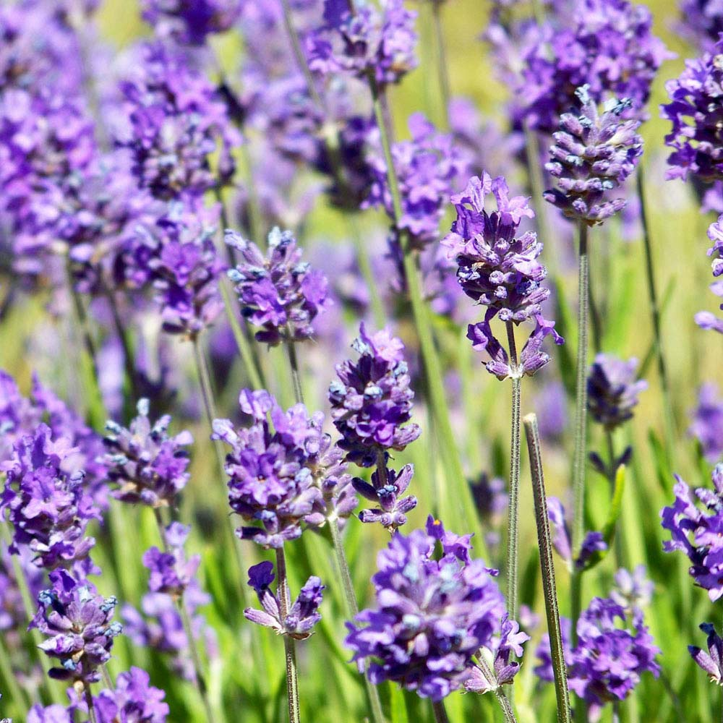
Today, we will be learning all about wild flowers. We will be describing their appearance and the importance of having wildflowers in our environment.
By the end of the lesson I want you to be able to identify some wild flowers. This is one.
You might know what it is already.
If you don’t I will give you a clue. It smells lovely and lots of people use it to help them sleep!

Slide 5
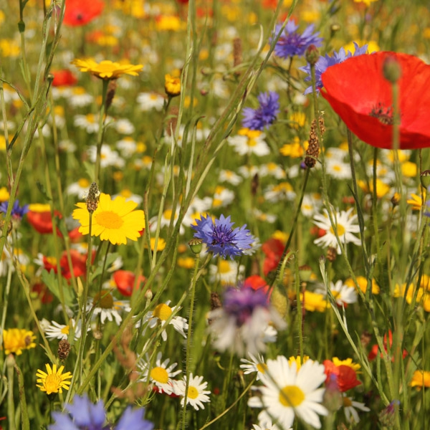
What are wildflowers and why do plants grow in the wild?
Wild flowers and plants can grow without any help from humans. They are what we would call naturally occurring plants.
They are often lots of different, shapes, colours and sizes. They can grow in a variety of different places and you will often find specific types of wild plants in different types of environments.

Slide 6
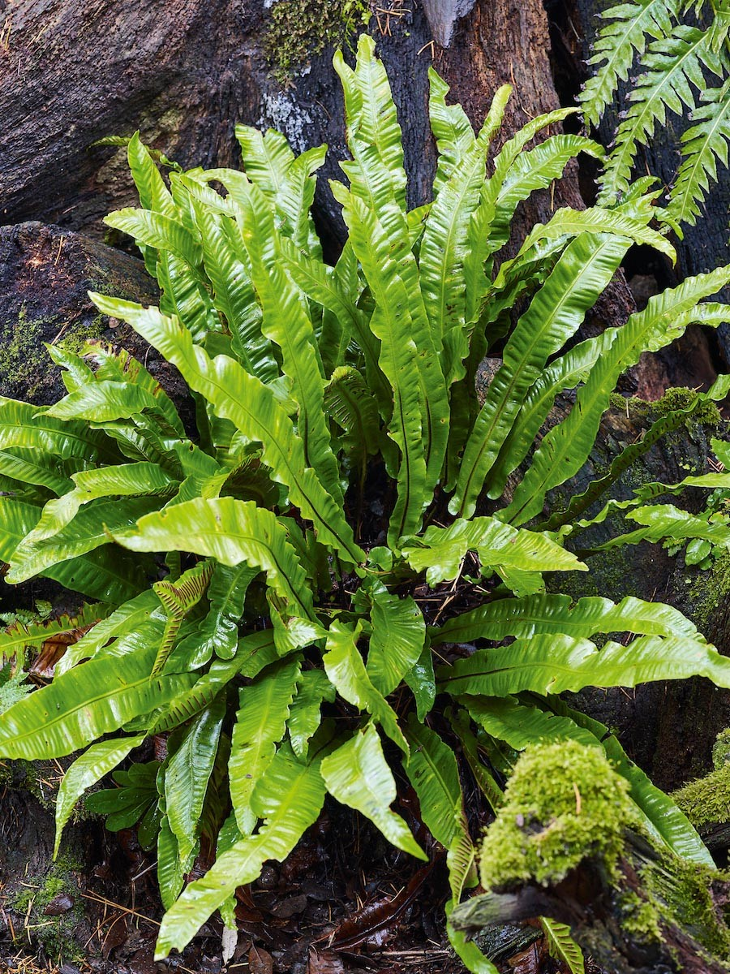
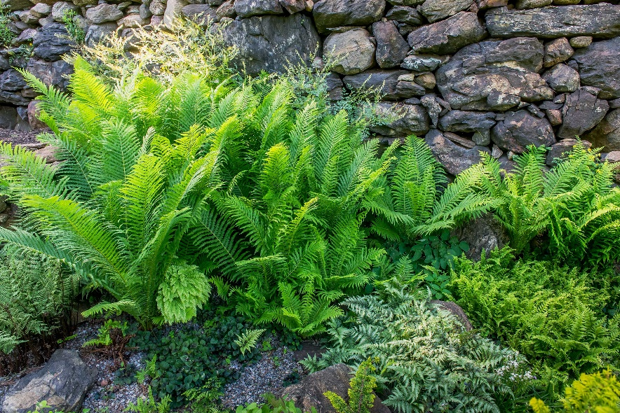
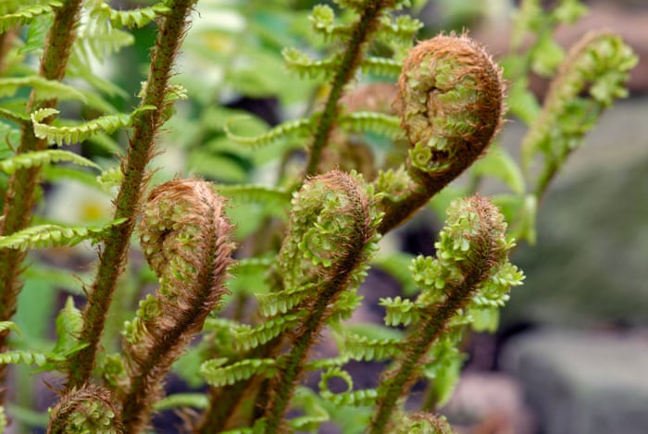
Ferns
You might have heard of a particular type of wild plant. These are a type of wild plant that can grow almost anywhere.
You will often find a type of fern plant when you are out walking.

Slide 7

Why are wildflowers important?
Wildflowers are really important to our environment. They provide a rich habitat (a home) for lots of different insects and animals. Wildflowers are really helpful to animals such as birds and small mammals during the winter months, as food is scarce in the countryside, wildflower seeds become an important food source. Wildflowers also provide a perfect place for bees to collect pollen.

Slide 8

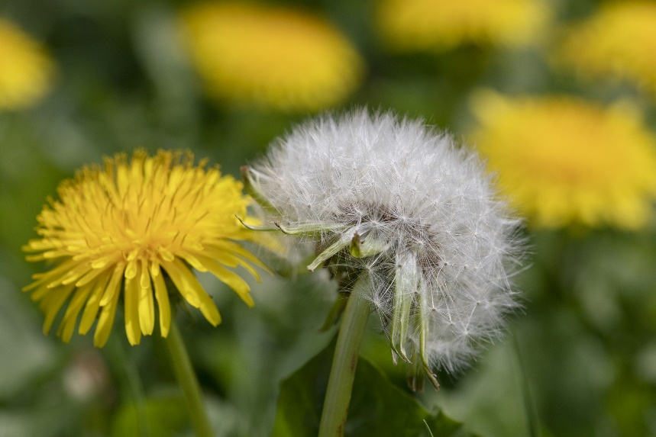
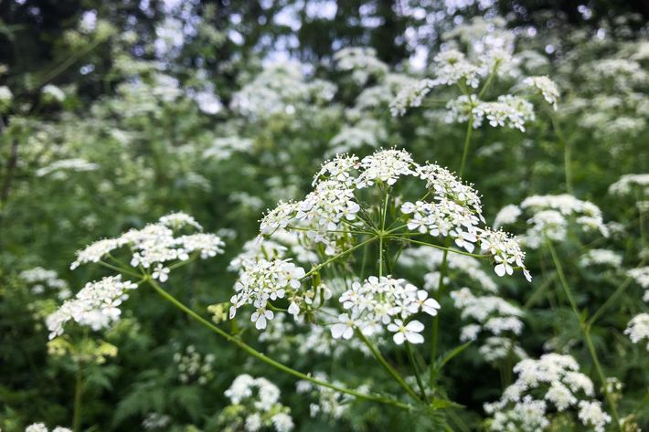
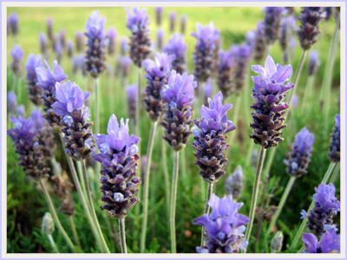


Lets take a look at some wild flowers.
Can you name any?

Slide 9

Poppies
Daisies
Lavender
Cow Parsley
Dandelion

Slide 10
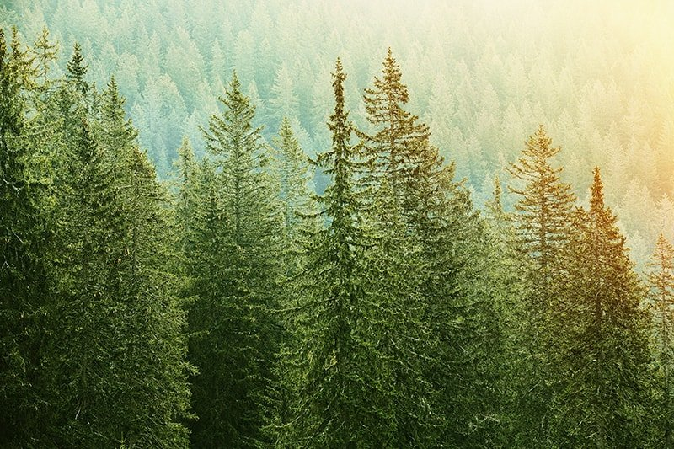
Recap Part Two
What is the difference between deciduous and evergreen trees?

Slide 11
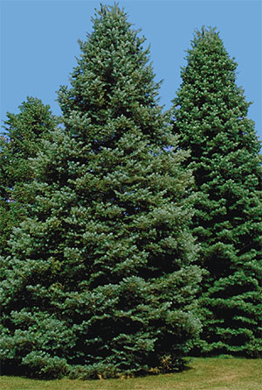
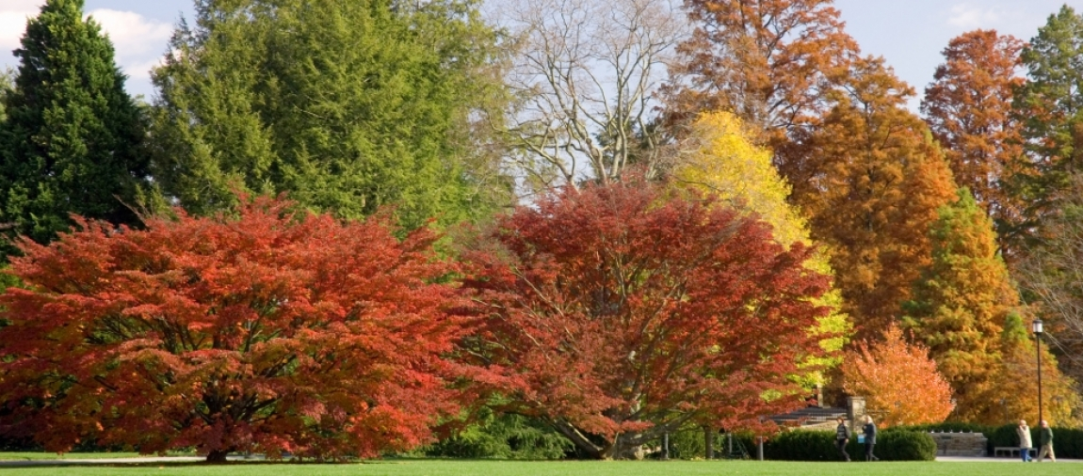
Types of Trees
Deciduous Trees
Evergreen Trees

Slide 12

Evergreen Trees
Before we start? Make a quick note of anything that you already know about evergreen trees.

Slide 13
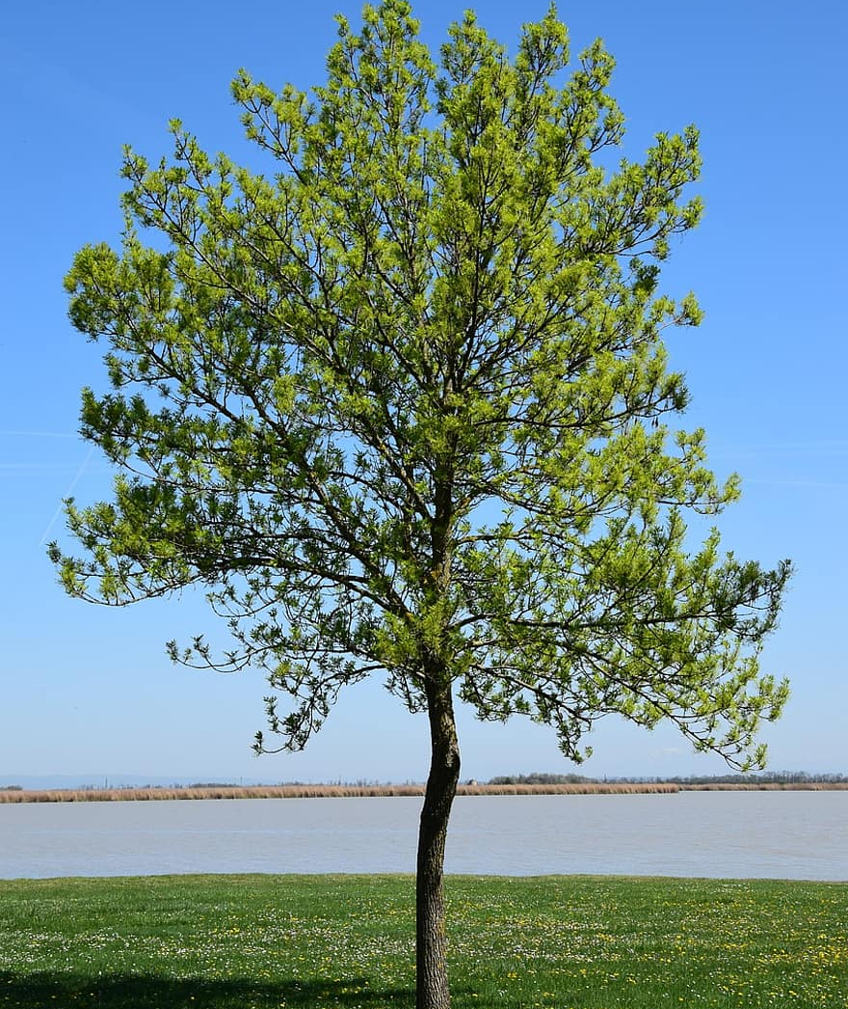
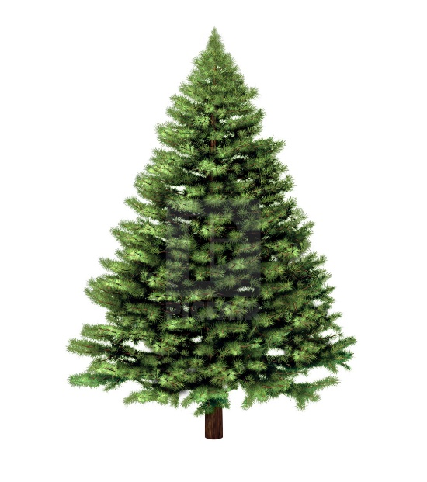
Evergreen trees do not lose their leaves, in the winter when other types of trees will have lost their leaves, you might see evergreen trees covered in snow or frost but their leaves will still be there. These types of trees don’t really change in their appearance, they will look the same throughout the year and the season changes.
Deciduous trees lose their leaves in the autumn and their leaves re grow in the spring time. During the winter months, you will see these trees without leaves. However, during the spring and summer it might be a little trickier to establish the difference between evergreen and deciduous trees.
Which of these trees is deciduous and which is evergreen?

Slide 14


Deciduous Trees
What do we already know ?
Deciduous trees lose their leaves in the autumn and they re grow in the spring. During the summer months, they will have big bushy green leaves covering their branches.
During the autumn period before the leaves fall then they begin to change colour? Have a think about what colours you have seen leaves turn.
Deciduous trees leaves when they are green are all different shapes and sizes and are usually flat. They also have lots of little veins running through them.
Because the leaves of deciduous trees are thin and flat, this makes it easier for them to drop to the ground in the autumn months.

Slide 15
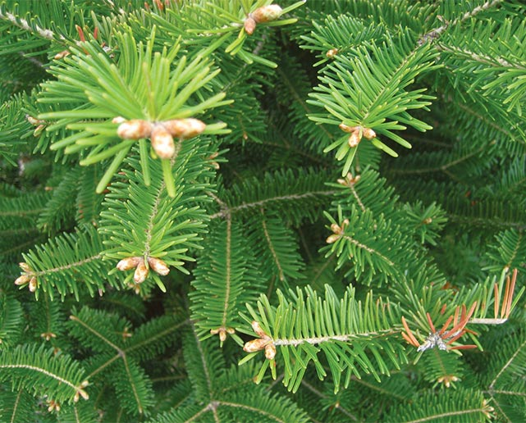
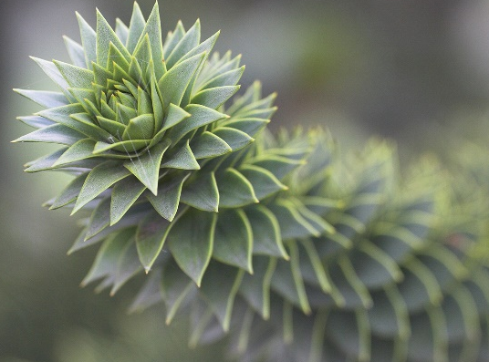
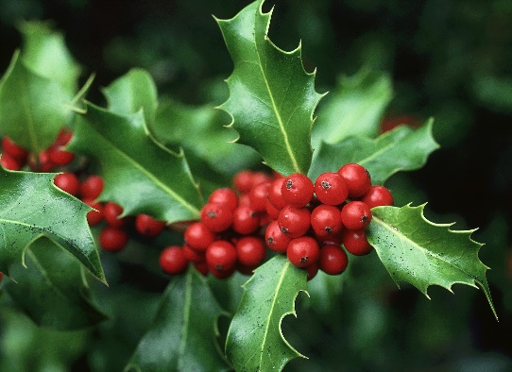
Evergreen Trees
What do we already know?
Evergreen trees do not lose their leaves during the winter and their leaves stay green all year round. You might sometimes see some leaves from an evergreen tree on the floor. This is because they have been blown off in the wind.
The leaves of evergreen trees are different to those on deciduous trees. Evergreen leaves are often quite spikey, thick and are not flat, this means that we cannot see the veins on them as we can on deciduous tree leaves.

Slide 16
Task
Can you create a piece of work that explains the difference between deciduous and evergreen trees or discusses the importance of wildflowers. You could do some more research to add to the information that you already know. Can you find out an interesting fact that we haven’t found out together?
You could produce a mind map for each type of tree.
You could go out and take some photos of the different types of trees and compare them.
You could have a go at drawing the different types of leaves and compare the differences in the leaves.
Sources
The internet .
Books from home.
Daily walks.
Extra Task
Can you use the identification sheets to spot any of the different trees or wildflowers in your gardens or when you are out on a walk?

Slide 17

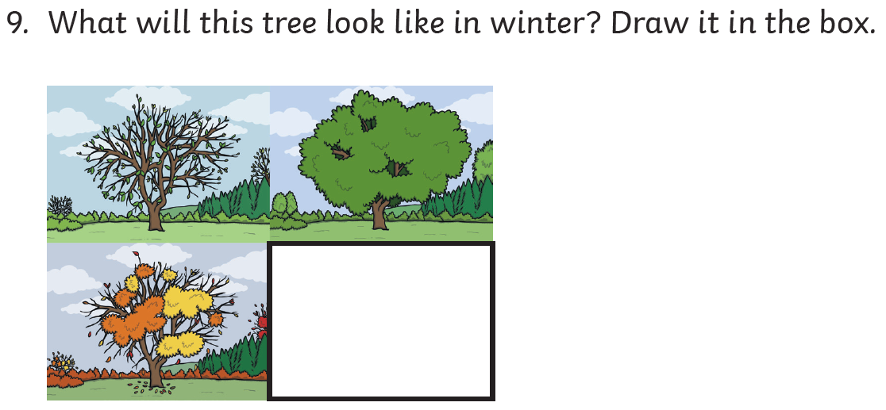
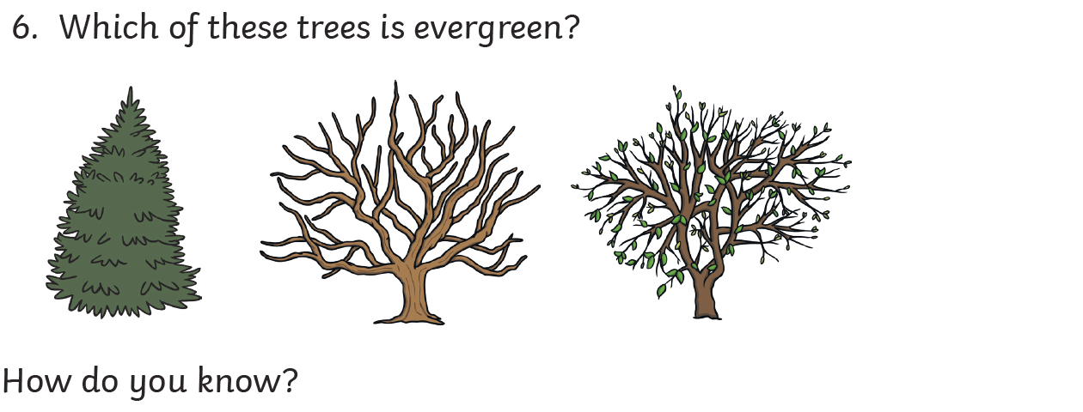
Extension Task
I will use this as the starter to our next lesson so be prepared!

Slide 18
Can you remember one of my first slides today?
What wildflower was the image of? Can you name this wildflower?

