Slide 1
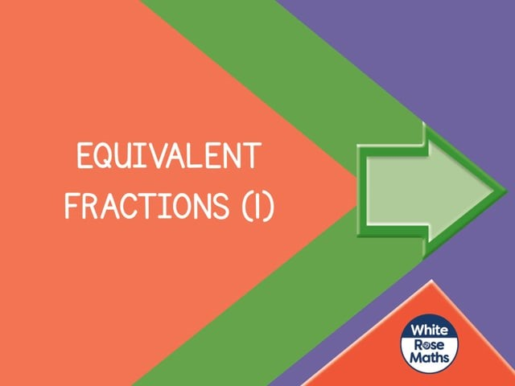


Slide 2
1) What fraction of each shape is shaded?
2) How many sevenths are there in one?
3) How many tenths are there in two?

Slide 3



1) What fraction of each shape is shaded?
$$\frac{\text{5}}{\text{9}}$$
$$\frac{\text{1}}{\text{4}}$$
$$\frac{\text{1}}{\text{1}}$$
Or 1
2) How many sevenths are there in one?
7
3) How many tenths are there in two?
20

Slide 5



equivalent
“of equal value, amount or meaning”
are equivalent to
3 $+$ 3
is equivalent to
5 $+$ 1
1 cm
is equivalent to
10 mm

Slide 6



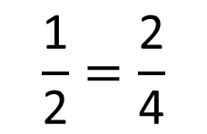



$$\frac{\text{1}}{\text{2}}$$
$$\frac{\text{1}}{\text{2}}$$
$$\frac{\text{1}}{\text{4}}$$
$$\frac{\text{1}}{\text{4}}$$
$$\frac{\text{1}}{\text{4}}$$
$$\frac{\text{1}}{\text{4}}$$
$$\frac{\text{1}}{\text{2}}=\frac{\text{2}}{\text{4}}$$

Slide 7





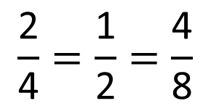








$$\frac{\text{1}}{\text{4}}$$
$$\frac{\text{1}}{\text{4}}$$
$$\frac{\text{1}}{\text{4}}$$
$$\frac{\text{1}}{\text{4}}$$
$$\frac{\text{1}}{\text{8}}$$
$$\frac{\text{1}}{\text{8}}$$
$$\frac{\text{1}}{\text{8}}$$
$$\frac{\text{1}}{\text{8}}$$
$$\frac{\text{1}}{\text{8}}$$
$$\frac{\text{1}}{\text{8}}$$
$$\frac{\text{1}}{\text{8}}$$
$$\frac{\text{1}}{\text{8}}$$
How many eighths are equivalent to a half?
$$\frac{\text{2}}{\text{4}}=\frac{\text{1}}{\text{2}}=\frac{\text{4}}{\text{8}}$$
Have a think

Slide 8

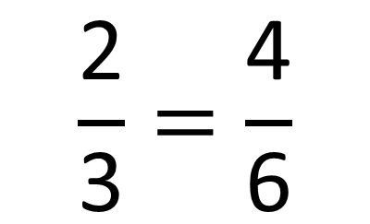
Have a think
$$\frac{\text{2}}{\text{3}}=\frac{\text{4}}{\text{6}}$$

Slide 9
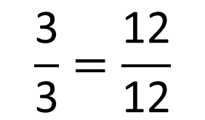
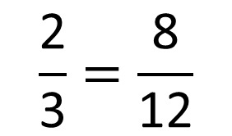
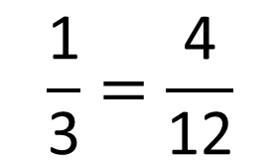
$$\frac{\text{1}}{\text{3}}=\frac{\text{4}}{\text{12}}$$
$$\frac{\text{2}}{\text{3}}=\frac{\text{8}}{\text{12}}$$
$$\frac{\text{3}}{\text{3}}=\frac{\text{12}}{\text{12}}$$

Slide 10
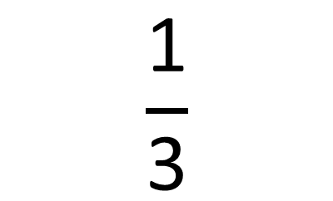
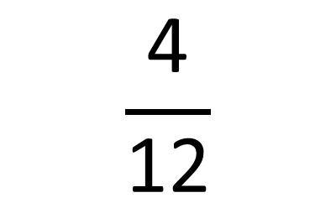
$$\frac{\text{4}}{\text{12}}$$
$$\frac{\text{1}}{\text{3}}$$
Have a think

Slide 11
Have a go at questions
1 – 4 on the worksheet

Slide 12


Have a think
I could use any of these bar models to show $\frac{\text{1}}{\text{2}}$

Slide 14
Have a go at the rest of the worksheet

