Slide 1
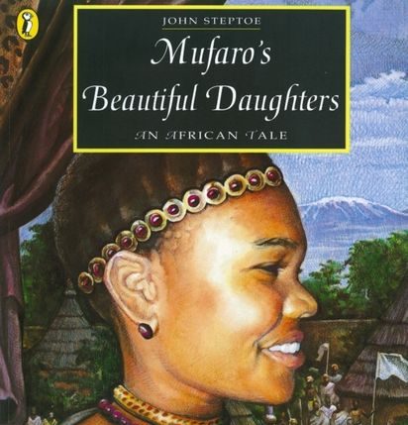
Warm Up – Can you spot the mistakes?
He coul'dnt believe his eyes
He didn't know were she was.
The journey was long, dangerous, and hard.
Eventually Nyasha realised she was talking to the king.

Slide 2
LC: Can I use speech bubbles to show conversation?
Yesterday you wrote a monologue and practised using inverted commas.
Today, you will be writing a conversation between 2 characters using speech bubbles.

Slide 3
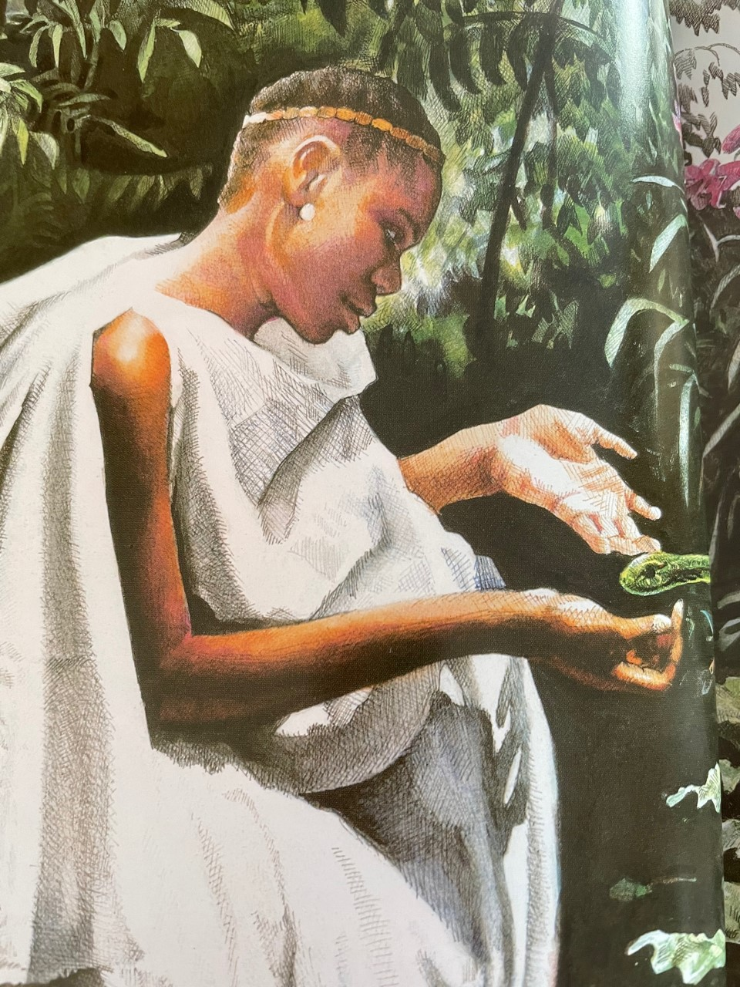
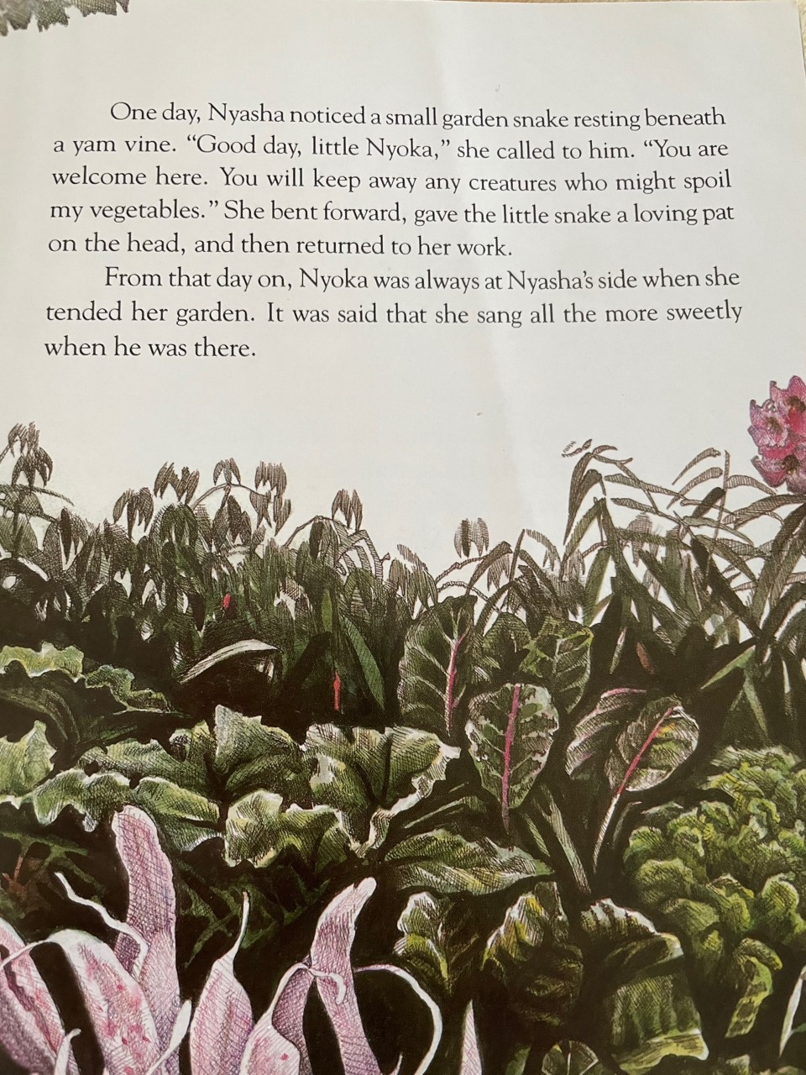
Let's read this section together.

Slide 4
Nyoka becomes her pet that she can share her worries with him. What do you tell your pets if you are worried?
What might Nyasha tell him?
Nyasha might tell him about her unkind sister.
Nyoka might tell her how he'd love to be her pet. Perhaps he even might tell her, he has some powers to help.

Slide 5
What might it look like in my book?
You are so precious to me and a very kind pet.
Nyasha
I really love to see you.
You are so lovely and kind.
Nyoka

Slide 6
LC: Can I use speech bubbles?
Toolkit:
An imginary conversation bteween Nyasha and the snake Nyoka.
Use speech bubbles.

