Slide 1
Year 2 Maths Revision
LC: Can you add two 2 - digit numbers (crossing 10)?

Slide 2
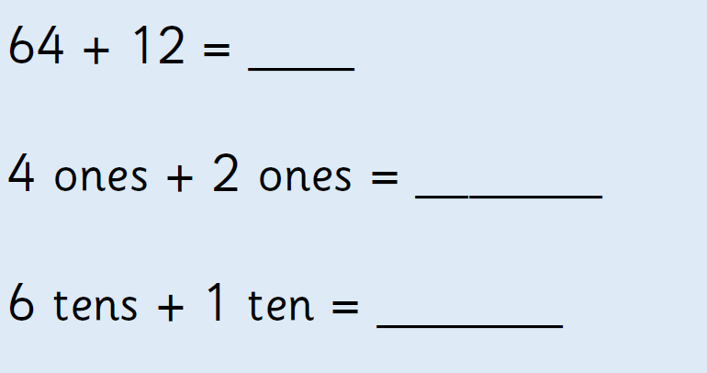
How can we solve?
Remember, we add the ones and then the tens.

Slide 3
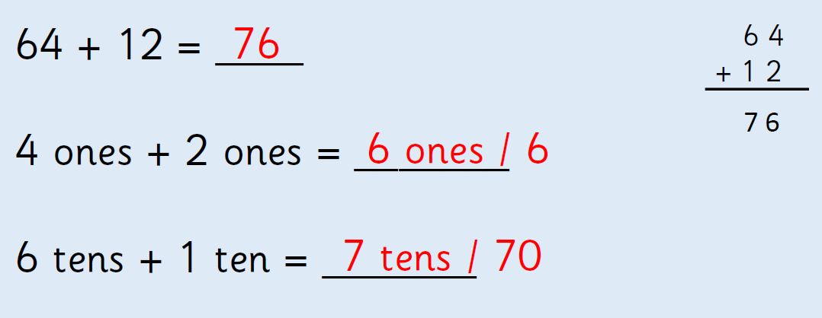

Slide 4
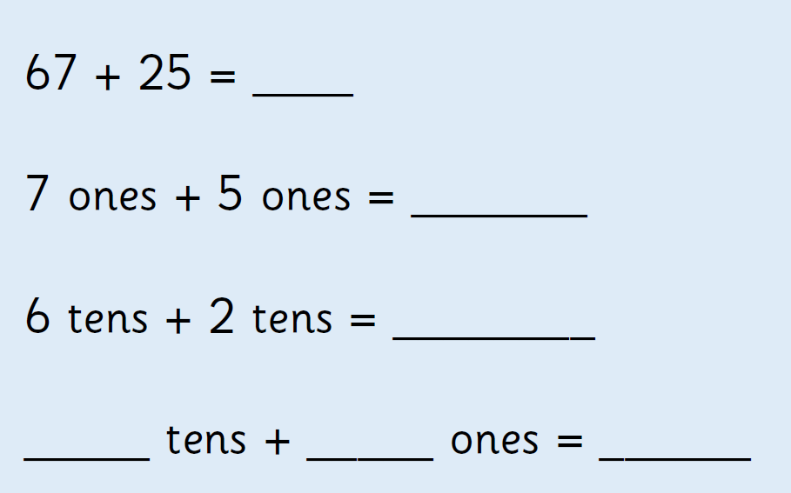
Now look at this problem. What do you notice about the ones?

Slide 5
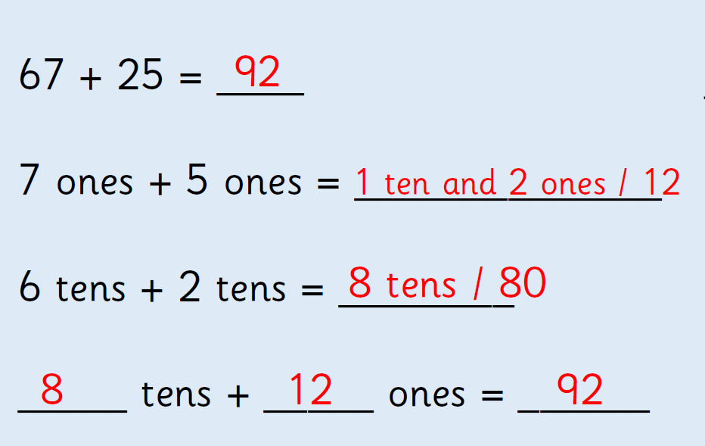

Slide 6
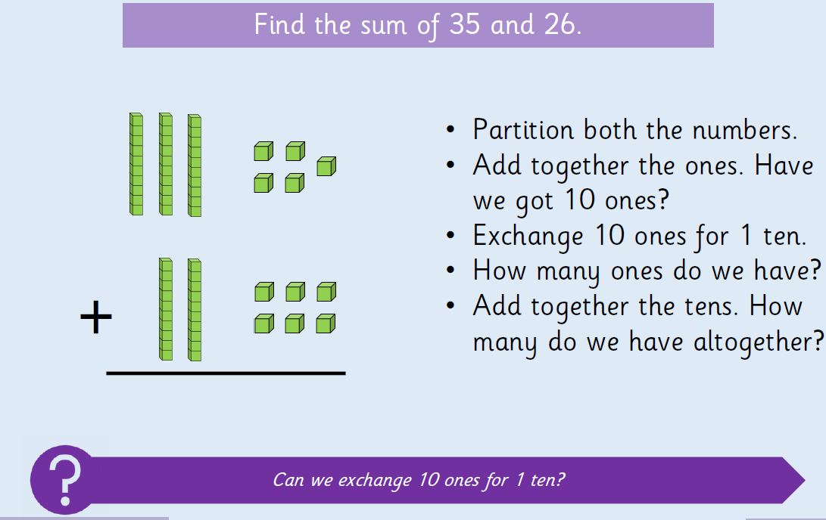

Slide 7
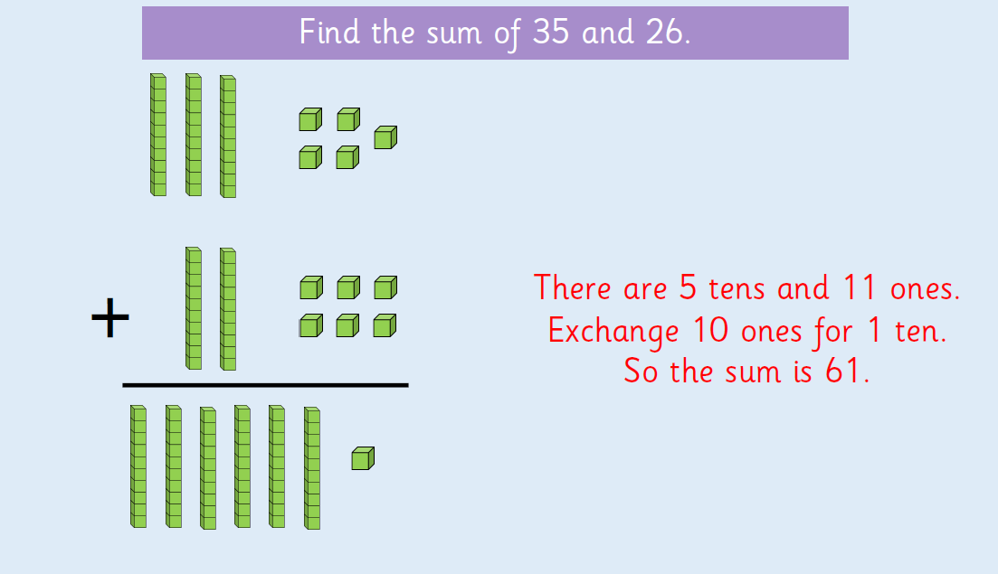

Slide 8
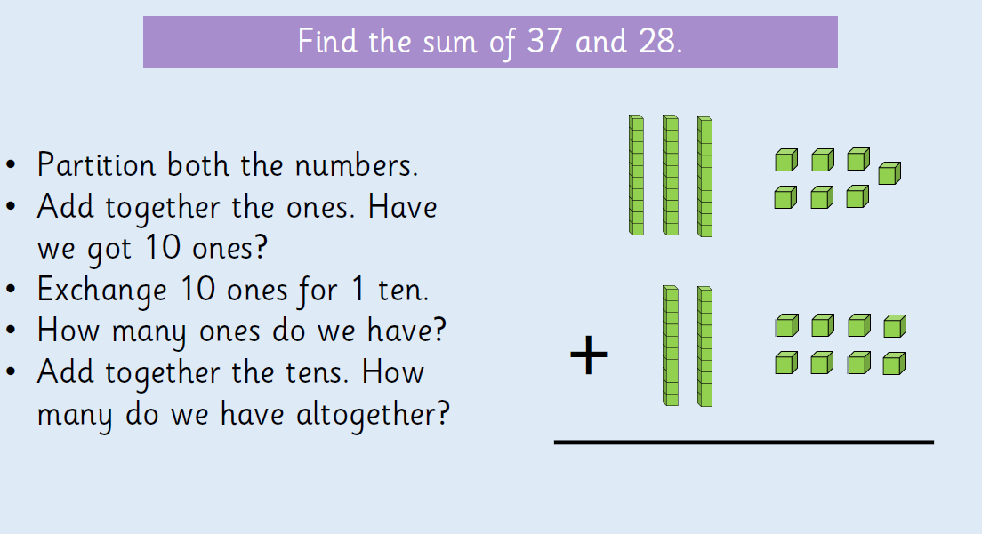

Slide 9
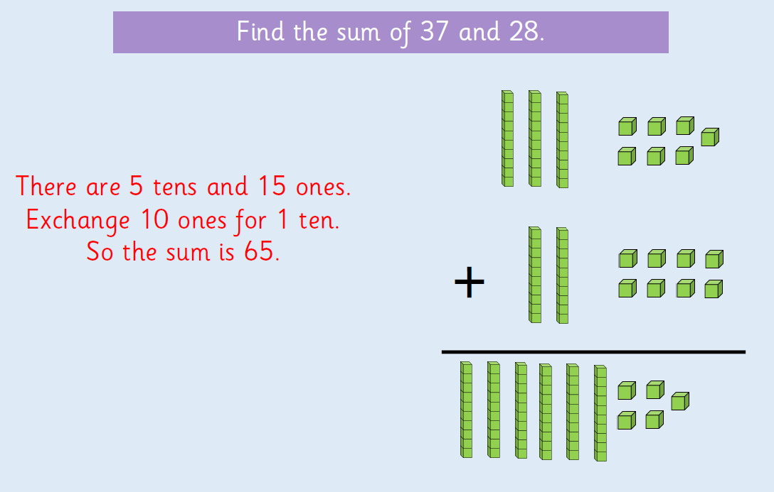

Slide 10
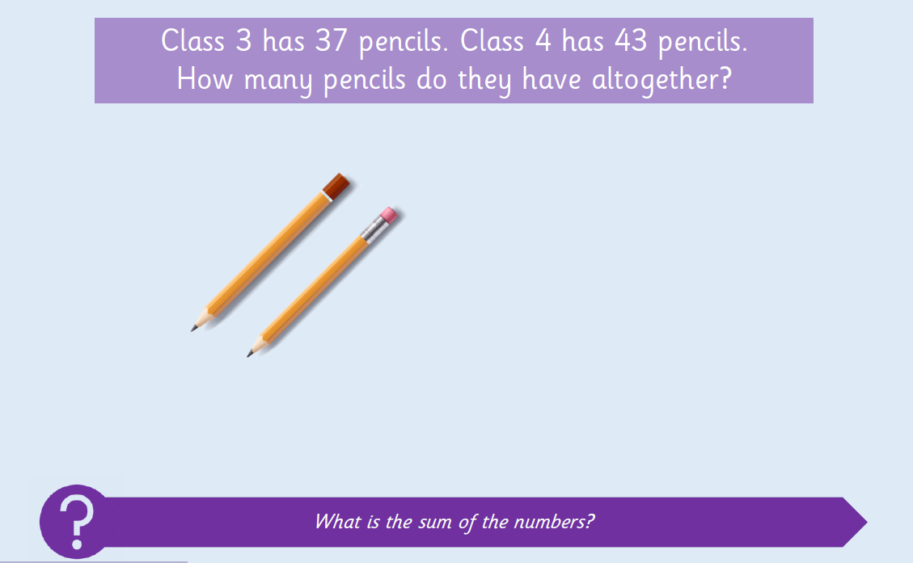
Use paper or a whiteboard to solve:
Remember you can draw sticks for the tens and dots for the ones.

Slide 11
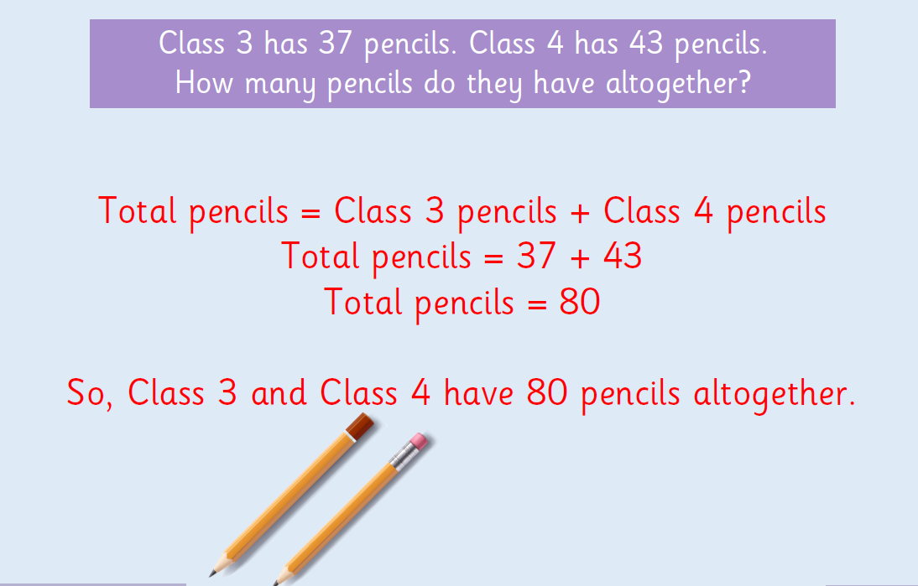

Slide 12
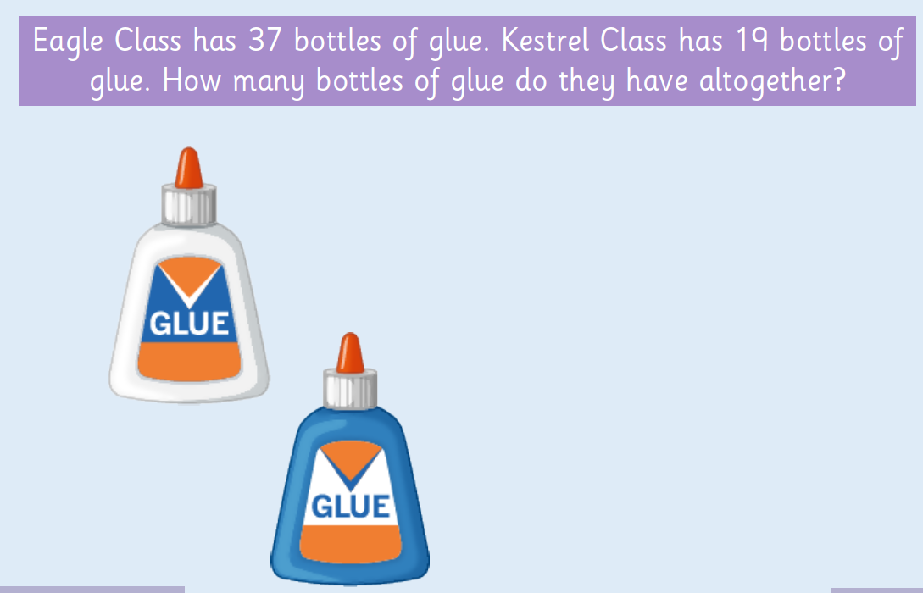
Use paper or a whiteboard to solve:
Remember you can draw sticks for the tens and dots for the ones.

Slide 13
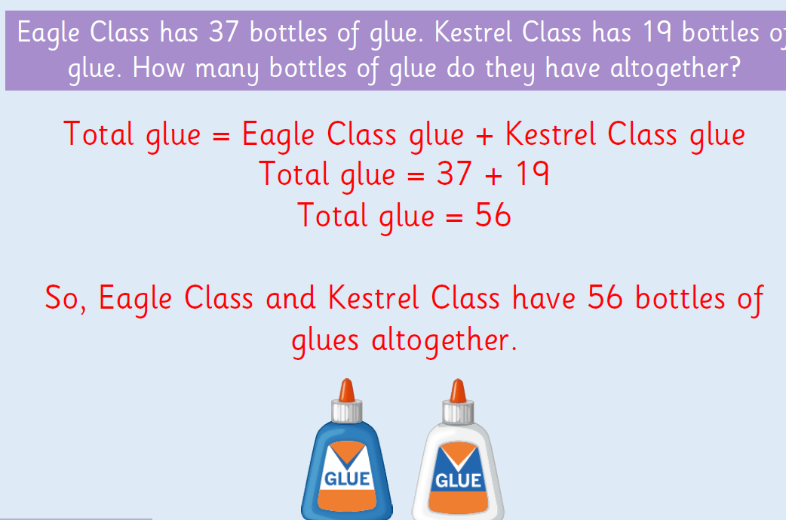

Slide 14
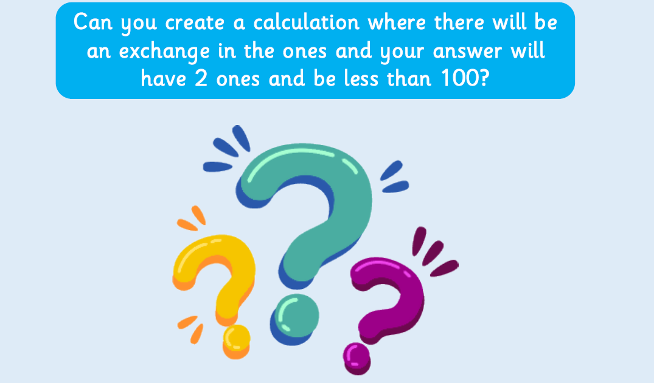
Clue: If you have 2 ones and an exchange, look for two digits (in your ones column) which total 12.

Slide 15
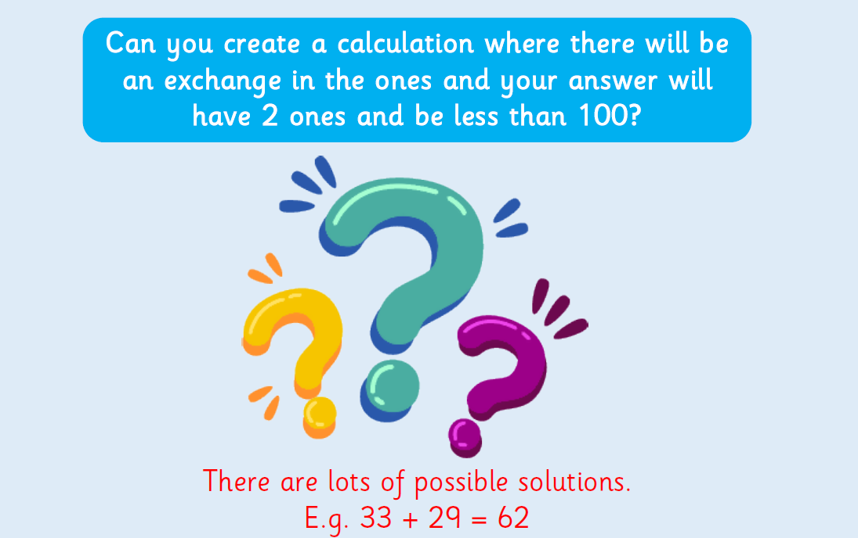

Slide 16
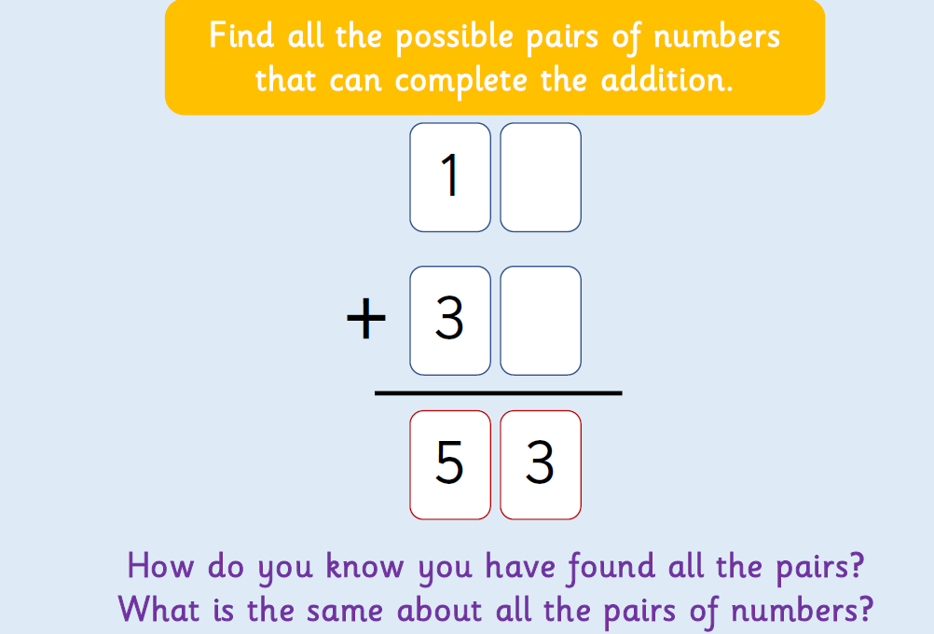
Challenge: On paper or whiteboards

Slide 17


