Slide 1
Year 1 Maths – Lesson 4
(Place Value to 50)
LC: Can you count in 5’s?
Video Link for slides:
https://vimeo.com/507075995

Slide 2
BBC Bitesize – counting in 5’s https://www.bbc.co.uk/bitesize/articles/zhfjqp3

Slide 4





1) How many socks?
2) How many?
3) What is missing? 12, 10, 8, ___
4) What is missing?

Slide 5
1) How many socks?
2) How many?
3) What is missing? 12, 10, 8, ___
4) What is missing?
8
14
6

Slide 7


How many counters?
5
10
15
20
25

Slide 8
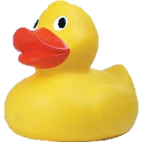


I am going to count by 5s!
5, 10, 15, 20, 25
There are 25 ducks.
How many ducks?

Slide 9
Have a go at questions 1 & 2 on the worksheet

Slide 10


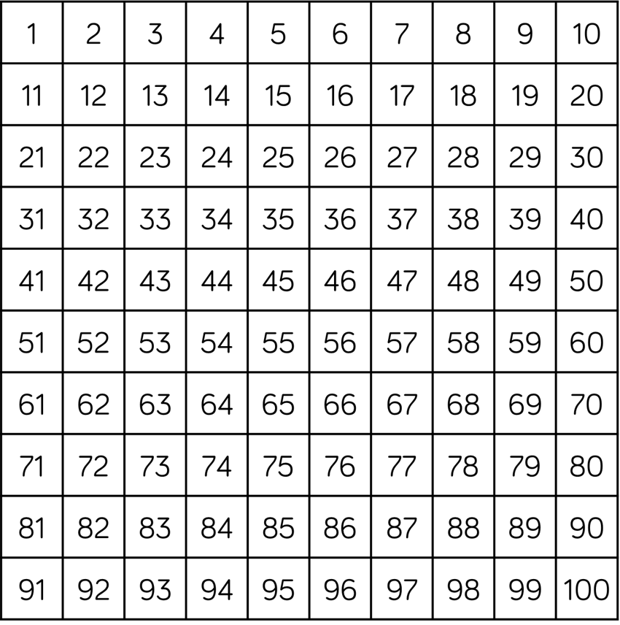
Have a think
There are 5 pears in each bag.
There are 9 bags.
There are 45 pears.

Slide 11

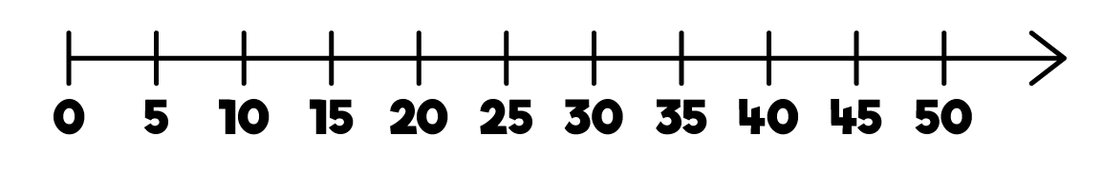
Can you count on in 5s,
starting at 20?

Slide 12


How many pencils?
30
How many chocolates?
20
Have a think

Slide 13
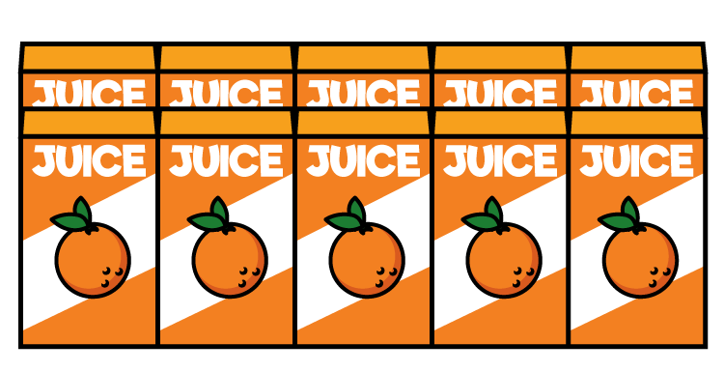
How many juice boxes did the children drink?

Slide 14
What numbers are missing?
25
15 | 20 | ? | 30 | 35 | 40 | 45 | ?
50

Slide 15
Have a go at question 3 on the worksheet

Slide 16
Have a go at question 4 on the worksheet

Slide 17



What numbers did they both count?
I counted by 2s
to 50!
I counted by 5s
to 50!
You both counted
10, 20, 30, 40, 50!

