Slide 1
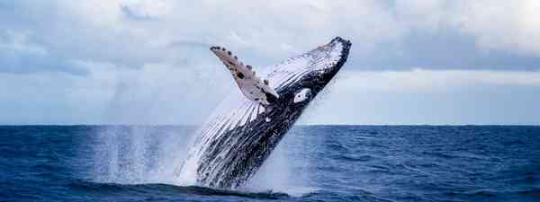
ENGLISH

Slide 2
Lesson 4
All about Whales

Slide 3
Lesson 4
Final research day
Use the time today to conduct some final research.
This might include Internet research or going back through any missed videos or texts from previous lessons.
There is also an information PowerPoint in the folder to work through.
Remember... some information will be duplicating by now as you have already done a lot of research, so you don't need to write down repeated facts.

Slide 4

Lesson 4
Don't Forget to look at the information PowerPoint
In the folder

Slide 5
ENGLISH

