Slide 1
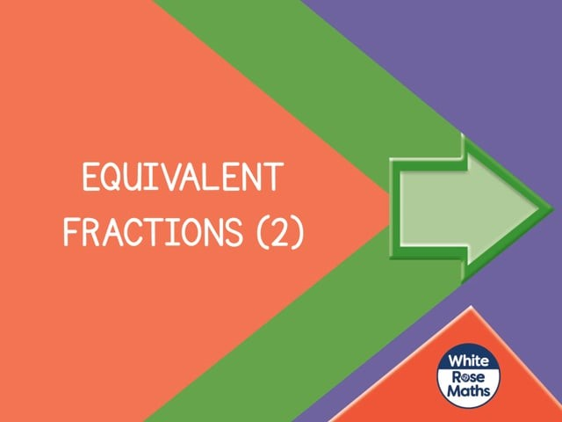


Slide 2
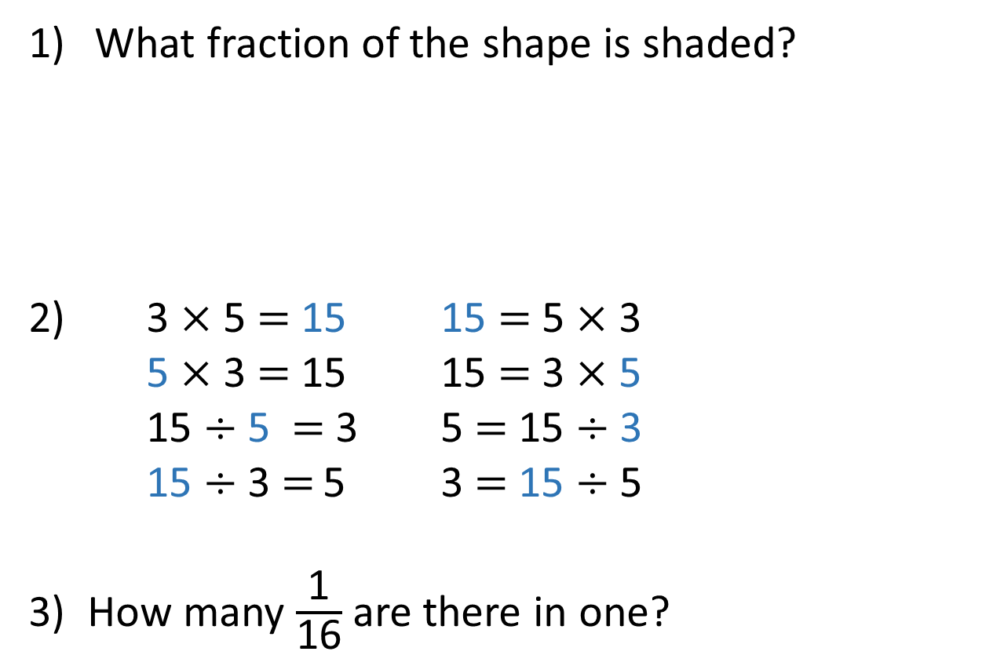
What fraction of the shape is shaded?
3 $×$ 5 $=$ 15 15 $=$ 5 $×$ 3
5 $×$ 3 $=$ 15 15 $=$ 3 $×$ 5
15 $÷$ 5 $=$ 3 5 $=$ 15 $÷$ 3
15 $÷$ 3 $=$ 5 3 $=$ 15 $÷$ 5
3) How many $\frac{\text{1}}{\text{16}}$ are there in one?

Slide 3
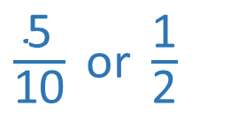
What fraction of the shape is shaded?
3 $×$ 5 $=$ 15 15 $=$ 5 $×$ 3
5 $×$ 3 $=$ 15 15 $=$ 3 $×$ 5
15 $÷$ 5 $=$ 3 5 $=$ 15 $÷$ 3
15 $÷$ 3 $=$ 5 3 $=$ 15 $÷$ 5
3) How many $\frac{\text{1}}{\text{16}}$ are there in one?
$\frac{\text{5}}{\text{10}} \text{or} \frac{\text{1}}{\text{2}}$
16

Slide 5
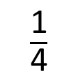
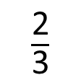
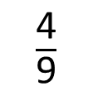
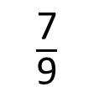
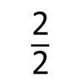
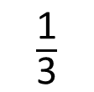
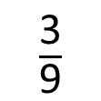
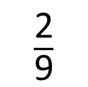
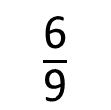
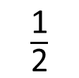
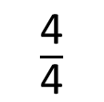
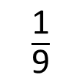
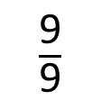
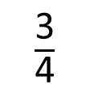
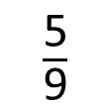
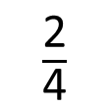
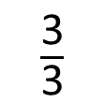
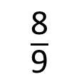
0
$\frac{\text{1}}{\text{2}}$
1
$\frac{\text{2}}{\text{2}}$
$\frac{\text{1}}{\text{4}}$
$\frac{\text{2}}{\text{4}}$
$\frac{\text{3}}{\text{4}}$
0
1
$\frac{\text{4}}{\text{4}}$
What do you notice?
$\frac{\text{1}}{\text{3}}$
$\frac{\text{2}}{\text{3}}$
0
1
$\frac{\text{3}}{\text{3}}$
$\frac{\text{1}}{\text{9}}$
$\frac{\text{2}}{\text{9}}$
$\frac{\text{3}}{\text{9}}$
$\frac{\text{4}}{\text{9}}$
$\frac{\text{5}}{\text{9}}$
$\frac{\text{6}}{\text{9}}$
$\frac{\text{7}}{\text{9}}$
$\frac{\text{8}}{\text{9}}$
0
1
$\frac{\text{9}}{\text{9}}$

Slide 6
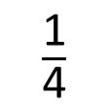
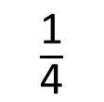
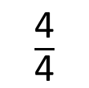
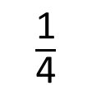
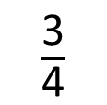
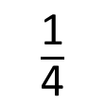
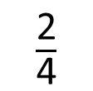
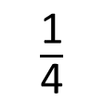
$\frac{\text{1}}{\text{4}}$
$\frac{\text{1}}{\text{4}}$
$\frac{\text{1}}{\text{4}}$
$\frac{\text{1}}{\text{4}}$
0
$\frac{\text{1}}{\text{4}}$
$\frac{\text{2}}{\text{4}}$
$\frac{\text{3}}{\text{4}}$
1
$\frac{\text{4}}{\text{4}}$

Slide 7
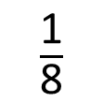
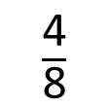
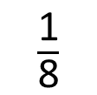
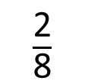
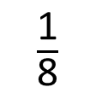
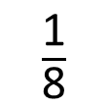
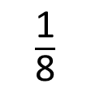
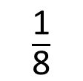
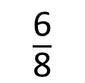
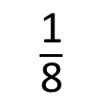
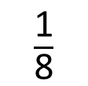
$\frac{\text{1}}{\text{8}}$
$\frac{\text{1}}{\text{8}}$
$\frac{\text{1}}{\text{8}}$
$\frac{\text{1}}{\text{8}}$
$\frac{\text{1}}{\text{8}}$
$\frac{\text{1}}{\text{8}}$
$\frac{\text{1}}{\text{8}}$
$\frac{\text{1}}{\text{8}}$
$\frac{\text{2}}{\text{8}}$
$\frac{\text{4}}{\text{8}}$
$\frac{\text{6}}{\text{8}}$
0
$\frac{\text{1}}{\text{4}}$
$\frac{\text{2}}{\text{4}}$
$\frac{\text{3}}{\text{4}}$
1
$\frac{\text{4}}{\text{4}}$

Slide 8

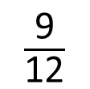


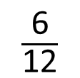
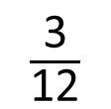









$\frac{\text{1}}{\text{12}}$
$\frac{\text{1}}{\text{12}}$
$\frac{\text{1}}{\text{12}}$
$\frac{\text{1}}{\text{12}}$
$\frac{\text{1}}{\text{12}}$
$\frac{\text{1}}{\text{12}}$
$\frac{\text{1}}{\text{12}}$
$\frac{\text{1}}{\text{12}}$
$\frac{\text{1}}{\text{12}}$
$\frac{\text{1}}{\text{12}}$
$\frac{\text{1}}{\text{12}}$
$\frac{\text{1}}{\text{12}}$
$\frac{\text{3}}{\text{12}}$
$\frac{\text{6}}{\text{12}}$
$\frac{\text{9}}{\text{12}}$
0
$\frac{\text{1}}{\text{4}}$
$\frac{\text{2}}{\text{4}}$
$\frac{\text{3}}{\text{4}}$
1
$\frac{\text{4}}{\text{4}}$

Slide 9






0
$\frac{\text{12}}{\text{16}}$
1
$\frac{\text{1}}{\text{16}}$
$\frac{\text{3}}{\text{4}}$
$\frac{\text{2}}{\text{16}}$
$\frac{\text{3}}{\text{16}}$
$\frac{\text{1}}{\text{4}}$
$\frac{\text{4}}{\text{16}}$
$\frac{\text{2}}{\text{4}}$
$\frac{\text{8}}{\text{16}}$
$\frac{\text{4}}{\text{4}}$

Slide 10
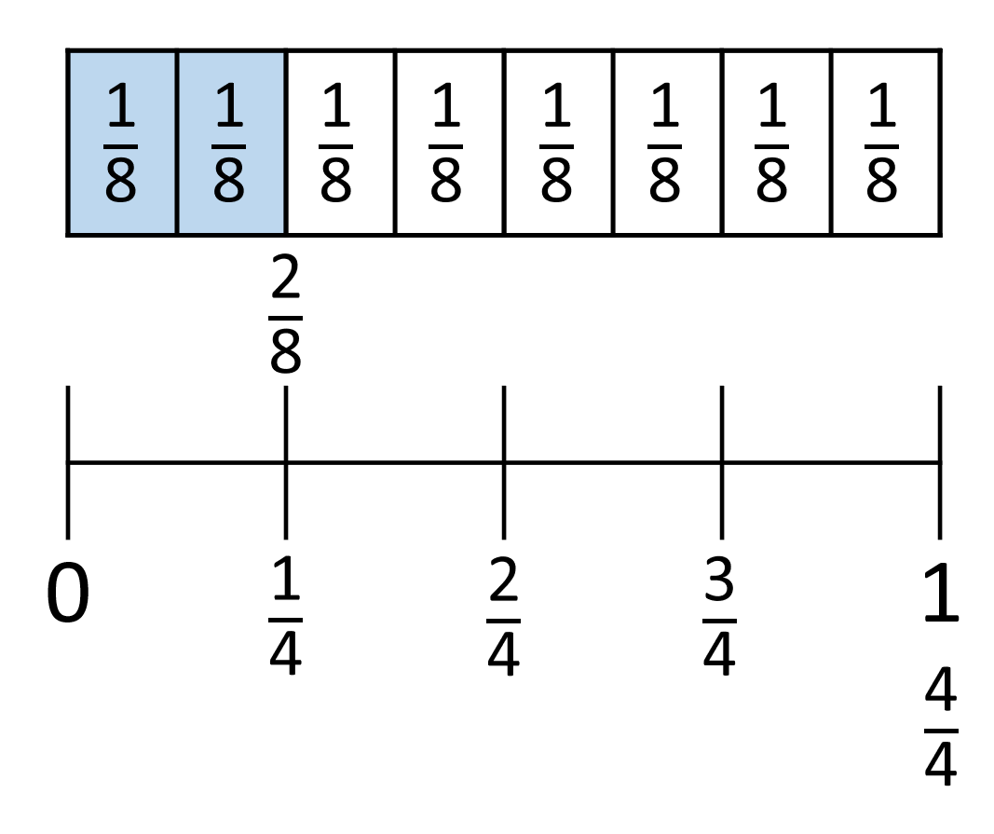
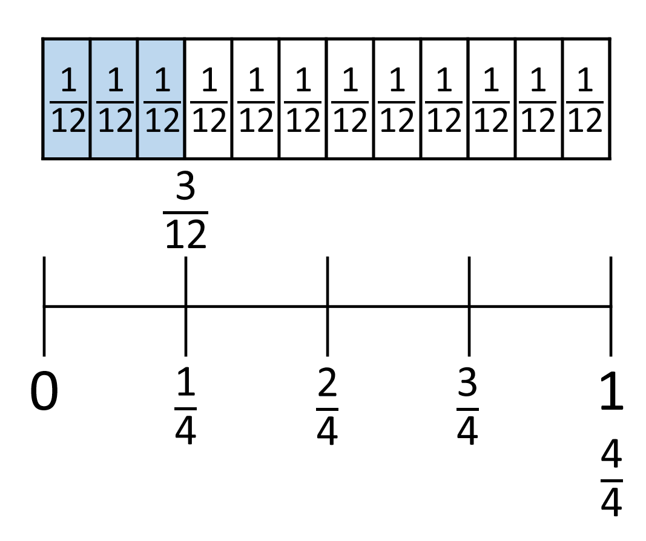
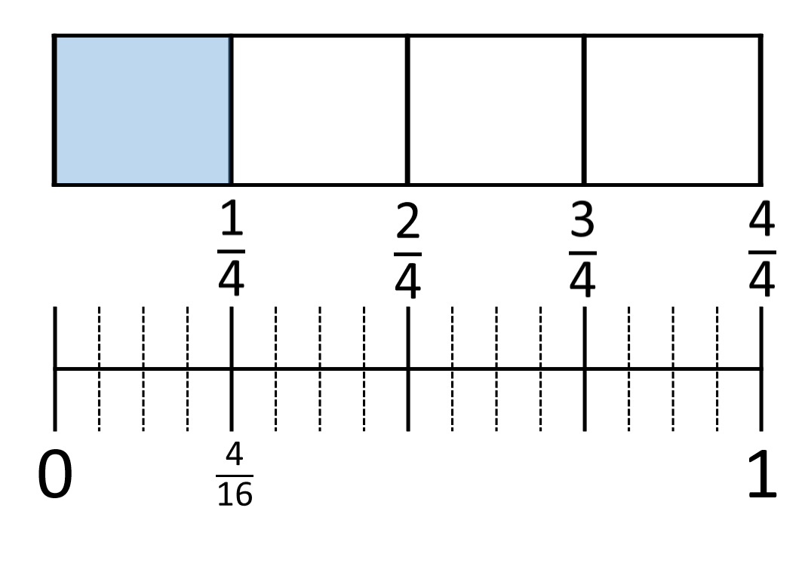
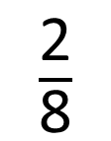


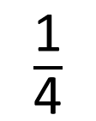
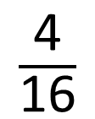
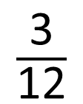

$\frac{\text{1}}{\text{4}}$
$\frac{\text{2}}{\text{8}}$
$\frac{\text{3}}{\text{12}}$
$\frac{\text{4}}{\text{16}}$
$$=$$
$$=$$
$$=$$
What other equivalent fractions can you find?

Slide 11
Have a go at questions
1 – 3 on the worksheet

Slide 12































$\frac{\text{1}}{\text{5}}$
$\frac{\text{2}}{\text{5}}$
$\frac{\text{3}}{\text{5}}$
$\frac{\text{4}}{\text{5}}$
0
1
$\frac{\text{1}}{\text{10}}$
$\frac{\text{2}}{\text{10}}$
$\frac{\text{3}}{\text{10}}$
$\frac{\text{4}}{\text{10}}$
$\frac{\text{5}}{\text{10}}$
$\frac{\text{6}}{\text{10}}$
$\frac{\text{7}}{\text{10}}$
$\frac{\text{8}}{\text{10}}$
$\frac{\text{9}}{\text{10}}$
$\frac{\text{1}}{\text{5}}$
$\frac{\text{2}}{\text{5}}$
$\frac{\text{3}}{\text{5}}$
$\frac{\text{4}}{\text{5}}$
0
1
$\frac{\text{1}}{\text{15}}$
$\frac{\text{2}}{\text{15}}$
$\frac{\text{3}}{\text{15}}$
$\frac{\text{4}}{\text{15}}$
$\frac{\text{5}}{\text{15}}$
$\frac{\text{6}}{\text{15}}$
$\frac{\text{7}}{\text{15}}$
$\frac{\text{8}}{\text{15}}$
$\frac{\text{9}}{\text{15}}$
$\frac{\text{10}}{\text{15}}$
$\frac{\text{11}}{\text{15}}$
$\frac{\text{12}}{\text{15}}$
$\frac{\text{13}}{\text{15}}$
$\frac{\text{14}}{\text{15}}$

Slide 13








$\frac{\text{1}}{\text{4}}$
Have a think
$\frac{\text{2}}{\text{4}}$
$\frac{\text{3}}{\text{4}}$
0
1
$\frac{\text{5}}{\text{12}}$
$\frac{\text{7}}{\text{12}}$
$\frac{\text{5}}{\text{12}}$ is halfway between and .
Draw an arrow to where is on the number line.
What fraction is represented by the ?
$\frac{\text{7}}{\text{12}}$

Slide 14
Have a go at the rest of the worksheet

