Slide 1


Slide 2


Slide 3
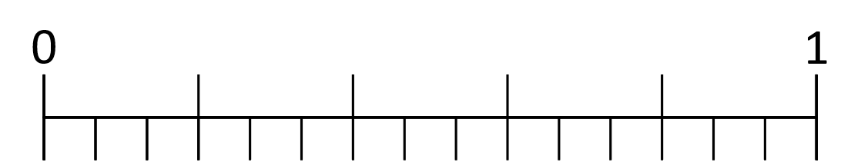
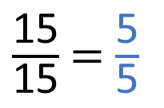
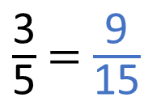
What equivalent fractions can you see in the bar models?
Use the number line to find the equivalent fractions.
$\frac{\text{3}}{\text{5}}$ = $\frac{\text{9}}{\text{15}}$
$\frac{\text{15}}{\text{15}}$ = $\frac{\text{5}}{\text{5}}$

Slide 4














What equivalent fractions can you see in the bar models?
Use the number line to find the equivalent fractions.
$\frac{\text{1}}{\text{9}}$
$\frac{\text{1}}{\text{9}}$
$\frac{\text{1}}{\text{9}}$
$\frac{\text{1}}{\text{9}}$
$\frac{\text{1}}{\text{9}}$
$\frac{\text{1}}{\text{9}}$
$\frac{\text{1}}{\text{9}}$
$\frac{\text{1}}{\text{9}}$
$\frac{\text{1}}{\text{9}}$
$\frac{\text{1}}{\text{3}}$
$\frac{\text{1}}{\text{3}}$
$\frac{\text{1}}{\text{3}}$
$\frac{\text{3}}{\text{5}}$ = $\frac{\text{9}}{\text{15}}$
$\frac{\text{15}}{\text{15}}$ = $\frac{\text{5}}{\text{5}}$
$\frac{\text{3}}{\text{5}}$
$\frac{\text{15}}{\text{15}}$

Slide 6
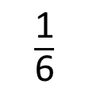
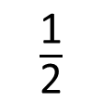
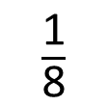
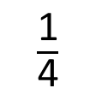
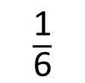
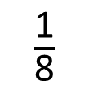
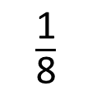

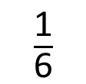
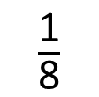
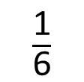
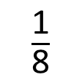
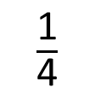
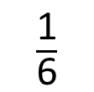
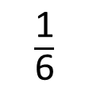
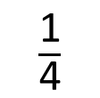
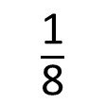
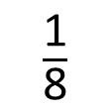
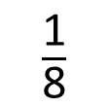
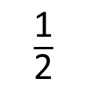
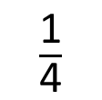
$\frac{\text{1}}{\text{2}}$
$\frac{\text{1}}{\text{2}}$
$\frac{\text{1}}{\text{4}}$
$\frac{\text{1}}{\text{4}}$
$\frac{\text{1}}{\text{4}}$
$\frac{\text{1}}{\text{4}}$
$\frac{\text{1}}{\text{2}}$ $=$ $\frac{\text{2}}{\text{4}}$ $=$ $\frac{\text{3}}{\text{6}}$ $=$ $\frac{\text{4}}{\text{8}}$
$\frac{\text{1}}{\text{6}}$
$\frac{\text{1}}{\text{6}}$
$\frac{\text{1}}{\text{6}}$
$\frac{\text{1}}{\text{6}}$
$\frac{\text{1}}{\text{6}}$
$\frac{\text{1}}{\text{6}}$
$\frac{\text{1}}{\text{8}}$
$\frac{\text{1}}{\text{8}}$
$\frac{\text{1}}{\text{8}}$
$\frac{\text{1}}{\text{8}}$
$\frac{\text{1}}{\text{8}}$
$\frac{\text{1}}{\text{8}}$
$\frac{\text{1}}{\text{8}}$
$\frac{\text{1}}{\text{8}}$

Slide 7











$\frac{\text{1}}{\text{2}}$
$\frac{\text{1}}{\text{2}}$
1
$\frac{\text{1}}{\text{2}}$
$\frac{\text{1}}{\text{3}}$
$\frac{\text{1}}{\text{4}}$
$\frac{\text{1}}{\text{4}}$
$\frac{\text{1}}{\text{4}}$
$\frac{\text{1}}{\text{4}}$
$\frac{\text{1}}{\text{4}}$
$\frac{\text{1}}{\text{5}}$
$\frac{\text{1}}{\text{2}}$ $=$ $\frac{\text{2}}{\text{4}}$ $=$ $\frac{\text{3}}{\text{6}}$ $=$ $\frac{\text{4}}{\text{8}}$
$\frac{\text{1}}{\text{6}}$
$\frac{\text{1}}{\text{7}}$
$\frac{\text{1}}{\text{6}}$
$\frac{\text{1}}{\text{6}}$
$\frac{\text{1}}{\text{6}}$
$\frac{\text{1}}{\text{6}}$
$\frac{\text{1}}{\text{6}}$
$\frac{\text{1}}{\text{6}}$
$\frac{\text{1}}{\text{8}}$
$\frac{\text{1}}{\text{9}}$
$\frac{\text{1}}{\text{10}}$
$\frac{\text{1}}{\text{8}}$
$\frac{\text{1}}{\text{8}}$
$\frac{\text{1}}{\text{8}}$
$\frac{\text{1}}{\text{8}}$
$\frac{\text{1}}{\text{8}}$
$\frac{\text{1}}{\text{8}}$
$\frac{\text{1}}{\text{8}}$
$\frac{\text{1}}{\text{8}}$
$\frac{\text{1}}{\text{11}}$
$\frac{\text{1}}{\text{12}}$

Slide 8




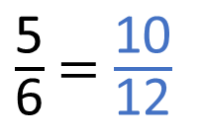







$\frac{\text{5}}{\text{6}}$ = $\frac{\text{10}}{\text{12}}$
1
$\frac{\text{1}}{\text{2}}$
$\frac{\text{1}}{\text{3}}$
$\frac{\text{1}}{\text{4}}$
$\frac{\text{1}}{\text{5}}$
$\frac{\text{1}}{\text{6}}$
$\frac{\text{1}}{\text{7}}$
$\frac{\text{1}}{\text{8}}$
$\frac{\text{1}}{\text{9}}$
$\frac{\text{1}}{\text{10}}$
$\frac{\text{1}}{\text{11}}$
$\frac{\text{1}}{\text{12}}$

Slide 9

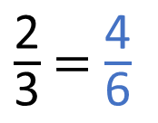
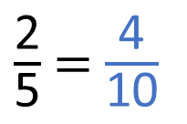
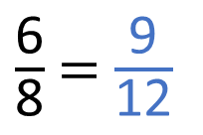
$\frac{\text{2}}{\text{5}}$ = $\frac{\text{4}}{\text{10}}$
$\frac{\text{2}}{\text{3}}$ = $\frac{\text{4}}{\text{6}}$
$\frac{\text{6}}{\text{8}}$ = $\frac{\text{9}}{\text{12}}$
Have a think
1
$\frac{\text{1}}{\text{2}}$
$\frac{\text{1}}{\text{3}}$
$\frac{\text{1}}{\text{4}}$
$\frac{\text{1}}{\text{5}}$
$\frac{\text{1}}{\text{6}}$
$\frac{\text{1}}{\text{7}}$
$\frac{\text{1}}{\text{8}}$
$\frac{\text{1}}{\text{9}}$
$\frac{\text{1}}{\text{10}}$
$\frac{\text{1}}{\text{11}}$
$\frac{\text{1}}{\text{12}}$

Slide 10
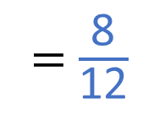
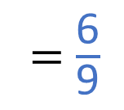
$\frac{\text{2}}{\text{5}}$ = $\frac{\text{4}}{\text{10}}$
$\frac{\text{2}}{\text{3}}$ = $\frac{\text{4}}{\text{6}}$
= $\frac{\text{6}}{\text{9}}$
= $\frac{\text{8}}{\text{12}}$
$\frac{\text{6}}{\text{8}}$ = $\frac{\text{9}}{\text{12}}$
1
$\frac{\text{1}}{\text{2}}$
$\frac{\text{1}}{\text{3}}$
$\frac{\text{1}}{\text{4}}$
$\frac{\text{1}}{\text{5}}$
$\frac{\text{1}}{\text{6}}$
$\frac{\text{1}}{\text{7}}$
$\frac{\text{1}}{\text{8}}$
$\frac{\text{1}}{\text{9}}$
$\frac{\text{1}}{\text{10}}$
$\frac{\text{1}}{\text{11}}$
$\frac{\text{1}}{\text{12}}$

Slide 11
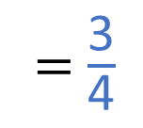
$\frac{\text{2}}{\text{5}}$ = $\frac{\text{4}}{\text{10}}$
$\frac{\text{2}}{\text{3}}$ = $\frac{\text{4}}{\text{6}}$
= $\frac{\text{6}}{\text{9}}$
= $\frac{\text{8}}{\text{12}}$
$\frac{\text{6}}{\text{8}}$ = $\frac{\text{9}}{\text{12}}$
= $\frac{\text{3}}{\text{4}}$
1
$\frac{\text{1}}{\text{2}}$
$\frac{\text{1}}{\text{3}}$
$\frac{\text{1}}{\text{4}}$
$\frac{\text{1}}{\text{5}}$
$\frac{\text{1}}{\text{6}}$
$\frac{\text{1}}{\text{7}}$
$\frac{\text{1}}{\text{8}}$
$\frac{\text{1}}{\text{9}}$
$\frac{\text{1}}{\text{10}}$
$\frac{\text{1}}{\text{11}}$
$\frac{\text{1}}{\text{12}}$

Slide 12
Have a go at the worksheet

